Slide 1


An integrative view of the regulatory and transcriptional landscapes in mouse myeloid hematopoiesis
Mock-ups of Figures

Slide 2
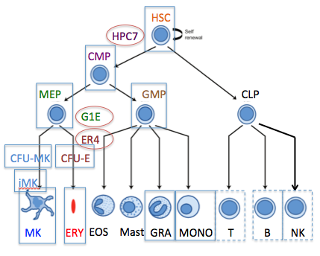
Mock up of Fig. 1
Cell type | Stage, tissue | CTCF | K36me3 | K9me3 | K27me3 | K4me1 | ATAC DNase | K4me3 | K27ac | RNA
LSK | Ad, BM | CK,EH | GSM548826 GSM548827 |  | GSM548824, ..25
CMP | Ad, BM
HPC7 | ES diffr |  |  |  |  |  | D
GMP | Ad, BM
MEP | Ad, BM
G1E | ES diffr
G1E-ER4 | ES diffr
CFUE | Ad, BM sp
ERY_BM | Ad, BM sp | GSM1151145 |  |  | GSM689847 | GSM689846 |  | EH | EH,GSM802477
ERY_FL | Fet, liver | ENCSR397RHW |  |  |  |  | D |  | ENCSR000CDU
CFUMK | Ad, BM
MK_imm | Ad, BM
MK_mat | Fet, liver
NEU | Ad, blood | GSM2445202 | GSM2445216 | GSM2445214 | GSM2445212
MON | Ad, blood | ENCSR000CFJ
CLP | Ad, BM
B | Ad, sp
NK | Ad, sp
T_CD4 | Ad, sp | GSM1480825 |  |  | GSM1151621
T_CD8 | Ad, sp | GSM1023418 |  |  | GSM1972997
A. Differentiation map of cell types
B. Datasets
New: RNA-seq, ATAC-seq, selected TFs and histone modifications
New: Hi-C data and derived tracks from HPC7 and G1E-ER4 cells
Compile complementary data from earlier work and other sources
Integration via IDEAS to define epigenetic states
New, this paper
Previous, this group
Other sources
Epigenetic states via IDEAS

Slide 3
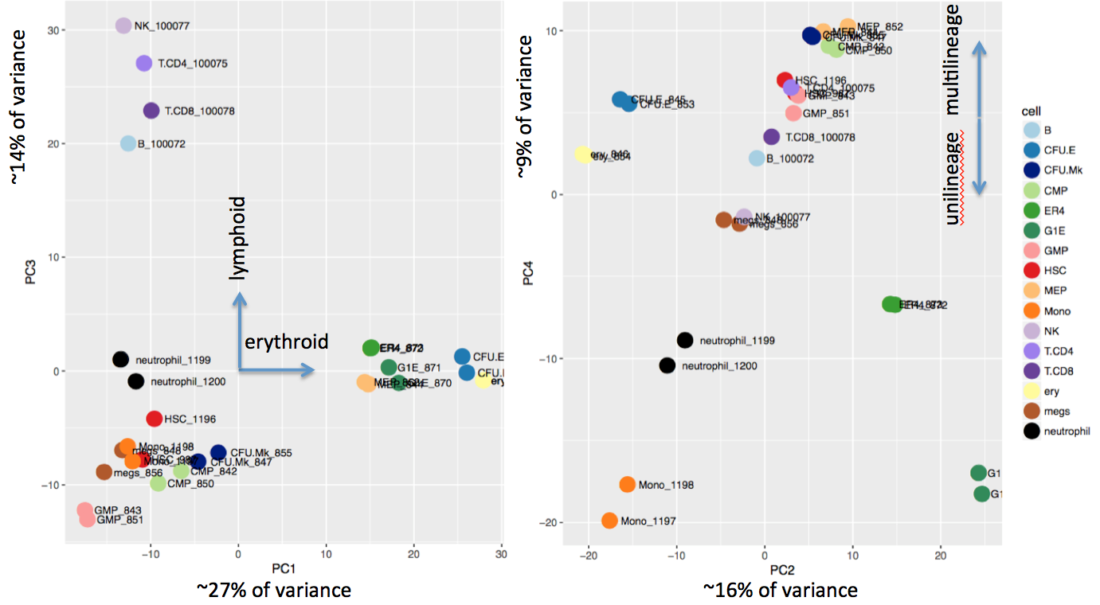
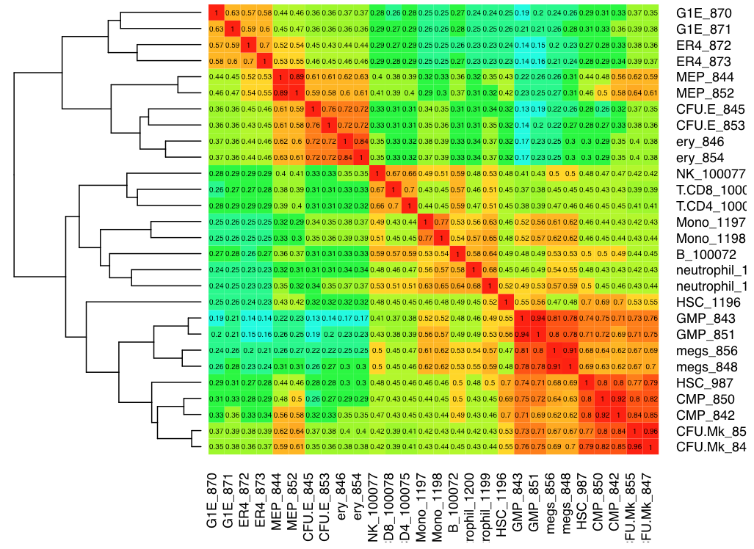
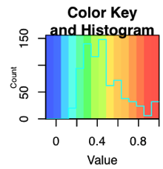
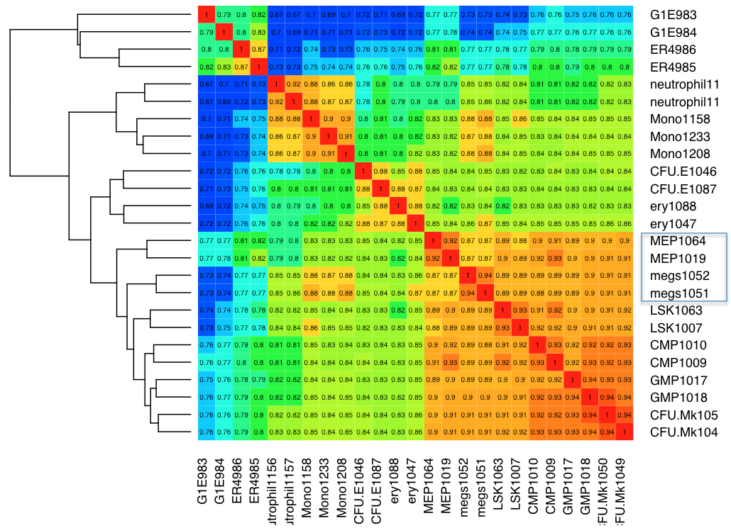
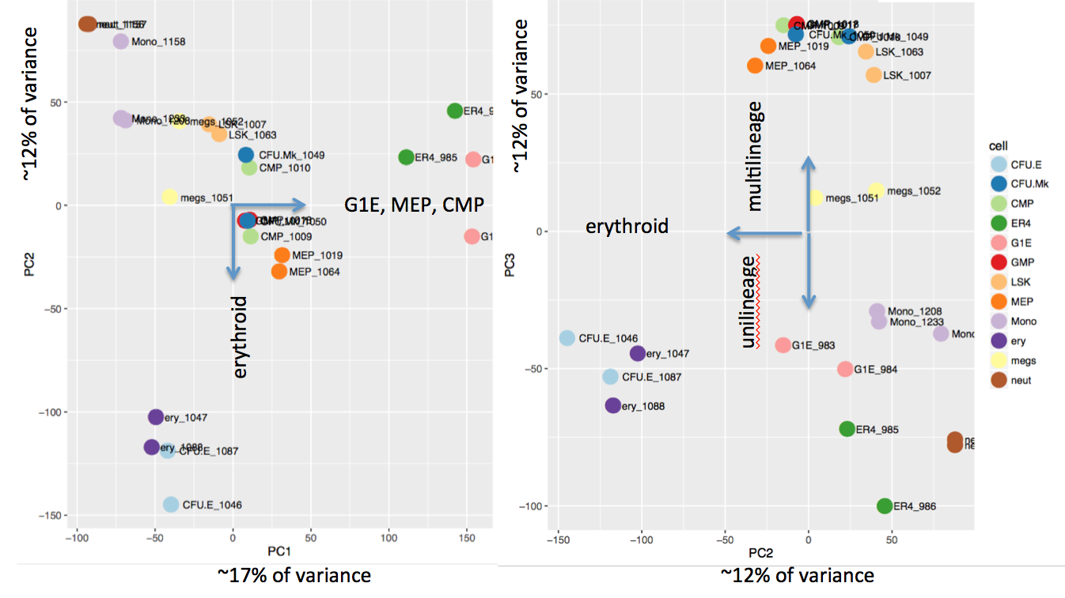
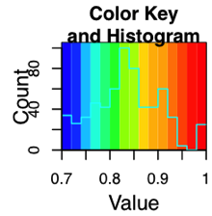
Mock-up of Fig. 2. Relationships of cell types based on different features
Hierarchical clustering
PCA
ATAC-seq
RNA-seq

Slide 4
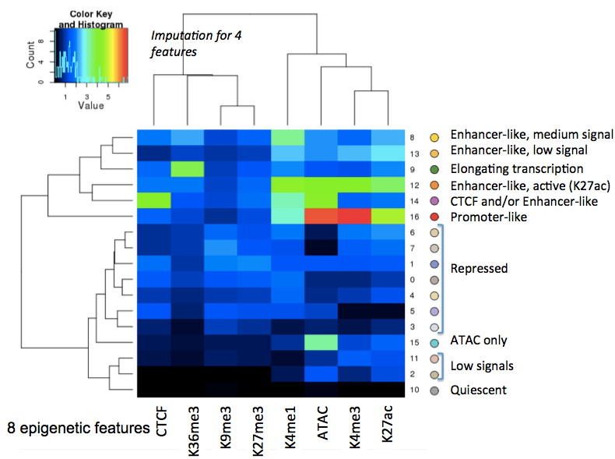
Mockup of Fig. 3. IDEAS 15.8, 17 state model
A. Epigenetic states
B. Example locus, IDEAS output
Color ATAC-seq signal by epigenetic states and annotate ATAC-seq peaks by epigenetic state. Maybe also include at ATAC-seq signal track?

Slide 5
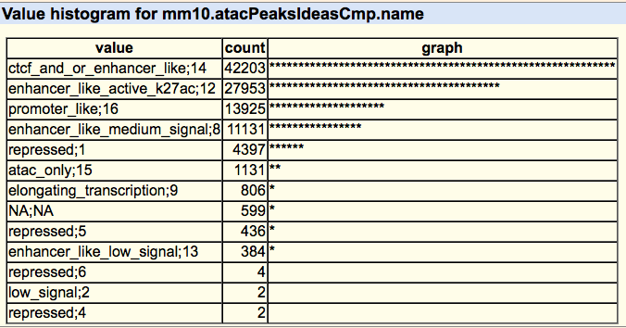
Summarize and illustrate the collection of cREs
Genome-wide distribution of cRE categories (this is only for CMP)
Enrichment of bound TFs in various categories of ATAC-seq peaks
Try ATAC-seq peaks in each of the 17 states (17 rows per cell type) in each cell type. We can choose one or two to show, but I expect CMP, ERY_BM, ERY_FL, MK_imm, T_CD4, T_CD8 may be among the most interesting.
All TFs, make sure you include all the ones from VISION group as well as CODEX, group by cell type

Slide 6
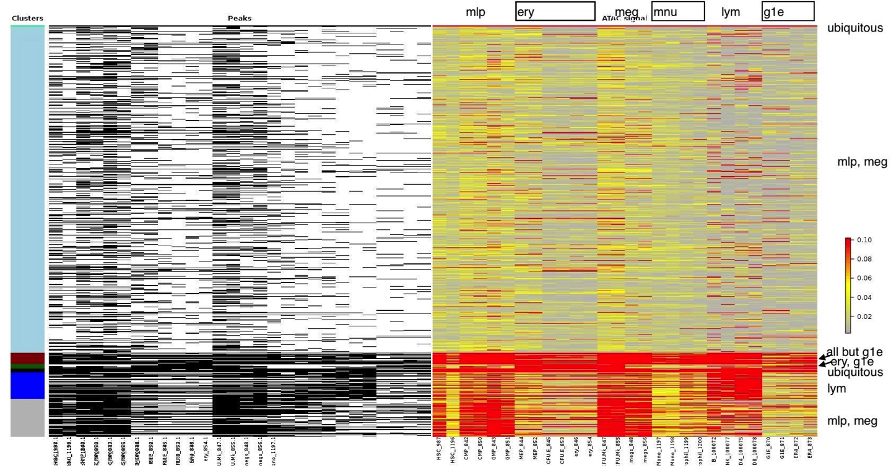
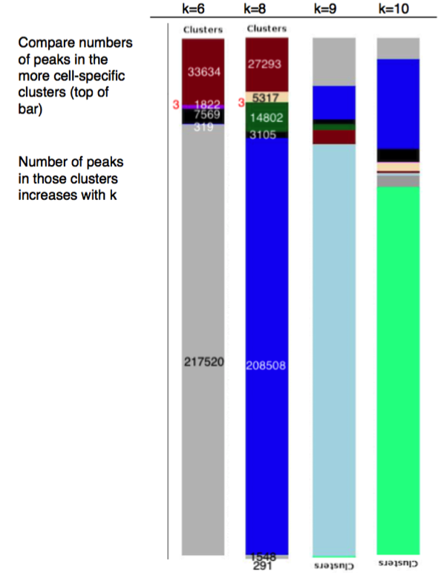
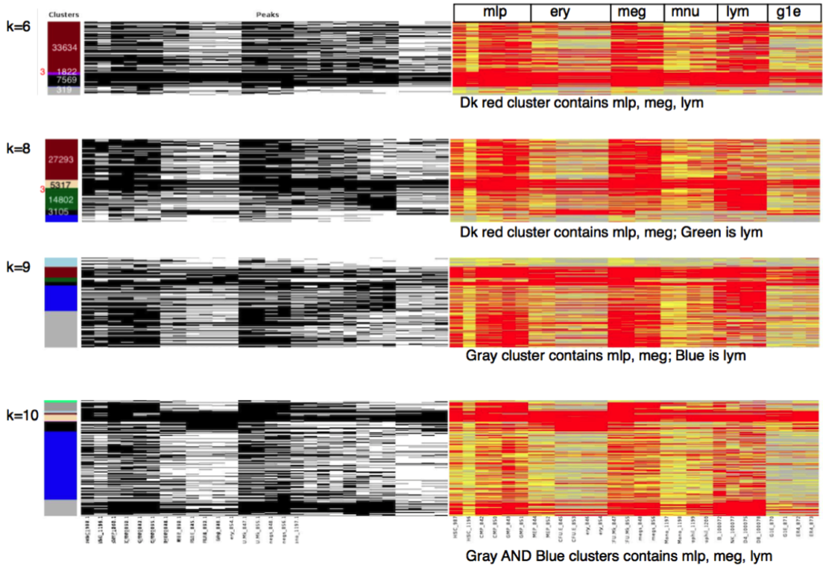
Suppl Fig. 1. Unsupervised clustering of ATAC-seq peaks
ATAC-seq, Homer peaks, retain those called in at least two datasets (210k?)

Slide 7
Numbers and frequencies of index sets
Observed 8190 index sets
Total number possible is 2^16 = 65,536
Number of peaks in each set range from 1 to 10,329
Focus on 118 index sets that contained at least 200 peaks
Encompass 153,636 peaks
Log, base 10

Slide 8
Visualize the patterns of peak occurrences across cell types
Index
HSC | CMP | MEP | G1E | ER4 | CFU-E | ERY | CFU-MK | MEG | GMP | MONO | NEU | B | NK | T-CD4 | T-CD8
0 | 1 | 1 | 0 | 0 | 1 | 1 | 1 | 0 | 0 | 0 | 0 | 0 | 0 | 0 | 0
Follow a decision tree
Place the index sets into groups based on the presence or absence in each cell type sequentially.
The visualization is dependent on order of consideration of cell types.
…

Slide 9
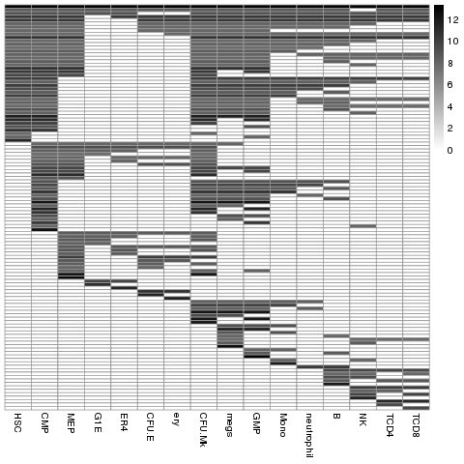
Visualization of index sets sorted by decision tree
Index
HSC | CMP | MEP | G1E | ER4 | CFU-E | ERY | CFU-MK | MEG | GMP | MONO | NEUROPHIL | B | NK | T-CD4 | T-CD8
0 | 1 | 1 | 0 | 0 | 1 | 1 | 1 | 0 | 0 | 0 | 0 | 0 | 0 | 0 | 0
Gray-scale represent the number of peak in each Index set (log2 scale)
index set
…
Notes:
Indexed peak set
HSC-CMP-MEP-G1E-ER4-CFU-E-ERY

Slide 10
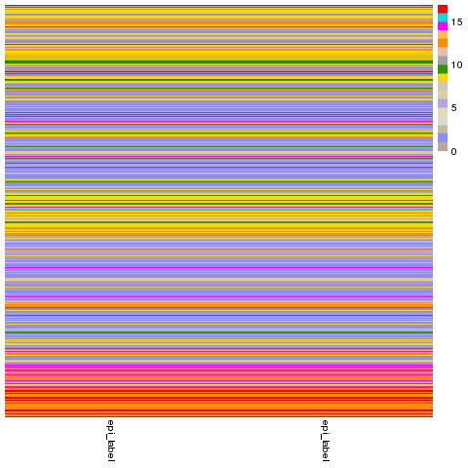
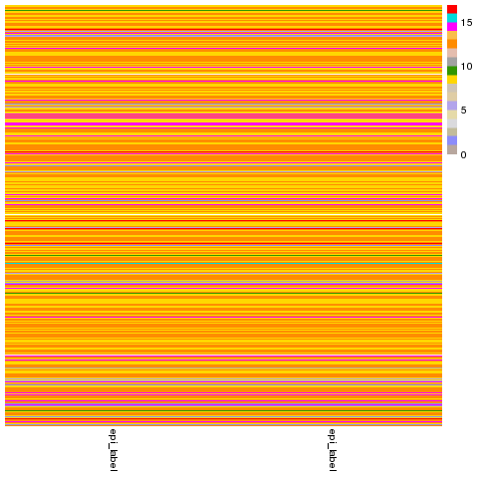
Methods to find an informative IDEAS epigenetic state for each index set
State label of all peaks in MEP
State label of peaks in index set in MEP
Gray-scale reflects number of peaks
7 Index sets
Target Index set
Most frequent state (state 12, orange, in MEP)
(Target index: 0_0_1_0_1_0_0_0_1_1_0_0_0_0_0_0)
Most enriched state (state 12, orange, in MEP)
LSK
CMP
NK
T-CD4
MEP
T-CD8
GMP
MEG
MONO
NEU
CFU-E
ERY
G1E
G1E
B
Enrichment = Foreground / Background
Foreground = regions labeled as state 12 in the target Index set (1059 peaks)
Background = all regions labeled as state 12 in all 153,636 DNA intervals
153,636 peaks sorted by peak index
1,059 peaks

Slide 11
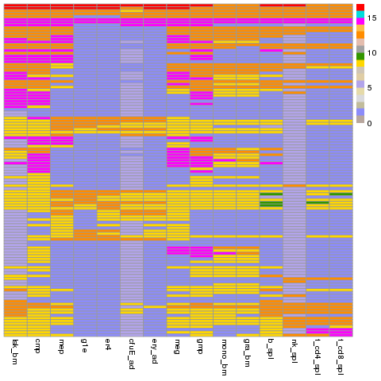
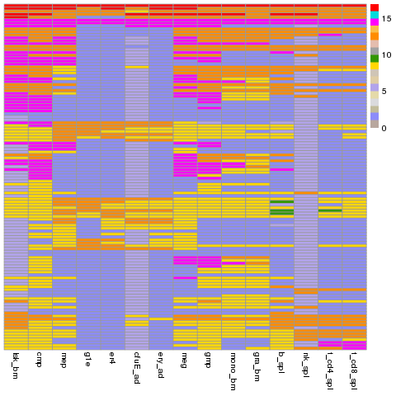
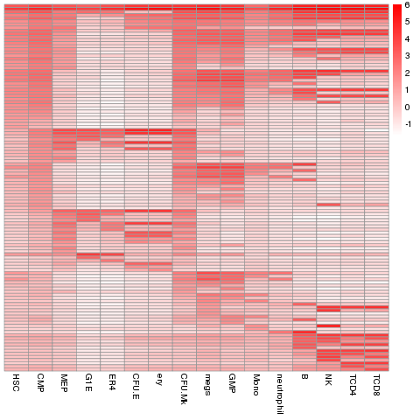
Index sets across a cell type progression, with most frequent IDEAS state and ATAC-seq signal
118 rows:
118 Index sets
log2 (number of peaks)
Most frequent IDEAS state
Log2(average ATAC-seq signal)
promoter
CTCF
LSK > CMP > MEP > G1E > ER4 > CFUE > ERY> CFU-MK > MEG > GMP > MONO > NEU > B > NK > T-CD4 > T-CD8

Slide 12
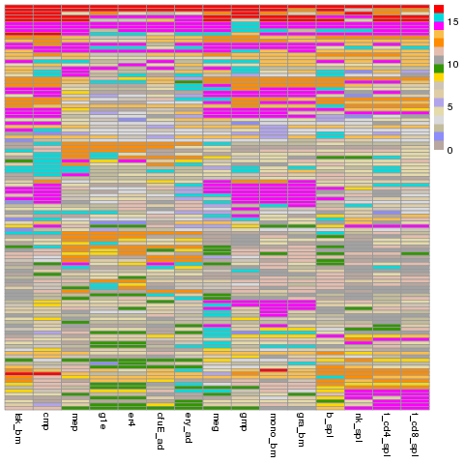
Index sets across a cell type progression, with most enriched IDEAS state and ATAC-seq signal
log2 (number of peaks)
Most enriched IDEAS state
Log2(average ATAC-seq signal)
LSK > CMP > MEP > G1E > ER4 > CFUE > ERY> CFU-MK > MEG > GMP > MONO > NEU > B > NK > T-CD4 > T-CD8

Slide 13
TF ChIP-seq peak enrichment of Index sets (with erythroid cells early in type order)
CTCF
ERY-Progenitors
ERY
SMAD1
GATA2
GATA1
GATA1
TAL1
RNF2
LDB1
NFE2
TAL1
GATA1
LSK> CMP > MEP > G1E > ER4 > CFUE > ERY> CFU-MK > MEG > GMP > MONO > NEU > B > NK > T-CD4 > T-CD8

Slide 14
Assign cREs to target genes

Slide 15
Evaluation, e.g. how well do our integrated data explain patterns of gene expression?

Slide 16
Views of landscape at different scales

