Slide 1
Evolutionary signatures of function: Positive selection
Lesson 9_2: Evolutionary signatures of function
BMMB 551
Hardison

Slide 2
Three major classes of evolution
Neutral evolution
Acts on DNA with no function
Genetic drift allows some random mutations to become fixed in a population
Purifying (negative) selection
Acts on DNA with a conserved function
Signature: Rate of change is significantly slower than that of neutral DNA
Often see this at “larger” evolutionary distance (e.g. >10 million years)
Darwinian or adaptive (positive) selection
Acts on DNA in which changes benefit an organism
Signature: Rate of change is significantly faster than that of neutral DNA
Most apparent over shorter evolutionary distances

Slide 3
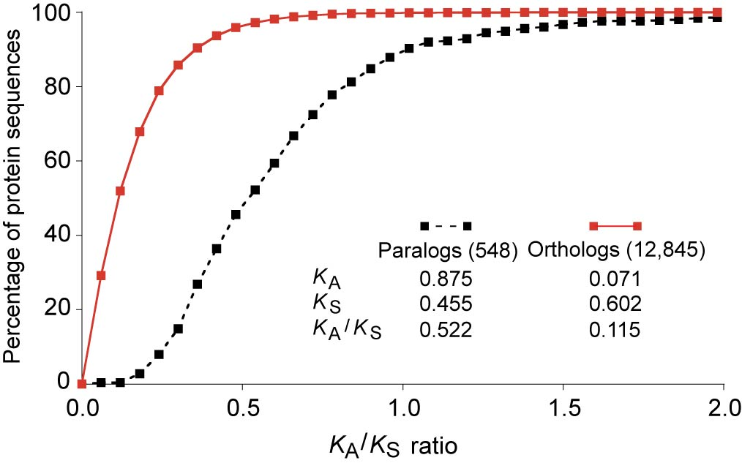
Most protein-coding exons are under constraint
Cumulative distribution of K_{A}/K_{S} ratios determined from human-mouse comparisons.
Almost all orthologous exons have quite low values for K_{A}/K_{S}, indicating strong constraint. In contrast, most paralogous exons have much higher K_{A}/K_{S} ratios suggesting that some are undergoing adaptive evolution.
Waterston et al. (2002) Mouse genome paper, Nature 420: 520-562. Fig. 21

Slide 4
Adaptive evolution of a duplicated gene in leaf-eating monkeys
One case study: Zhang et al. Nature Genetics 2002

Slide 5
Evolution of a new function: Gene duplication and adaptive protein evolution
From Hiroshi Akashi

Slide 6
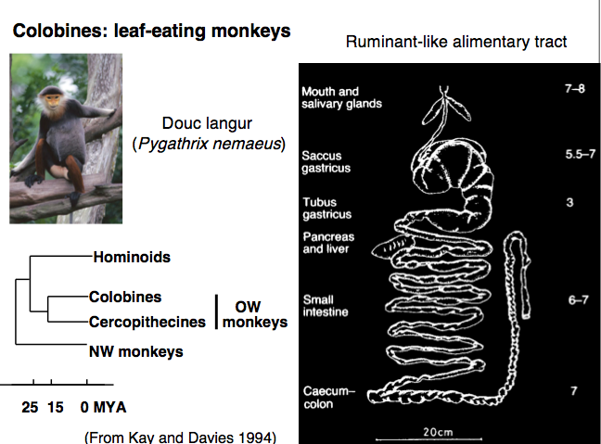
Adaptations to eating leaves
From Hiroshi Akashi

Slide 7
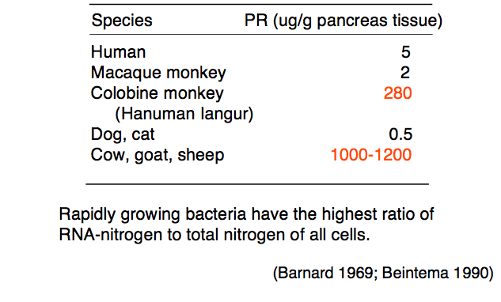
Elevated expression of pancreatic RNase in colobine monkeys and ruminants
From Hiroshi Akashi

Slide 8
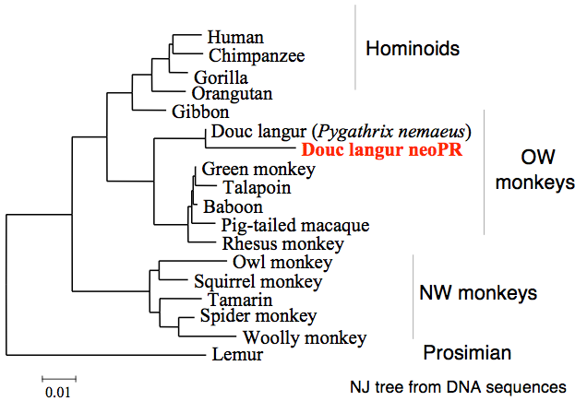
Gene tree of pancreatic RNases in primates
From Hiroshi Akashi

Slide 9
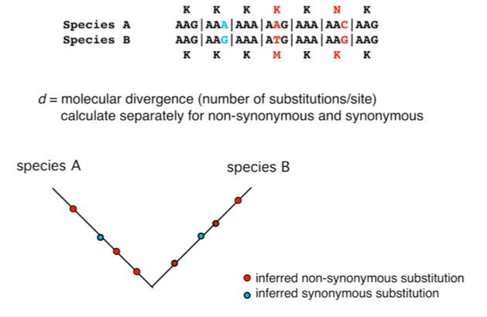
Inferring d_{n} (K_{A}) and d_{s} (K_{S})
From Hiroshi Akashi

Slide 10
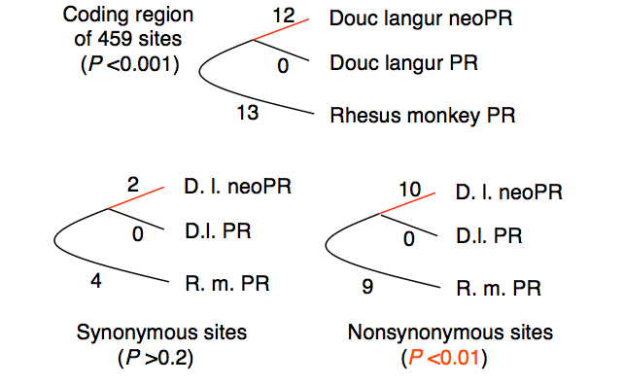
Test of rate constancy (the molecular clock)
RNASE1B
RNASE1
RNASE1
From Hiroshi Akashi

Slide 11
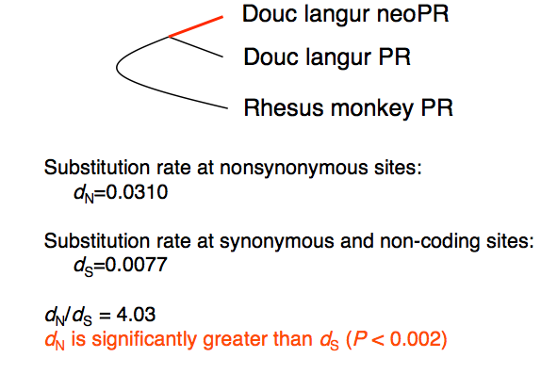
Test of positive Darwinian selection (adaptation)
RNASE1B
RNASE1
RNASE1
From Hiroshi Akashi

Slide 12
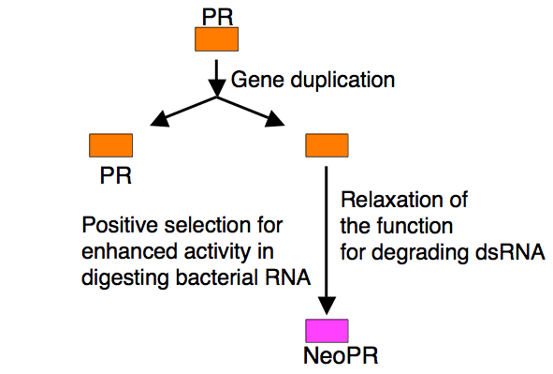
Evolution of new function: Gene duplication and adaptive protein evolution
From Hiroshi Akashi

Slide 13
Evidence for adaptive protein evolution
Functional assays
Changes in protein activity
Relate to ecology of organism
Sequence evolution
Rejection of rate constancy
Faster rate of evolution in protein-altering sites than silent sites
Types of amino acid substitutions
Sequence studies reveal candidates for adaptive evolution
From Hiroshi Akashi

Slide 14
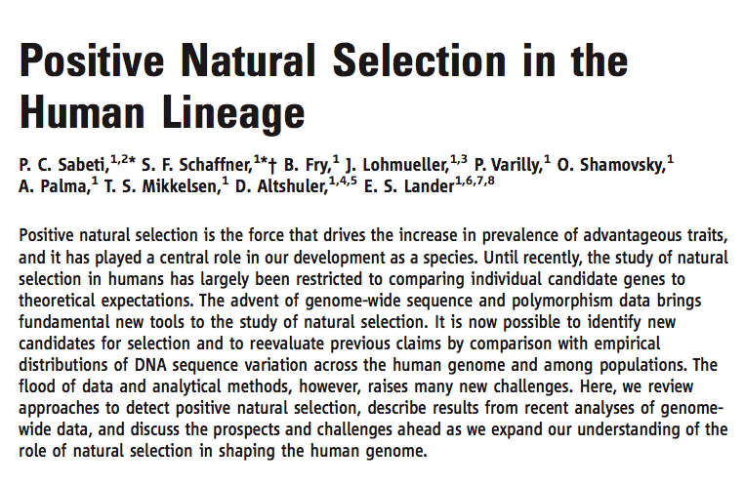
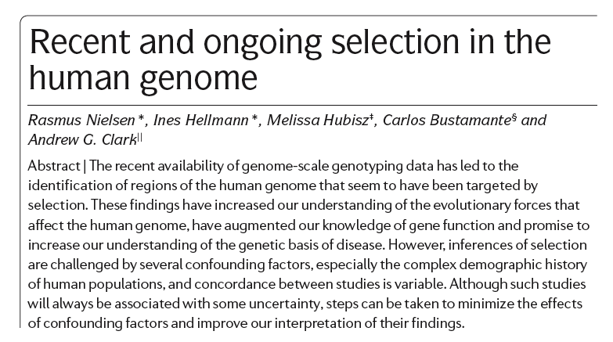
Evidence of selection from allele frequencies
R. Nielsen et al. 2007, Nature Reviews
Genetics 8: 857
P.C. Sabeti et al. 2006, Science 312: 1614

Slide 15
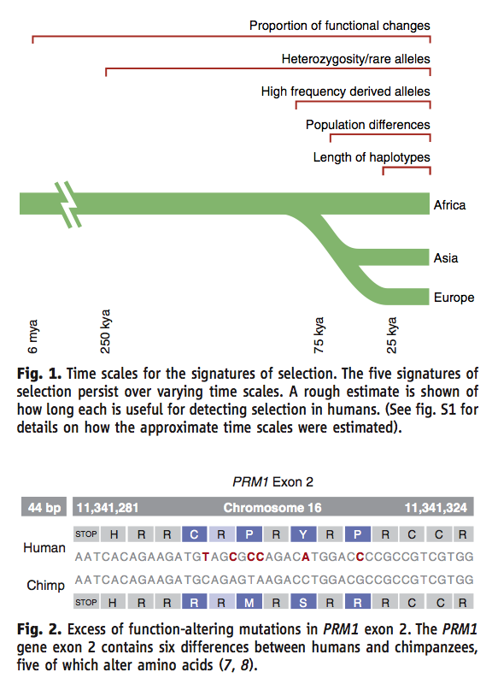
Different tests interrogate distinct time scales
e.g. K_{A}/K_{S}
P.C. Sabeti et al. 2006, Science 312: 1614

Slide 16
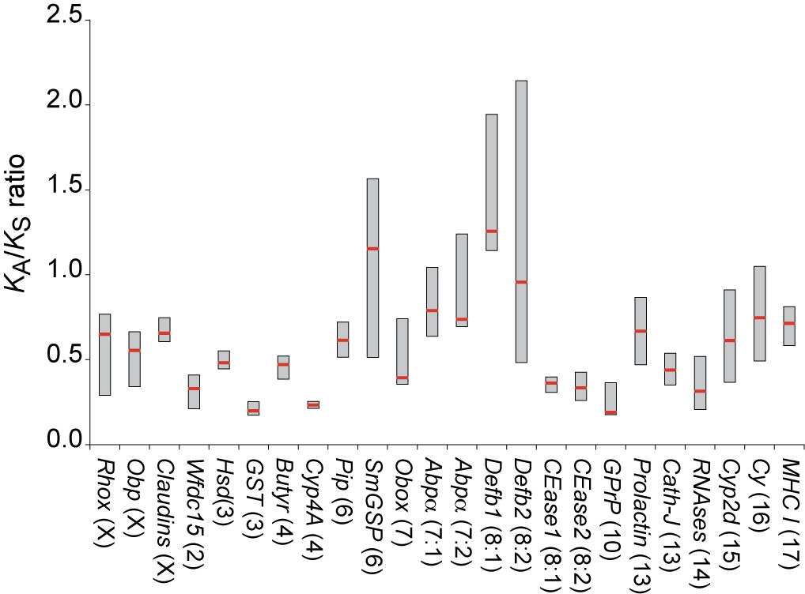
Types of genes with strong signal for positive selection
Human-mouse comparisons of multigene families
Immune response
Reproduction
Chemosensation
Xenobiotic metabolism
Waterston et al. (2002) Nature. Mouse Genome paper

Slide 17
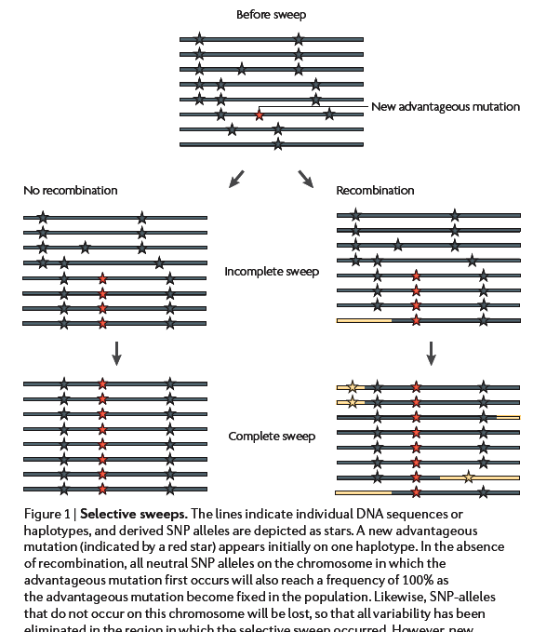
Selective sweeps change allele frequencies
R. Nielsen et al. 2007, Nature Reviews
Genetics 8: 857

Slide 18
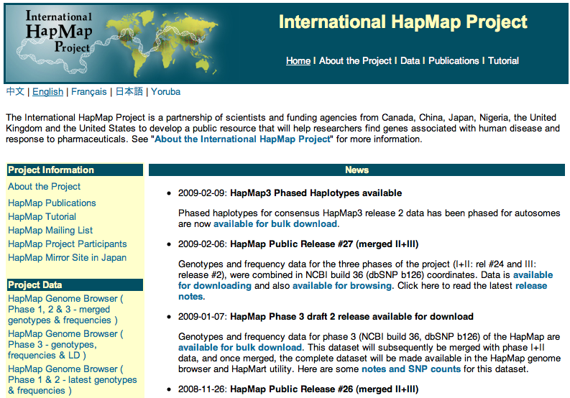
HapMap Project
http://www.hapmap.org/

Slide 19
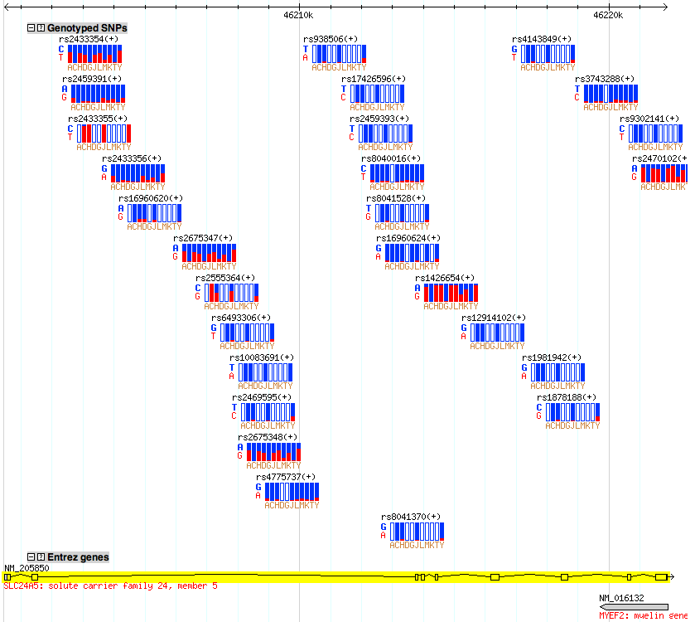
Caucasian “specific” alleles at SLC24A5

Slide 20
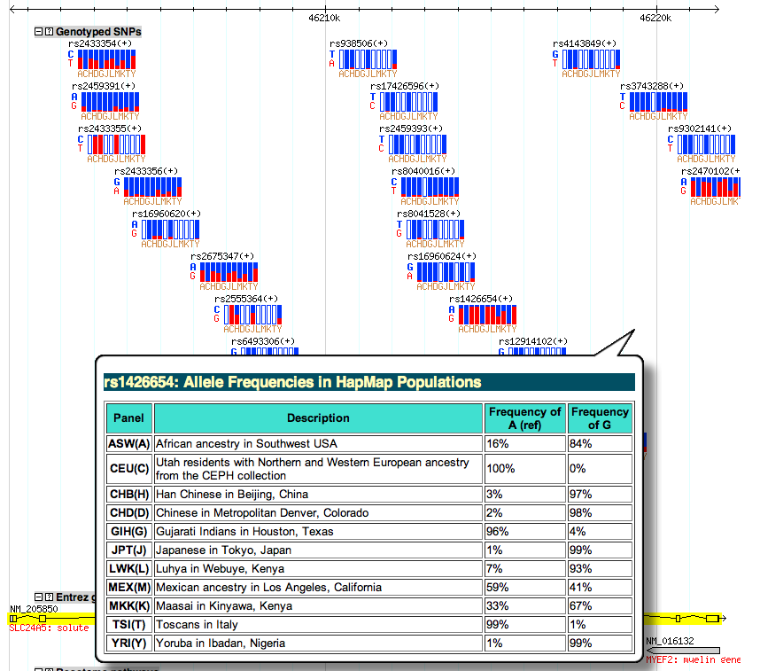
Allele frequencies at SLC24A5

Slide 21
Genome-wide searches for selection
Skews in allele frequency spectra and extended blocks of linkage disequilibrium can be explained by
Recent selection
Changes in population structure, e.g. recent expansions
Changes driven by population structure affect all loci
Selection operates only on specific loci
Significant outliers are more likely to be caused by selection than population effects

Slide 22
Some genome-wide scans for selection
Interspecies divergence: coding sequences only
Human vs chimp, K_{A}/K_{S} test for more changes in functional coding sites than expected
Clark et al. 2003 Science, Nielsen et al. 2005 PLoS Biology, Bustamante et al. 2005 Nature
Skew in allele frequency distribution: all genomic sequences
Tajima’s D
Carlson et al. 2005 Genome Research
Changes in recombination maps: all genomic sequences
Long range haplotype, extended regions of homozygosity, etc.
Sabeti et al. 2002 Nature, Wang et al. 2006 PNAS, Voight et al 2006 PLoS Biology
These are on hg18 assembly of human!!!!

Slide 23
Extended haplotype homozygosity
A selective sweep will generate longer segments of reduced genetic variation
Long range haplotype, extended haplotype homozygosity (EHH), etc.
Sabeti et al. 2002 Nature, Wang et al. 2006 PNAS, Voight et al 2006 PLoS Biology
Cross-population EHH, using populations from Human Genome Diversity Project
Measure EHH in populations from seven different continents
HGDP XP-EHH tracks in UCSC Genome Browser
Pickrell JK …. Pritchard JK (2009) Genome Research 19:826

Slide 24
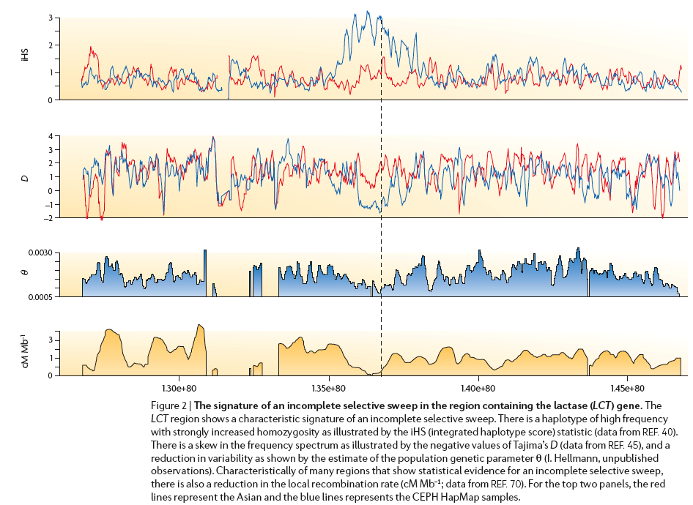
Four measures indicating selection in LCT
Caucasian
Asian
R. Nielsen et al. 2007, Nature Reviews Genetics 8: 857

Slide 25
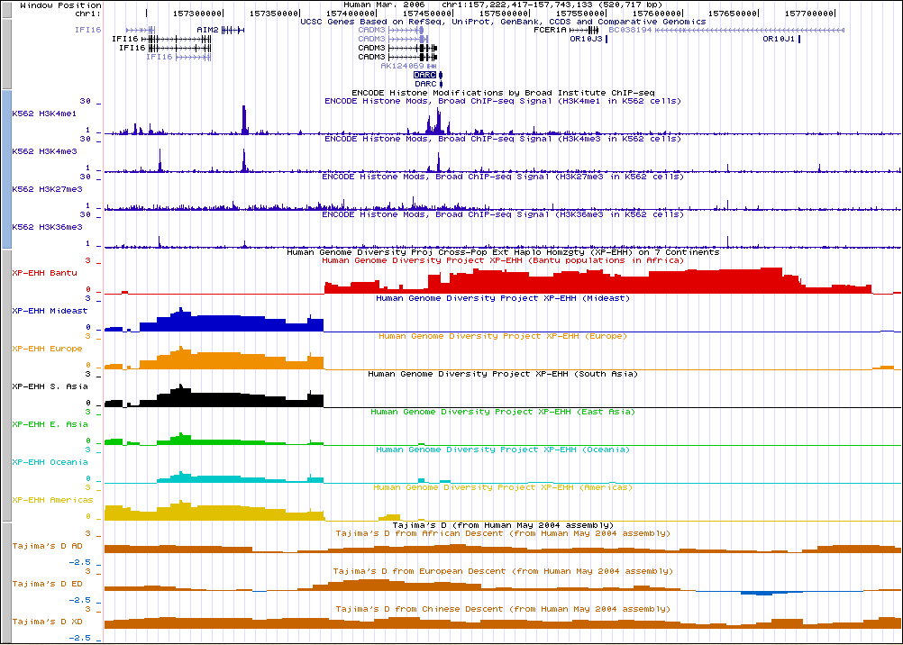
Selective sweep in Bantu at DARC=FY

Slide 26
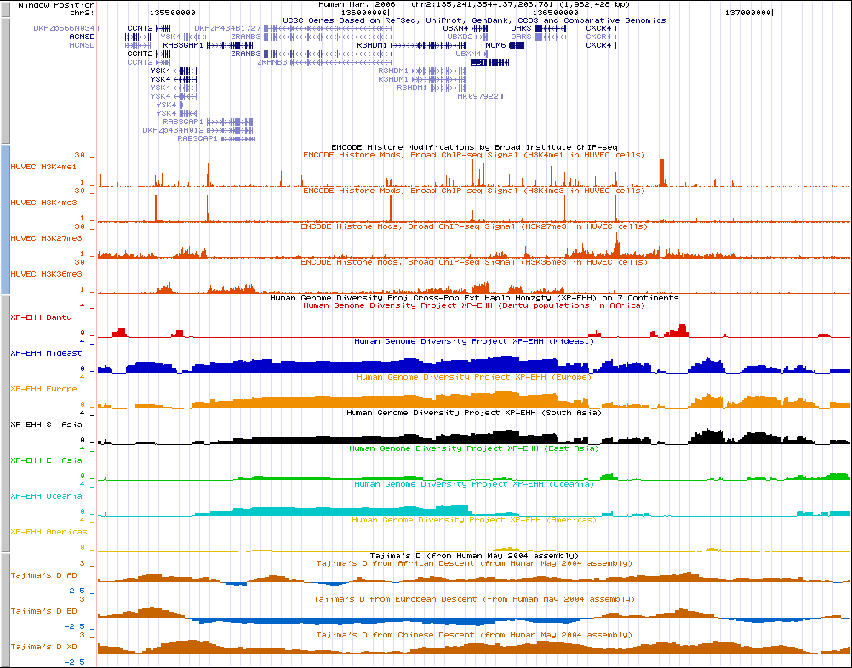
Selection around LCT
EHH in Europeans (and others), not Bantu

Slide 27
How genes become maladaptive
“Thrifty genotype hypothesis”, James Neel

Slide 28
Origins of disease alleles
New mutations produce rare alleles that are pathogenic
Hbb-S allele causing sickle cell disease has arisen multiple times in the past 10,000 yr
Is at high frequency in some populations because it is protective against malaria
In comparisons with related species, the disease alleles are the derived ones
Old sequences that were adaptive in earlier environments are now pathogenic
These disease variants may be identical to those in related species or our ancestral species

Slide 29
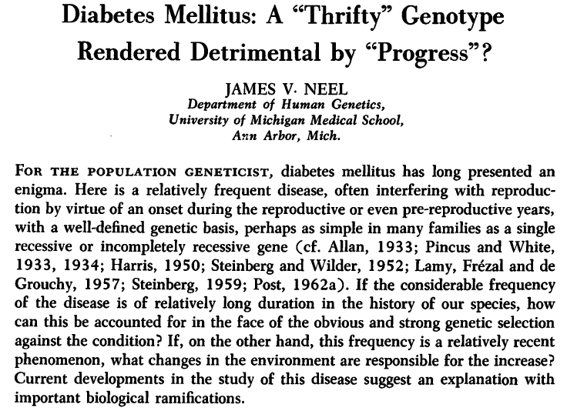
Neel’s thrifty genotype hypothesis
(1962) Am J Hum Genet. 14:353-362

Slide 30
Some key insights
“The foregoing considerations may be taken to indicate that in the early years
of life the diabetic genotype is, to employ a somewhat colloquial but expressive
term, a "thrifty" genotype, in the sense of being exceptionally efficient in the
intake and/or utilization of food.”
“A second possible mechanism to be considered involves a pancreas more
rapidly responsive to increases in the level of blood glucose. In this connection
it must be remembered that during the first 99 per cent or more of man's life
on earth, while he existed as a hunter and gatherer, it was often feast or famine. Periods of gorging alternated with periods of greatly reduced food intake. The individual whose pancreatic responses minimized post-prandial glycosuria might have, during a period of starvation, an extra pound of adipose reserve. In this connection Baird and Farquhar (1962) have recently demonstrated a striking increase in the ability of newborn infants of diabetic mothers to handle a glucose load, this accompanied by a marked elevation in plasma insulin-like activity ….”

Slide 31
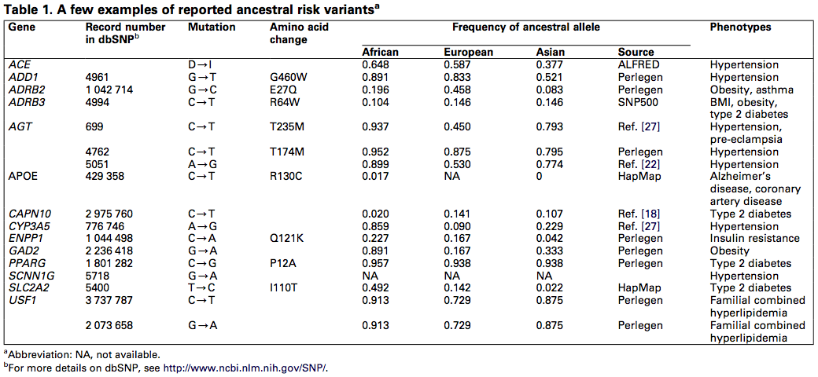
Reported ancestral risk variants
DiRienzo and Hudson (2005) An evolutionary framework for common diseases: the ancestral-susceptibility model. Trends in Genetics

Slide 32
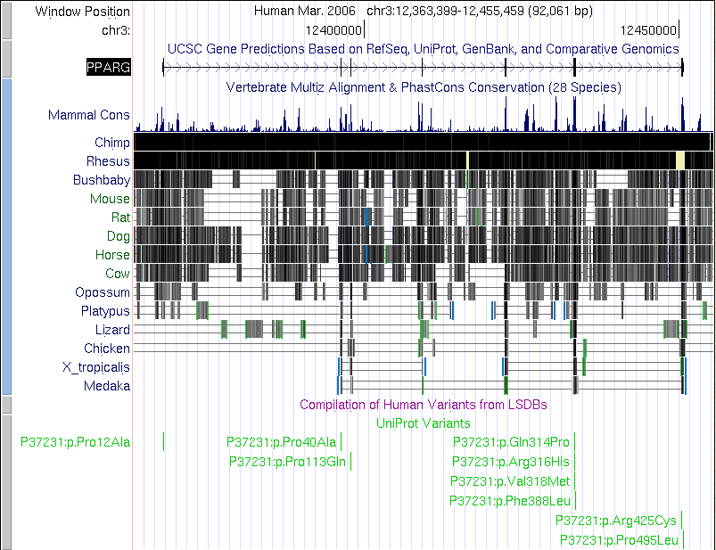
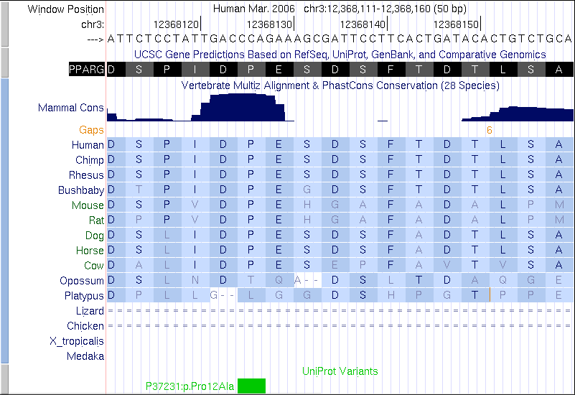
PPARG P12A: Minor, derived allele is protective against T2D
Risk allele (P12) is ancestral

Slide 33
Hypothesis for common alleles associated with disease
Ancestral alleles were adapted to ancient environment
Propose “a radical and relatively recent change in the selective pressures acting on biological processes responsible for maintaining the correct balance between the organism and its environment”
The recent environmental change disrupts the balance, leading to detrimental phenotypes

Slide 34
Summary
Comparisons between recently diverged species or within individuals in a population can reveal signatures consistent with positive selection.
Positive selection should lead to Ka/Ks>1
Indicates more change in the region under consideration (Ka) than in the neutral model
Often used in comparisons of recently diverged species
Positive selection acting on an advantageous allele in a population of individuals generates a selective sweep
Alleles (likely neutral) linked to the the advantageous allele also rise to high frequency
Generates long stretches of homozygosity beyond neutral expectation
Several other tests are commonly used
A large change in the environment can render previously advantageous alleles to be detrimental
Can explain why some ancestral alleles are now associated with disease risk
Neel’s hypothesis to explain why diabetes remains at high frequency

