Slide 1
Evolutionary signatures of function: Negative selection
Lesson 9_1: Evolutionary signatures of function
Hardison
BMMB 551

Slide 2
Changes in genome sequence

Slide 3
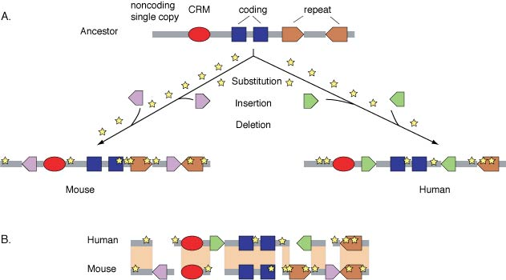
Types of sequence change in DNA
CRM = cis-regulatory module, e.g. promoter or enhancer

Slide 4
Changes in DNA and protein sequences
Occur naturally at a “low” rate
Accounts for sequence divergence within and between species
Observe these differences over a tremendous range of time scales
Days: chemical or physical mutagenesis in the lab
10,000 to 100,000 years: human polymorphisms
5 to 500 million years (Myr) : comparisons of homologous genes or proteins
about 5 Myr: Human vs chimp
about 60-80 Myr: Human vs. mouse, E. coli vs. Salmonella typhimurium
about 300 Myr: Human vs. chicken
about 450 Myr: Human vs. zebrafish

Slide 5
Principles of Molecular Evolution
“Functionally less important molecules or parts of a molecule evolve faster than more important ones.”
Kimura and Ohta (1974) PNAS USA 71: 2848-2852
More recently: Rates of evolution vary in characteristic ways for different functional classes
Try to use rates of sequence change to assign function!

Slide 6
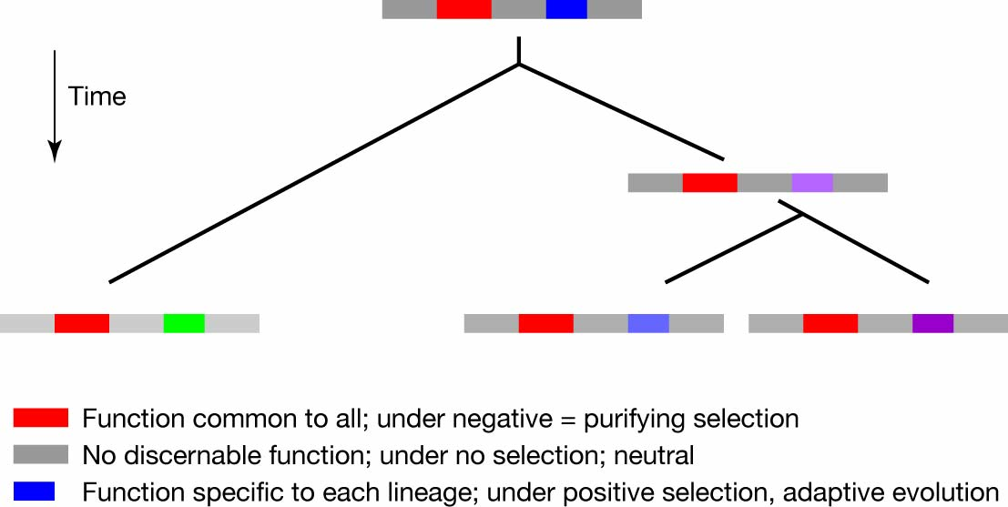
Three modes of evolution

Slide 7
Three major classes of evolution
Neutral evolution
Acts on DNA with no function
Genetic drift allows some random mutations to become fixed in a population
Purifying (negative) selection
Acts on DNA with a conserved function
Signature: Rate of change is significantly slower than that of neutral DNA
Often see this at “larger” evolutionary distance (e.g. >10 million years)
Darwinian or adaptive (positive) selection
Acts on DNA in which changes benefit an organism
Signature: Rate of change is significantly faster than that of neutral DNA
Most apparent over shorter evolutionary distances

Slide 8
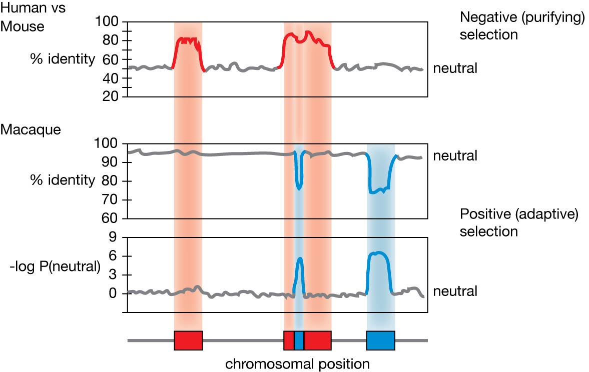
Negative and positive selection observed at different phylogenetic distances
:
ca. 80M yr
Human vs.
ca. 25M yr

Slide 9
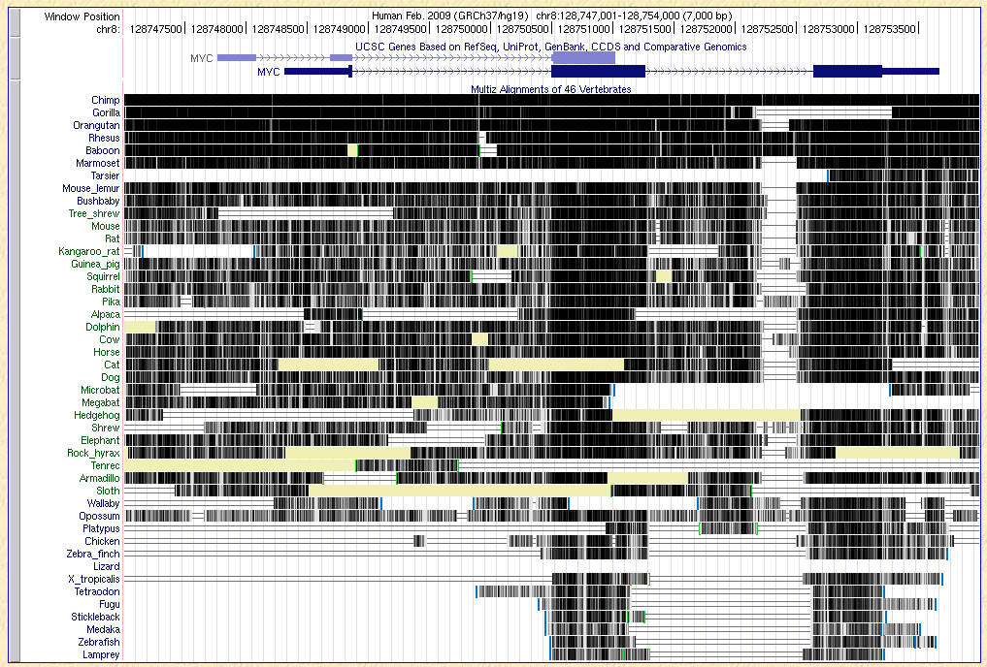
Patterns of aligning sequences

Slide 10
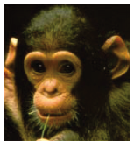
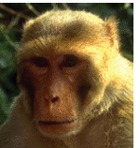
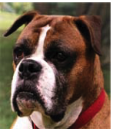
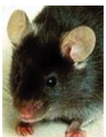
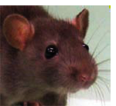
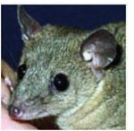
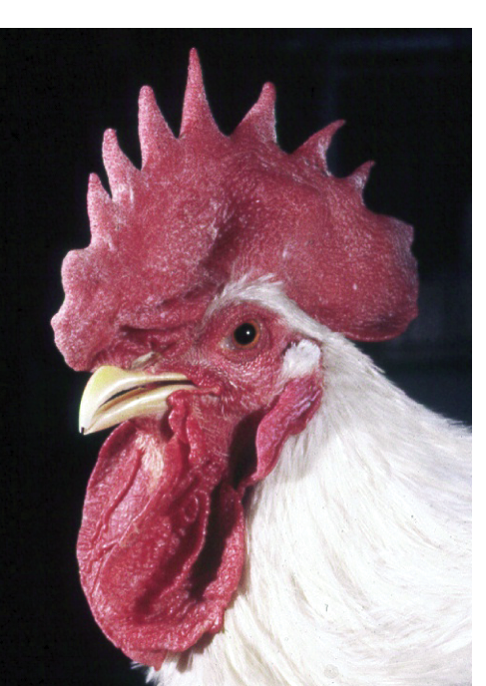
Functional classes show distinctive trends in phylogenetic depth of conservation
Candidate transcriptional regulatory regions
pTRR: based on epigenetic marks:
PRPs: predicted by patterns in alignments
Miller et al. 2007 Genome Research, 28-way alignments of vertebrates …

Slide 11
Models for neutral DNA
Synonymous substitution sites
Only in protein-coding DNA sequences
Some are still subject to selection
Codon bias
Splicing enhancers
Pseudogenes
Are you sure it really has no function?
Neutral evolution only after inactivation - when was it inactivated?
Ancestral repeats
The repetitive DNA families present in all placental mammals result from transposons that have not been active since the mammalian radiation
Most are remnants of old transposons and do not function even in DNA movement
But some (currently estimated as a small fraction) are active, e.g. in gene regulation

Slide 12
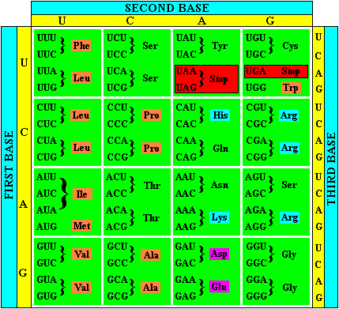
The Genetic Code
25 Words are needed to code for the 20 amino acids and the start and stop sites
The Triplet Code allows for 64 codons to be coded
=> Degeneracy of the genetic code
Most (but not all) changes in 1st position
change encoded amino acid
All changes in 2nd position
change encoded amino acid
Many (but not all) changes in 3rd position do not change encoded amino acid

Slide 13
Inferring selection from substitutions in coding regions
Silent (synonymous)
Do not change the encoded amino acid
Occur in degenerate positions in the codon
Are often not subject to purifying selection and thus occur more frequently in moderately distant interspecies comparisons
Rate of synonymous substitutions at synonymous sites = K_{S}
Nonsilent (nonsynonymous)
Do change the encoded amino acid
Occur in non-degenerate positions in the codon
Are more likely to be subject to purifying selection and thus occur less frequently in moderately distant interspecies comparisons
Rate of nonsynonymous substitutions at nonsynonymous sites = K_{A}
Interpretation
Ratio K_{A} / K_{S} << 1, infer constraint (negative or purifying selection)
Ratio K_{A} / K_{S} > 1, infer adaptation (positive selection)

Slide 14
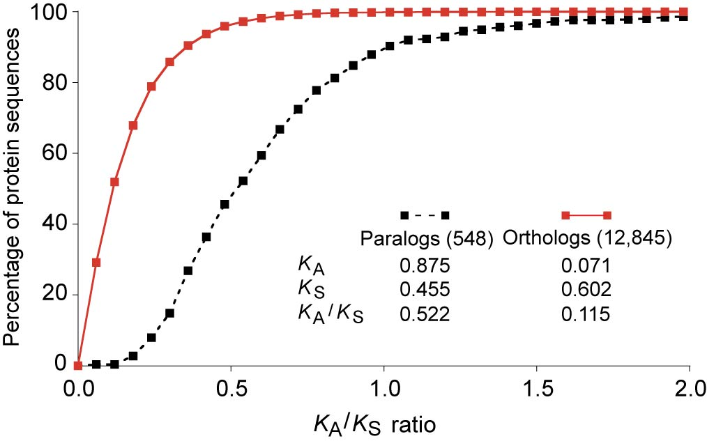
Most protein-coding exons are under constraint
Cumulative distribution of K_{A}/K_{S} ratios determined from human-mouse comparisons.
Almost all orthologous exons have quite low values for K_{A}/K_{S}, indicating strong constraint. In contrast, most paralogous exons have much higher K_{A}/K_{S} ratios suggesting that some are undergoing adaptive evolution.
Waterston et al. (2002) Mouse genome paper, Nature 420: 520-562. Fig. 21

Slide 15
Fundamental process in comparative genomics
1. Get genome sequences from species or individuals separated by a distance appropriate to the question you are addressing
2. Align those sequences
3.a. Find informative similarities
E.g. Blast search vs sequence databases
3.b. Compare the alignments to a neutral model or other appropriate group
Amount of similarity
Likelihood of being under selection (negative or positive)
Patterns in alignments

Slide 16
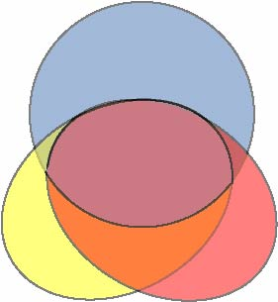
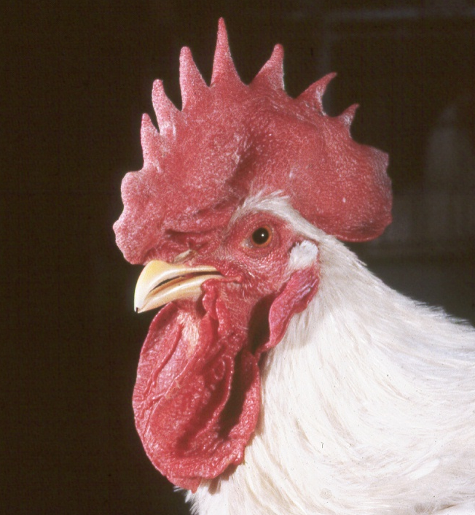
Comparative genomics to find functional sequences
Genome size
Find common sequences
blastZ, multiZ
2,900
Human
Sequences under purifying selection: ~ 145 Mbp
2,400
All mammals
1000 Mbp
2,500
Mouse
Rat
1,200
million base pairs
(Mbp)
Also birds: 72 Mb
Papers in Nature from mouse and rat and chicken genome consortia, 2002, 2004

Slide 17
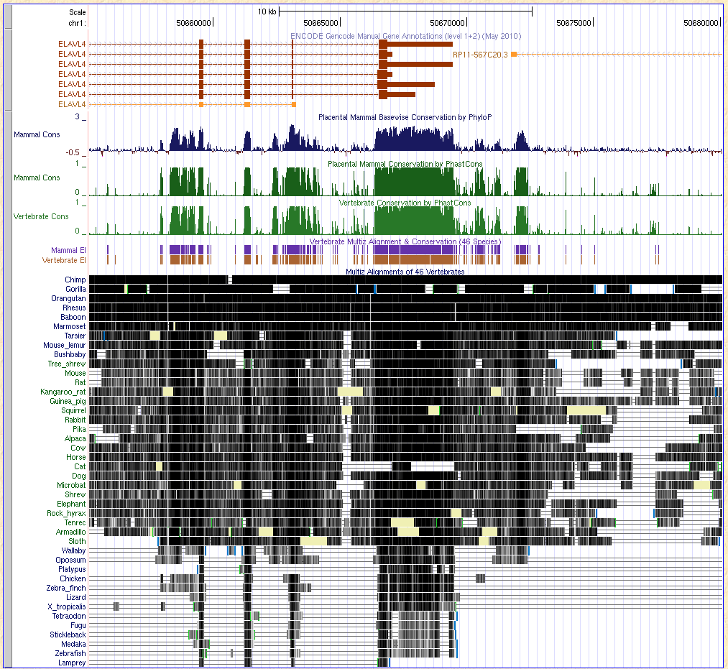
Resources on GRCh37 (h19)
Alignment: 46 vertebrates
phastCons
Mammal
Vertebrate
PhyloP
Base by base score
Can be positive or negative
Conserved elements
Discrete intervals

Slide 18
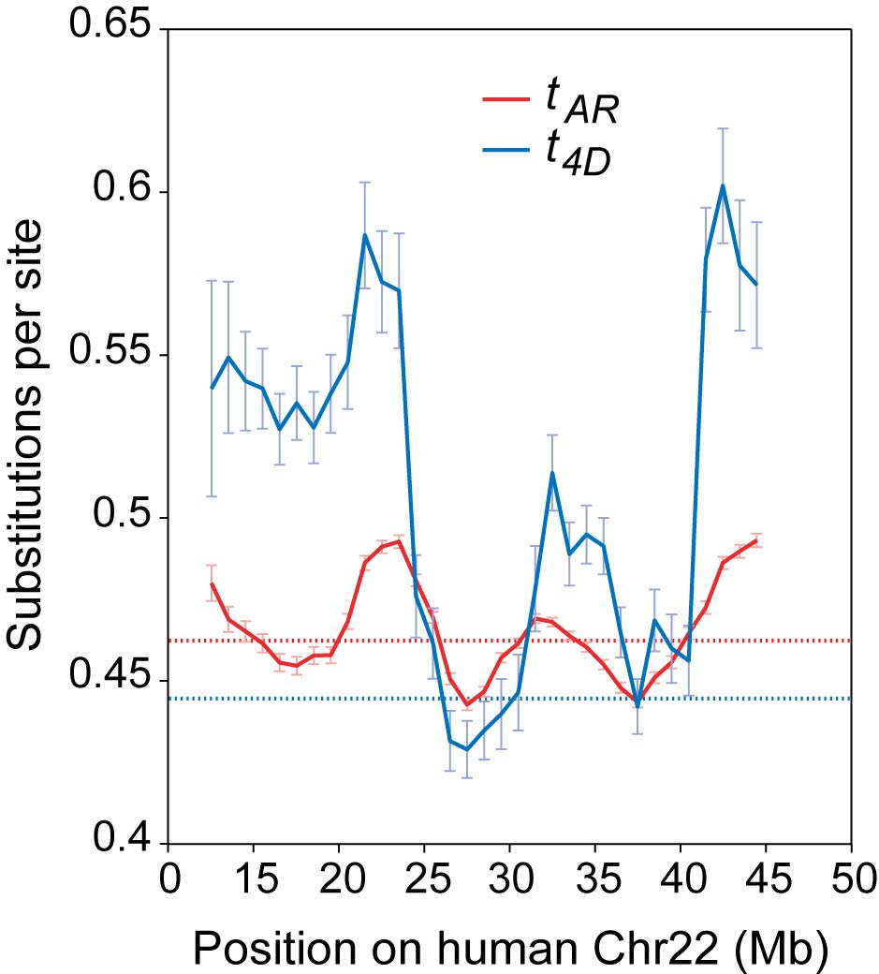
Variation in nucleotide substitution rate
Waterston et al. (2002) Mouse genome paper, Nature 420: 520-562. Fig. 30

Slide 19
Use measures of alignment quality to discriminate functional from nonfunctional DNA
Compute a conservation score adjusted for the local neutral rate
Score S for a 50 bp region R is the normalized fraction of aligned bases that are identical
Subtract mean for aligned ancestral repeats in the surrounding region
Divide by standard deviation
p = fraction of aligned sites in R that are
identical between human and mouse
μ = average fraction of aligned sites that
are identical in aligned ancestral repeats in
the surrounding region
n = number of aligned sites in R
Waterston et al. (2002) Mouse genome paper, Nature 420: 520-562. p. 549

Slide 20
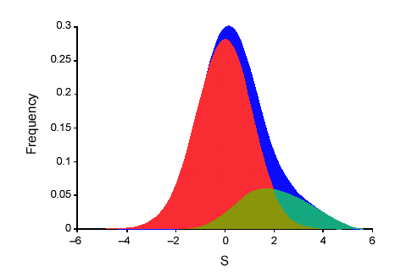
Decomposition of conservation score into neutral and likely-selected portions
Neutral DNA (ARs)
All DNA
Likely selected DNA
At least 5-6%
S is the conservation score adjusted for variation in the local substitution rate.
The frequency of the S score for all 50bp windows in the human genome is shown.
From the distribution of S scores in ancestral repeats (mostly neutral DNA), can compute a probability that a given alignment could result from locally adjusted neutral rate.
Waterston et al. (2002) Mouse genome paper, Nature 420: 520-562. Fig. 28

Slide 21
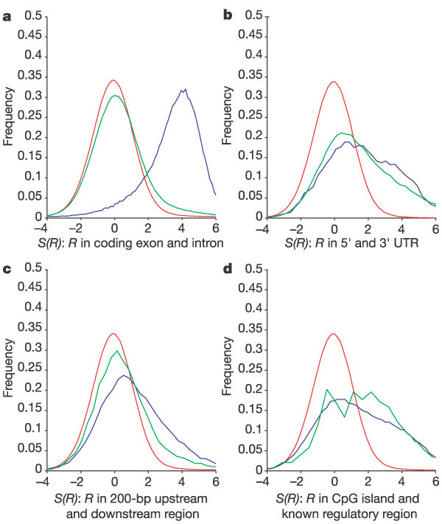
Conservation score S in different types of regions
Red: Ancestral repeats (mostly neutral)
Blue: First class in label
Green: Second class in label
Waterston et al. (2002) Mouse genome paper, Nature 420: 520-562. Fig. 24

Slide 22
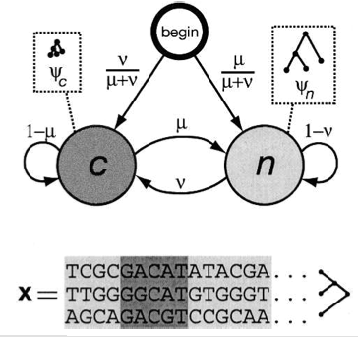
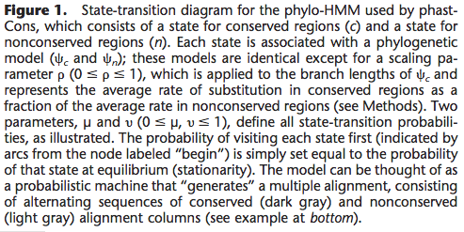
phastCons: Likelihood of being constrained
Phylogenetic Hidden Markov Model
Posterior probability that a site is among the 5 % most highly conserved sites
Allows for variation in rates along lineages
c is “conserved” (constrained)
n is “nonconserved” (aligns but is not clearly subject to purifying selection)
Siepel et al. (2005) Genome Research 15:1034-1050

Slide 23
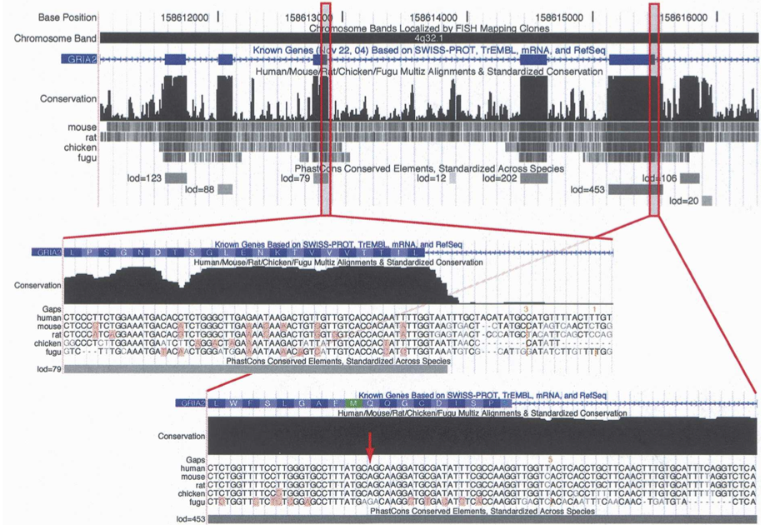
Some constrained introns are editing complementary regions:GRIA2
Siepel et al. 2005, Genome Research

Slide 24
Negative and positive selection observed at different phylogenetic distances
:

Slide 25
Summary
Multispecies alignments can be used to predict whether a sequence is functional (signature of purifying selection)
At least 5-6% of the human genome (and the orthologous sequences in other species) share a function that is under purifying (negative) selection
Does not include lineage-specific function or account for turnover of functional regions
Almost all coding exons are under constraint
about 1.2% of genome
But some show evidence of positive selection: adaptation
The remaining 4-5% of the human genome under constraint is noncoding
Some of this noncoding constrained DNA regulates gene expression
Ultraconserved DNA: many enhancers for genes encoding developmental regulatory proteins
Some but not all regulatory regions show evidence of constraint (but are not ultraconserved)

