Slide 1

Transcriptome analysis: Quantitation and comparisons
Genomics Lesson 8_2
Hardison

Slide 2
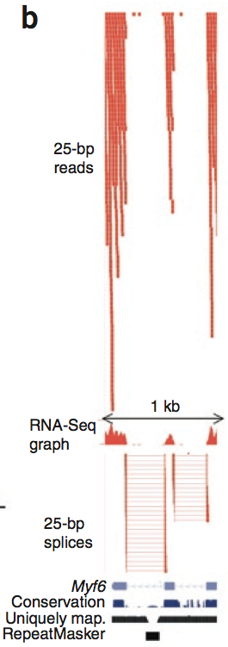
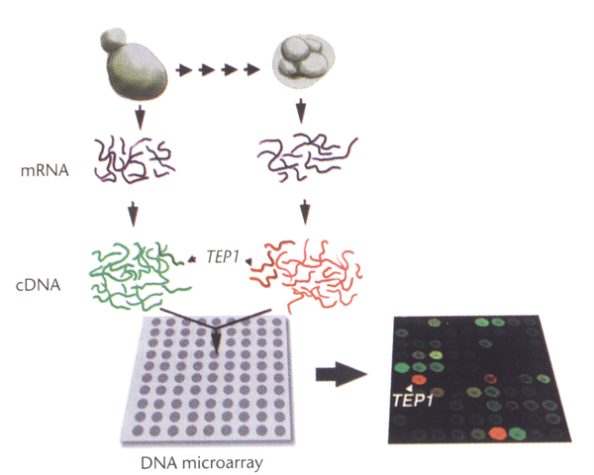
Assays to determine the transcriptome
Hybridize the cDNA to microarrays of probes covering
  All protein-coding genes
  Almost all genomic DNA
Sequence the cDNA: RNA-seq
Fluorescent signal intensity
RPKM = reads per kilobase of exon per million mapped reads
  Two massively parallel analytical methods

Slide 3
Data preprocessing: normalization, RMA

Slide 4
Preprocessing data
Filtering
  Are the signals strong enough to be reliable?
  Are the differences significant, given the background signal?
Normalization
  Remove confounding variance, e.g. systematic differences in slide production (e.g., spotting inefficiency), preparation of labeled RNA, etc.
Missing data
  A few missing data can be imputed
Centering
  May want to row-center (i.e. by gene) the data so that similar trends are captured.

Slide 5
RMA is a common measure of expression
Irizarry RA, Hobbs B, Collin F, Beazer-Barclay YD, Antonellis KJ, Scherf U, Speed TP (2003) Exploration, normalization, and summaries of high density oligonucleotide array probe level data. Biostatistics. 4:249-264.
Develop a summary measure of expression level that is a robust multi-array average (RMA) of background-adjusted, normalized, and log-transformed values of the perfect match intensities
Implemented in the Bioconductor package in R

Slide 6
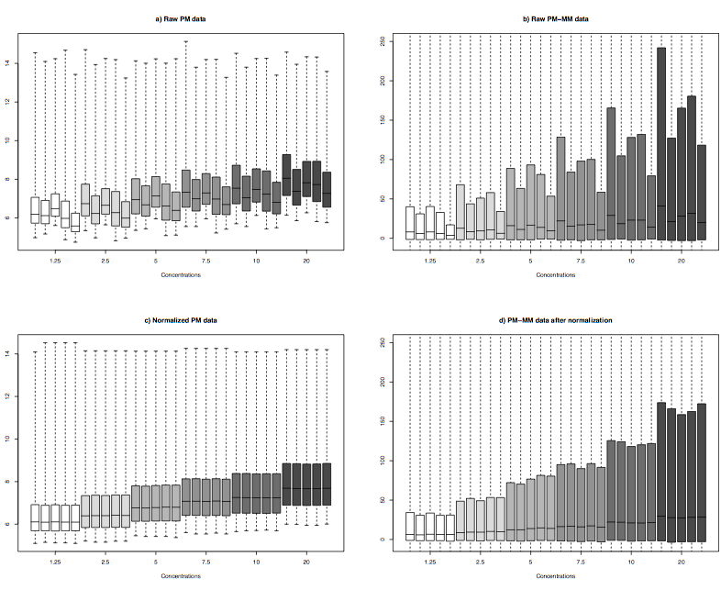
Need to normalize between arrays
Raw data: PM-MM
Irizarry et al., 2003
Datasets are a concentration series of human liver RNA. Each concentration of RNA was hybridized to 5 GeneChip arrays, and each array was analyzed on a different scanner.
Note the different distributions for each replicate, and a clear scanner effect: results from 1 are higher than those from 5
All distributions are the same after quantile normalization
Raw data: PM (perfect match)
Perfect match - mismatch
Quantile normalized: PM
Quantile normalized: PM-MM
Concentrations of RNA

Slide 7
Quantile normalization
Bolstad BM, Irizarry RA, Astrand M, Speed TP (2003) A comparison of normalization methods for high density oligonucleotide array data based on variance and bias. Bioinformatics 19:185-193.
Quantile normalization
Goal: make the distribution of probe intensities the same for each array in a set
Works as well or better than other, more complex or time-consuming methods
Algorithm:
  “1. given n arrays of length p, form X of dimension p × n where each array is a column;
  2. sort each column of X to give X_{sort};
  3. take the means across rows of X_{sort} and assign this mean to each element in the row to get X′_{sort};
  4. get X_{normalized} by rearranging each column of X′_{sort} to have the same ordering as original X ”

Slide 8
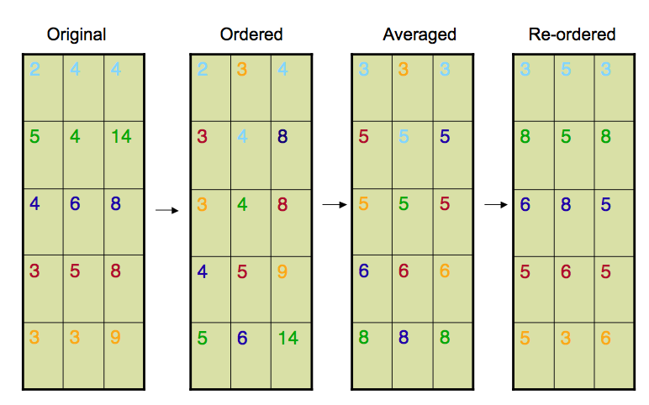
Example of quantile normalization
  “1. given n arrays of length p, form X of dimension p × n where each array is a column;
  2. sort each column of X to give X_{sort};
  3. take the means across rows of X_{sort} and assign this mean to each element in the row to get X′_{sort};
  4. get X_{normalized} by rearranging each column of X′_{sort} to have the same ordering as original X ”
http://www.biostat.jhsph.edu/~ririzarr/Teaching/688/normalization.pdf

Slide 9
Need to normalize between arrays
Raw data: PM-MM
Irizarry et al., 2003
Datasets are a concentration series of human liver RNA. Each concentration of RNA was hybridized to 5 GeneChip arrays, and each array was analyzed on a different scanner.
Note the different distributions for each replicate, and a clear scanner effect: results from 1 are higher than those from 5
All distributions are the same after quantile normalization
Raw data: PM (perfect match)
Perfect match - mismatch
Quantile normalized: PM
Quantile normalized: PM-MM
Concentrations of RNA

Slide 10
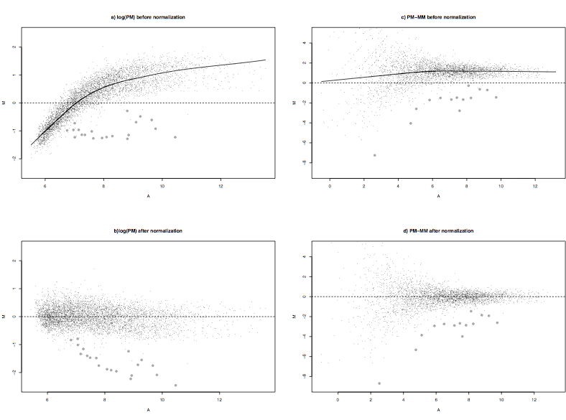
M vs A plots illustrate benefits of normalization
From Irizzary et al., 2003
Magnitude of difference vs Abundance
M=log₂(PM₁/PM₂)
A=log₂ sqrt (PM₁ x PM₂)
Data are replicates (small dots) with spike-in RNAs at different concentrations for each array (larger dots)
Expect no difference for replicates, so data cloud around M= 0 is the desired result and allows you to see consistent differences in the spike-ins
Raw data
0
M
Quantile normalized
0
A
PM only
PM - MM

Slide 11
Row-centering data
Example: want to group genes by similar patterns of expression, but amplitude of signal is not important
One common method: For each row (expression of a given gene), subtract the mean for the T expression levels, and divide by the standard deviation
Used when clustering genes by expression patterns
10
+
Expression
0
relative expr
-
1
conditions
0
1
2
3
0
1
2
3
before
after

Slide 12
Data Matrix
Matrix with expression values arrayed:
one row for each gene
one column for each condition.
These should be comparable numbers, on a scale and format appropriate to the questions and the data analysis tools one intends to use, possibly no holes, possibly a reduced set of genes.
X_{1,1}
.
.
.
X_{1,T}
X_{i,j} is an expression value
.
.
.
rows i = 1…N (genes)
columns j = 1…T (conditions)
.
.
.
.
.
.
X_{N,1}
.
.
.
X_{N,T}

Slide 13
Finding meaningful trends in the data: clustering

Slide 14
Data analysis: Look at the extremes
Question: Expression of which genes is characteristic of a certain state of differentiation or pathology?
  Normal vs cancerous cells
  Sub-classifications of cancerous cells
Analysis: Find genes expressed in cancer but NOT normal
  T can be 2, look for no detectable signal in normal but significant expression in cancer
Eisen et al: “A natural first step in extracting this information is to examine the extremes, e.g., genes with significant differential expression in two individual samples or in a time series after a given treatment. This simple technique can be extremely efficient, for example, in screens for potential tumor markers or drug targets.”

Slide 15
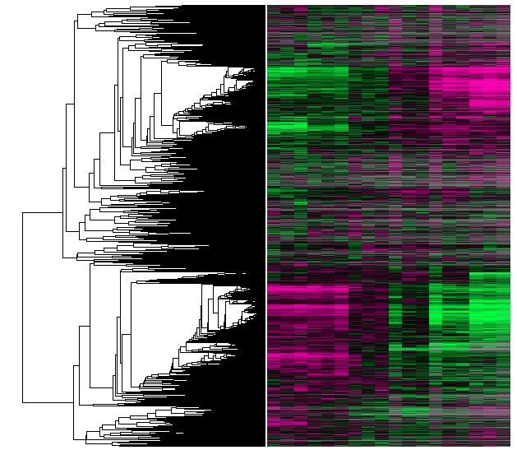
Data analysis: Holistic approach
Question: Expression of which genes plays a role in a given biological processes?
  e.g. cell cycle, response to a stimulus or class of stimuli -- drug treatments, shocks to the cell
  Can we group relevant genes on the basis of expression similarity?
Analysis: Find cohorts of co-expressed genes in entire dataset
Given:
Find:
Expression levels in different conditions
X_{1,1}
.
.
.
X_{1,T}
genes
.
.
.
.
.
.
.
.
.
X_{N,1}
.
.
.
X_{N,T}

Slide 16
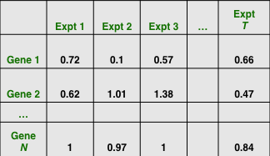
Organizing genes by similarity in their expression patterns
Experiment 1
2
3
...T
Down-regulated
{g1}
g1
g2
Up-regulated
{g2, g4}; {g3}; {g5}
g3
g4
g5
Jyotsna Kasturi
No change
{g6}
g6
Clusters
Input Profiles

Slide 17
Clustering
Goal: Categorize or group similar data items together
Methods
  Supervised or Unsupervised
    Supervised: expression profiles are classified with respect to known reference profiles
  Hierarchical algorithms
  Partitional methods
    K-means, e.g.
Similarity measures
  Correlation coefficient
  Euclidean distance
  L_{m} distance
Notes:
More ambitious, attempt to model and infer regulatory networks on a global scale, or along more specific
Subcomponents such as a pathway or a set of co-regulated genes.

Slide 18
Similarity in gene expression data
Adopt a mathematical description of similarity
One of many measures of similarity:
  Dot products of the two T-dimensional vectors representing a series of T measurements.
  Expression ratio for condition
  0 1 2 3
  GeneP 0.1 1.9 2.8 3.1 vector P
  GeneQ 0 -2.0 -2.7 -3.3 vector Q
  vector P . vector Q = (0.1x0) + (1.9x -2.0) + (2.8x -2.7) + (3.1x -3.3)
Standard correlation coefficient fits well with co-expression.
  The dot product of two normalized vectors
The correlation coefficient captures similarity in shapes of two curves, but it does not emphasize the magnitude of the two series of measurements.

Slide 19
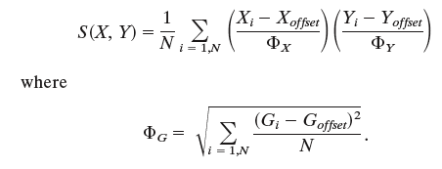
A metric for similarity in expression patterns
Eisen et al: “The gene similarity metric we use is a form of correlation coefficient. Let G_{i} equal the (log-transformed) primary data for gene G in condition i. For any two genes X and Y observed over a series of T conditions, a similarity score can be computed as follows:”
T
T
T
T
If G_{offset} = mean of observations on G, then
Φ_{G} = standard deviation of G
S(X, Y) = Pearson correlation coefficient of the observations of X and Y.
Often use G_{offset} = 0 (i.e. fluorescence ratio of 1.0) for a reference state.

Slide 20
Value of the metric for genes with different patterns
T
T
+3
GeneP
P_{i}-P_{offset}
Gets larger and positive for conditions 1-3
0
G_{offset}
relative expr
Q_{i}-Q_{offset}
Gets larger and negative for conditions 1-3
-3
GeneQ
0
1
2
3
conditions
S(P,Q), the sum of the products for conditions 0-3, is a large negative value.

Slide 21
Value of the metric for genes with similar patterns
T
T
+3
GeneR
Gets larger and positive for conditions 1 and 2, smaller for condition 3
R_{i}-R_{offset}
0
G_{offset}
relative expr
GeneS
S_{i}-S_{offset}
Gets larger and positive for conditions 1 and 2, smaller for condition 3
-3
0
1
2
3
conditions
S(R,S), the sum of the products for conditions 0-3, is a large positive value.

Slide 22
Hierarchical clustering
Compute a matrix of all pairwise distances S(X,Y) for the N genes
Q R S …
P -11 1 1
Q -8 -9
R 4
Find the highest value (the most similar pair).
Create a node by joining these two genes. Then compute an expression profile for that node by averaging the observed expression values for the two genes.
Update the similarity matrix with the new node replacing the two genes.
Repeat the process N-1 times until only one gene is left.
  In each iteration, the expression profile for the new node is an average of the values, weighted by the number of genes in the previous nodes.
Method is based on “pairwise average-linkage” (Sokal and Michener, 1958) or Unweighted Pair Group Method with Arithmetic Mean (UPGMA)
Generates a dendrogram that links all the elements (gene expression profiles) into a single tree. Genes with similar expression patterns are close in the tree.
+3
GeneP
+3
GeneR
relative expr
relative expr
0
0
GeneS
-3
GeneQ
-3
0
1
2
3
0
1
2
3
conditions
conditions

Slide 23
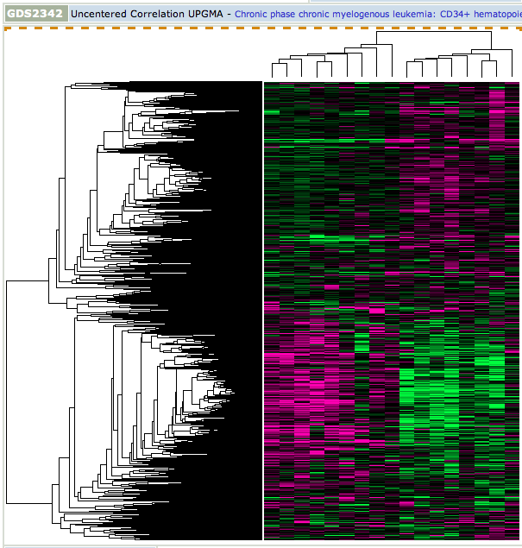
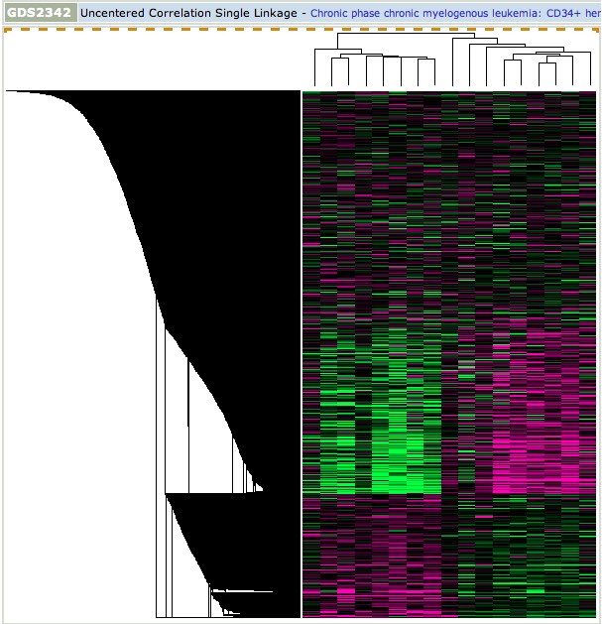
Different methods of linking clusters
Average linkage clustering: linking distance is the average of all pairwise distances between elements in clusters (e.g. UPGMA)
CML
normal
Amt txn,
condition 2
Amt txn, condition 1
Single linkage clustering: linking distance is the minimum between two clusters
normal
CML
Amt txn,
condition 2
Amt txn, condition 1
GEO GDS2342: Diaz-Blanco E, Bruns I, Neumann F, Fischer JC et al. Molecular signature of CD34(+) hematopoietic stem and progenitor cells of patients with CML in chronic phase. Leukemia 2007 21:494-504. PMID: 17252012

Slide 24
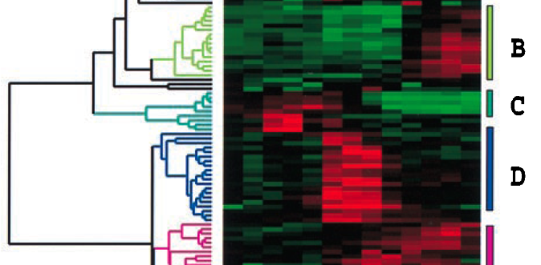
False color display of data
Represent expression data graphically by coloring each cell on the basis of the measured fluorescence ratio.
log ratios of 0 (ratios of 1, i.e. expression level is unchanged): color black
log ratios positive: color red, with increasing intensity for larger positive number
log ratios negative: color green, with increasing intensity for larger negative number
Add dendrogram to side of image
Profiles for some of the genes responding to addition of serum to previously quiescent cells
Fig. 1, Eisen et al.

Slide 25
K-means clustering

Slide 26
K-means clustering
K-means clustering generates a specific number of disjoint, flat (non-hierarchical) clusters.
  No dendrogram.
  Rather, the data are partitioned.
Properties of the K-means algorithm
  There are always K clusters.
  There is always at least one item in each cluster.
  The clusters are non-hierarchical and they do not overlap.
  Every member of a cluster is closer to its cluster than any other cluster.

Slide 27
The K-means Algorithm Process
User specifies the number of clusters they want (K)
Randomly guess the center locations for K clusters
For each data point, calculate the distance from the data point to each center
For each center, compute the centroid of the points that it “owns”
Move the center to that centroid
Repeat this until the clusters are stable and the process terminates.
Andrew Moore’s tutorial at CMU: http://www.autonlab.org/tutorials/kmeans11.pdf

Slide 28
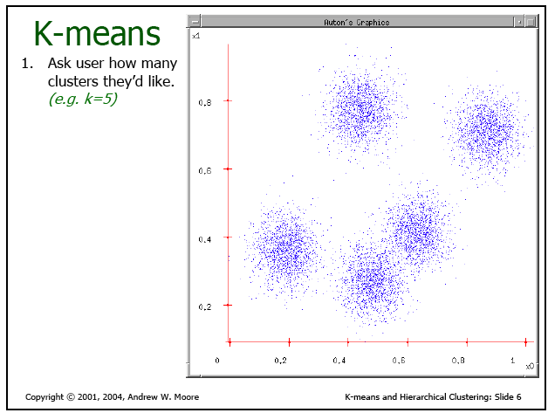
Choose desired number of clusters

Slide 29
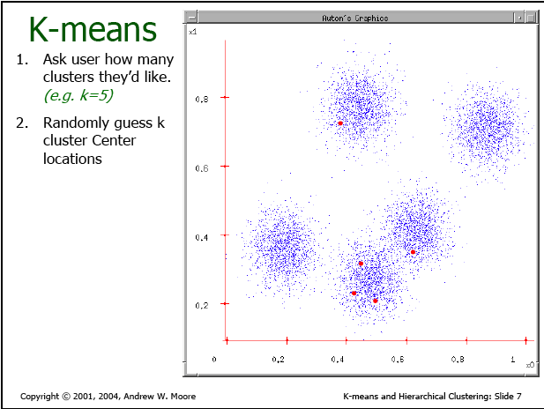
Guess center locations

Slide 30
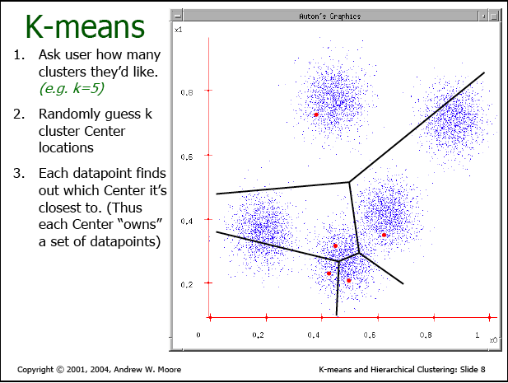
Find closest center for each datapoint

Slide 31
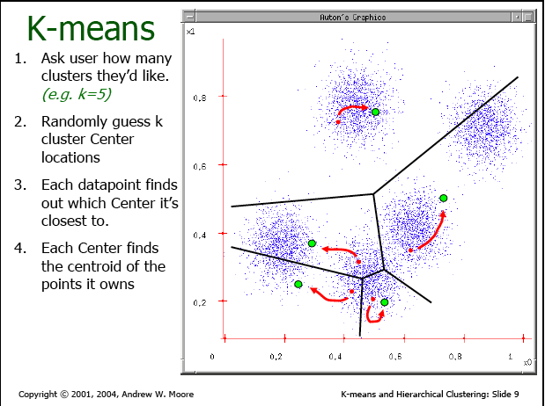
Find new centroids

Slide 32
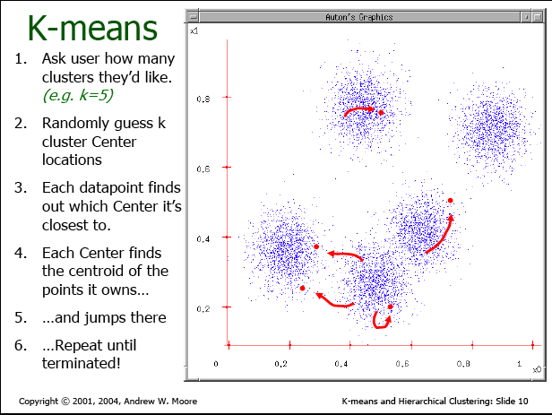
Move centers, and then repeat …

Slide 33
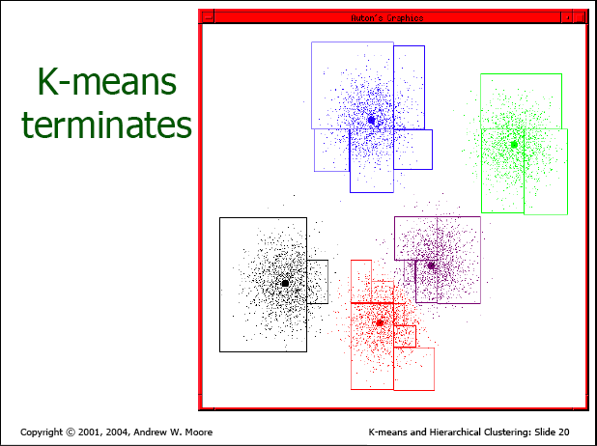
Termination at stable clusters

Slide 34
Features of agglomerative hierarchical clustering
Advantages
  Can produce an ordering of the objects, which may be informative for data display.
  Smaller clusters are generated, which may be helpful for discovery.
Disadvantages
  Objects that may have been 'incorrectly' grouped at an early stage cannot be relocated subsequently.
  Use of different distance metrics may generate different clusters.

Slide 35
Features of K-means clustering
Advantages
  Good for finding globular clusters
    Genes whose expression patterns are roughly spherical or elliptical in T-dimensional space
    Line between any 2 members of the cluster stays within the cluster
  Can be faster than hierarchical clustering for small K
Disadvantages
  Do not know ideal K
  The choice of initial partition can greatly affect the final clusters that result, in terms of inter-cluster and intracluster distances and cohesion.

