Slide 1
Transcriptomes: Microarrays and RNA-seq
Genomics Lesson 8_1
Hardison

Slide 2
transcriptomes

Slide 3
Transcriptome
All the DNA that is transcribed in all the cells in an organism
Protein-coding genes
Both primary transcript and mature mRNA
Noncoding genes
tRNA, rRNA for translation
snRNAs for RNA splicing
microRNAs: regulatory
long noncoding RNAs: regulatory and ???

Slide 4
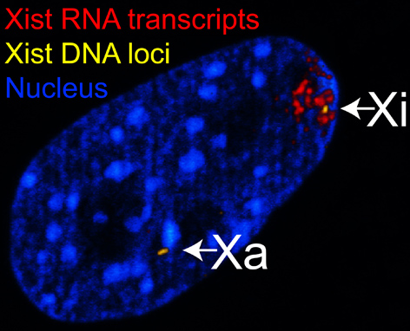
RNA interference
RNA-based mechanisms that block gene expression
Some RNAs prevent transcription
E.g. Xist: turn off expression from one X chromosome in females
Some RNAs prevent the expression of transcribed genes
Post-transcriptional gene silencing (PTSG)
E.g. microRNAs, short interfering RNAs
Reinius et al. 2010 BMC Genomics 11: 614
Notes:
From Wikipedia: “The figure shows confocal images from a combined RNA-DNA FISH experiment for Xist in female mouse fibroblast cells (Female-biased expression of long non-coding RNAs in domains that escape X-inactivation in mouse, B Reinius et al 2010, BMC Genomics (6), http://www.biomedcentral.com/1471-2164/11/614/abstract). The figure was adapted from Figure 5 in the original publication and contrast was adjusted to make the figure clear in thumbnail format. Open access: Unrestricted use, distribution and reproduction in any medium is permitted, provided the original article is properly cited.”
“The figure shows confocal microscopy images from a combined RNA-DNA FISH experiment for Xist in fibroblast cells from adult female mouse, demonstrating that Xist RNA is coating only one of the X-chromosomes. RNA FISH signals from Xist RNA are shown in red color, marking the inactive X-chromosome (Xi). DNA FISH signals from Xist loci are shown in yellow color, marking both active and inactive X-chromosomes (Xa, Xi). The nucleus (DAPI-stained) is shown in blue color. “

Slide 5
microRNAs (miRNAs)
Endogenous RNAs, about 22 nt in length, that play important regulatory roles
Found in animals and plants
Target specific mRNAs for cleavage or translational repression
First discovered: lin-4, a gene that controls timing of C. elegans larval development
Does not code for a protein.
Encodes a pair of small RNAs: 61 nt precursor and 22 nt product
Complementary to 3’UTR of lin-14 gene
Hybrid leads to repression of translation
Laboratories of Victor Ambrose (1993) and Gary Ruvkun
Diagrams show the stem-loop structures, miRNAs in red, miRNA* in blue, and flanking sequences
Founding miRNAs: lin-4 and let-7, C. elegans
David Bartel (2004) Cell 116: 281-297

Slide 6
Three modes of action of small silencing RNAs
David Bartel (2004) Cell 116: 281-297

Slide 7
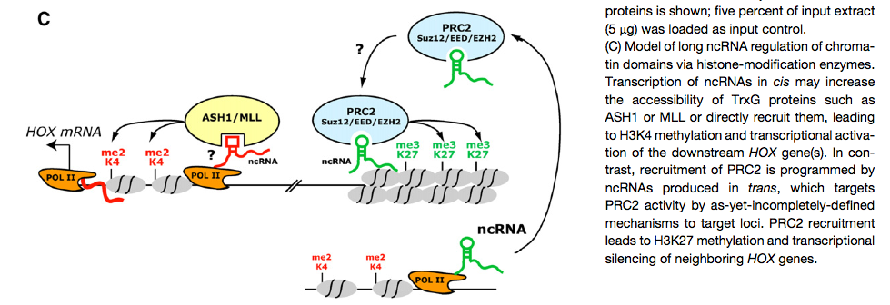
Long noncoding RNAs regulating gene expression
Model: HOTAIR recruits enzymes that place repressive marks on chromatin
Rinn et al. (2007) Cell 129: 1311-1323

Slide 8
Global measurements of gene expression

Slide 9
Global measurement of gene expression
Reliable quantitative measures of many (preferably all) genes in an organism in a single experiment provides answers to critical questions
What genes change expression levels during differentiation among certain cell types?
Normal vs cancerous cells
Sub-classifications of cancerous cells
Cells in different tissues or regions of an organ
What are global affects of genetic knockouts?
E.g., examine all the genes whose expression is altered when a histone acetyl transferase is mutated
What regions are transcribed?
Coding?
Noncoding?

Slide 10
Determine transcriptome from cDNA
Double-stranded DNA
RNA synthesis
Select PolyA+ RNA from total RNA
Convert RNA to complementary DNA (cDNA)
Reverse transcriptase
Oligo-dT primer, complementary to polyA tail to start synthesis from 3’ end
Random primers to start synthesis at multiple places
Second strand synthesis
5’
AAAAAAA
3’
Fragmentation
AAAA
Reverse transcription
dATP, dTTP, dGTP, dCTP
AAAA
TTTT
First strand cDNA
Second-strand synthesis
dATP, dTTP, dGTP, dCTP
TTTT
AAAA
Double-stranded cDNA

Slide 11
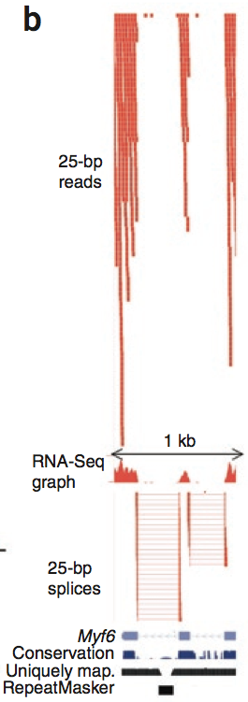
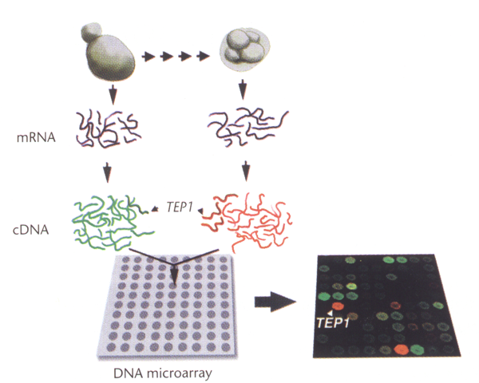
Assays to determine the transcriptome
Hybridize the cDNA to microarrays of probes covering
All protein-coding genes
Almost all genomic DNA
Sequence the cDNA: RNA-seq
Two massively parallel analytical methods

Slide 12
Hybridization to microarrays of genes
Advantages
Mature technology
Replicates of biological samples
Well established methods for normalization and statistical analysis
Consistent quantitation
Limitations
Can only ascertain what is on the tiling arrays
Limit to the dynamic range for quantitation
Can saturate the fluorescence detector
Low signals are hard to distinguish from background

Slide 13
RNA-seq
Advantages: little bias
Can observe previously unknown transcripts
Can identify novel splicing isoforms
Very wide dynamic range
E.g., low end is about one transcript per gene per 10 cells
High end: hundreds of thousands of transcripts per gene per cell
Is starting to be applied to to single cell analysis
Disadvantages: new technology, analysis in flux
Analysis methods are under constant development
Best methods for quantitation not yet clear
Methods for statistical analysis, inclusion of replicates, still being developed
De novo determination of gene models still under development

Slide 14
Transcriptome analysis on microarrays

Slide 15
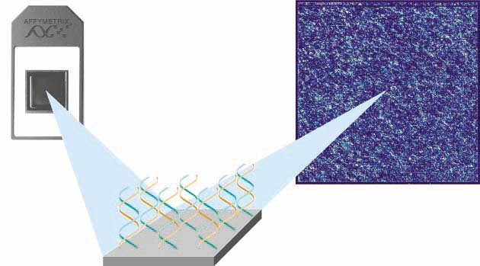
Affymetrix GeneChips
Purchase GeneChips containing probes for transcripts from organism of interest
Need a well-annotated genome (or at least transcriptome)
Make labeled cDNA (fluorescent)
Hybridize to GeneChip
Scan to obtain fluorescent intensity at each position
Convert to measurement of RNA levels
Can use similar technology for discovery IF employ a tiling array of probes across an entire genome rather than probesets based on gene sequences

Slide 16
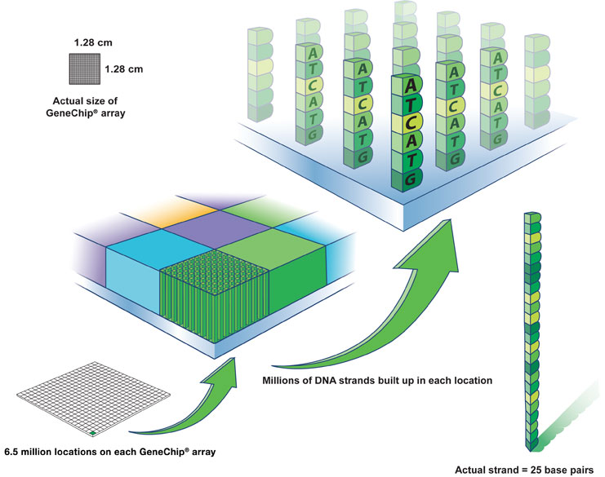
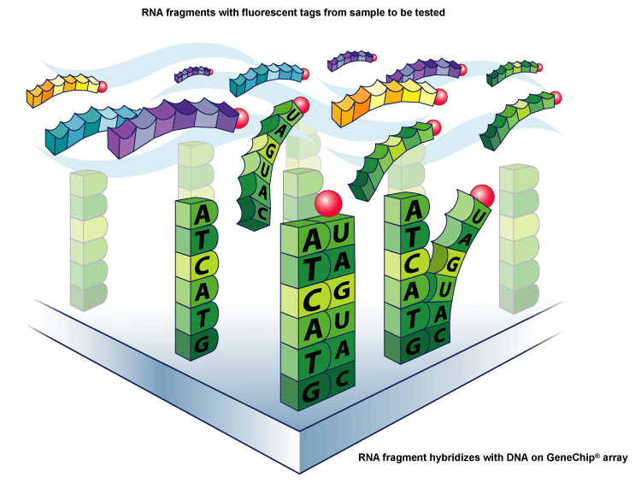
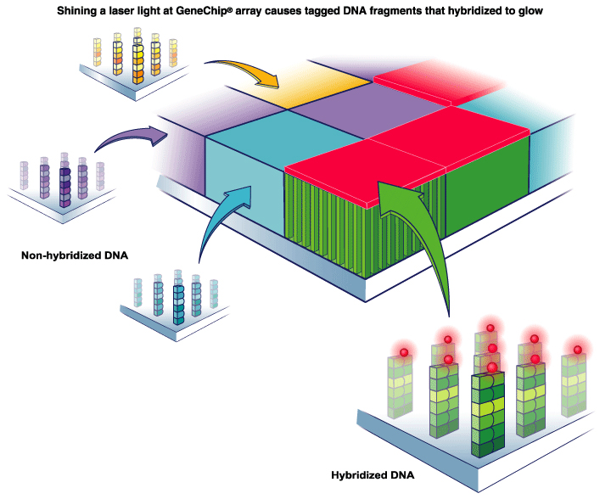
Hybridization of cDNA to ca. 500K probes

Slide 17
Multiple probes per gene on high density microarrays
Consider a DNA copy of mRNA (CFTR), small part of the sequence:
CAGGCACCCAGAGTAGTAGGTCTTTGGCATTAGGAGCTTGAGCCCAGACG..
For each gene, design 11 oligonucleotides (25-mers), exact match
CAGGCACCCAGAGTAGTAGGTCTTT
etc.
GGCATTAGGAGCTTGAGCCCAGACG
Plus 11 oligonucleotides (25-mers), single mismatch
CAGGCACCCAGACTAGTAGGTCTTT
etc.
GGCATTAGGAGCTAGAGCCCAGACG
After hybridization, compute the signal from the exact match oligonts and the mismatch
oligonts. This average difference is the value that is related to the expression level.
More recently, Affy has opted for perfect match only probes.

Slide 18
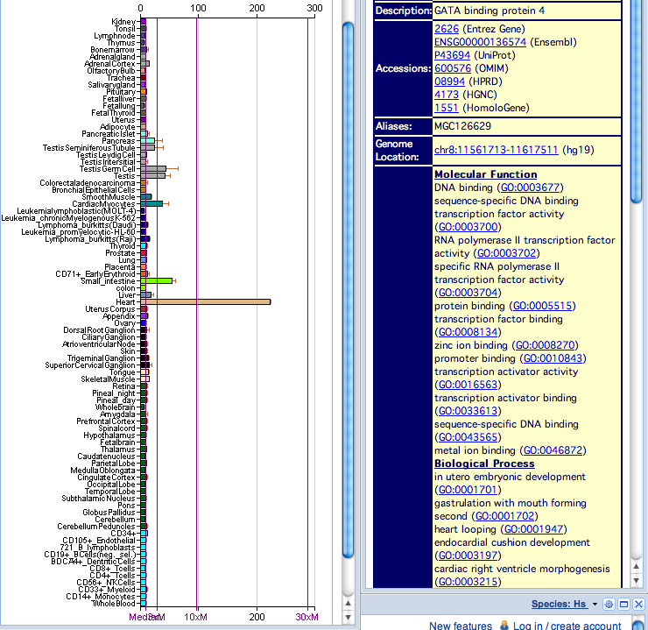
BioGPS (formerly GNF SymAtlas)
Transcript levels for human and mouse genes, scores of tissues
http://biogps.gnf.org/?symatlas=/SymAtlas/symform%3F#goto=welcome
Genomics Institute of the Novartis Foundation: Su, A.I. et al. (2004) A gene atlas of the mouse and human protein-encoding transcriptomes. PNAS 101, 6062-6067

Slide 19
Discovery of novel transcripts

Slide 20
Microarrays of genome sequences
Can spot or synthesize short segments at high density so that the entire (nonrepetitive) sequence from a human chromosome or smaller genome are on a microarray chip.
Can interrogate ALL the (nonrepetitive) sequences for
Transcription
Presence RNA polymerase
Presence of a transcription pre-initiation complex
Evidence of replication
Etc etc

Slide 21
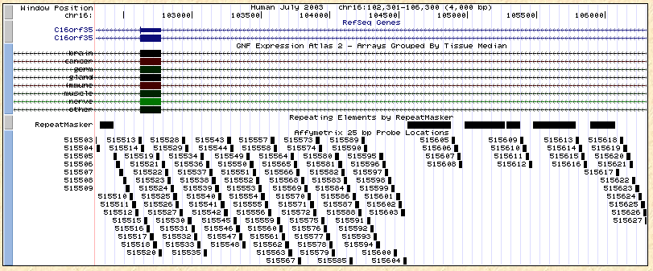
High density tiling arrays to examine events at all nonrepetitive DNA

Slide 22
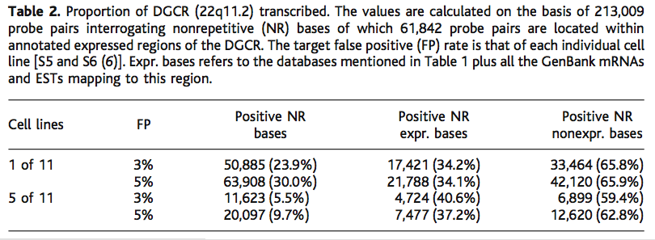
Much more of human genome is present as stable polyA+ RNA in cytoplasm than previously thought
% of the 213k total NR bases
% of the positive NR bases (col 3)
Previously annotated as coding
P. Kapranov et al., Science 296, 916 -919 (2002)
Much of this is noncoding RNA

Slide 23
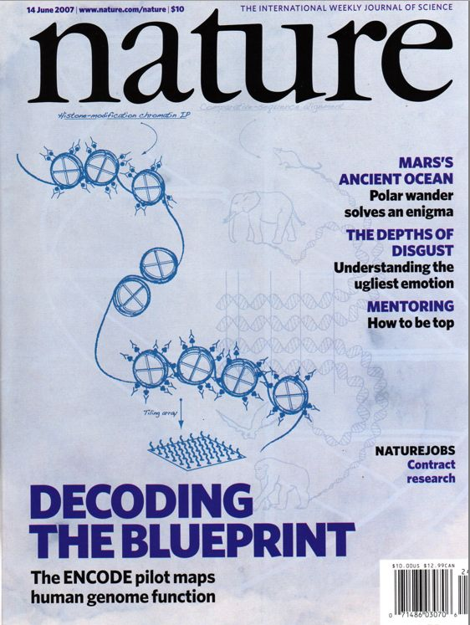
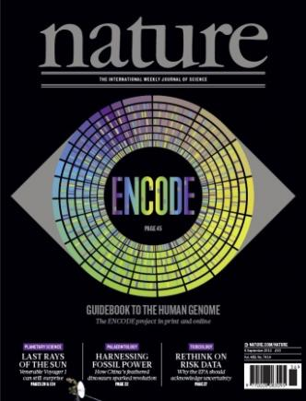
Major conclusions from ENCODE Genes and Transcripts
“The human genome is pervasively transcribed, such that the majority of its bases are associated with at least one primary transcript and many transcripts link distal regions to established protein-coding loci.”
“Many novel non-protein-coding transcripts have been identified, with many of these overlapping protein-coding loci and others located in regions of the genome previously thought to be transcriptionally silent.”
“The vast majority (80.4%) of the human genome participates in at least one biochemical RNA- and/or chromatin-associated event in at least one cell type.”
June 14, 2007: ENCODE Consortium, Functional regions in 1% of the human genome. Nature
Sept 2012: ENCODE Consortium: Integrated Encyclopedia of DNA Elements, Nature

Slide 24
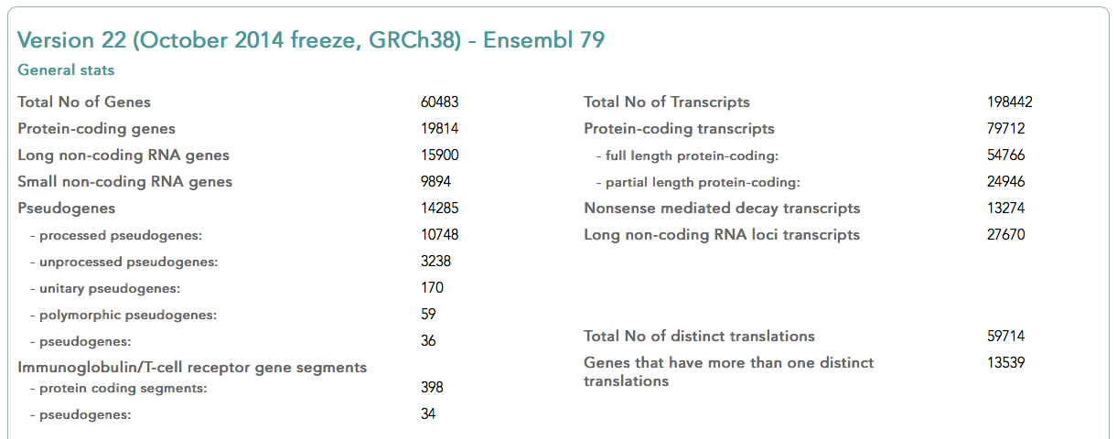
GENCODE: the comprehensive catalogue of protein-coding, non-coding genes and pseudogenes

Slide 25
RNA-seq

Slide 26
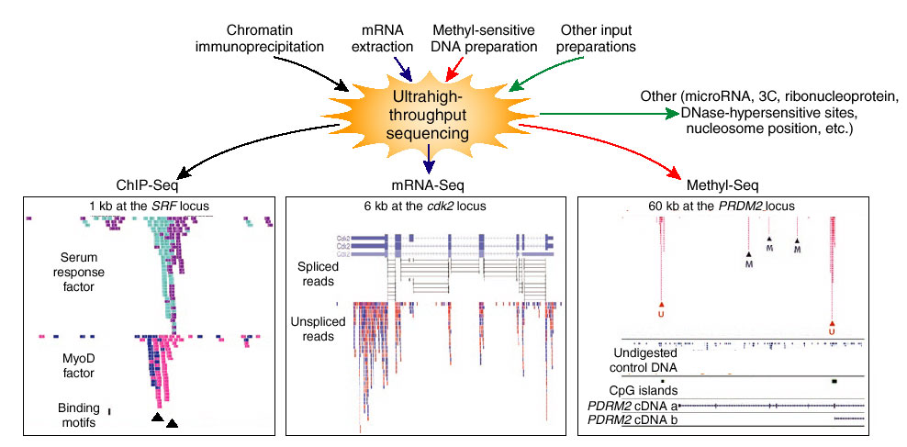
Enrichment of sequence tags reveals function
Barbara Wold & Richard M Myers (2008) “Sequence Census Methods” Nature Methods 5:19-21

Slide 27
Strand-specific vs. both strand RNA-seq
Double-stranded DNA
RNA synthesis
Select PolyA+ RNA from total RNA
5’
AAAAAAA
3’
Fragmentation
D. Parkhomchuk, … H. Lehrach, A. Soldatov (2009) Transcriptome analysis by strand-specific sequencing of complementary DNA. Nucleic Acids Res. 37: e123.
AAAA
Reverse transcription
dATP, dTTP, dGTP, dCTP
AAAA
TTTT
First strand cDNA
Second-strand synthesis
dATP, dTTP, dGTP, dCTP
dATP, dUTP, dGTP, dCTP
Double-stranded
cDNA
TTTT
TTTT
AAAA
AAAA
3’
AnAnnnA
5’
3’
AnAnnnA
5’
3’
AnAnnnA
5’
UnUnnnU
3’
5’
TnTnnnT
3’
5’
3’
5’
UnUnnnU
Adapter ligation
Remove U, uracil-N-glycosylase
3’
AnAnnnA
5’
Abasic scission
5’
3’
5’
3’
AnAnnnA
TnTnnnT
AnAnnnA
5’
3’
5’
*n *nnn *
3’
PCR amplification and sequencing
Slide from Tejaswini Mishra

Slide 28
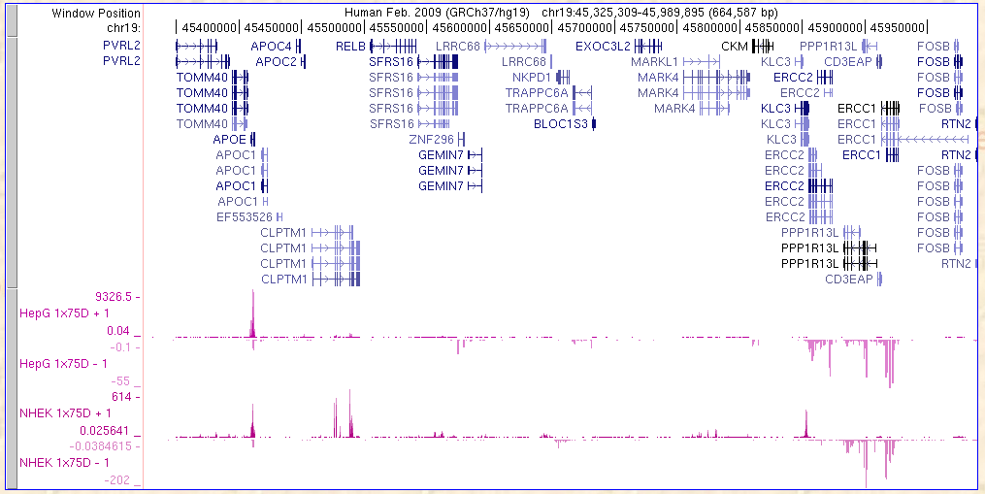
Example of strand-specific RNA-seq
Maintain information about polarity (R to L or L to R) of transcripts
Quantitation of transcript abundance
Shown is ENCODE RNA-seq data, CalTech group
Currently: challenging to turn RNA-seq data into a coherent gene model

Slide 29
Summary of lesson 8_1
The transcriptome is the set of all transcribed genes (coding and noncoding) in a given cell types
Often includes quantitative estimates of level of expression
High throughput methods are widely used to determine transcriptomes from cDNA
Hybridization to microarrays of genes
Only see genes that are on the microarray
Methods for normalization and analysis are mature
Massively parallel sequencing: RNA-seq
Can find all transcribed regions, even those that are not annotated as genes
Methods of analysis are still maturing

