Slide 1
Gene annotation: Combined pipelines
Genomics Lesson 7_3
Hardison

Slide 2
3 approaches to gene predictions
Evidence-based
Transcribed regions
Align to mRNA sequence from the same species
Align to spliced ESTs from the same species
Sequence similarity to previously identified proteins (e.g. blastx), genes or mRNAs from the same or related species
Ab initio recognition of groups of exons
Markov Models that find likely protein-coding regions in bacterial genomes (Glimmer)
Hidden Markov Models that combine statistical information about splice sites, coding bias, patterns in coding sequences, exon and intron lengths (Genscan)
Combine statistical models with interspecies alignments (Twinscan, N-SCAN, SGP)
Combinations of both

Slide 3
Pipelines that combine multiple approaches
Gene annotation

Slide 4
Datasets of human genes
UCSC Genes
Combination of RNAs in RefSeq and GenBank, plus protein sequences in UniProt=SwissProt+TrEMBL
Require support from at least one GenBank RNA and one additional type of evidence
Has splice variants
Now includes genes that do not code for protein
RefSeq Genes
Reference sequences of proteins, mRNAs, genes
Curated at NCBI
Ensembl Genes
CCDS = Consensus Coding Sequences
Exact matches among predictions and annotations from four sources: EBI, NCBI, UCSC, Wellcome Trust Sanger Institute
GENCODE: human curation of mRNA and EST data combined with automated annotation

Slide 5
Ensembl protein-coding gene prediction pipeline
Known, species-specific proteins and cDNAs are mapped to the genome to create transcript models
Proteins from other species are then placed on the genome for another set of transcript models
Protein- and cDNA-based transcripts are combined to identify both untranslated regions (UTRs) and protein-coding regions.
Redundant transcripts are eliminated and gene models are created
Ab initio predictions from Genscan that are ALSO supported by ESTs are considered
Get only a small number of novel predictions for human and mouse, but is still useful for other genomes
From Curwen et al 2004, Genome Research 14:942-950. “The Ensembl Automatic Gene Annotation System”

Slide 6
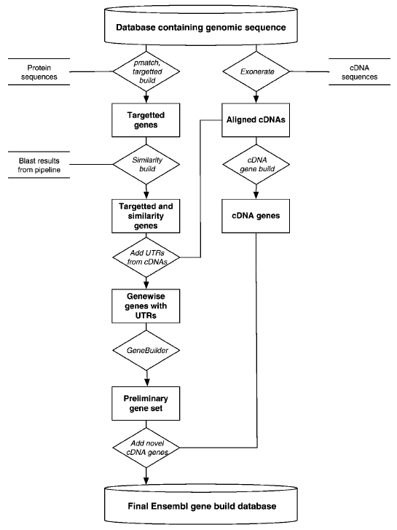
Ensembl gene build, circa 2004
Same species
Other species
Curwen et al 2004, Genome Research 14:942-950

Slide 7
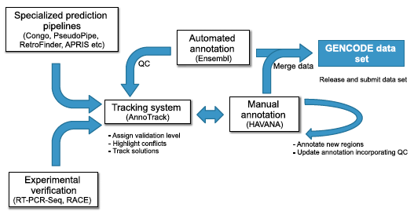
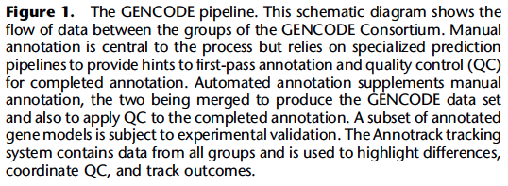
GENCODE combines automated and manual curation
Harrow et al. (2012) Genome Res. 22: 1760-1774

Slide 8
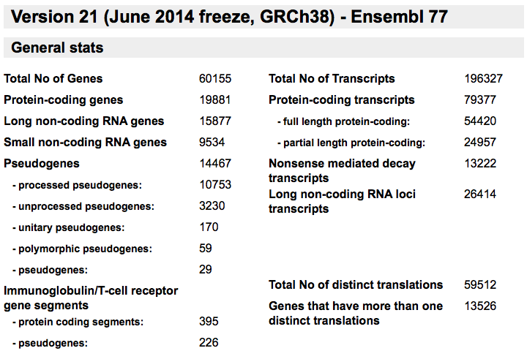
Statistics on GENCODE 21 human gene build (2014)

Slide 9
Alternative splicing is common
Human Genome paper 2001 (Lander et al)
Previous lower estimate: alternative splicing in 35% of human genes (papers from 1999-2000)
Chromosome 22
642 transcripts cover 245 genes, 2.6 txpts/gene
2 or more transcripts for 145 (59%) genes
Chromosome 19
1859 transcripts cover 544 genes, 3.2 txpts/gene
Human 2004
1.54 transcripts per locus
ENCODE project 2007
5.4 transcripts per locus
Compare to worm: alternative splicing in 22% of genes

Slide 10
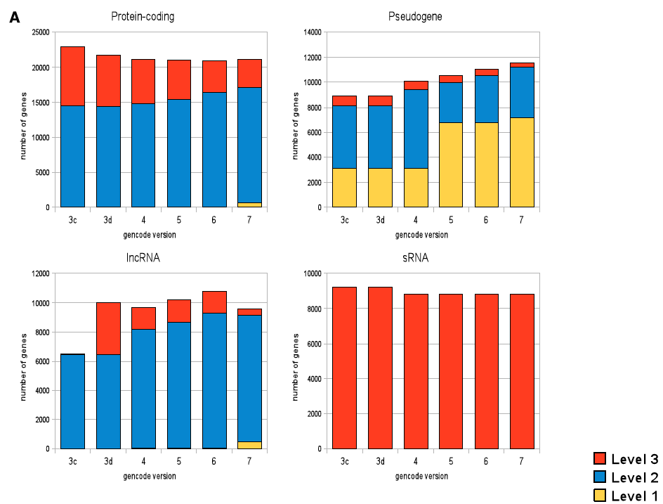
Improvements in GENCODE annotation
Harrow et al. (2012) Genome Res. 22: 1760-1774

Slide 11
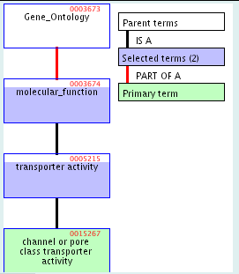
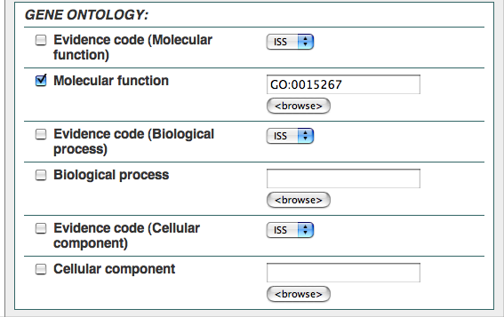
Ensembl and BioMart for gene-centric data on vertebrate genomes
http://www.ensembl.org/
http://www.ensembl.org/biomart/martview
Task: Find all the human genes whose product is a channel or pore class transporter.

Slide 12
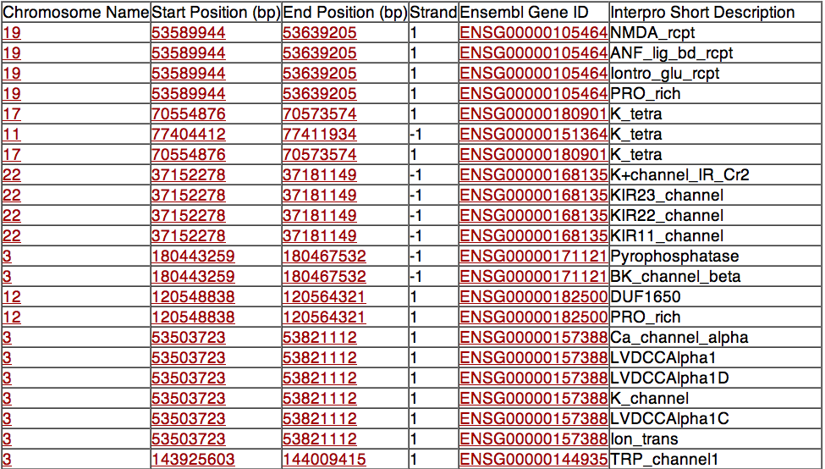
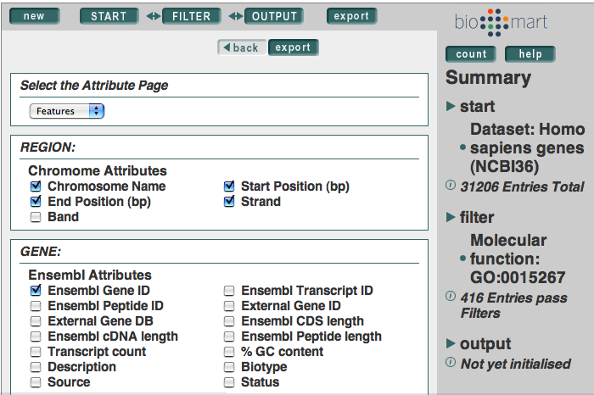
BioMart finds genes in the requested class
channel or pore class transporter

Slide 13
GENCODE: www.gencodegenes.org

