Slide 1

Gene Annotation: ab initio approaches
Genomics Lesson 7_2
Hardison

Slide 2
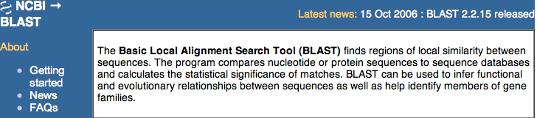
3 approaches to gene predictions
Evidence-based
  Transcribed regions
    Align to mRNA sequence from the same species
    Align to spliced ESTs from the same species
  Sequence similarity to previously identified proteins (e.g. blastx), genes or mRNAs from the same or related species
Ab initio recognition of groups of exons
  Markov Models that find likely protein-coding regions in bacterial genomes (Glimmer)
  Hidden Markov Models that combine statistical information about splice sites, coding bias, patterns in coding sequences, exon and intron lengths (Genscan)
  Combine statistical models with interspecies alignments (Twinscan, N-SCAN, SGP)
Combinations of both

Slide 3
Predicting genes from sequence: ab initio approaches
Gene annotation

Slide 4
Annotation of microbial genome
Genes comprise the vast majority of microbial genomes
Annotation is largely a gene-finding exercise.
View part of genome of Aquifex aeolicus
Microbial Genome Browser, UCSC
Lowe Lab along with UCSC Genome Browser Group
http://microbes.ucsc.edu/

Slide 5
Central dogma of molecular biology
DNA
RNA
Protein
transcription
translation

Slide 6
One grammar used in genomics: The Genetic Code maps information in DNA (RNA) to protein
Position in Codon
1st 2nd . 3rd
U C A G
U UUU Phe UCU Ser UAU Tyr UGU Cys U
UUC Phe UCC Ser UAC Tyr UGC Cys C
UUA Leu UCA Ser UAA Term UGA Term A
UUG Leu UCG Ser UAG Term UGG Trp G
C CUU Leu CCU Pro CAU His CGU Arg U
CUC Leu CCC Pro CAC His CGC Arg C
CUA Leu CCA Pro CAA Gln CGA Arg A
CUG Leu CCG Pro CAG Gln CGG Arg G
A AUU Ile ACU Thr AAU Asn AGU Ser U
AUC Ile ACC Thr AAC Asn AGC Ser C
AUA Ile ACA Thr AAA Lys AGA Arg A
AUG* Met ACG Thr AAG Lys AGG Arg G
G GUU Val GCU Ala GAU Asp GGU Gly U
GUC Val GCC Ala GAC Asp GGC Gly C
GUA Val GCA Ala GAA Glu GGA Gly A
GUG* Val GCG Ala GAG Glu GGG Gly G
* Sometimes used as initiator codons.
25 words are needed to code for the 20 amino acids and the start and stop sites
The Triplet Code allows for 64 codons to be coded
=> Degeneracy of the genetic code

Slide 7
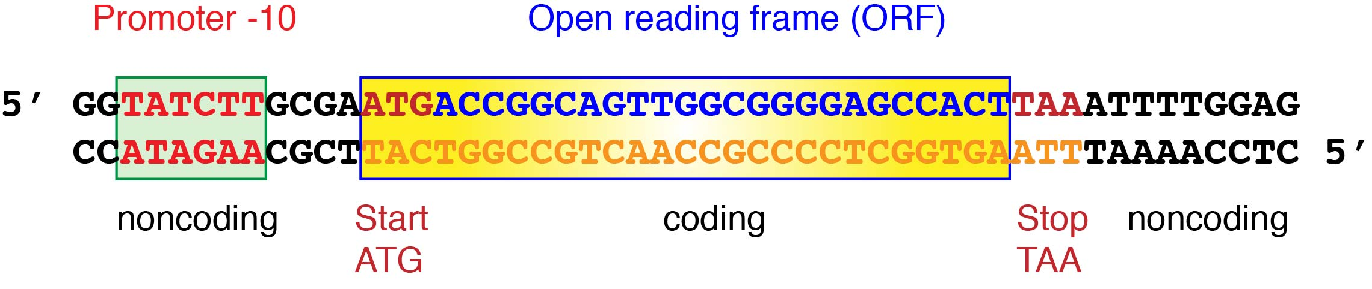
Gene structure in bacteria

Slide 8
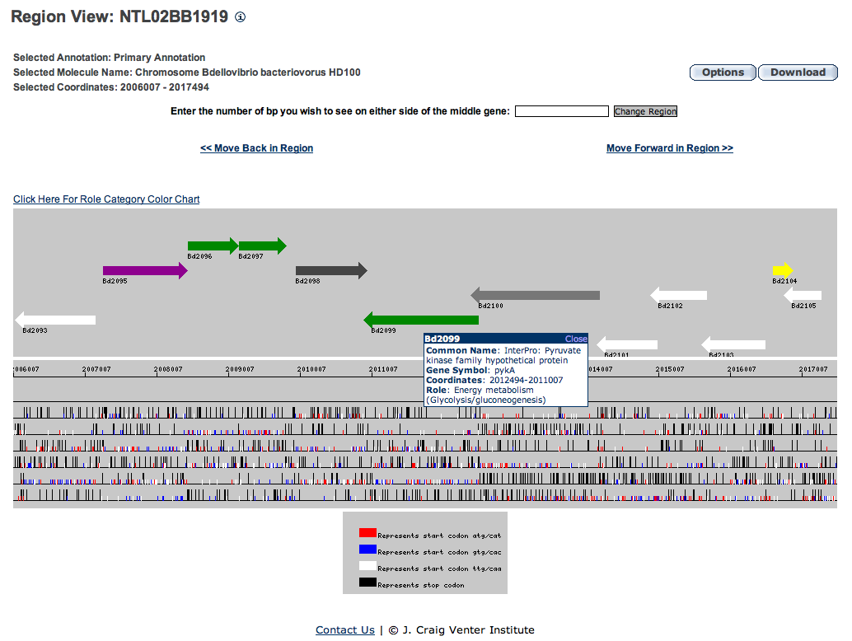
Challenge of overlapping open reading frames
2 ORFs for each gene:
Which is the right one?
CMR

Slide 9
Finding genes in bacteria
In bacterial genomes, most sequences code for protein
Finding open reading frames (ORFs) has substantial power for identifying candidate genes
  Which of multiple ORFs actually codes for a protein?
  What are the exact start points for coding regions?
  If there is a close homolog to a protein in another species, then a fast homology search (blast, FastA) will work for deciding among multiple ORFs
What about genes that have no close match in the databases?
  Must rely on properties of coding sequences that differ from noncoding sequence
First task: How likely is it that a particular ORF actually codes for protein?

Slide 10
Basic model
Start
Codon
Stop
The task is to determine if a given string of letters (nucleotides) in DNA is likely to generated from a protein-coding gene.
You can get discriminatory power from the frequency with which one letter follows another IF those frequencies differ enough between coding vs noncoding regions.
For a discrete subsequence in the genome (e.g. an ORF or an arbitrary interval), is it likely to code for a protein?

Slide 11
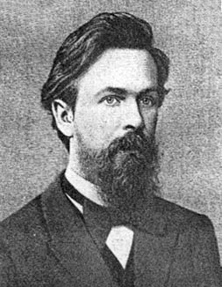
Markov chain
A first order Markov chain is a model for generating a series of symbols in which the probability of occurrence of a symbol at position x_{i} depends on the symbol at the preceding position, x_{i-1}.
  Symbols can be letters, nucleotides, amino acids, bits of speech, loaded vs. fair dice, web page hits (used by Google search engine for prioritizing) etc. etc.
Russian mathematician Andrei Andreyevich Markov
  1856 - 1922

Slide 12
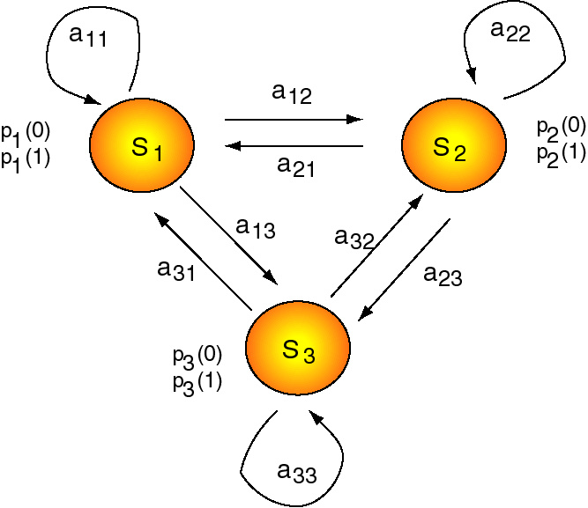
A general Markov chain
A Markov chain is a group of N discrete states (S₁, S₂,…, S_{N}).
Each state emits an observable character.
  Letter
  Sound
  Face of a die ….
The system can change states at intervals, according to a set of probabilities associated with the states.
  The probability for changing from state 1 to state 2 is a₁₂.
  Called transition probabilities
  Note that the probability of moving to a new state is determined by the prior state

Slide 13
Markov chains for DNA sequences
A Markov chain for DNA sequences needs 4 states
  Each state emits a particular nucleotide
  State T “emits” an T
States are connected by arrows
  Each arrow is associated with a probability parameter that gives the likelihood of a transition to the next state
  Transition probability
  a_{st} = P(x_{i}=t | x_{i-1}=s)
A
T
C
G

Slide 14
Estimate transition probabilities by training
Positive training set: a collection of objects from the class you want to find
  E.g., a collection of bacterial sequences known to code for protein
Negative training set: a collection of objects from the class you don’t want to include
  E.g., a collection of noncoding sequences from bacteria
Count the number of times a symbol t follows a particular symbol s in each training set, and divide by all the times that any symbol follows s
  These are estimates of the transition probabilities that comprise the positive and negative Markov models
  An example of machine-learning
E.g. in a training set of known coding regions, T may follow C 250 times, and C may be followed by any base 750 times. Then a_{CT}⁺ = 0.33.

Slide 15
Example of transition probability matrices: CpG islands
Empirical frequencies of the nucleotide designated on each row being followed by the nucleotide in each column. Each row sums to 1. Matrices have 16 entries.
CpG islands (+)
+ A C G T
A 0.180 0.274 0.426 0.120
C 0.171 0.368 0.274 0.188
G 0.161 0.339 0.375 0.125
T 0.079 0.355 0.384 0.182
nonCpG islands (-)
- A C G T
A 0.300 0.205 0.285 0.210
C 0.322 0.298 0.078 0.302
G 0.248 0.246 0.298 0.208
T 0.177 0.239 0.292 0.292
From Durbin et al. (1998) Biological Sequence Analysis: Probabilistic Models of Proteins and Nucleic Acids (Cambridge University Press, Cambridge), pp. 50-51. They counted dinucleotide frequencies in 48 CpG islands and in non-CpG islands, total of 60,000 nucleotides.

Slide 16
Use Markov models for discrimination
Discriminatory score S :
x is a sequence of length L
Matrix of log (base 2) likelihood scores:
A C G T
A -0.740 0.419 0.580 -0.803
C -0.913 0.302 1.812 -0.685
G -0.624 0.461 0.331 -0.730
T -1.169 0.573 0.393 -0.679
E.g., C followed by G is scored positively for distinguishing CpG island from non-CpG island DNA. TpA is scored negatively, reflecting GC-richness of CpG islands.

Slide 17
Markov models for finding coding regions
Use known protein-coding genes for the training set
  Use a different training set for each species to generate specific transition probability matrices
Use higher order Markov models
  The order of a Markov chain refers to the number of preceding symbols that are considered in the transition probability.
  Previous discussion was limited to 1st order models
  Higher order models better capture differences in sequence properties between coding and noncoding DNA
GCGCTAGCGCCGATCATCTACTCG
GCGCTAGCGCCGATCATCTACTCG
GCGCTAGCGCCGATCATCTACTCG
GCGCTAGCGCCGATCATCTACTCG
GCGCTAGCGCCGATCATCTACTCG
GCGCTAGCGCCGATCATCTACTCG
GCGCTAGCGCCGATCATCTACTCG
First order
Second order
Fifth order

Slide 18
Fixed order Markov models for gene prediction
GeneMark
  Borodovsky M, McIninch JD, Koonin EV, Rudd KE, Medigue C, Danchin A. (1995) Nucleic Acids Res. 23:3554-3562.
Train 6 submodels
  One for each reading frame in forward and reverse strand
  Frame-dependent models (non-homogeneous Markov chains)
  Plus another model for noncoding DNA
Fixed order Markov model, order k=5
  Uses the preceding 5 nucleotides to predict a nucleotide
Train the model on known protein-coding sequences
  For a k order Markov model on a 4 symbol alphabet (A,C,G,T), the number of transition probabilities needed is
  4 ^{(k +1)} = 4096 for k=5
  Requires a very large training set
If the amount of training data is not sufficient, you have the problem of over-fitting: the model does well in predicting the data in the training set but does not generalize well to other datasets

Slide 19
Interpolated Markov models for gene prediction
GLIMMER (Gene Locator and Interpolated Markov Modeler)
  Salzberg, Delcher, Kasif, White (1998) Nucleic Acids Research 26:544-548. (TIGR)
  Server is at NCBI Microbial Genomes
  http://www.ncbi.nlm.nih.gov/genomes/MICROBES/glimmer_3.cgi
Vary the order of the Markov model
  k ranges from 1 to 8
Higher orders have greater discriminatory power, but require much more training data
  Some hexamers are common enough to get sufficient counts from training sets
  Other strings are less common and thus lower order models are used
  Use higher orders when sufficient data are in the training set

Slide 20
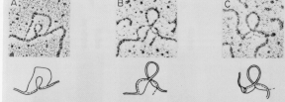
Genes can be in many pieces in eukaryotes
Electron micrographs of duplexes between mature mRNA and the genomic DNA that encodes it
The introns separating exons are transcribed but then are removed by splicing to form mRNA
protein

Slide 21
New task: find a functional region within a long sequence
Recall that the first task was to evaluate whether a string of nucleotides are likely to come from some functional class
  E.g., CpG island, coding region
  Markov chains are effective for this; work well for predicting protein-coding genes whose sequence is contiguous on a chromosome (e.g. bacterial genes)
A related goal is to read through a long, unannotated DNA sequence and find regions that are in a functional class.
  The DNA sequence is the observed signal.
The nucleotide at each position could be generated by emission from the Markov chain for one class or the other.
  C can come from state C in the + class or from state C in the - class.
Combine the Markov chains for the + class and - class into one model
  Need to relabel the states by class they are in
  Can switch between classes with some probability: yet another transition probability

Slide 22
Hidden Markov Models
Situations in which a symbol can be generated from more than one state can be described by hidden Markov models (HMMs)
  Each state can emit multiple symbols, each with a particular emission probability
  In an HMM, there is not a one-to-one correspondence between the states and the symbols
In a Markov chain, each state emits one symbol
  Can tell which state the model was in when x_{i} was emitted simply by examining x_{i} (an A only comes from state A)
We distinguish between the observed parts of a problem and the hidden parts
  Observable states : the states of the process that are visible (e.g., a DNA sequence).
  Hidden states : the series of states of the system that generated that sequence.
    E.g. CpG could have come from states in the + class or - class:
      C⁺ > G⁺
      C⁺ > G⁻
      C⁻ > G⁺
      C⁻ > G⁻

Slide 23
A general hidden Markov model = HMM
Still have a group of N discrete states
  S₁, S₂,…, S_{N}
Now each state has a probability (p) of emitting an observable character
  0 or 1
  A, G, C or T
Still have transition probabilities (e.g. a₁₂) for changing between states.
You can think of an HMM as a machine that generates sequences. Starting with an initial state, a new state is chosen. This can be the same as the initial one (e.g. if the initial state is S₁, then the probability of staying in it is a₁₁) or a different state (e.g. going to state S₂ with a probability of a₁₂). In the new state, a character is emitted to the sequence, with a probability characteristic of that state; e.g. emission of a 0 from S₁ has a probability of p₁(0). When completed, a series of characters is observed, e.g. 0110111000111, but the path through the states from which they are emitted is not observed (hence the Markov chain is hidden).
Paraphrased from a review by Sean Eddy

Slide 24
HMM for dice in occasionally dishonest casino
Use a fair die most of time
Occasionally switch to a loaded die, which gives a six 50% of the time
Given the results of a series of rolls of the dice (observed states), you can use an algorithm (Viterbi) to find the most likely path through the HMM to predict whether the fair or loaded die was used
Rolls ..6511664531326512456366646316366631623264552362666..
Die ..LLLLLLFFFFFFFFFFFFLLLLLLLLLLLLLLLLFFFLLLLLLLLLLLL..
Prediction ..LLLLLLFFFFFFFFFFFFLLLLLLLLLLLLLLLLLLLLLLLLLLLLLLL..
0.95
0.90
Fair
1: 1/6
2: 1/6
3: 1/6
4: 1/6
5: 1/6
6: 1/6
Loaded
1: 1/10
2: 1/10
3: 1/10
4: 1/10
5: 1/10
6: 1/2
0.05
Emission probabilities are given in the boxes corresponding to each state. Durbin et al., 1998
0.10

Slide 25
HMMs for finding genes or exons
This is analogous to predicting whether a series of rolls of dice came from fair or loaded ones
You want to know, given a sequence of nucleotides (observed signal), by what path through the states (hidden) were they most likely generated?
Strings of nucleotides likely to have been “emitted” from a state corresponding to a coding-sequence generator are probably coding sequences.
  Need a good HMM
  Need good training data
  Need good algorithms for finding most probable paths
For eukaryotic genes, have to distinguish exons, introns, untranslated regions

Slide 26
Types of exons in eukaryotes
Transcription
“stop”
Transcription start site
polyA
5’
GT
AG
GT
AG
GT
AG
GT
AG
Gene
3’
promoter
Open reading frame
Initial exon
Internal exon
Internal coding exon
Terminal exon
Translation
Translation
Start
Stop
mRNA
5’
3’
5’ untranslated region
Protein
coding
region
3’ untranslated region

Slide 27
Gene finders for eukaryotes
Ab initio computation
  Use an explicit, sophisticated model of gene structure, splice site properties, etc to predict exons
GENSCAN
  http://genes.mit.edu/GENSCAN.html
GRAILexp
FGENE, etc.

Slide 28
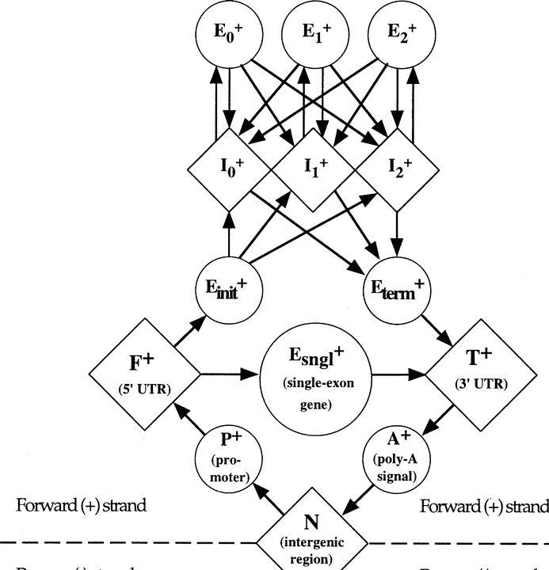
Burge and Karlin’s HMM for gene prediction: Genscan

Slide 29
Genscan analysis of HBB gene
Probability of the indicated DNA segment being an exon of the specified class

Slide 30
How accurate are ab initio predictions?
Accuracy per nucleotide Accuracy per exon
Method Sn Sp AC Sn Sp Missing Wrong
exon exon
GENESCAN 0.93 0.93 0.91 0.78 0.81 0.09 0.09
FGENEH 0.77 0.85 0.78 0.61 0.61 0.15 0.11
GRAILII 0.72 0.84 0.75 0.36 0.41 0.25 0.10
Sn = Sensitivity = True positives / Actual positives
Sp = Specificity = True positives / Predicted positives
AC = Approximate correlation
Program finds predicted positives (PP) and predicted negatives (PN).
Annotation determines actual positives (AP) and actual negatives (AN).
For a nucleotide or exon classified as both PP and AP, it is a
true positive (TP). Likewise, classification as a PP but an AN make it a
false positive (FP), etc.

Slide 31
Combine HMMs with additional information
Conservation of sequences between species plus models of gene structure
  Twinscan (Korf et al, 2000) combines ideas similar to Genscan prediction with interspecies homology.
    Now they provide N-SCAN (M. Brent)
  SGP (R. Guigo)
  Exoniphy (Siepel and Haussler) combines HMMs with phylogenetic information in alignments
Matches to spliced ESTs, mRNAs and known genes
  GRAILexp combines expression and prediction

Slide 32
Applications of ab initio gene predictors
These methods have good success for predicting protein coding genes in bacteria AND for finding coding exons in large, complex genomes (even when coding exons are sparse)
Success rate is less for combining exons into accurate gene models (all the exons used to encode a protein).
MUCH better than simply finding ORFs, but greater accuracy is achieved by combining predictions with other data (transcripts, known gene and protein sequences, etc.)

