Slide 1
Gene Annotation: Evidence-based approaches
Genomics Lesson 7_1
Hardison

Slide 2
3 basic approaches to gene predictions
Evidence-based
Transcribed regions
Align to mRNA sequence from the same species
Align to spliced ESTs from the same species
Sequence similarity to previously identified proteins (e.g. blastx), genes or mRNAs from the same or related species
Ab initio recognition of groups of exons
Markov Models that find likely protein-coding regions in bacterial genomes (Glimmer)
Hidden Markov Models that combine statistical information about splice sites, coding bias, patterns in coding sequences, exon and intron lengths (Genscan)
Combine statistical models with interspecies alignments (Twinscan, N-SCAN, SGP)
Combinations of both

Slide 3
Evidence-based approaches: RNA
Gene annotation

Slide 4
Construction of cDNA clones
cDNA clones are copies of mRNAs
Complementary DNA or Copy DNA
Use the enzyme reverse transcriptase to copy mRNA into complementary DNA, called cDNA.
This is equivalent to the template strand of the duplex DNA.
Use a DNA polymerase to copy that cDNA into the nontemplate (message synonymous) strand.
For microbial clone: Insert the duplex cDNA product into a cloning vector and propagate in a host, e.g. E. coli.

Slide 5
Synthesis of cDNA clones
mRNA
5’
AAAAAAA
3’
Anneal oligo-dT primer
TTTTT
AAAAAAA
3’
Reverse transcriptase:
RNA-directed DNA polymerase
RNase H
TTTTT
5’
Duplex cDNA
dNTPs
5’
GGGG
AAAAA
3’
AAAAAAA
3’
3’
CCCC
TTTTT
5’
TTTTT
5’
Hydrolyze remaining RNA with base
Restriction endonuclease
Cut the adaptor
TTTTT
5’
GGGG
AAAAA
CCCC
TTTTT
Product is complementary DNA, called cDNA. It is equivalent to the template strand of the duplex DNA.
Ligate duplex cDNA into a plasmid
Problem: How to get a primer for 2nd strand synthesis?
cDNA
TTTTT
5’
Terminal deoxynucleotidyl transferase
dCTPs
Transform the population of cDNA plasmids into bacteria. Result is a cDNA library.
CCCC
TTTTT
5’
Ligate an adaptor to the 3’ end
5’
GGGG
3’
5’
GGGG
TTTTT
5’
3’
CCCC
DNA polymerase
dNTPs
5’
GGGG
AAAAA
3’
3’
CCCC
TTTTT
5’
Duplex cDNA

Slide 6
Limitations of cDNA synthesis
First strand synthesis often does not go to completion.
Individual cDNA clones will frequently have the reverse complement of only part of the mRNA.
Multiple cDNA clones from a single mRNA will be present in the library
Priming second strand synthesis is inefficient
Some methods necessarily result in the loss of sequences at the 5’ end of the nontemplate strand
Can take specialized approaches to capture the 5’ ends of mRNA; utilize distinctive properties of the 5’ cap on mRNA
CAGE, cap-analysis of gene expression
Kodzius … Y. Hayashizaki and P. Carninci (2006) Nature Methods 3:211-222.

Slide 7
EST sequencing project
Sequence part of cDNAs to find an expressed sequence tag (EST).
Sometimes cDNAs come from normalized libraries
Depleted of cDNAs from abundant mRNAs
Enriched in cDNAs from rare mRNAs
Ends of randomly chosen clones are sequenced in a high-throughput strategy
Aim is to sequence part of every mRNA from a given tissue, cell line, etc.
Have in GenBank (dbEST release 130101, Jan 01, 2013):
74 million EST sequences
8.7 million from human, 4.8 million from mouse
Millions of ESTs from wide range of animals, plants and other species
>1200 different organisms

Slide 8
cDNA clones and ESTs
5’ UTR
Protein coding
3’ UTR
mRNA
5’
AAAA
3’
Duplex inserts in cDNA clones
ESTs are sequences from each end of the cDNA inserts
Unigene cluster is an group of overlapping ESTs, likely from one gene

Slide 9
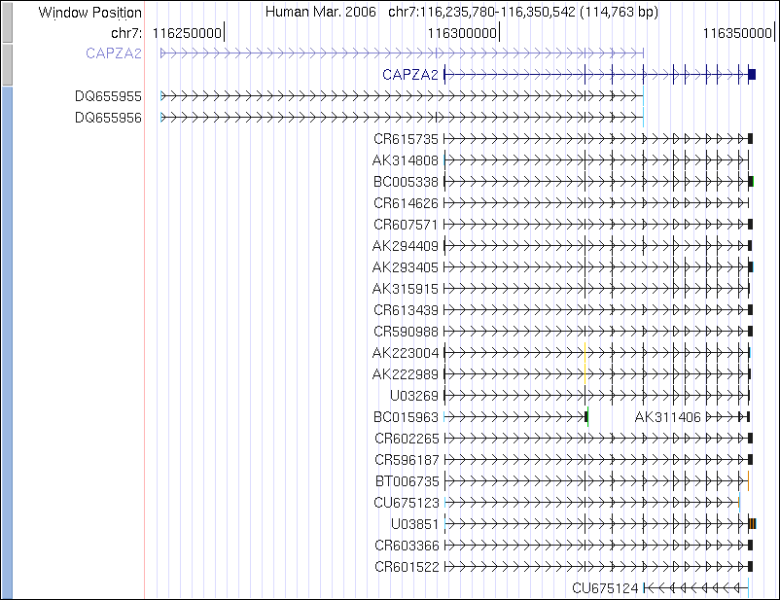
Human mRNAs
Collect human mRNAs from GenBank records
Ultimate source: Sequences deposited in databases by scientists worldwide
Align them to the human genome using blat
If mRNA aligns to multiple places, keep the one with the highest nucleotide identity
Require at least 96% identity
Information: “Methods” section on “Track Settings” page in UCSC Genome Browser

Slide 10
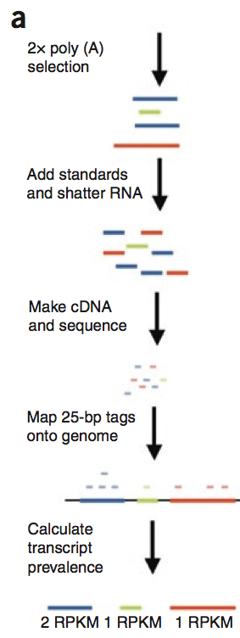
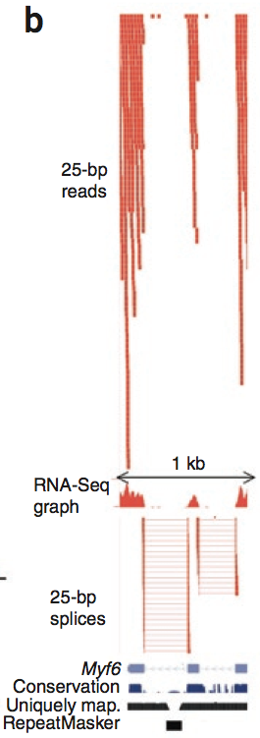
Sequence cDNA directly: RNA-seq
A natural extension of EST techniques is to sequence all the RNA (cDNA copy of it)
Second generation sequencing
Enough reads to cover an entire transcriptome of mammals (e.g. 40 million reads)
No need to make bacterial clones (cDNA plasmids)
Fragment RNA lightly to get better coverage
Random priming for cDNA synthesis
Construct libraries for sequencing
Sequence, map, quantify
A. Mortazavi, B. Williams, K. McCue, L. Schaeffer, B. Wold (2008) Mapping and quantifying mammalian transcriptomes by RNA-Seq. Nature Methods, 5: 621-628.

Slide 11
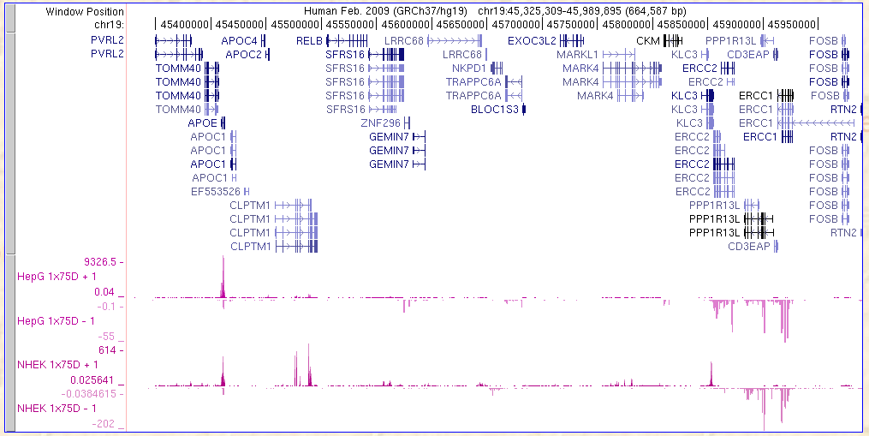
Example of strand-specific RNA-seq
Polarity (R to L or L to R) of transcripts
Quantitation of transcript abundance
Currently: challenging to turn RNA-seq data into a coherent gene model

Slide 12
RNAs can be coding (for protein) or noncoding
Much of the initial annotation of genes in genomic sequences focused on the genes coding for proteins
The mRNAs (coding for proteins) in a preparation of polyA+ RNAs are usually more abundant than the noncoding RNAs
Individual studies of genes were almost exclusively devoted to those coding for proteins, at least until the 2000’s
Ab initio methods for gene prediction are designed to find protein-coding genes
Deeper sequencing of RNAs has revealed thousands of noncoding RNAs
More EST sequencing (randomly choosing cDNA clones) and RNA-seq gives the sensitivity to reveal the noncoding RNAs
Studies of the regulatory role of microRNAs and other small RNAs also stimulated interest in this class of transcripts

