Slide 1
Galaxy: An online analysis platform for genomics data
Hardison
Genomics6_1

Slide 2
Galaxy for analyzing genome data
https://usegalaxy.org

Slide 3
Two faces of Galaxy
A web site where you can easily perform complex analyses integrating various data sources and computational tools
A framework to easily build similar sites that integrate your choice of tools and data sources

Slide 4
Galaxy: Data retrieval and analysis
Data can be retrieved from multiple external sources, or uploaded from user’s computer
Hundreds of computational tools, e.g.
Data file manipulation
File conversion
Operations: union, intersection, complement …
Compute functions on data
Statistics: basic to multivariate
EMBOSS tools for sequence analysis
Molecular evolutionary analysis
“Next generation sequence” (NGS) mapping and analysis
Workflows

Slide 5
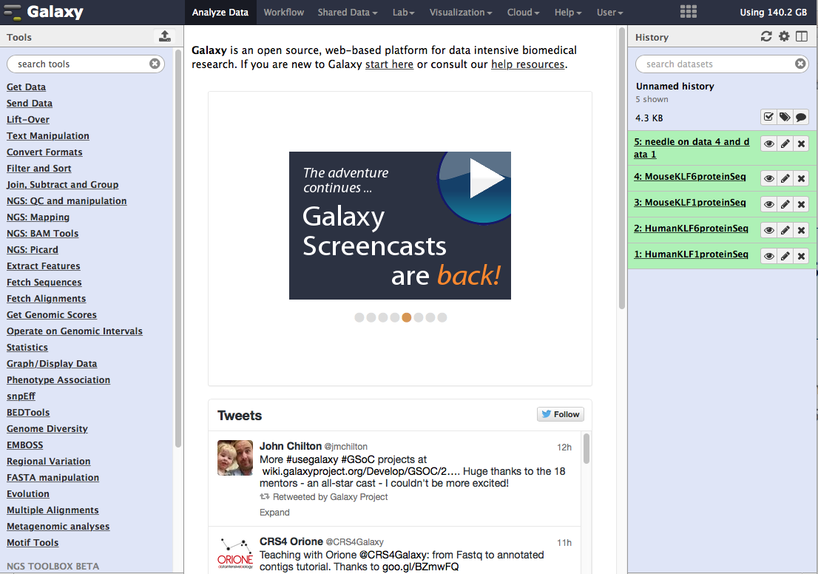
Welcome to Galaxy
Welcome screen, changes periodically
When tools are invoked, displays information on the tool and allows user to chose parameters

Slide 6
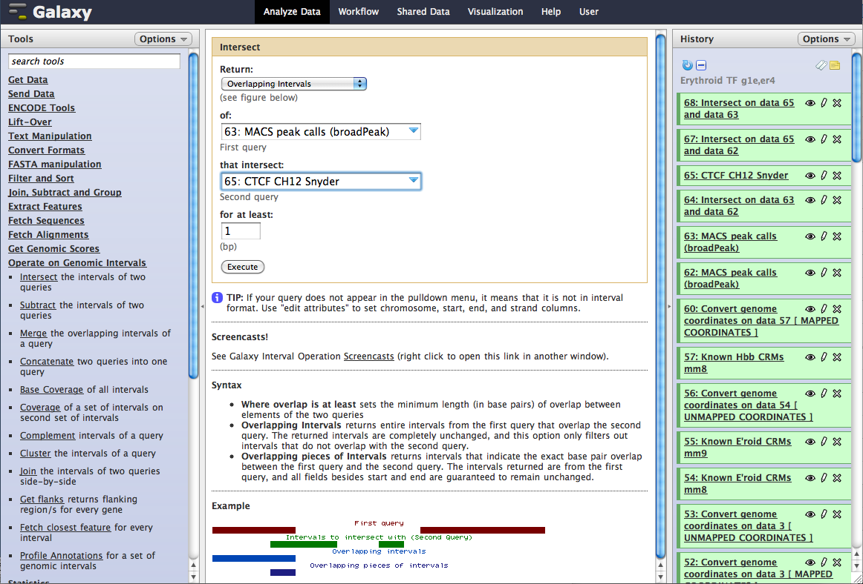
Tool choice
toggles
Info on tool, interface to run it

Slide 7
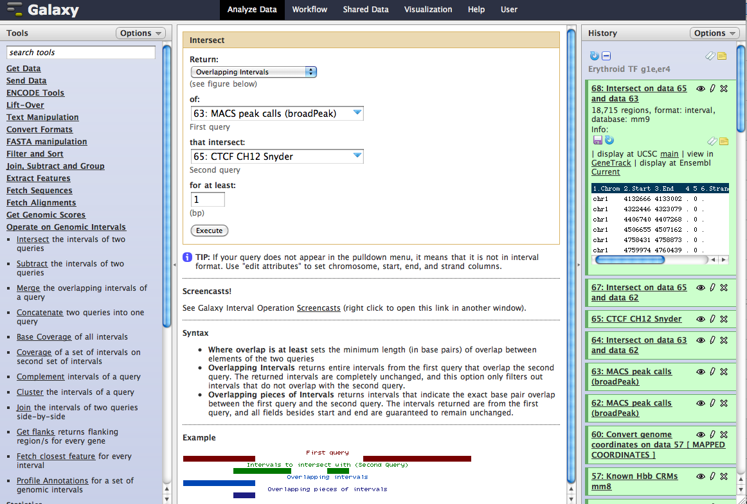
History
Titles are toggles; more information is displayed when you click on them
Click on the “eye” to see all the data
Click on the “pencil” to edit the attributes
Click on the “x” to delete

Slide 8
Background jobs in Galaxy

Slide 9
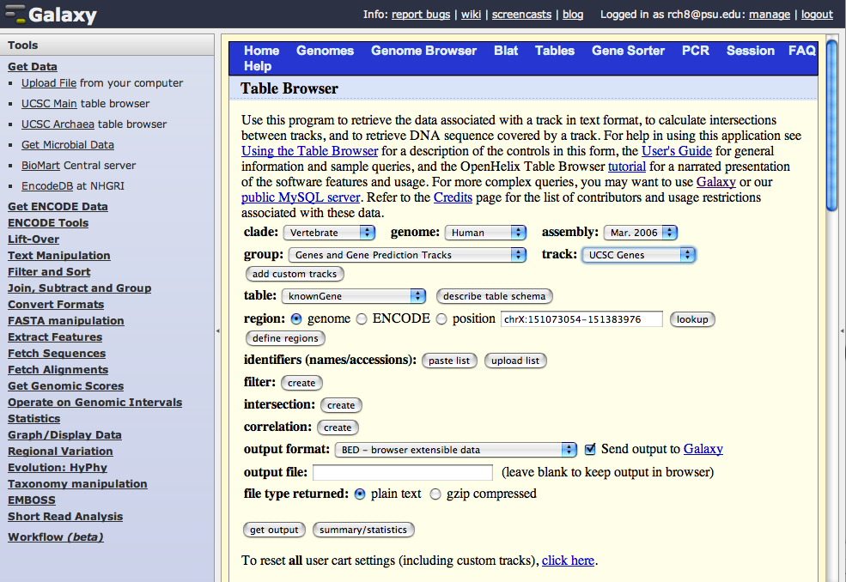
Galaxy via Table Browser: coding exons

Slide 10
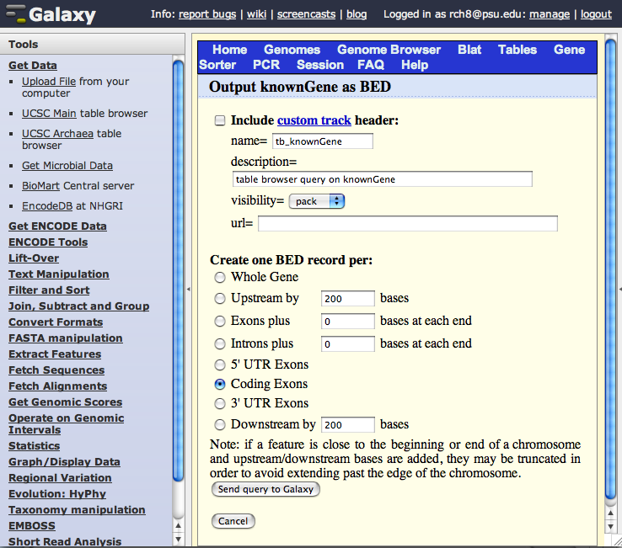
2nd page: choose coding exons

Slide 11
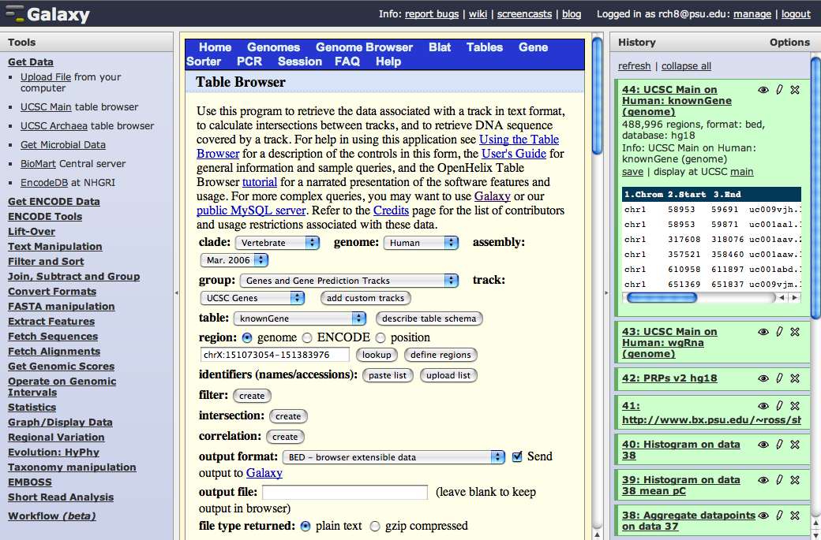
Coding exons result

Slide 12
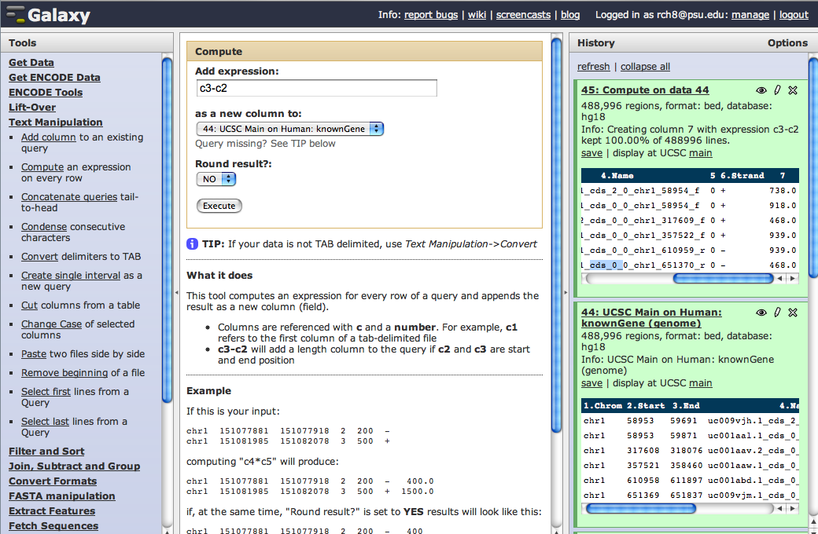
Compute exon lengths

Slide 13
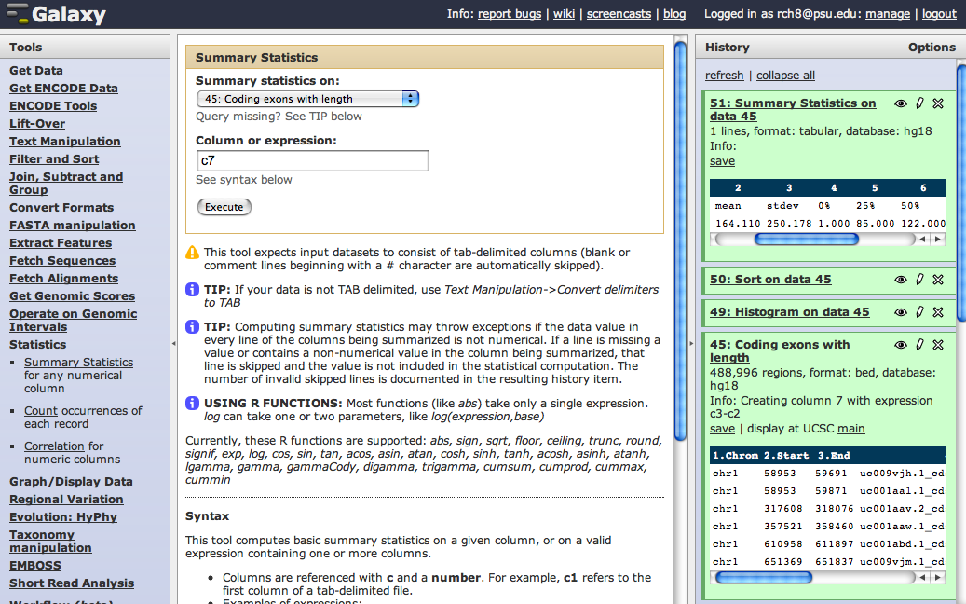
Statistics on exon lengths

Slide 14
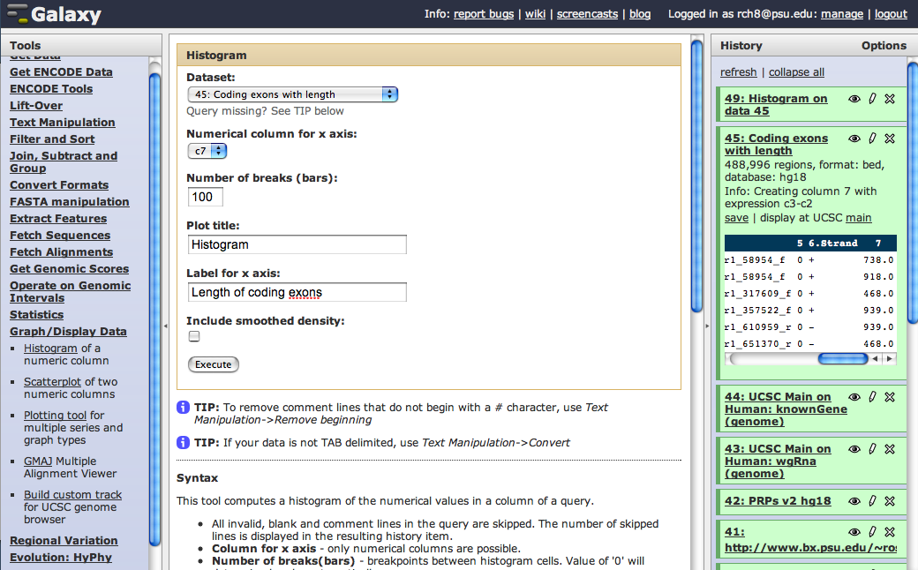
Make histogram of exon lengths

Slide 15
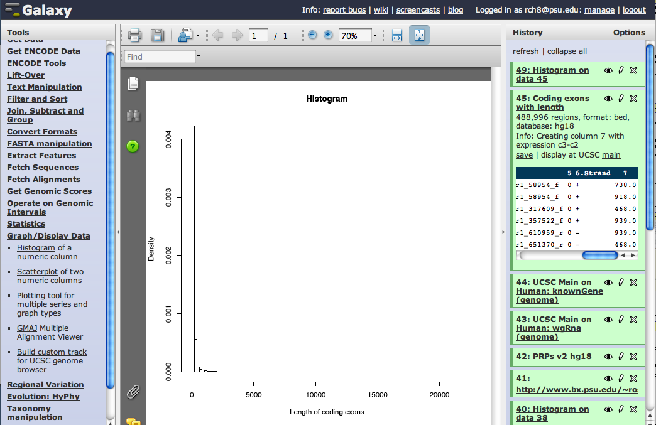
Histogram of exon lengths

Slide 16
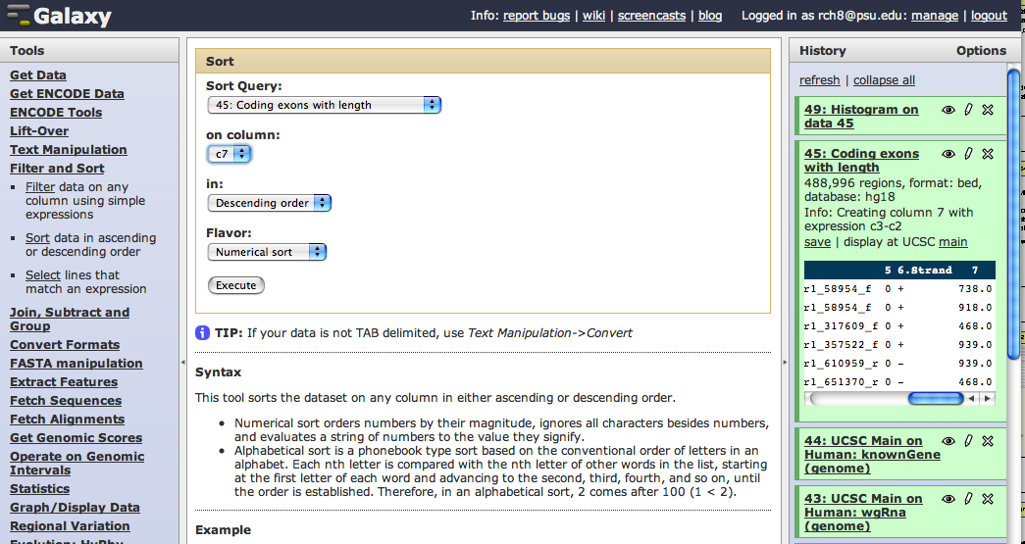
Sort on exon length

Slide 17
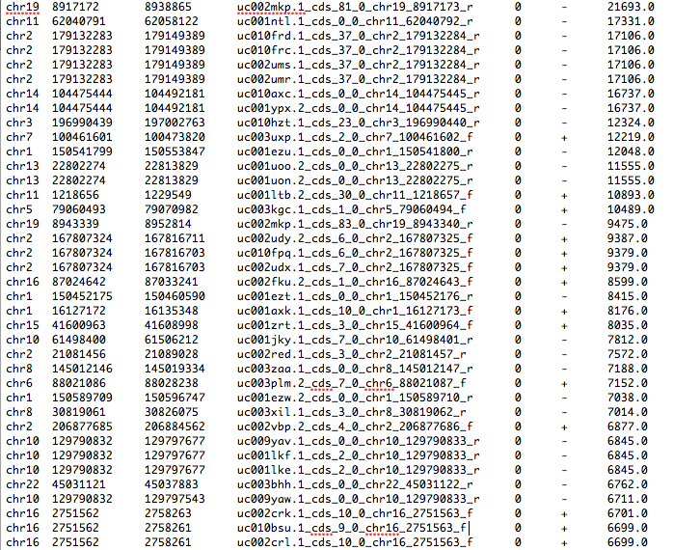
Small number of very long exons

Slide 18
Longest exon
21,693bp exon in MUC16; average length is 164bp.

Slide 19
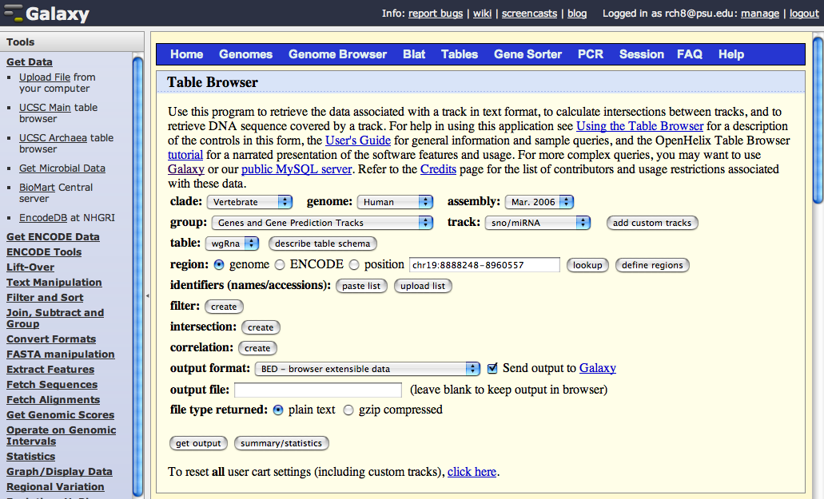
Get microRNAs and snoRNAs

Slide 20
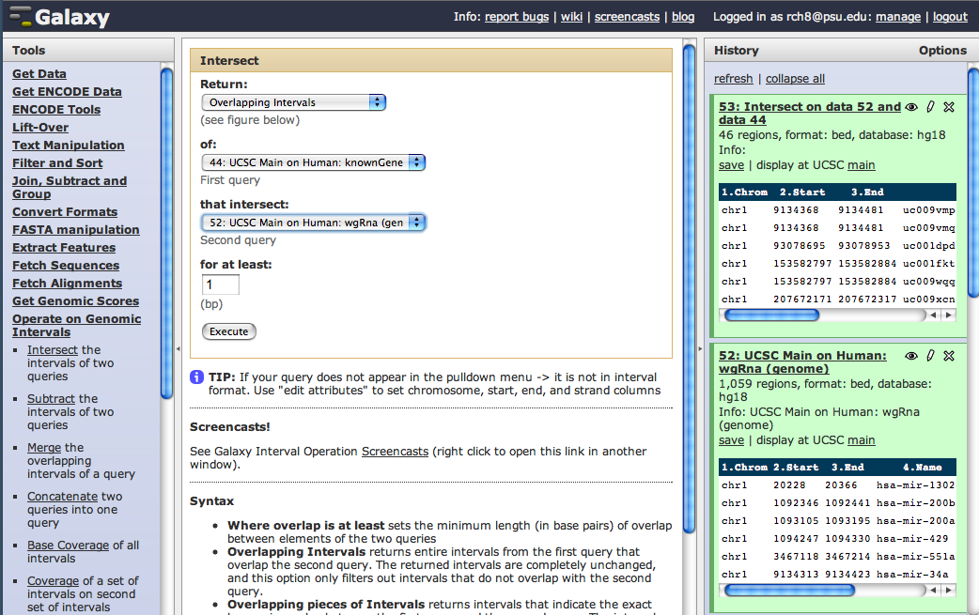
Intersection of coding exons and microRNAs

Slide 21
Screencasts and tutorials
Click on these on the Welcome Page for tutorials.

