Slide 1
Databases and browsers for genomics data
Hardison
Genomics5_1

Slide 2
Types of data in genomics
Protein and DNA sequences
Protein structure and function
Comparisons of DNA and protein sequences
Between species
Among individuals within a species
Gene expression profiles
Chromosomes and chromatin (epigenetic) data
Experimental manipulation
Variation and phenotypes

Slide 3
Modes of use of genomic data
Stored in databases
GenBank
Short Read Archive
Gene Expression Omnibus
Array Express
Databases are the foundation for all the web-based genome browsers
Viewed in browsers
UCSC Genome Browser
Ensembl
SGD
FlyBase
WormBase
Analyzed with bioinformatics tools
Commercial toolsets
Command-line programs
Galaxy

Slide 4
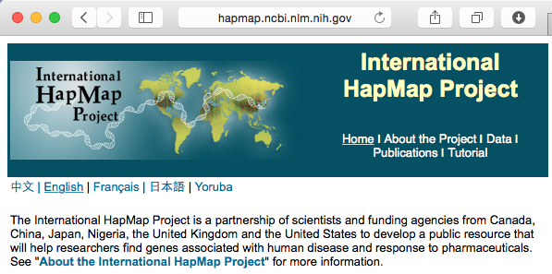
Some major web resources in genomics
UCSC Genome Browser and Table Browser
Ensembl and EnsMart/BioMart
NCBI
PubMed
Blast server
MapViewer
Gene Expression Omnibus
HapMap for haplotype and variation
Galaxy for data retrieval and analysis

Slide 5
Navigating the UCSC genome browser
http://genome.ucsc.edu

Slide 6
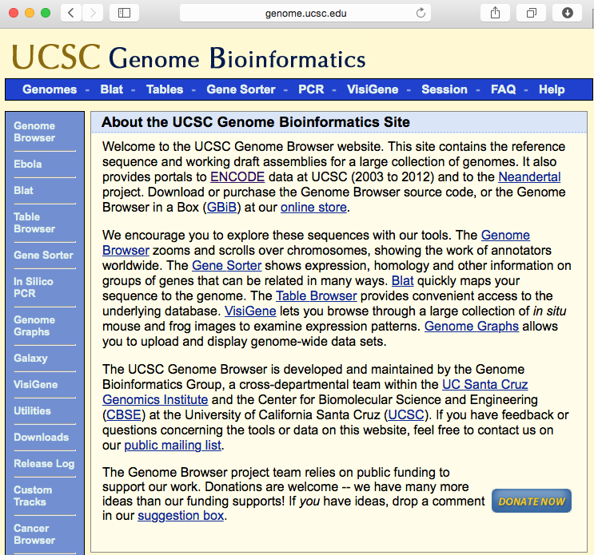
Initial page at http://genome.ucsc.edu

Slide 7
Select species, assembly, locus

Slide 8
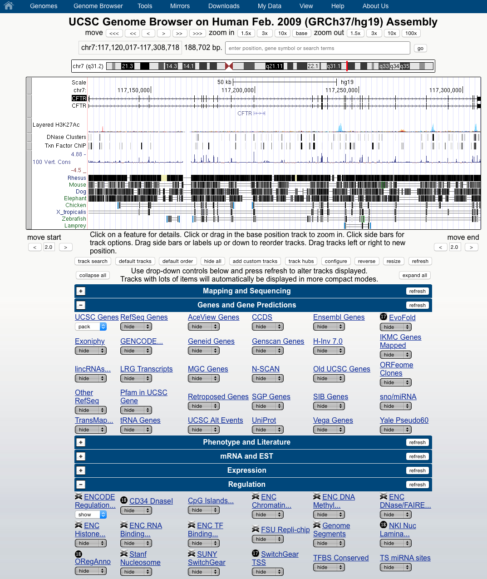
View of CFTR
Your initial view may differ; the UCSC Genome Browser remembers your last settings.

Slide 9
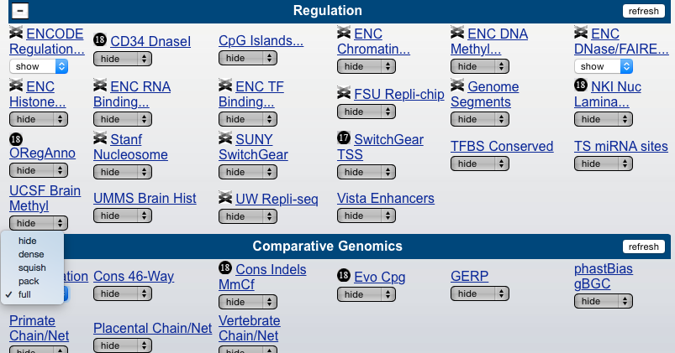
Use track controls to display desired tracks
“Conservation” pull-down menu; shift that to “hide”
Turn on “ENC DNase/FAIRE”
Click on “refresh”

Slide 10
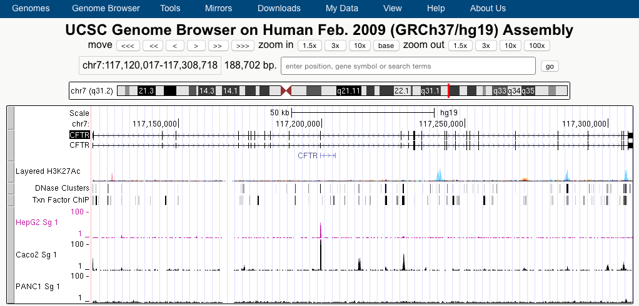
Now the desired tracks are displayed

Slide 11
Zoom out to see the flanking regions

Slide 12
Accessing the track control pages
This is a hyperlink to the track control page
And clicking on the left gray bar next to a track takes you to the track control page

Slide 13
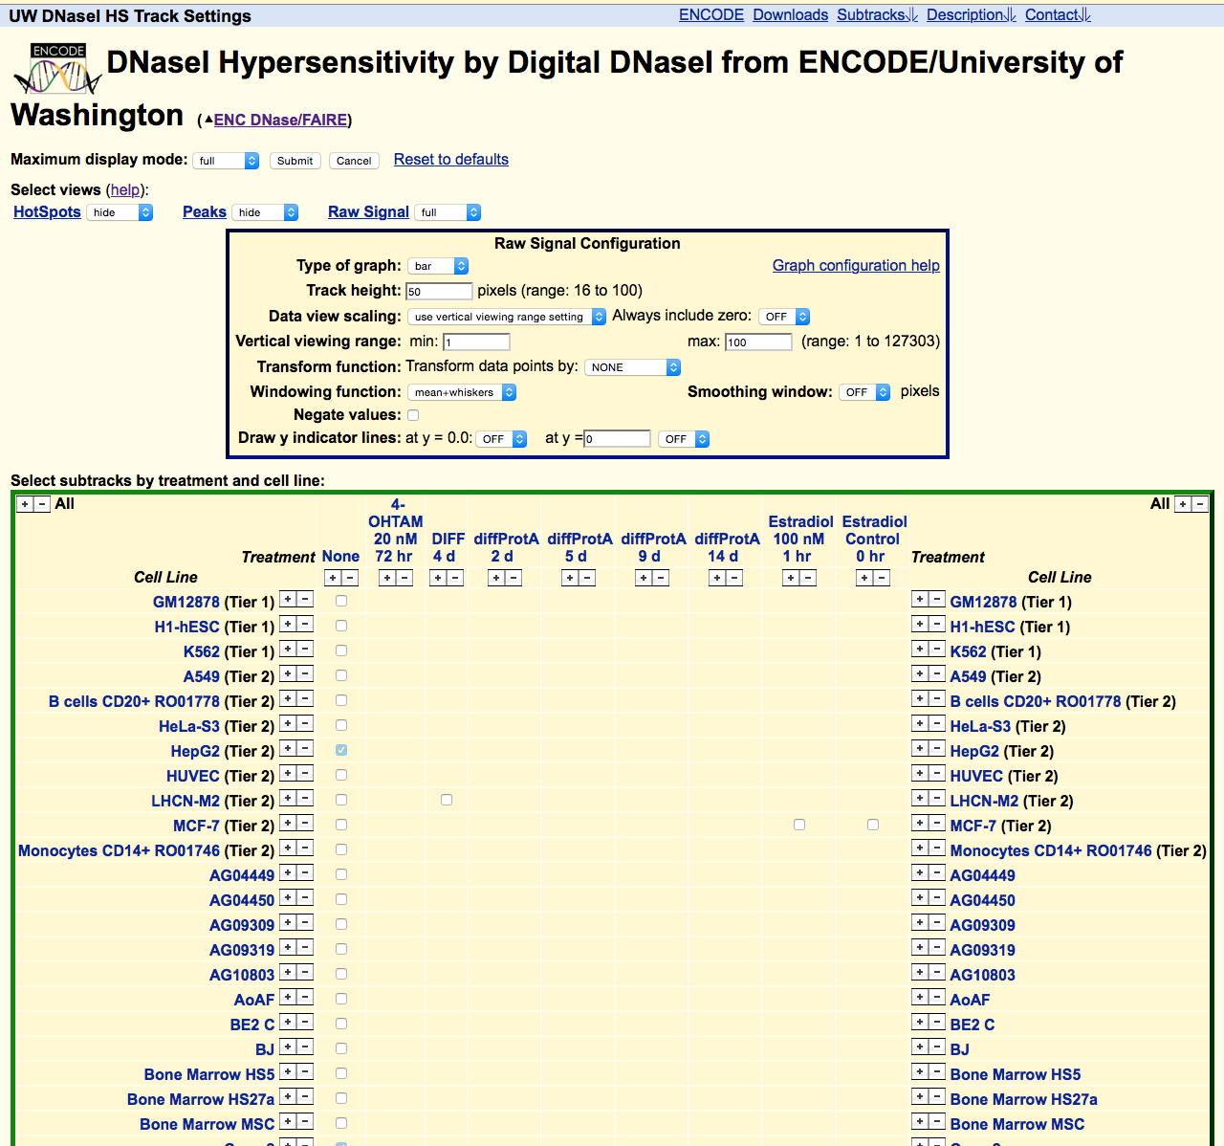
Track control page: adjust data selection and display

Slide 14
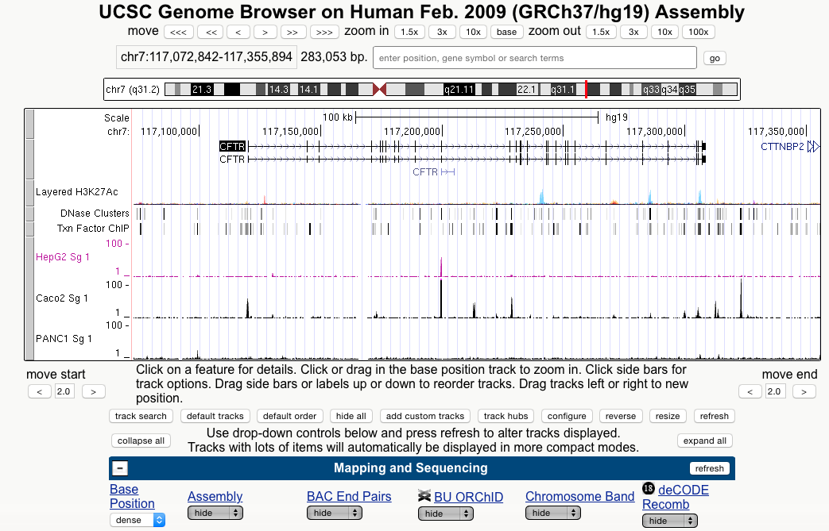
“Configure” and other powerful options

Slide 15
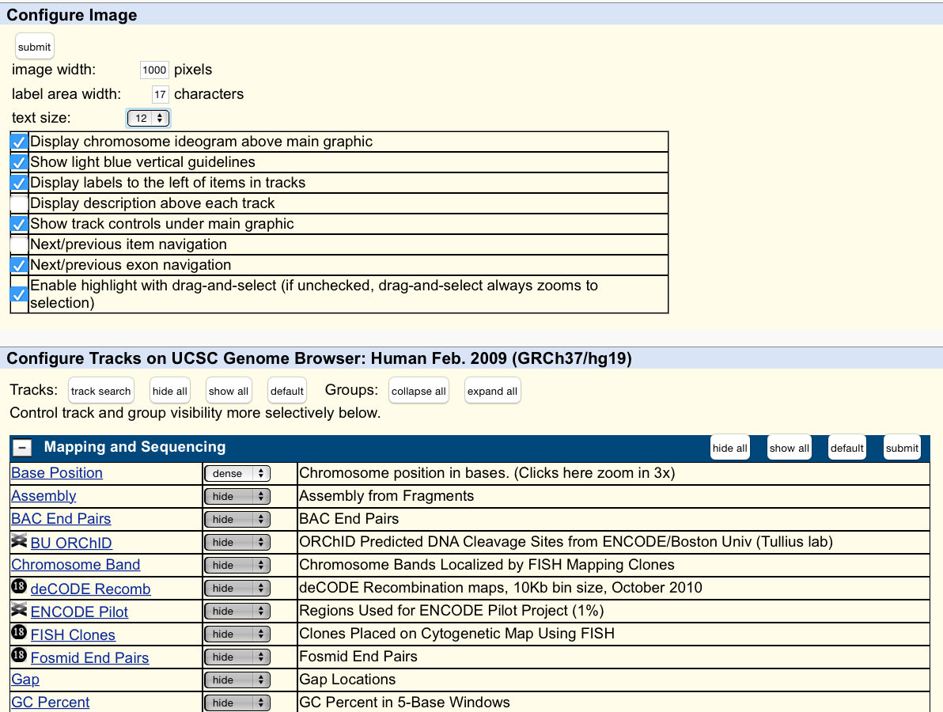
Configure image

Slide 16
Sequences
DNA sequences
Whole genomes and chromosomes
Genes
Transcripts
Protein-coding and noncoding transcripts
Full-length or partial (expressed sequence tags or ESTs)
Protein sequences
Known
Predicted
Repeats
Variants

Slide 17
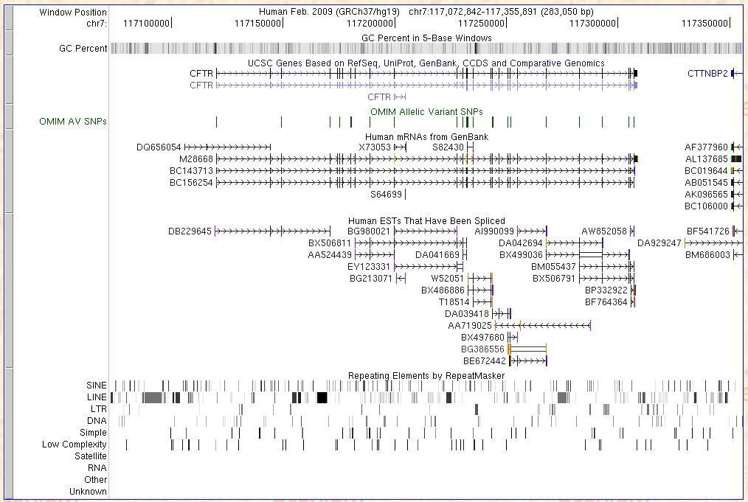
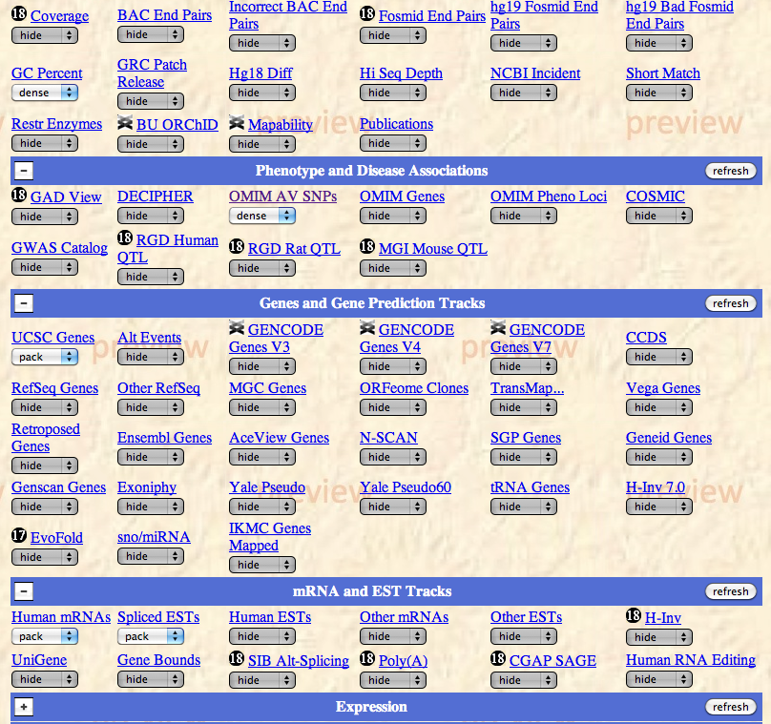
Sequences from CFTR: Browser view

Slide 18
Comparisons of sequences
Alignments
Analyze alignments to help identify functional sequences
Relationship between function, conservation, constraint
Measures of neutrality and signals for selection
Search for characteristic patterns in aligned DNA sequences
Protein-coding DNA sequences: exon prediction
Gene regulatory sequences

Slide 19
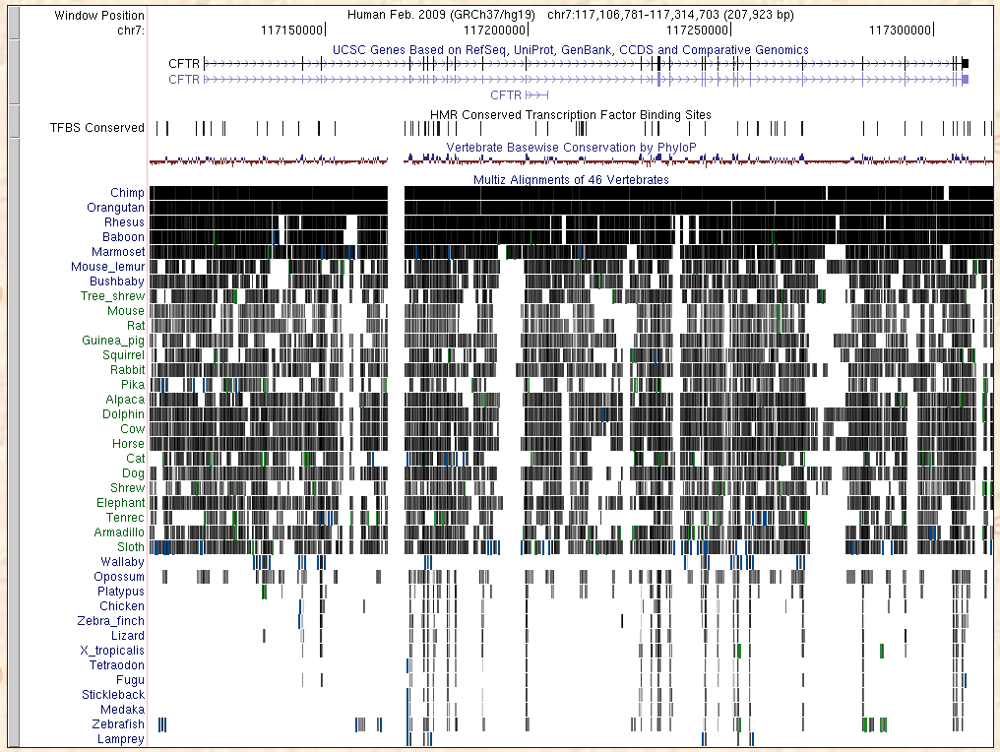
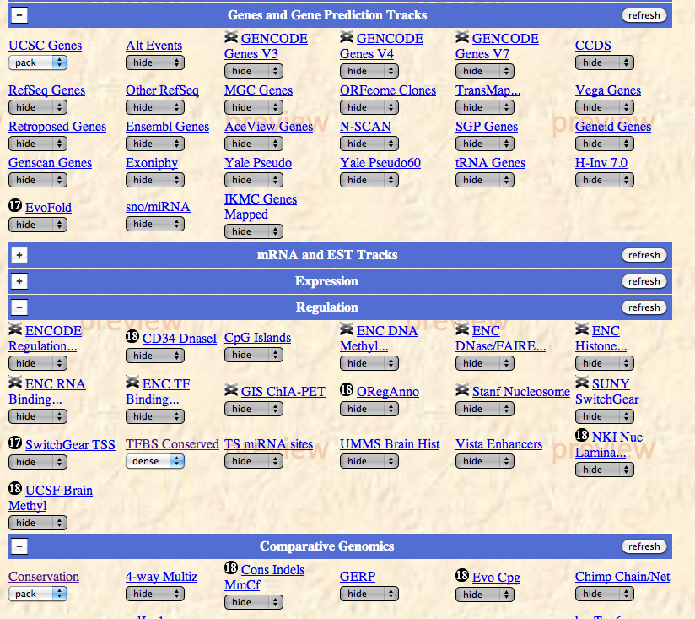
Sequence comparisons of CFTR

Slide 20
Genes expression data
“Transcriptome”
Measure transcript levels for all or large sets of genes
Microarray technology and hybridization
DNA sequences of tags made from transcripts
Learn some aspects of gene function
Co-expression of cohorts of genes
Developmental timing of expression
Tissue-specificity
Response to environmental signals
Abnormal expression in pathologies

Slide 21
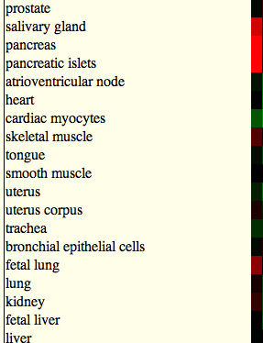
Expression profile for CFTR

Slide 22
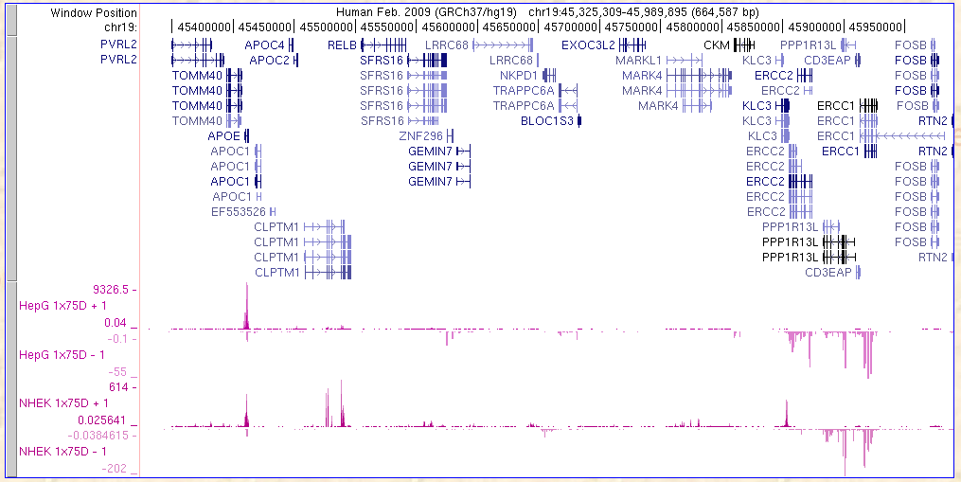
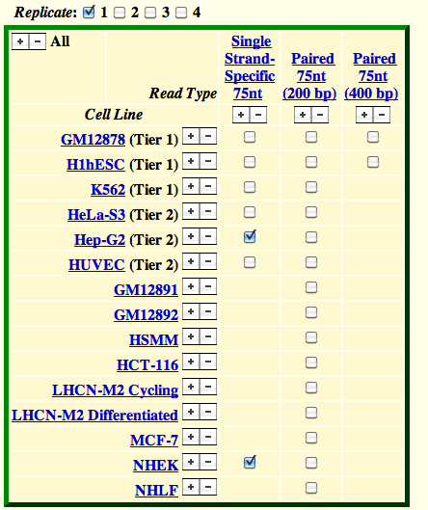
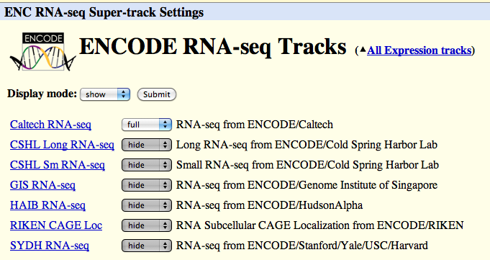
RNA-seq resolved by strand: APOE and ERCC1,2
Genes
RNA

Slide 23
Chromosomes and chromatin data
Histone modifications
Chromatin immunoprecipitation
Modifications associated with activation
Acetylation of H3 and H4
Methylation of H3K4 (mono-, di-, tri-)
Modifications associated with silencing
Methylation of H3K27, H3K9
Site occupancy by proteins
Chromatin immunoprecipitation
RNA polymerase, components of the preinitiation complex
Sequence-specific binding proteins
Altered chromatin structures
Accessible to DNase I (hypersensitive sites)
Replication
Timing
Origins

Slide 24
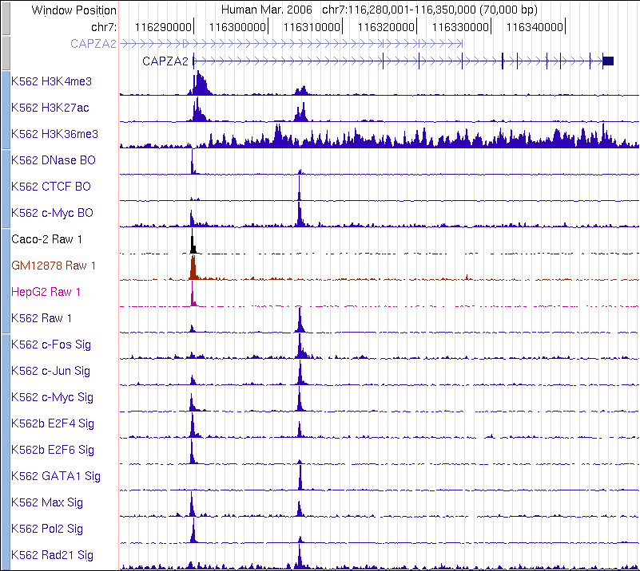
Chromatin modifications and transcription factor binding

Slide 25
Finding genome data
UCSC Table Browser
http://genome.ucsc.edu

Slide 26
Browsers vs Data Retrieval
Browsers are designed to show selected information on one locus or region at a time.
UCSC Genome Browser
Ensembl
Run on top of databases that record vast amounts of information.
Sometimes need to retrieve one type of information for many genomics intervals or genome-wide.
Access this by querying on the tables in the databases or “data marts”
UCSC Table Browser
EnsMart or BioMart

Slide 27
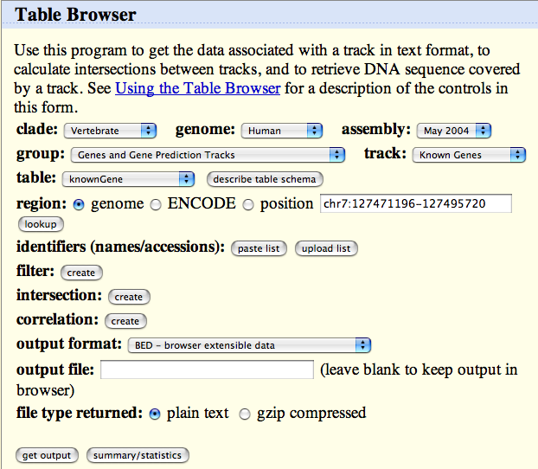
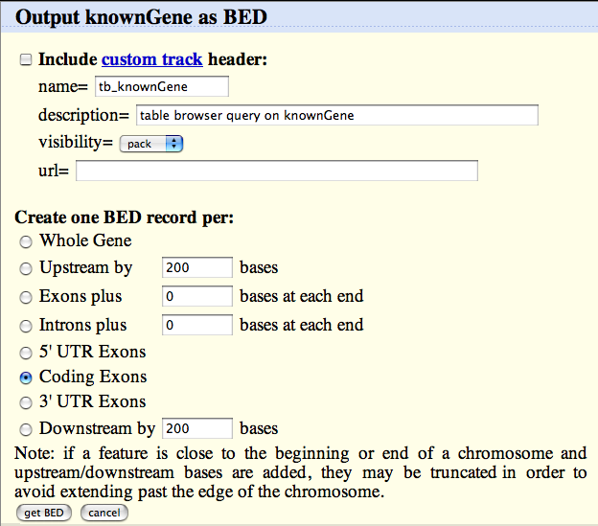
Retrieve all the protein-coding exons in humans

Slide 28
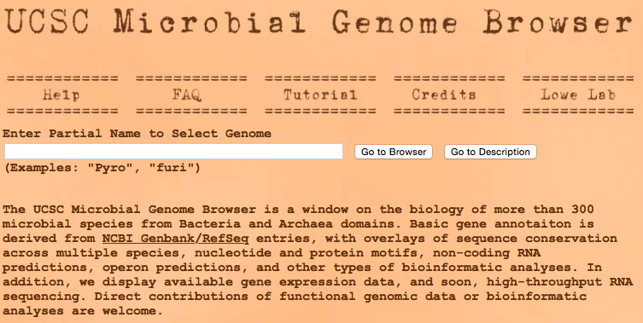
Microbial genomes
This was a good one, but it has been taken off line. I hope it gets funded again.
Microbial Genome Browser, UCSC
Lowe Lab along with UCSC Genome Browser Group
http://microbes.ucsc.edu/
Over 440 microbial species
JGI Integrated Microbial Genomes and Metagenomes
http://img.jgi.doe.gov
Microbial Genome Database for Comparative Analysis
http://mbgd.genome.ad.jp
Over 2800 species

Slide 29
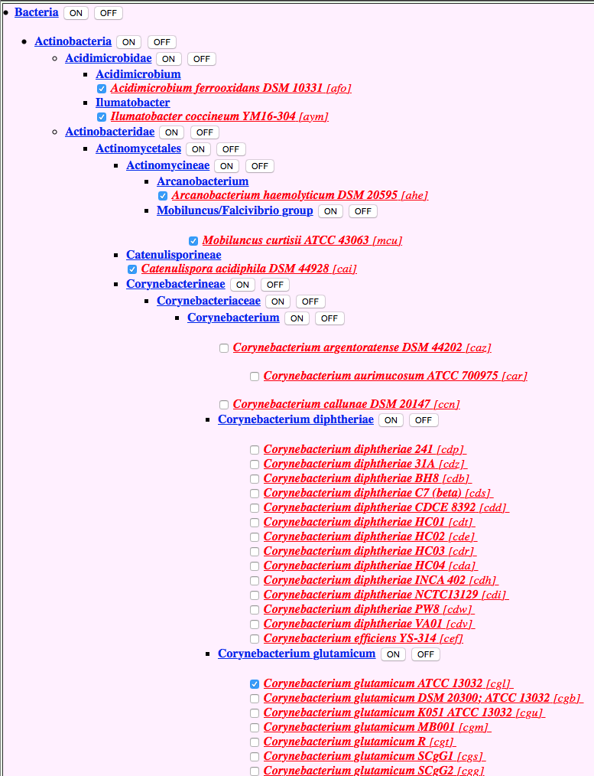
Microbial Taxonomy Search: MBGD

Slide 30
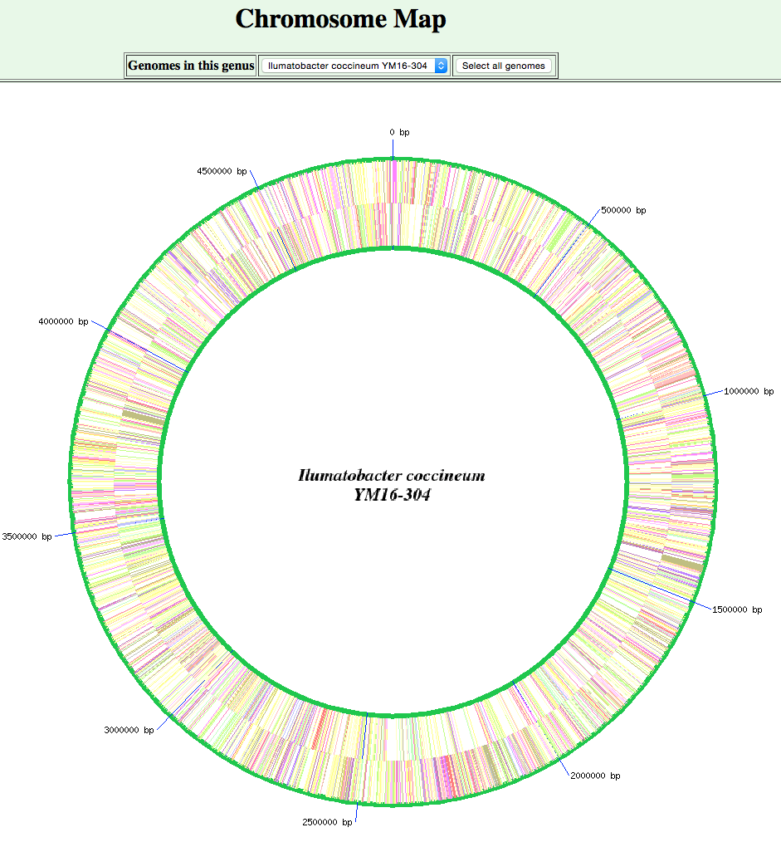
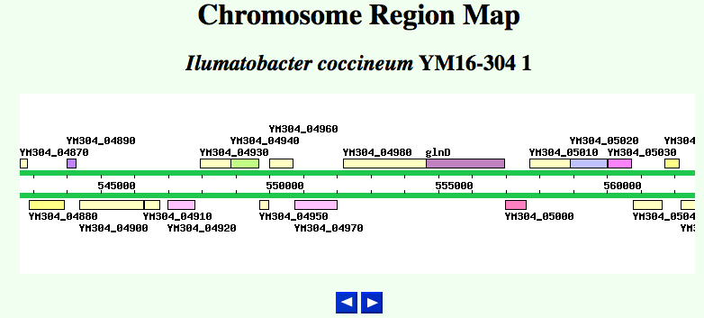
Illustrative views from MBGD

Slide 31
SGD

Slide 32
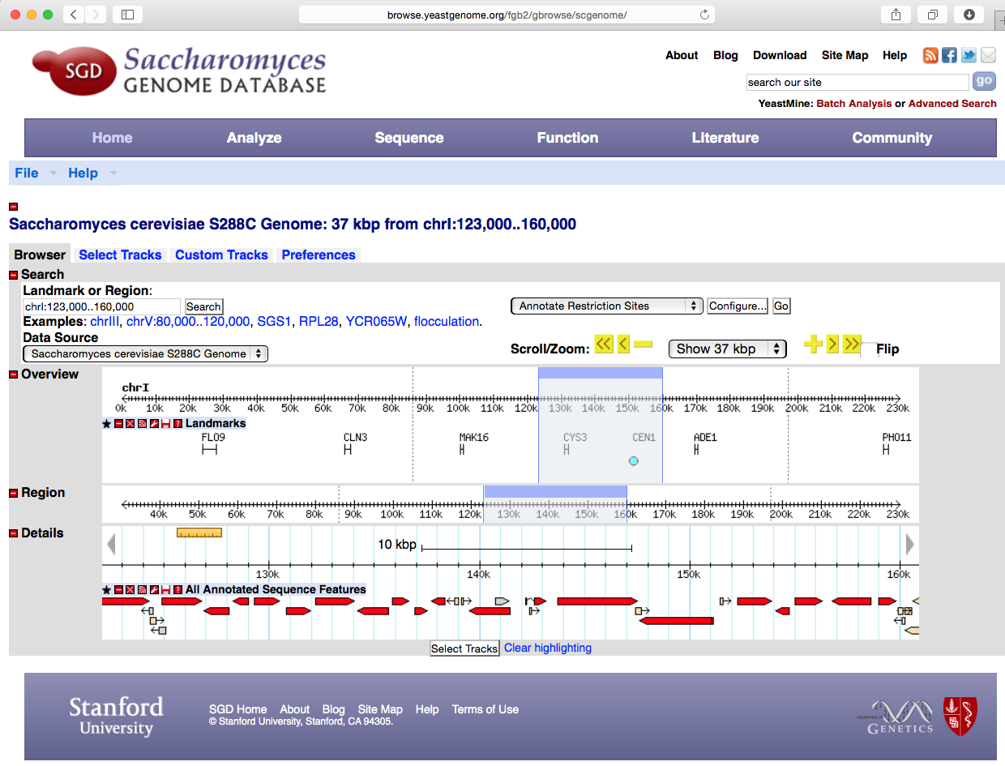
SGD Browser View

Slide 33
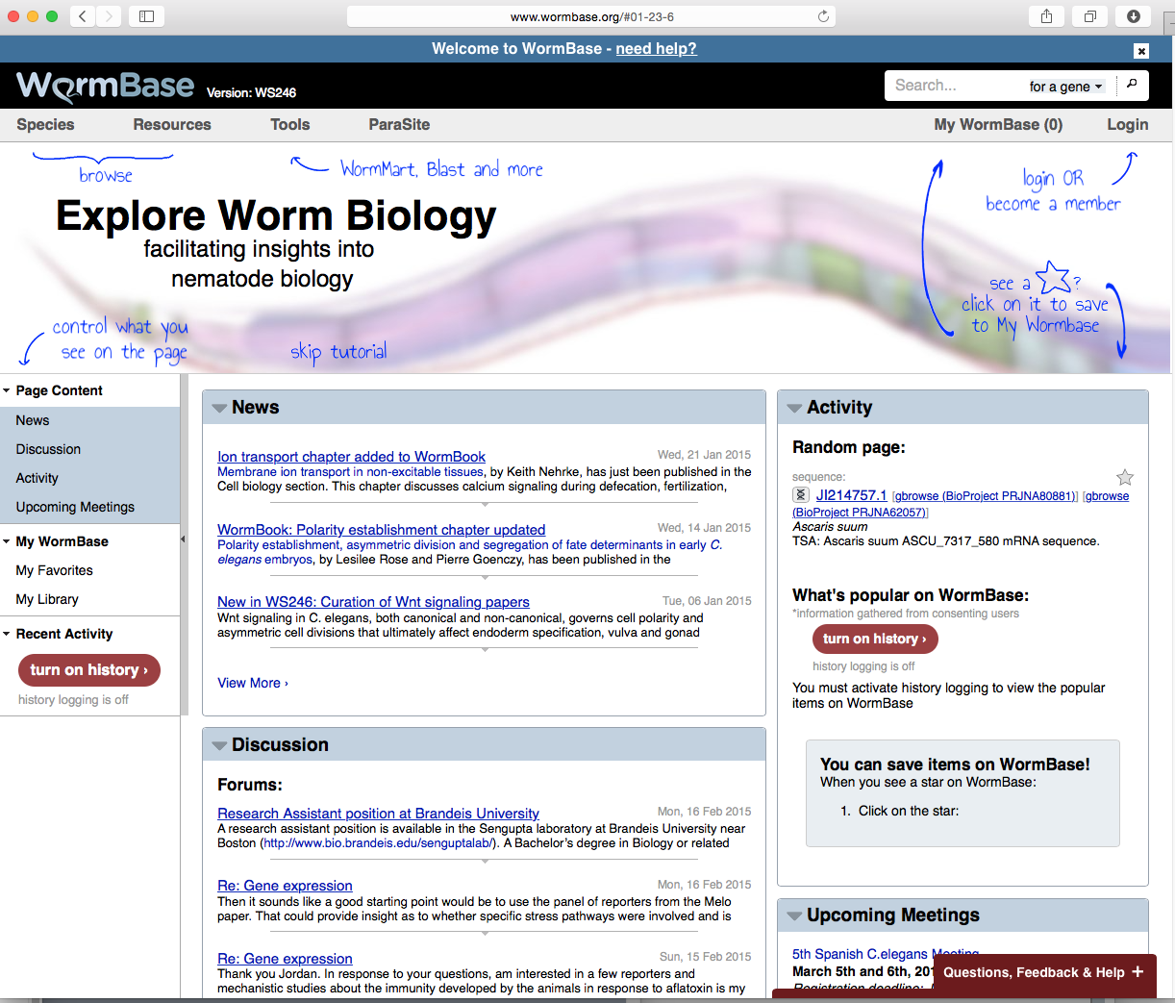
WormBase

Slide 34
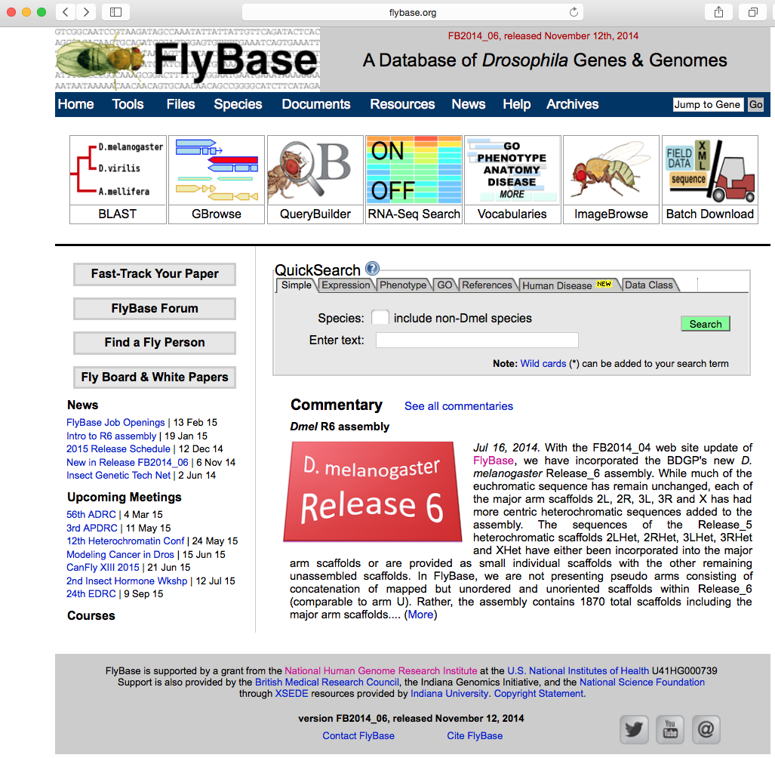
FlyBase

Slide 35
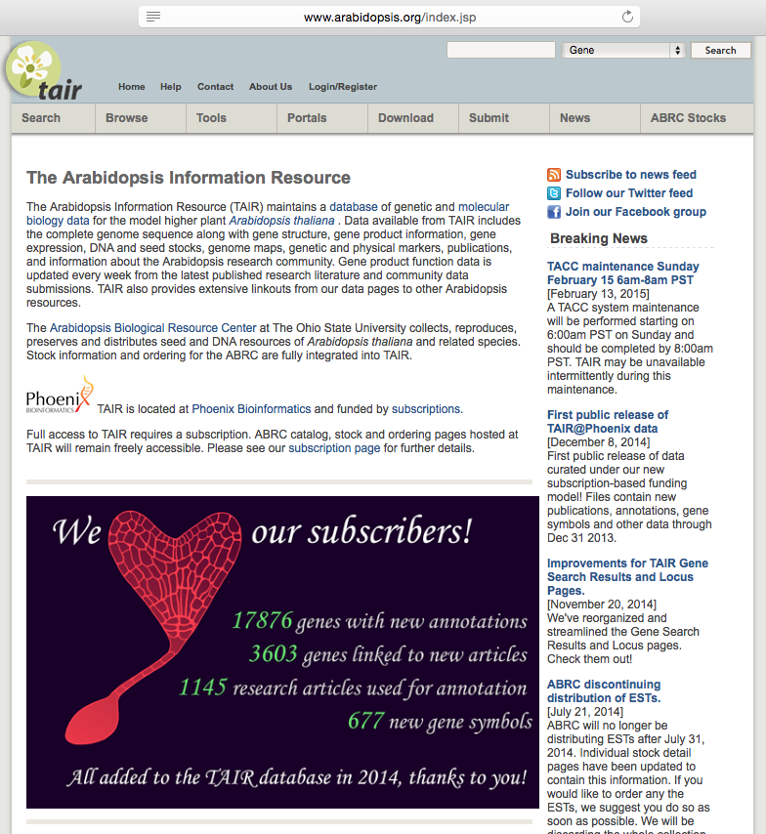
TAIR: The Arabidopsis Information Resource

