Slide 1
Genome Assembly
Hardison
Genomics 4_4
Sources: Webb Miller (Penn State)
Kun-Mao Chao and Luxin Zhang: Sequence Comparisons, Theory and Methods, Springer 2008
Bill Pearson (U. Virginia)
Vladimir Lukic (U. Melbourne)

Slide 2
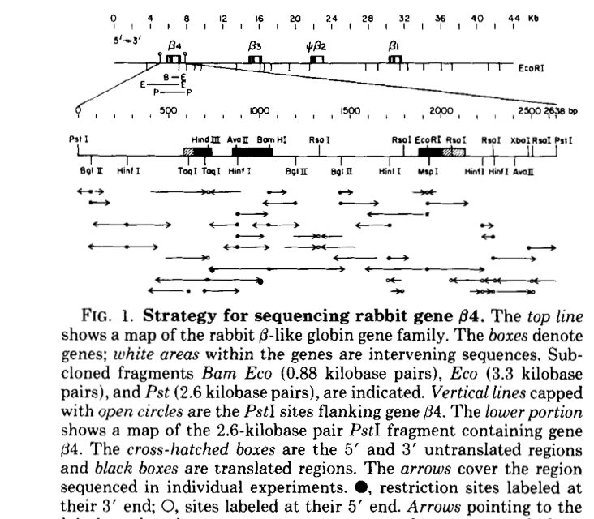
Assembling a gene sequence
Align sequencing reads to generate a series of overlapping sequences that cover the gene. Sequencing both strands is more accurate.
Hardison, R (1983) J. Biol. Chem. 258:8739-8744

Slide 3
Align multiple sequencing reads
Sequencher
Gene Codes Corp.
Stephan Schuster

Slide 4
Contig assembly
Assembly of libraries with 3 different insert sizes
gap
plasmid library (4-5 kb)
plasmid library (1-3 kb)
BAC library (130-2000 kb)
Stephan Schuster

Slide 5
Dealing with Gb, not Mb
Sizes of genomes vary over orders of magnitude
Bacterial: about 1 to 6 Mb
Yeast (Saccharomyces cerevisiae): 12 Mb
Fly (Drosophila melanogaster): 140 Mb
Plant (Arabidopsis thaliana, thale cress): 120 Mb
Fish (Danio rerio, zebrafish): 1,440 Mb (1.44 Gb)
Bird (Gallus gallus, chicken): 1,100 Mb (1.1 Gb)
Human (Homo sapiens reference): 3,100 Mb (3.1 Gb)
To organize the sequence information, use pre-existing maps if available
Genetic, radiation hybrid, physical clone maps
Current focus is on paired end reads, substantial genome coverage (12x to 30x) to drive de novo assembly

Slide 6
Genome Maps
Genetic linkage maps
Relative locations of specific DNA markers along the chromosome
Generate phenotype
Sequence tagged sites (STSs)
Always examine polymorphic markers
Use chromosome breaks during meiotic recombination to give the markers an opportunity to separate
Limited to 50% recombination
Radiation hybrid maps
Relative locations of specific DNA markers along the chromosome
Markers need not be polymorphic
Use random radiation-induced breaks in chromosomes to give the markers an opportunity to separate
“Separate” the human chromosome pieces in hybrid human-hamster cells
Associations above 50% can be meaningful
Physical maps
Fluorescent in situ hybridization (FISH)
Physical clone contigs

Slide 7
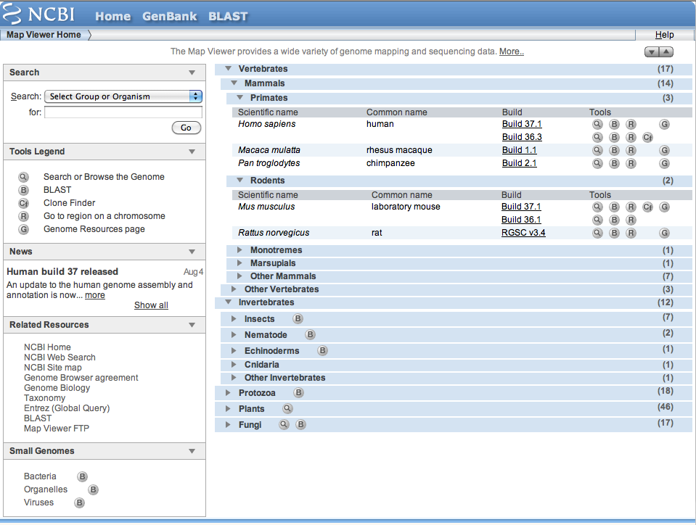
NCBI’s MapViewer

Slide 8
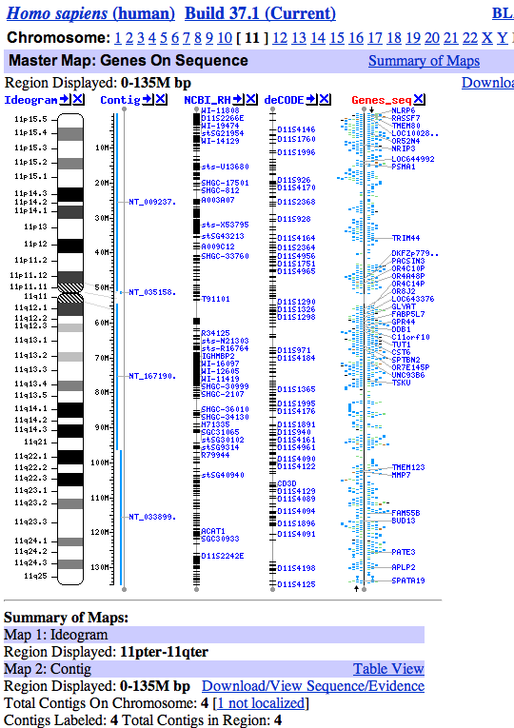
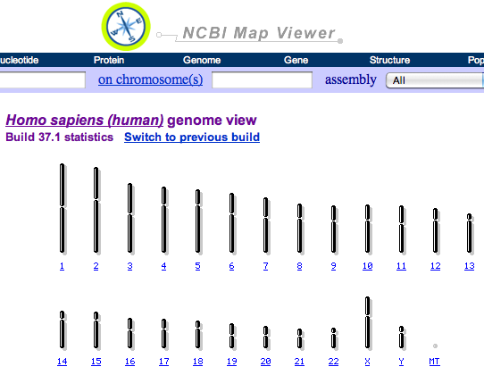
A few human genome maps

Slide 9
Genome sequencing after mapping
Bacterial artificial chromosomes (BACs) are vectors for cloning very long segments of DNA
E.g. Fragments of genomic DNA of 100kb or greater
Libraries of BACs were screened and mapped to find overlapping arrays of contiguous clones (contigs)
E.g. find common restriction fragments in collections of clones
Mapped contigs were then sequenced, using a combination of shotgun sequencing and directed sequencing
Restriction enzyme cleavage sites, e.g. HindIII
Minimal tiling path

Slide 10
Directed sequencing of BAC contigs
Chromosome 22 (part)
Anonymous markers and known genes mapped:
WI-12398
RAD53
D22S570
D22S1
CRYBB1
BAC contig, ends
sequenced
Mapped BACs are broken
into small pieces, which are
shot-gun sequenced and
assembled.
Gaps must be filled by alternate
approaches, e.g. directed PCR.

Slide 11
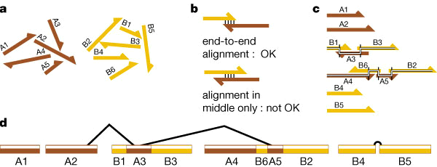
Assembly of sequenced contigs: GigAssembler
Figure 6 The key steps (a–d) in assembling individual sequenced clones into
the draft genome sequence. A1–A5 represent initial sequence contigs
derived from shotgun sequencing of clone A, and B1–B6 are from clone B.
J. Kent and D. Haussler for HGP (Human Genome Project)

Slide 12
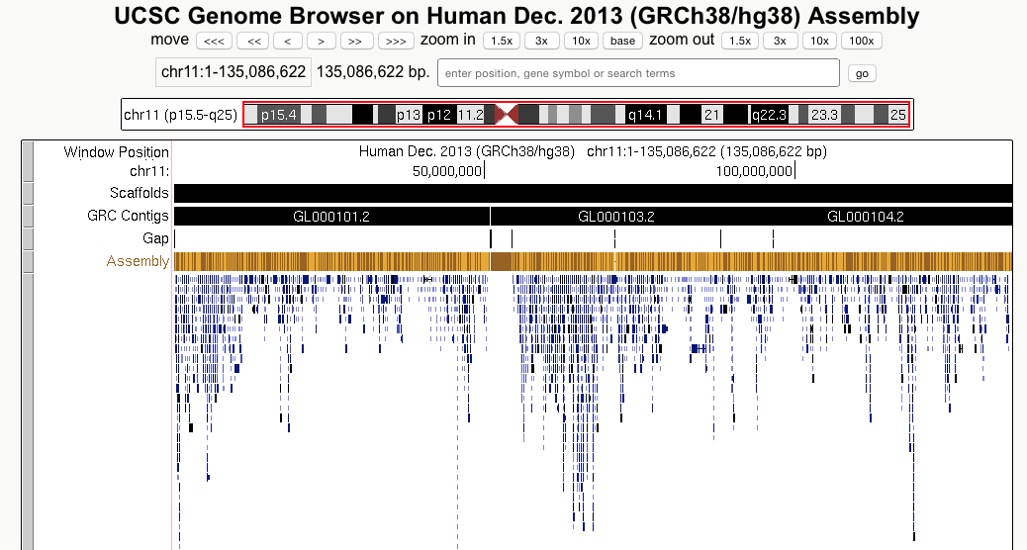
Assembly human Chr11

Slide 13
Shotgun sequencing of whole genomes
Pioneered by Celera
Haemophilus influenza
Homo sapiens
Break total genomic DNA into small pieces (around 1000 bp in size) and clone into plasmids
Sequence about 500 bp from each end.
Use sequence alignments to assemble a final sequence.
Use mate-pair reads to assemble, insert gaps
Requires that each bp be determined multiple times. For sequence reads of about 700 nt each:
about 3x coverage for small genomes (1-5 million bp)
about 10x coverage for large genomes (> 1 billion bp)

Slide 14
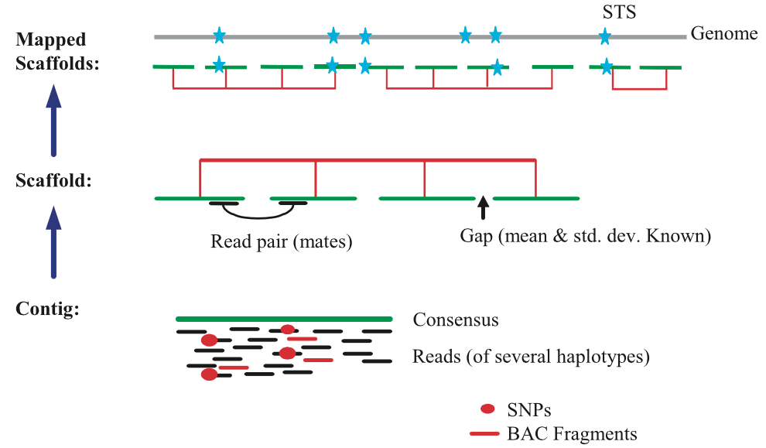
Anatomy of whole-genome assembly: Celera
Publicly funded project: 4364 Mb
Celera: 14,808 Mb
Venter et al., Science, 2001

Slide 15
Short read assemblers
Genome and transcriptome assembly

Slide 16
Alignment method needs to fit the problem, part 2
Problem | Features | Method | Example of program
Whole genome alignment | Each sequence can be very long, multiple rearrangements between them | Compute enormous number of local alignments, then chain them together | multiZ, TBA: use the precomputed alignments at UCSC Browser
 |  | Break genomes into regions of conserved synteny, run global aligner | Lagan, EPO (from EBI): use precomputed alignments at Ensembl
Multiple alignment | “Handful” of sequences that are similar throughout | Progressive, global alignments | ClustalW (one implementation is at EBI)
De novo assembly of genomes and transcriptomes | From 10’s of millions of short sequence reads, assemble genome or transcripts; no reference genome | Use De Bruijn graphs as foundation, other methods to refine assembly | Genome: Velvet…Transcriptome: Trinity suite of programs, from the Broad Institute

Slide 17
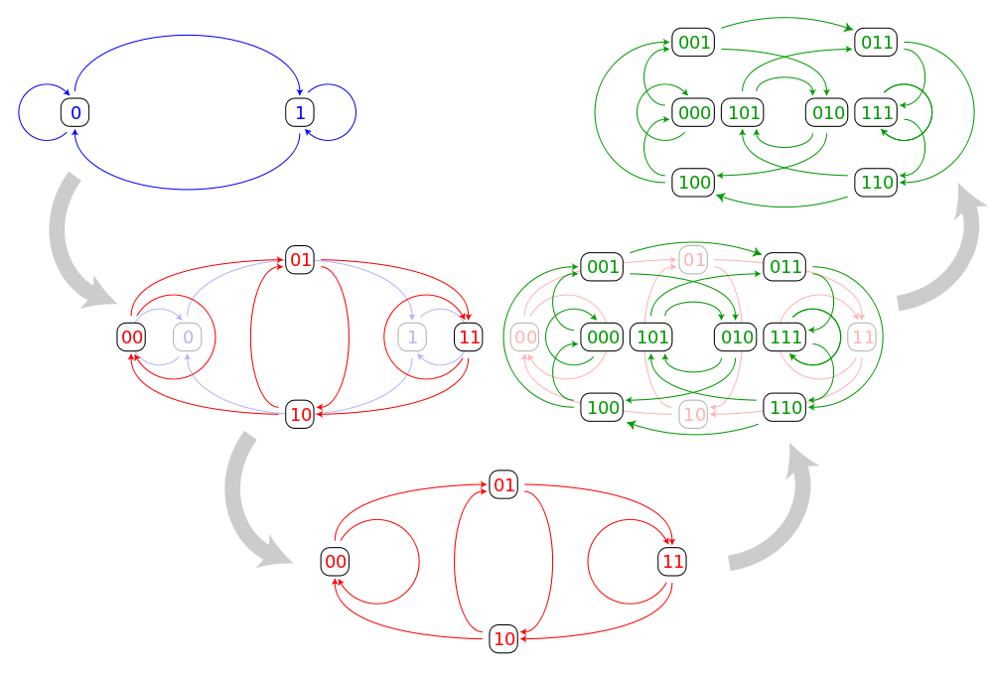
De Bruijn Graphs
From Wikipedia, the free encyclopedia: “In graph theory, an n-dimensional De Bruijn graph of m symbols is a directed graph representing overlaps between sequences of symbols. It has m^{n} vertices, consisting of all possible length-n sequences of the given symbols; the same symbol may appear multiple times in a sequence.”
“If one of the vertices can be expressed as another vertex by shifting all its symbols by one place to the left and adding a new symbol at the end of this vertex, then the latter has a directed edge to the former vertex.”
“The line graph construction of the three smallest binary De Bruijn graphs is depicted below.”
Finding overlaps in sequences of symbols gives an assembly.

Slide 18
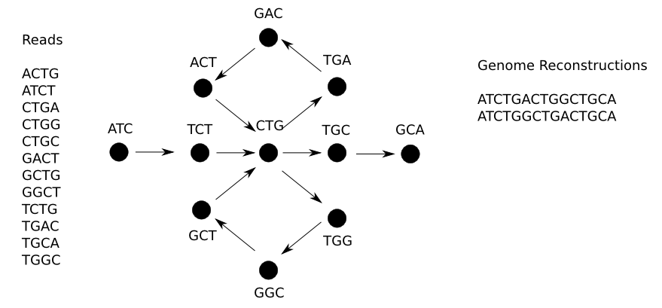
Assembly via finding an Eulerian path through a De Bruijn graph
“New assemblers, such as Velvet and Euler-USR, model the assembly problem as constructing, simplifying, and traversing the de Brujin graph of the read sequences.”
“Nodes in the de Brujin graph represent k-mers in the reads, and directed edges connect consecutive k-mers.”
“Under the assumption that the reads fully sample the sequence of the genome without significant errors, genome assembly is modeled as finding an Eulerian tour through the deBrujin graph that incorporates every edge of the graph.”
From the Center for Bioinformatics and Computational Biology at Univ. of Maryland and info on their program Contrail: http://www.cbcb.umd.edu/research/SR-assembly.shtml

Slide 19
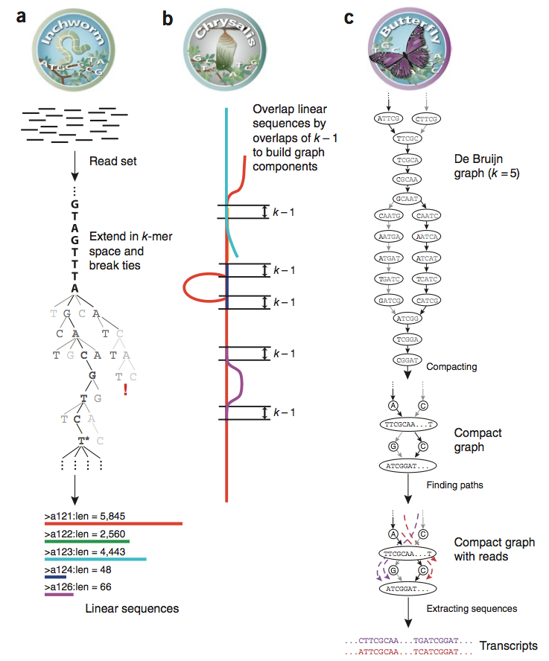
Trinity for de novo assembly of transcripts
Inchworm assembles contigs within a read set
Chrysalis clusters related contigs
Constructs De Bruijn graph components for each transcript (capture overlaps between transcript variants)
Butterfly resolves transcripts that are alternatively spliced or are from paralogous genes
Grabherr et al. (2011) Nature Biotechnology 29:644-652

Slide 20
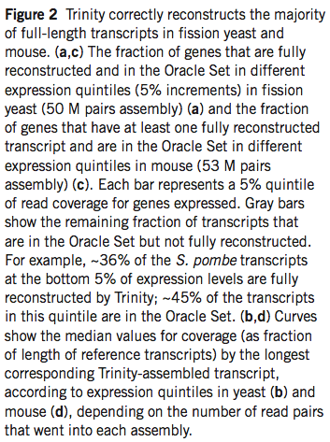
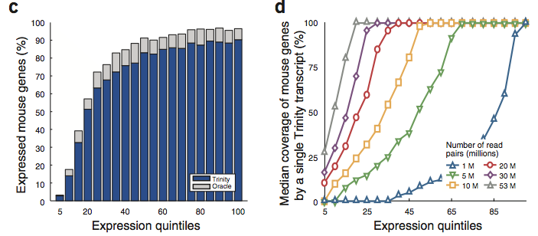
Trinity works well compared to methods based on mapping to reference genomes
Grabherr et al. (2011) Nature Biotechnology 29:644-652

Slide 21
Ongoing improvements
Longer reads
Illumina HiSeq short read sequencing
Paired end reads, up to 250 nucleotides from each end (HiSeq 2500)
Higher capacity, deeper coverage
Long reads from single molecules may help
Pacific Biosciences: sequences 10’s of kilobases from each molecule
Low accuracy (about 85% of nt calls are correct)
Combine high accuracy Illumina reads with the very long (lower accuracy) reads from PacBio

