Slide 1
Sequence alignments: Blast and beyond
Hardison
Genomics 4_3
Sources: Webb Miller (Penn State)
Kun-Mao Chao and Luxin Zhang: Sequence Comparisons, Theory and Methods, Springer 2008
Bill Pearson (U. Virginia)
Vladimir Lukic (U. Melbourne)

Slide 2
Heuristics for Efficient computation of near-optimal alignmenTs
Finds seeds and extend: Blast

Slide 3
Alignment method needs to fit the problem, part 1
Problem | Features | Method | Example of program
Pairwise alignment of proteins or genes | Moderate size (hundreds of letters), similar throughout | Dynamic programming, find optimal global alignment | Needleman-Wunsch (needle in EMBOSS/Galaxy)
 | Moderate size (hundreds of letters), subsequences similar | Dynamic programming, find optimal local alignment | Smith-Waterman (water in EMBOSS/Galaxy)
Find a match between a query sequence and a database | Query sequence could be hundreds of letters, database has >100M entries | Heuristic approach; find seeds (hits) and extend; local alignments | Blast family of programs; FastA (NCBI)
Find a match between a query sequence that is part of a large genome | Query is 25 or more nucleotides, genome can be 3 billion nucleotides | Heuristic approach, find and extend seeds, but engineered to be very fast | Blat (UCSC Genome Browser)
Align short reads to a genome | 10’s to 100’s of million reads, find best match in an assembled genome | Employ the Burroughs-Wheeler transform for efficient alignments | Bowtie or bwa, both implemented in Galaxy

Slide 4
Heuristic algorithms
Rapid heuristic algorithms, like FASTA and blast, do not examine all possible paths for local alignments
Are much faster than the rigorous Smith-Waterman algorithm because they examine only a portion of the potential alignments
Can produce results of similar quality in many cases
Ideal for searching large databases of sequences and for aligning long sequences

Slide 5
Basics of blast algorithm
Blast first scans the database for words (short strings of amino acids or nucleotides) that score at least T when aligned with some word in the query sequence. The aligned word pairs are hits.
Typically a word is 3 amino acids or 10 nucleotides
T is the significance threshold (Karlin and Altschul, 1990)
Blast then checks whether each hit lies within an alignment with a score sufficient to be reported.
Extend the hit in both directions, until the running alignment score has dropped more than X below the maximum score yet attained.
These extended alignments are high scoring segment pairs, or HSPs.
Extension step accounts for >90% of the execution time.

Slide 6
Improvements in blast2
Fewer extensions: require 2 hits (aligned word pairs) on a diagonal before extending
Extension of each aligned word pair generates an HSP
Introduce gaps
For HSPs (high scoring segment pairs) above a certain threshold, trigger a gapped extension
Set threshold so about 1 gapped extension is executed per 50 database sequences
Gapped extensions are costly in time, but improve sensitivity
Run the extension until alignment score drops by more than X below the maximum score yet obtained
Report gapped extension if the E-value is low enough to be of interest

Slide 7
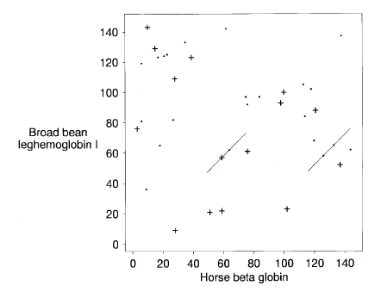
Blast2: require 2 hits on a diagonal
Altschul et al. BLAST2

Slide 8
Blast2: diagram of gapped alignments
Altschul et al. BLAST2

Slide 9
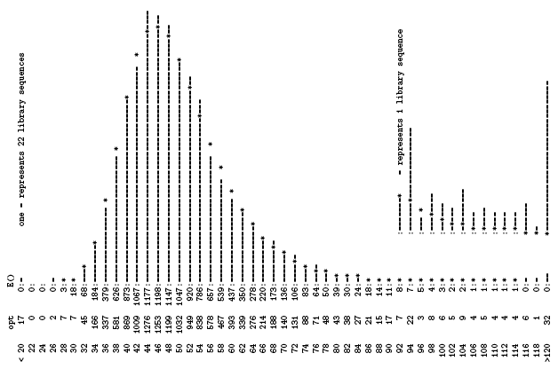
Distribution of alignment scores: Human H⁺ ATPase vs. PIR database
Bill Pearson, U. Va.

Slide 10
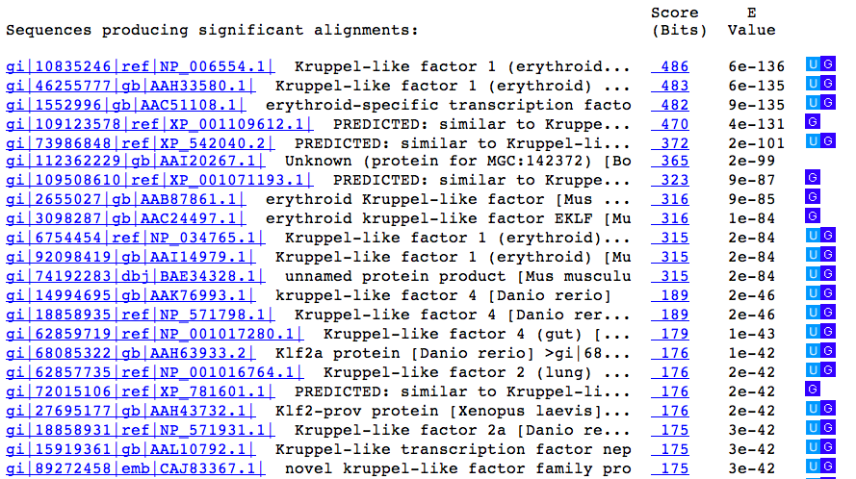
Interpreting blast output: KLF1
High score, low E:
Unlikely to occur in alignments of random sequences of the same length and amino acid composition

Slide 11
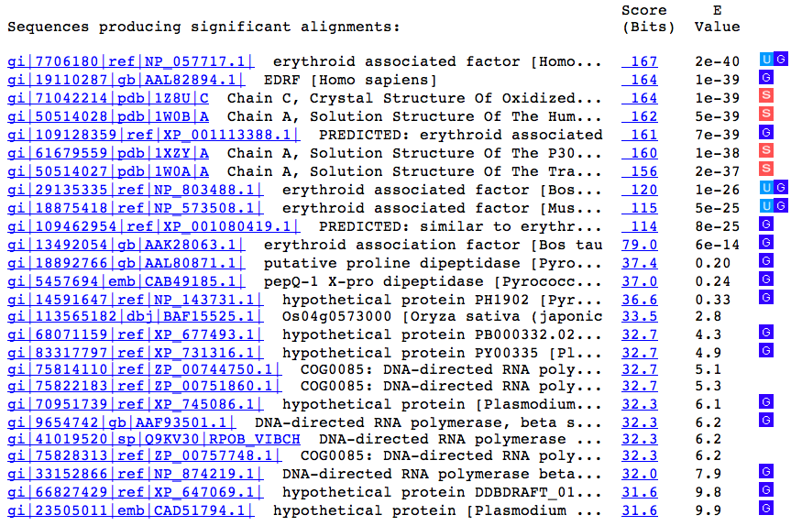
Blastp results with ERAF1
Big jump in E value

Slide 12
Alignment method needs to fit the problem, part 1
Problem | Features | Method | Example of program
Pairwise alignment of proteins or genes | Moderate size (hundreds of letters), similar throughout | Dynamic programming, find optimal global alignment | Needleman-Wunsch (needle in EMBOSS/Galaxy)
 | Moderate size (hundreds of letters), subsequences similar | Dynamic programming, find optimal local alignment | Smith-Waterman (water in EMBOSS/Galaxy)
Find a match between a query sequence and a database | Query sequence could be hundreds of letters, database has >100M entries | Heuristic approach; find seeds (hits) and extend; local alignments | Blast family of programs; FastA (NCBI)
Find a match between a query sequence that is part of a large genome | Query is 25 or more nucleotides, genome can be 3 billion nucleotides | Heuristic approach, find and extend seeds, but engineered to be very fast | Blat (UCSC Genome Browser)
Align short reads to a genome | 10’s to 100’s of million reads, find best match in an assembled genome | Employ the Burroughs-Wheeler transform for efficient alignments | Bowtie or bwa, both implemented in Galaxy

Slide 13
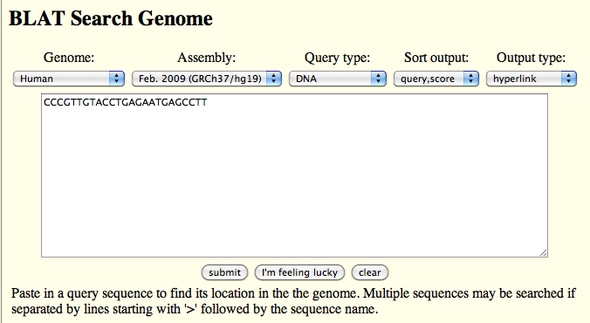
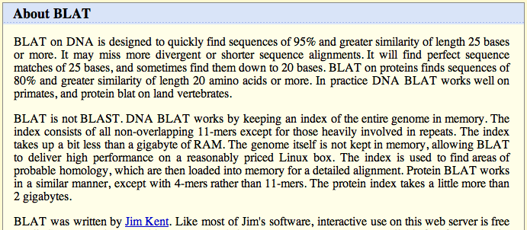
Blat: Rapid search for near-exact matches

Slide 14
Additional alignment methods
Large-scale alignments

Slide 15
Alignment method needs to fit the problem, part 1
Problem | Features | Method | Example of program
Pairwise alignment of proteins or genes | Moderate size (hundreds of letters), similar throughout | Dynamic programming, find optimal global alignment | Needleman-Wunsch (needle in EMBOSS/Galaxy)
 | Moderate size (hundreds of letters), subsequences similar | Dynamic programming, find optimal local alignment | Smith-Waterman (water in EMBOSS/Galaxy)
Find a match between a query sequence and a database | Query sequence could be hundreds of letters, database has >100M entries | Heuristic approach; find seeds (hits) and extend; local alignments | Blast family of programs; FastA (NCBI)
Find a match between a query sequence that is part of a large genome | Query is 25 or more nucleotides, genome can be 3 billion nucleotides | Heuristic approach, find and extend seeds, but engineered to be very fast | Blat (UCSC Genome Browser)
Align short reads to a genome | 10’s to 100’s of million reads, find best match in an assembled genome | Employ the Burroughs-Wheeler transform for efficient alignments | Bowtie or bwa, both implemented in Galaxy

Slide 16
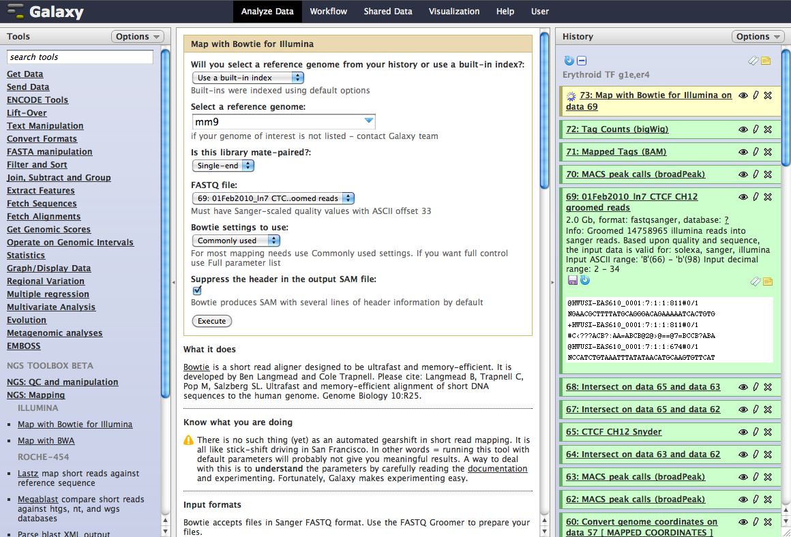
Mapping millions of short reads to a reference genome
Almost 15 million!

Slide 17
Alignment method needs to fit the problem, part 2
Problem | Features | Method | Example of program
Whole genome alignment | Each sequence can be very long, multiple rearrangements between them | Compute enormous number of local alignments, then chain them together | multiZ, TBA: use the precomputed alignments at UCSC Browser
 |  | Break genomes into regions of conserved synteny, run global aligner | Lagan, EPO (from EBI): use precomputed alignments at Ensembl
Multiple alignment | “Handful” of sequences that are similar throughout | Progressive, global alignments | ClustalW (one implementation is at EBI)
De novo assembly of genomes and transcriptomes | From 10’s of millions of short sequence reads, assemble genome or transcripts; no reference genome | Use De Bruijn graphs as foundation, other methods to refine assembly | Genome: Velvet…Transcriptome: Trinity suite of programs, from the Broad Institute

Slide 18
Precomputed alignments of genomes
blastZ for pairwise alignments
multiZ for 5-way alignment
Human, chimp, mouse, rat, chicken
Organize local alignments
Chains and nets
All against all comparisons
High sensitivity and specificity
Results available at
UCSC Genome Browser http://genome.ucsc.edu
Can extract alignments at Galaxy
Alternate genome wide alignments at Ensembl
EPO (Enredo, Pecan, Orpheus)
Schwartz et al., 2003, blastZ, Genome Research
Blanchette et al., 2004, TBA and multiZ, Genome Research

Slide 19
Genome-wide local alignment chains
Human: 2.9 Gb assembly. Mask interspersed repeats, break into 300 segments of 10 Mb.
Human
Mouse
blastZ: Each segment of human is given the opportunity to align with all mouse sequences.
Run blastZ in parallel for all human segments. Collect all local alignments above threshold.
Organize local alignments into a set of chains based on position in assembly and orientation.
Level 1 chain
Level 2 chain
Net

Slide 20
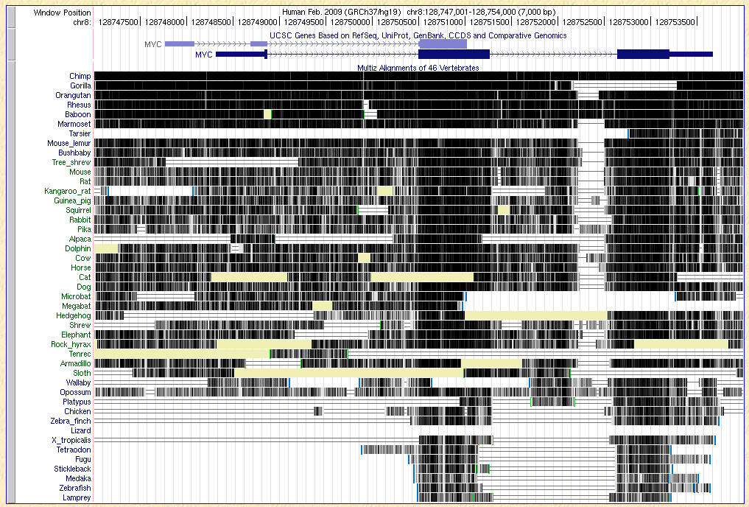
Patterns of aligning sequences

Slide 21
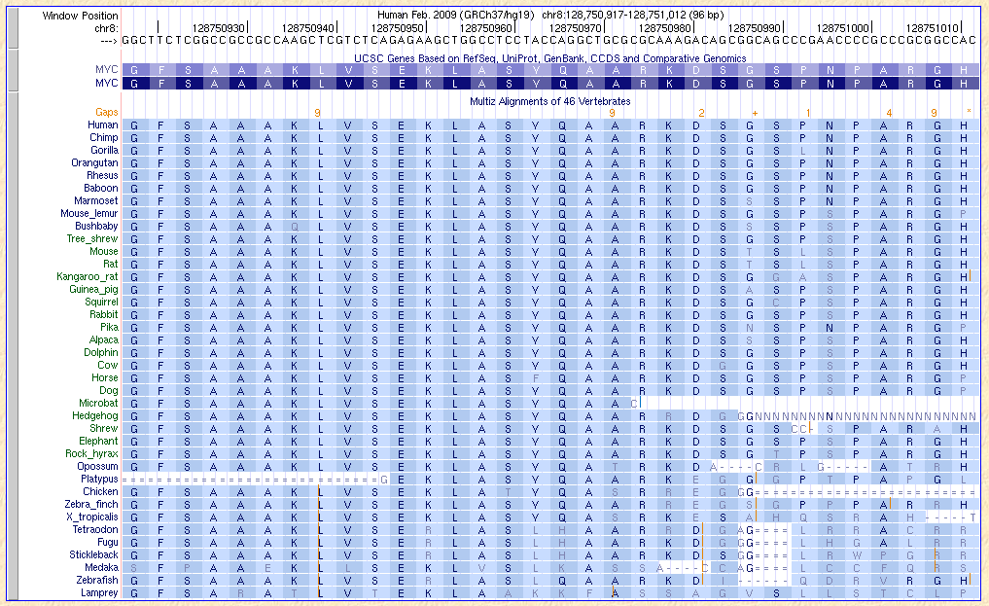
Precompted multispecies genome alignments: Amino acid view

Slide 22
Alignment method needs to fit the problem, part 2
Problem | Features | Method | Example of program
Whole genome alignment | Each sequence can be very long, multiple rearrangements between them | Compute enormous number of local alignments, then chain them together | multiZ, TBA: use the precomputed alignments at UCSC Browser
 |  | Break genomes into regions of conserved synteny, run global aligner | Lagan, EPO (from EBI): use precomputed alignments at Ensembl
Multiple alignment | “Handful” of sequences that are similar throughout | Progressive, global alignments | ClustalW (one implementation is at EBI)
De novo assembly of genomes and transcriptomes | From 10’s of millions of short sequence reads, assemble genome or transcripts; no reference genome | Use De Bruijn graphs as foundation, other methods to refine assembly | Genome: Velvet…Transcriptome: Trinity suite of programs, from the Broad Institute

Slide 23
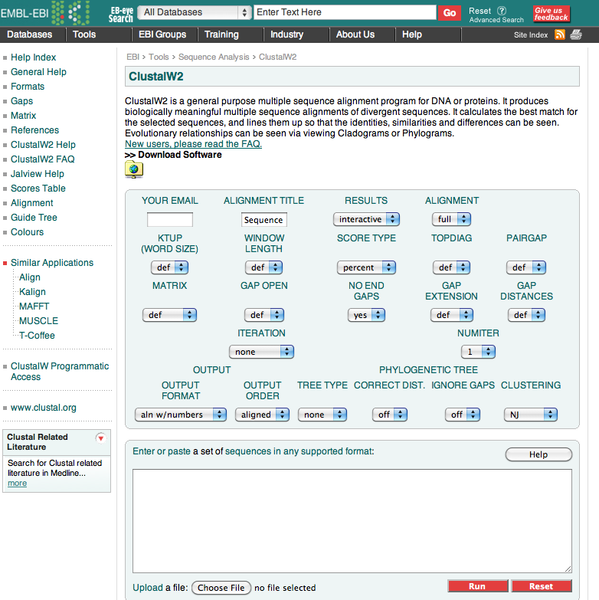
ClustalW for global multi-alignments of particular regions or proteins

Slide 24
ClustalW2 (EBI): Progressive multiple alignment
Sequence 1
Sequence 1
Sequence 1
Sequence 2
Sequence 2
Sequence 1
Sequence 2
Sequence 3
Sequence 2
Sequence 3
Sequence 5
Sequence 5
Sequence 4
Sequence 4
Sequence 3
Sequence 4
Sequence 5
Sequence 5
Sequence 4
Sequence 3
5x5 Distance Matrix
 | Seq1 | Seq2 | Seq5 | Seq4 | Seq3
Seq1
Seq2
Seq5
Seq4
Seq3
Sequence 1
Sequence 2
Sequence 5
Sequence 4
Sequence 3

Slide 25
Summary on alignments
Rigorous computation of optimal pairwise alignments
Large memory and time requirements
Global: Needleman and Wunsch
Local: Smith and Waterman
Heuristic search for close-to-optimal local alignments
Rapid search for “seeds” or “hits” against an index (database, genome); extend to HSPs
Blast and related programs: database searches, whole genome local alignments
Blat: very fast search for almost exact matches of 25 nt or longer between query and a genome
Bowtie and other aligners using BW transform: “ultra fast” short read aligners, efficient use of memory for genome index; align 25 million 35 nt reads per hr
Multiple alignments: Progressive addition to pairwise alignments
ClustalW: global multiple sequence alignments
Genome-wide: multiZ (UCSC), EPO (Ensembl), Mlagan, others

