Slide 1

Sequence alignments 2: Dynamic programming and an exercise
Hardison
Genomics 4_2
Sources: Webb Miller (Penn State)
Kun-Mao Chao and Luxin Zhang: Sequence Comparisons, Theory and Methods, Springer 2008
Bill Pearson (U. Virginia)
  Vladimir Likic, University of Melbourne
Colleen O’Rourke and Shaun Mahony (Penn State)

Slide 2
Dynamic programming for optimal alignmenTs

Slide 3
Alignment method needs to fit the problem, part 1
Problem | Features | Method | Example of program
Pairwise alignment of proteins or genes | Moderate size (hundreds of letters), similar throughout | Dynamic programming, find optimal global alignment | Needleman-Wunsch (needle in EMBOSS/Galaxy)
 | Moderate size (hundreds of letters), subsequences similar | Dynamic programming, find optimal local alignment | Smith-Waterman (water in EMBOSS/Galaxy)
Find a match between a query sequence and a database | Query sequence could be hundreds of letters, database has >100M entries | Heuristic approach; find seeds (hits) and extend; local alignments | Blast family of programs; FastA (NCBI)
Find a match between a query sequence that is part of a large genome | Query is 25 or more nucleotides, genome can be 3 billion nucleotides | Heuristic approach, find and extend seeds, but engineered to be very fast | Blat (UCSC Genome Browser)
Align short reads to a genome | 10’s to 100’s of million reads, find best match in an assembled genome | Employ the Burroughs-Wheeler transform for efficient alignments | Bowtie or bwa, both implemented in Galaxy

Slide 4
Efficient computation of optimal alignments
Dynamic programming
For two sequences of length m and n, respectively, determine the optimal score for each cell in an m+1 x n+1 matrix, and keep track of the path to get to that score
  add 1 residue to each sequence
  add 1 residue to sequence 1 and a gap to sequence 2
  add 1 residue to sequence 2 and a gap to sequence 1
Start with the last cell (lower right) and trace back an optimal solution.
More information:
  Kun-Mao Chao and Luxin Zhang: Sequence Comparisons, Theory and Methods, Springer 2008; Chapters 2 and 3
  http://www.ludwig.edu.au/course/lectures2005/Likic.pdf
  Vladimir Likic, University of Melbourne

Slide 5
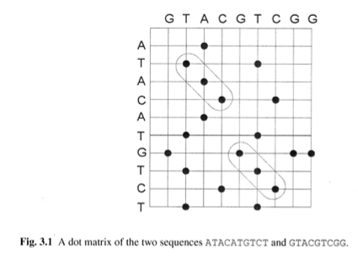
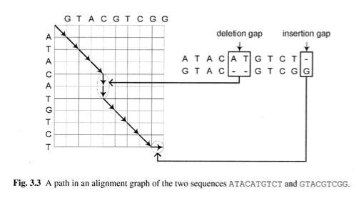
From dot matrix to alignment
Chao & Zhang, Sequence Comparisons

Slide 6
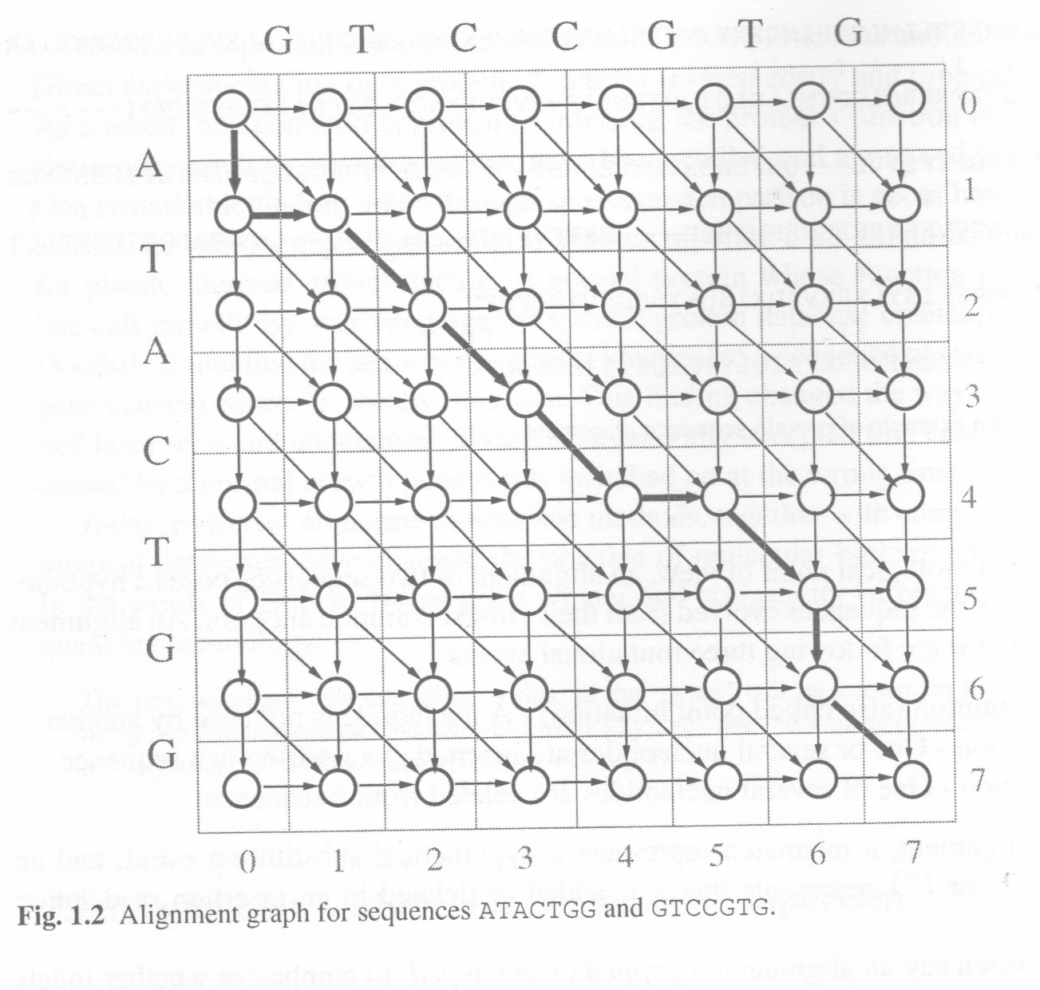
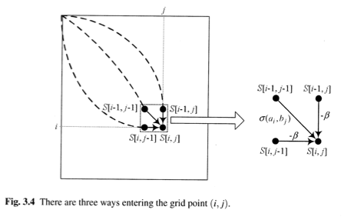
Alignment graphs show exploration of all possibilities
Chao & Zhang, Sequence Comparisons

Slide 7
Example of global alignment: sequences
The optimal global alignment was found between the following two sequences using affine gap penalties:
  Sequence 1, X: TGTTATCGTCCTA
  Sequence 2, Y: TGCTGTGCTA
The scoring scheme used was:
  Match = +5
  Mismatch = -4
  Gap opening: q = -10
  Gap extension: r = -4
Thanks to Colleen O’Rourke, homework for a course taught by Shaun Mahony, PSU

Slide 8
Example of global alignment: Computation of full matrix
Colleen O’Rourke

Slide 9
Example of global alignment: Maximum values and trace-back
Colleen O’Rourke

Slide 10
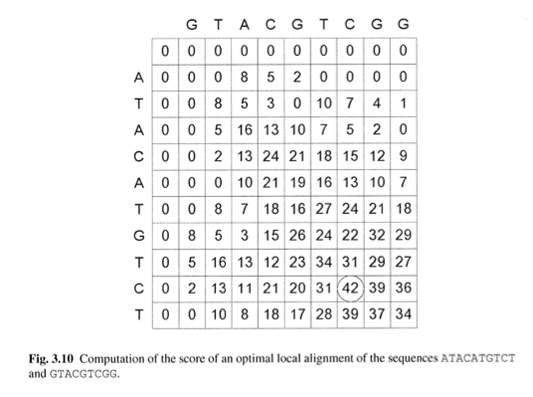
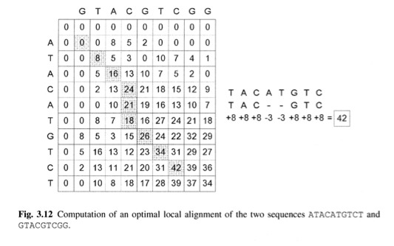
Local alignment graph, with trace-back
Chao & Zhang, Sequence Comparisons

Slide 11
Homology, orthology, paralogy
(When to use global and local aligners)

Slide 12
Similarity and homology
Sequences (or structures or other objects) that look like each other are similar.
If that similarity results from their having a common ancestor, those sequences are homologous.
  If the homologs have diverged because of a speciation event, the sequences are orthologous.
  If the homologs have diverged because of a gene duplication, the sequences are paralogous.
If the similarity results from convergent evolution from ancestrally different sequences, then the sequences are analogous.

Slide 13
Examples of orthologous and paralogous genes
Kruppel-like transcription factor = KLF
Activation domain
Kruppel-like Zn fingers
Duplication and divergence
Ancestor to
placental mammals
KLF1
KLF2
KLF3
KLF4
KLF5
KLF6
Speciation
Human
Mouse
KLF1
KLF2
KLF3
KLF1
KLF2
KLF3
KLF4
KLF5
KLF6
KLF4
KLF5
KLF6
Human KLF1 is orthologous to mouse KLF1, human KLF2 is orthologous to mouse KLF2, etc.
Human KLF1 is paralogous to human (or mouse) KLF6.

Slide 14
Homework: Global and local alignment of protein sequences
https://usegalaxy.org
Step 1.1. Upload the protein sequences (in FASTA format) for
Human KLF1
Human KLF6
Mouse KLF1
Mouse KLF6
The sequences are in a folder “Sequences for Assignment” at the Angel course site.
Human KLF1 and mouse KLF1 proteins are orthologous. Human KLF1 and human KLF6 are paralogous, as are mouse KLF1 and mouse KLF6.

Slide 15
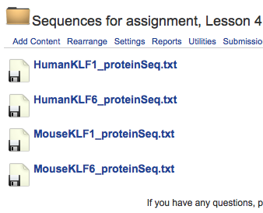
Accessing sequences on Angel site
Click on a name or file icon
Sequence in FastA format appears in window
Copy and paste the sequence into Galaxy, or save the sequence as a txt file on your computer

Slide 16
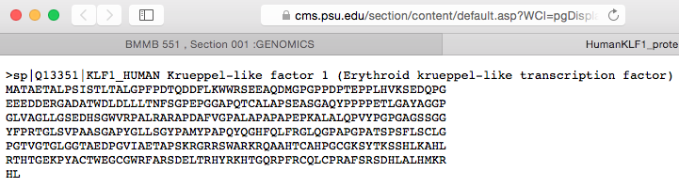
Accessing sequences on Angel site
Click on a name or file icon
Sequence in FastA format appears in window
Copy and paste the sequence into Galaxy, or save the sequence as a txt file on your computer

Slide 17
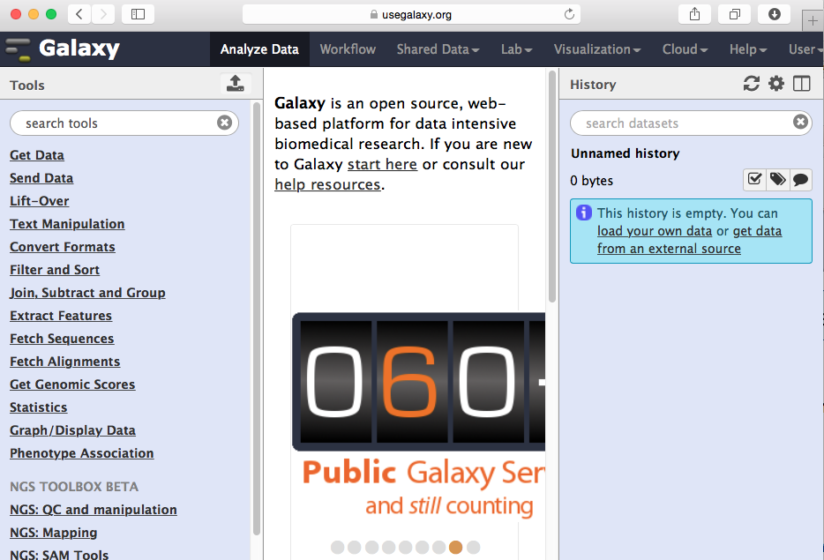
Galaxy interface
https://usegalaxy.org

Slide 18
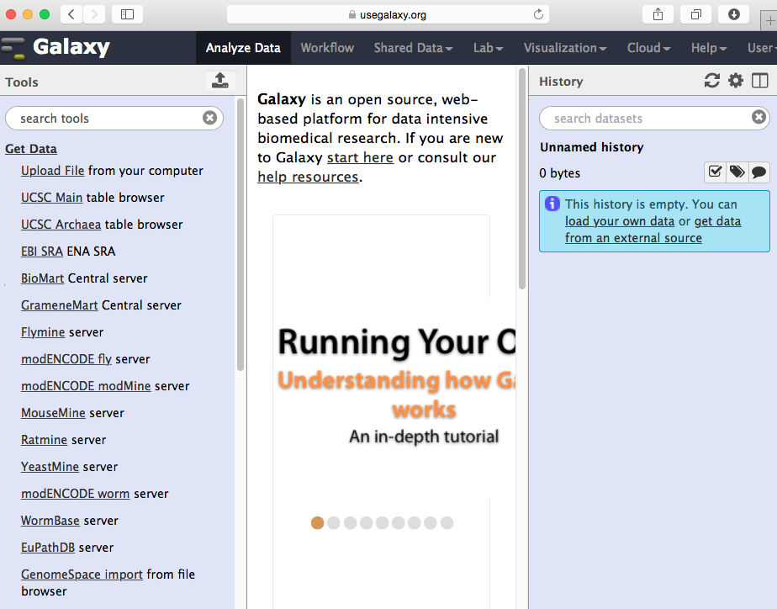
Get data

Slide 19
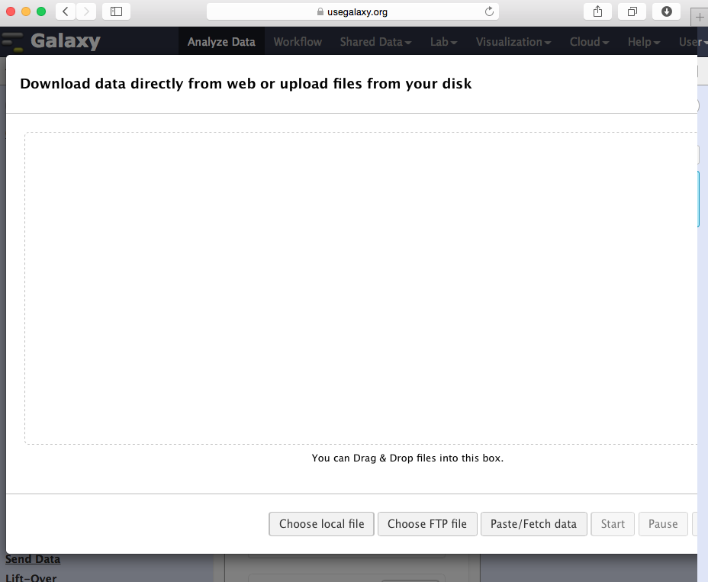
Window for uploading or pasting data

Slide 20
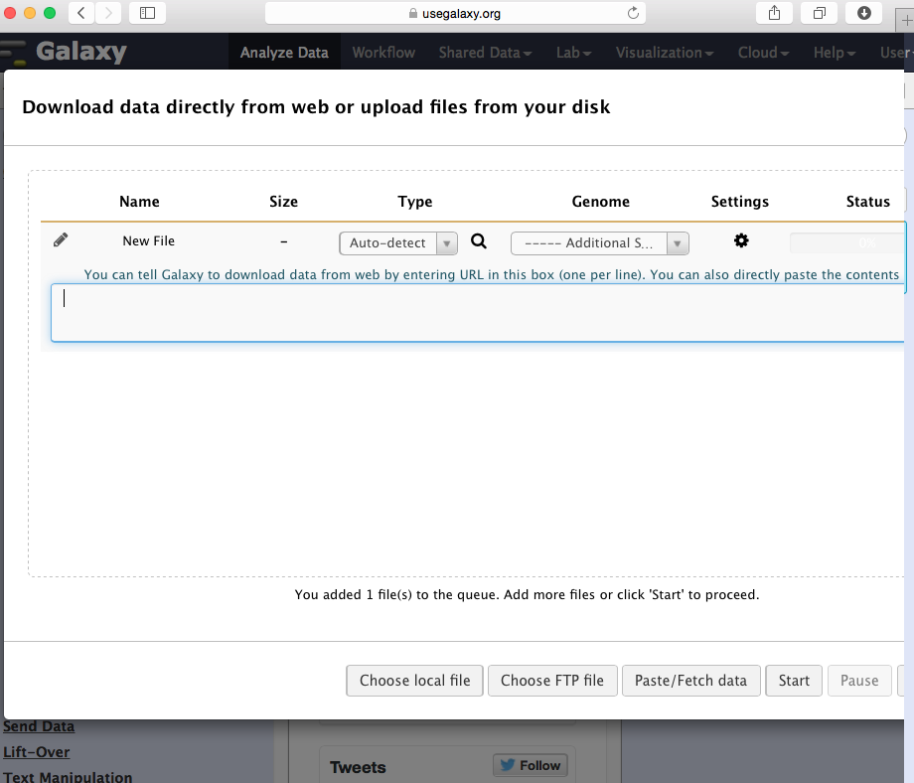
Window for pasting data

Slide 21
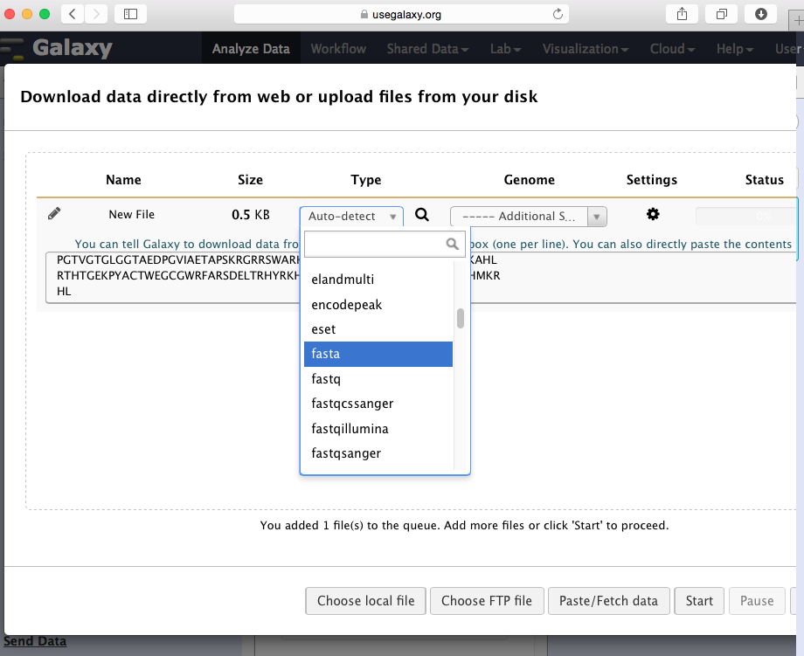
Choose correct file type: fastA

Slide 22
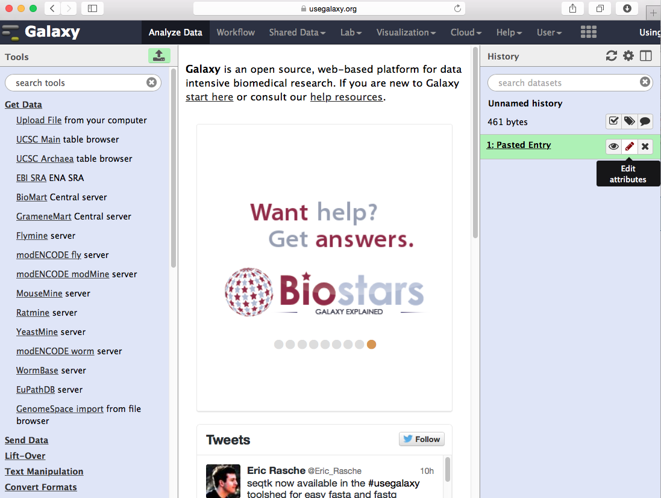
Galaxy history with uploaded sequence: edit attributes

Slide 23
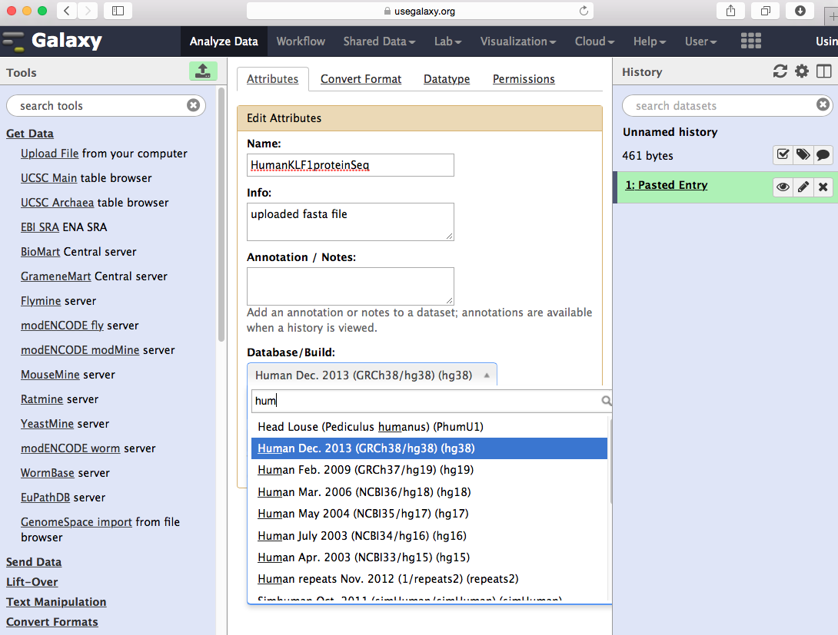
Rename the file, choose genome assembly

Slide 24
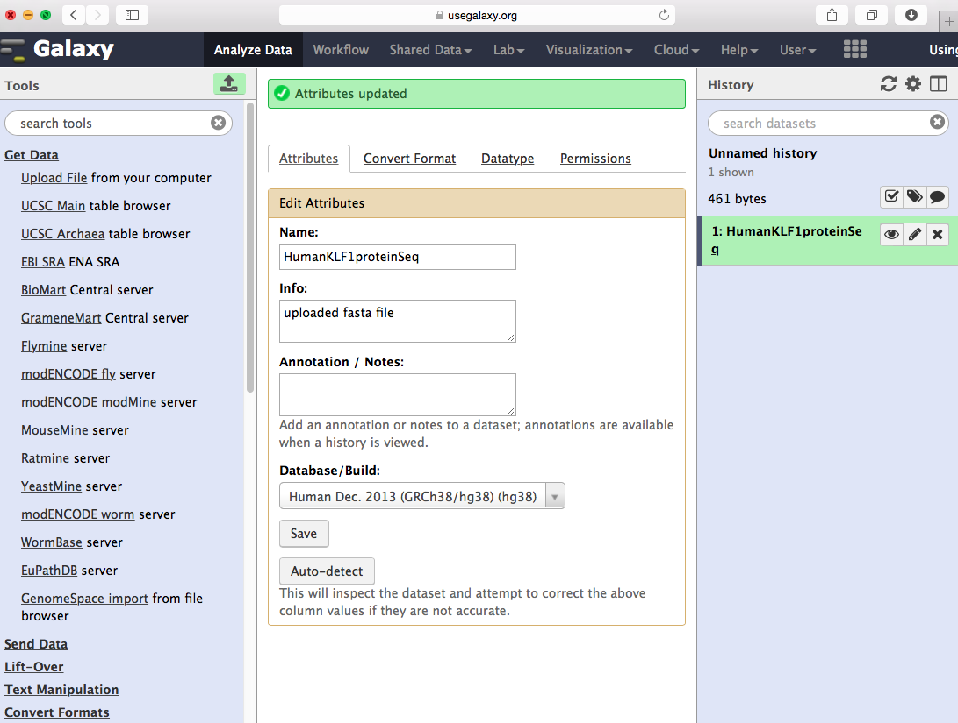
New file name after save

Slide 25
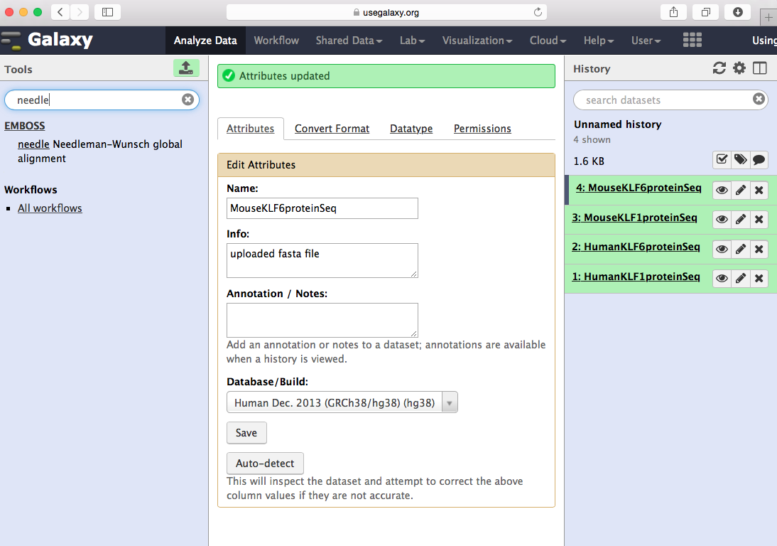
Search for “needle” tool (Needleman-Wuncsh)

Slide 26
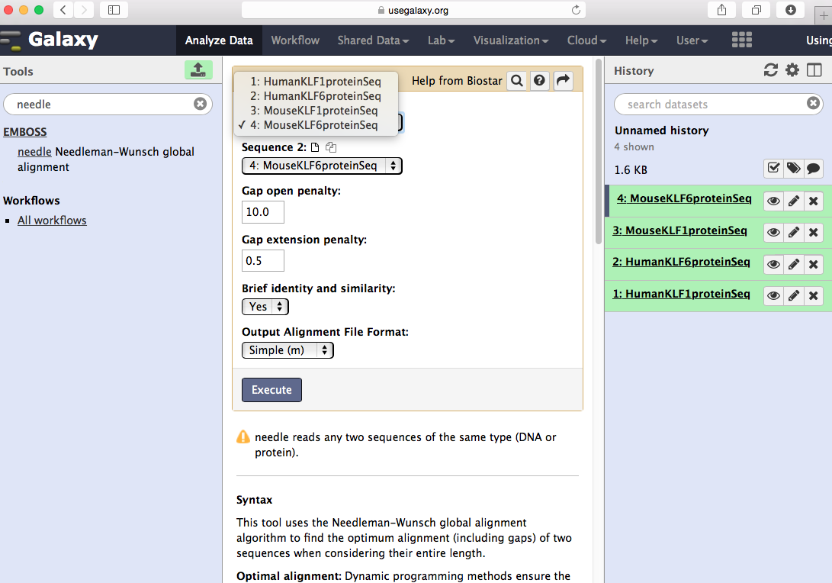
Choose sequences to align

Slide 27
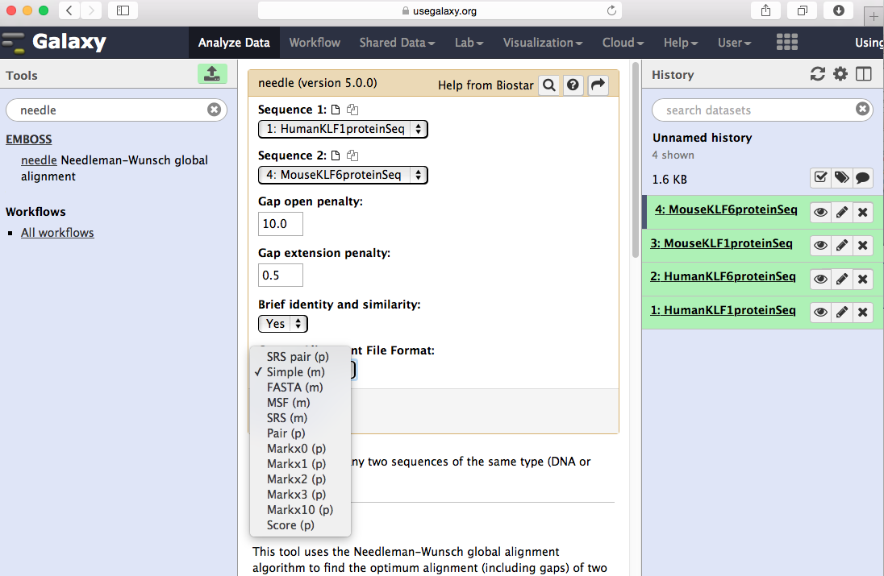
Choose “Simple” output

Slide 28
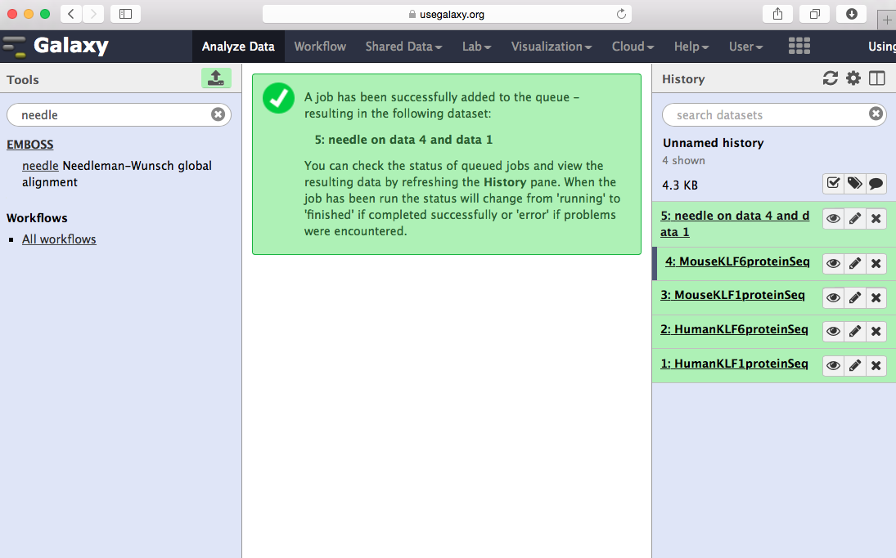
History item 5 has the alignment

Slide 29
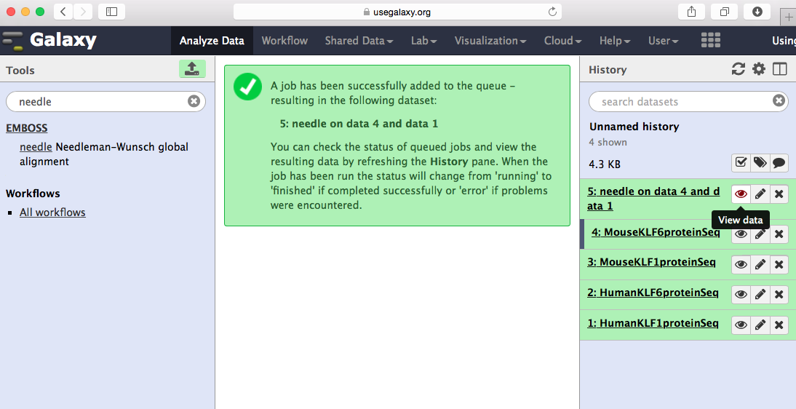
View data by clicking on “eye”

Slide 30
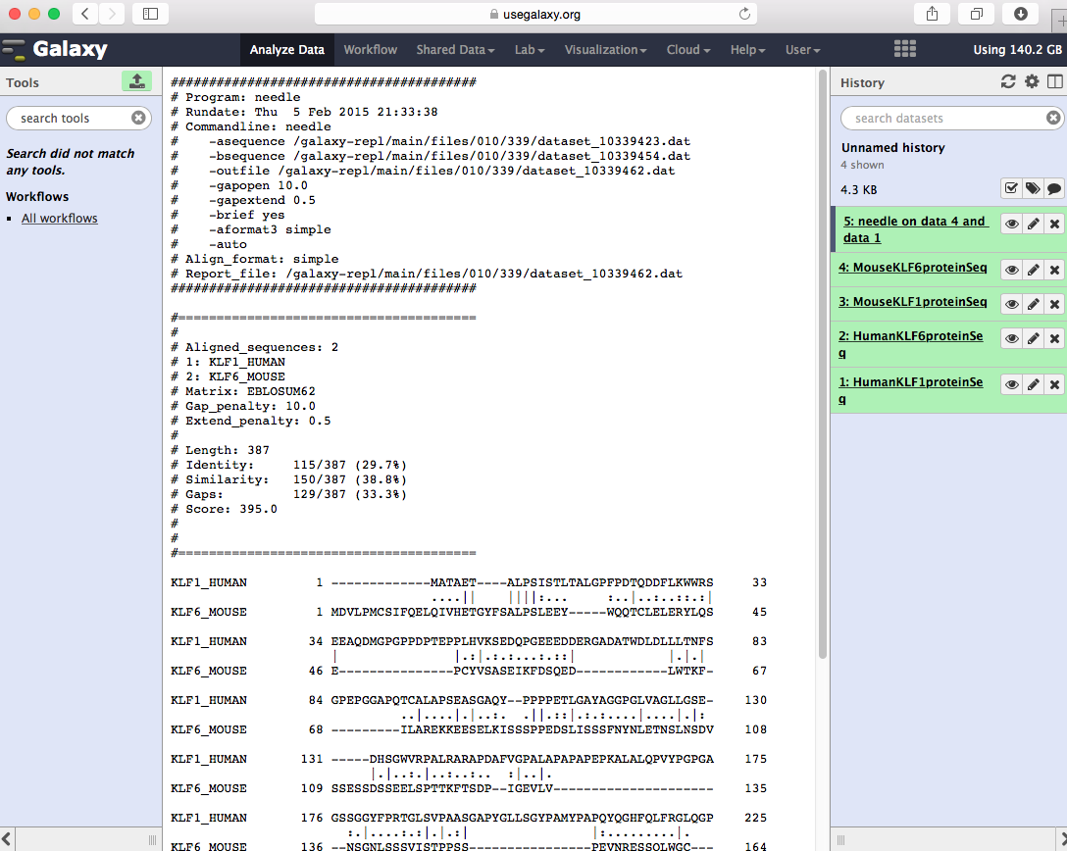
Output lists program and parameters

Slide 31
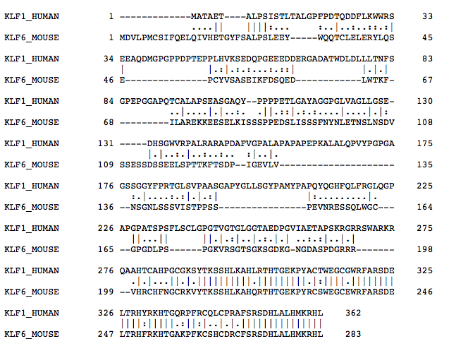
Global alignment of human KLF1 and human KLF6

