Slide 1

An exercise illustrating dynamic programming for alignments
Hardison
Genomics 4_2B
Sources:
Kun-Mao Chao and Luxin Zhang: Sequence Comparisons, Theory and Methods, Springer 2008
Bill Pearson (U. Virginia) CSH Course Computational Genomics

Slide 2
Alignment method needs to fit the problem, part 1
Problem | Features | Method | Example of program
Pairwise alignment of proteins or genes | Moderate size (hundreds of letters), similar throughout | Dynamic programming, find optimal global alignment | Needleman-Wunsch (needle in EMBOSS/Galaxy)
 | Moderate size (hundreds of letters), subsequences similar | Dynamic programming, find optimal local alignment | Smith-Waterman (water in EMBOSS/Galaxy)
Find a match between a query sequence and a database | Query sequence could be hundreds of letters, database has >100M entries | Heuristic approach; find seeds (hits) and extend; local alignments | Blast family of programs; FastA (NCBI)
Find a match between a query sequence that is part of a large genome | Query is 25 or more nucleotides, genome can be 3 billion nucleotides | Heuristic approach, find and extend seeds, but engineered to be very fast | Blat (UCSC Genome Browser)
Align short reads to a genome | 10’s to 100’s of million reads, find best match in an assembled genome | Employ the Burroughs-Wheeler transform for efficient alignments | Bowtie or bwa, both implemented in Galaxy

Slide 3
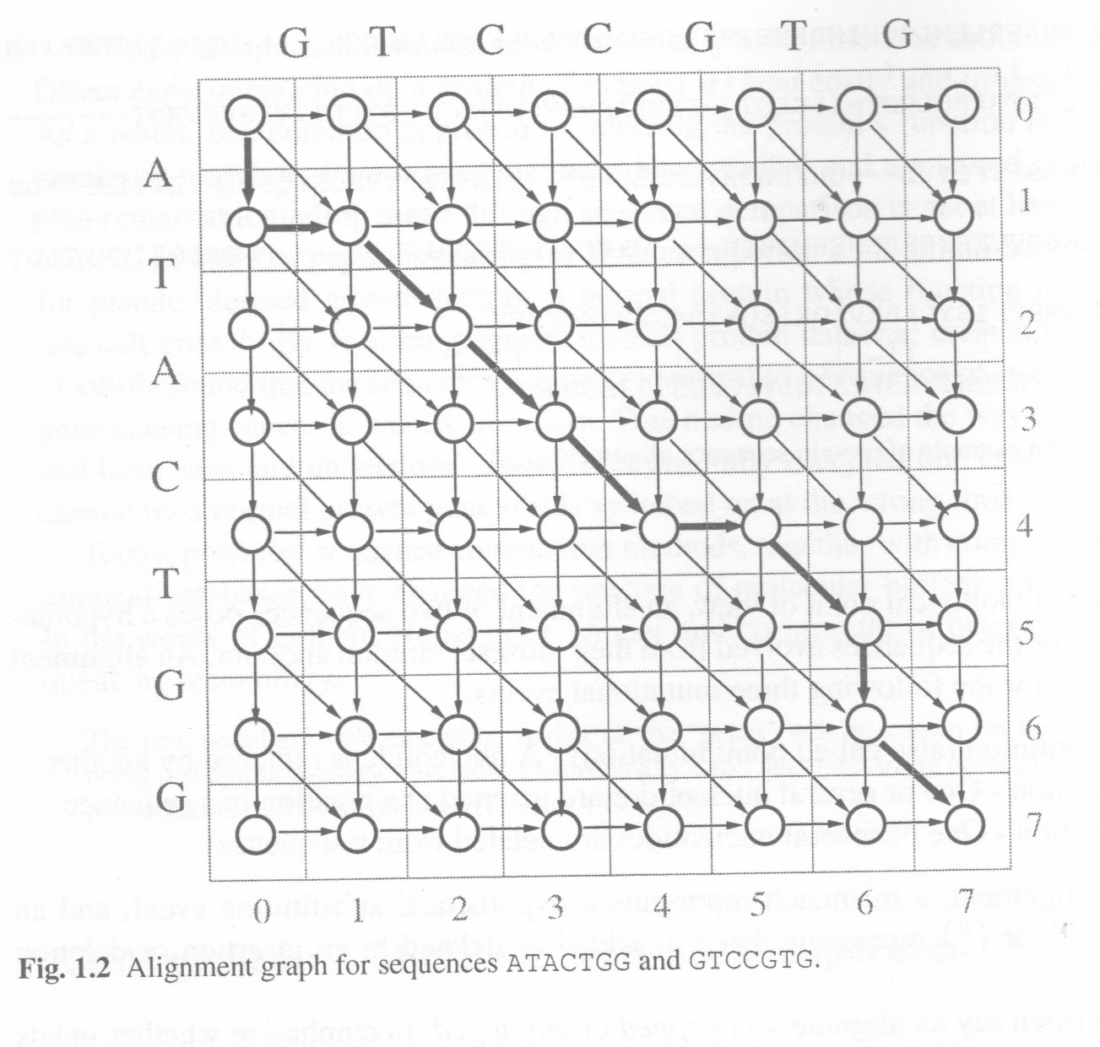
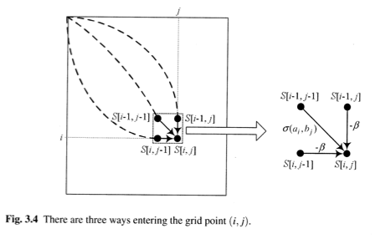
Alignment graphs show exploration of all possibilities
Chao & Zhang, Sequence Comparisons

Slide 4
Illustration of finding highest scoring edge into each node of the matrix

Slide 5
Highest scoring edge into each node of the matrix: the answer

Slide 6
Manual computation of highest scoring alignments between two sequences

Slide 7
Dynamic programming grid: template
In folder for Lesson 4, course Angel site

Slide 8
Sequences, scoring matrix, and programming grid

Slide 9
Initial scores along outer edges

Slide 10
Find maximal scores for first row with matches

Slide 11
Maximal scores for first row with matches: answer

Slide 12
Now fill out the rest of the matrix

Slide 13
The full matrix with maximal scores in each node and scores along each edge
Note: This was done manually, so there could be mistakes. Let me know if you find some!!

Slide 14
Highlight high-scoring paths through the matrix

Slide 15
Trace back a path for a highest-scoring alignment
+4 -2 = +2

Slide 16
A different path gives another alignment with the same highest score
+4 -2 = +2

