Slide 1

Sequence alignments: Scoring schemes and basic approaches
Hardison
Genomics 4_1
Sources: Webb Miller (Penn State)
Kun-Mao Chao and Luxin Zhang: Sequence Comparisons, Theory and Methods, Springer 2008
Bill Pearson (U. Virginia)
Vladimir Lukic (U. Melbourne)
Colleen O’Rourke and Shaun Mahony (Penn State)

Slide 2
Examples of use of alignments in genomics
Genome assembly; transcript assembly
Searching for related proteins or genes (blast)
Comparisons within and between species
  Finding sequence variants within species
  Infer functional sequences (constraint and adaptation)
Mapping function-associated sequences back to a reference genome
  Locations of transcription factor occupancy
  Mapping transcribed regions
  Sequence census: count number of short sequencing reads that map to the same location

Slide 3
Definition of alignments
Alignment
  A mapping of one sequence onto at least one other sequence to bring out similarities.
  An alignment column can contain matches, mismatches or gaps.
Global alignment
  The mapping extends throughout the sequences.
  Appropriate when the sequences are homologous throughout their lengths.
Local alignment
  The mapping is limited to the regions (subsequences) of highest similarity.
  Examples
    Database searches
    Finding exons in genomic DNA when mRNA is known
    Genomic sequence comparisons when rearrangements are present.

Slide 4
Alignment method needs to fit the problem, part 1
Problem | Features | Method | Example of program
Pairwise alignment of proteins or genes | Moderate size (hundreds of letters), similar throughout | Dynamic programming, find optimal global alignment | Needleman-Wunsch (needle in EMBOSS/Galaxy)
 | Moderate size (hundreds of letters), subsequences similar | Dynamic programming, find optimal local alignment | Smith-Waterman (water in EMBOSS/Galaxy)
Find a match between a query sequence and a database | Query sequence could be hundreds of letters, database has >100M entries | Heuristic approach; find seeds (hits) and extend; local alignments | Blast family of programs; FastA (NCBI)
Find a match between a query sequence that is part of a large genome | Query is 25 or more nucleotides, genome can be 3 billion nucleotides | Heuristic approach, find and extend seeds, but engineered to be very fast | Blat (UCSC Genome Browser)
Align short reads to a genome | 10’s to 100’s of million reads, find best match in an assembled genome | Employ the Burroughs-Wheeler transform for efficient alignments | Bowtie or bwa, both implemented in Galaxy

Slide 5
Alignment method needs to fit the problem, part 2
Problem | Features | Method | Example of program
Whole genome alignment | Each sequence can be very long, multiple rearrangements between them | Compute enormous number of local alignments, then chain them together | multiZ, TBA: use the precomputed alignments at UCSC Browser
 |  | Break genomes into regions of conserved synteny, run global aligner | Lagan, EPO (from EBI): use precomputed alignments at Ensembl
Multiple alignment | “Handful” of sequences that are similar throughout | Progressive, global alignments | ClustalW (one implementation is at EBI)
De novo assembly of genomes and transcriptomes | From 10’s of millions of short sequence reads, assemble genome or transcripts; no reference genome | Use De Bruijn graphs as foundation, other methods to refine assembly | Genome: Velvet…Transcriptome: Trinity suite of programs, from the Broad Institute

Slide 6
Substitution scores and gap penalties
Pairwise alignments

Slide 7
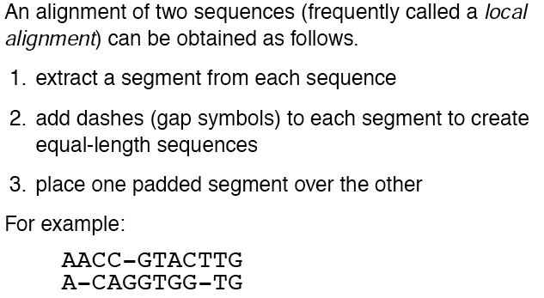
Making a local alignment
W. Miller

Slide 8

Alignment scores
To distinguish between “good” and “bad” alignments, we need a rule that assigns a numerical score to any alignment. The higher the score, the better the alignment.
Simple rule:
  Match scores +1
  Mismatch or gap scores -1
  Following alignment scores +2
W. Miller

Slide 9
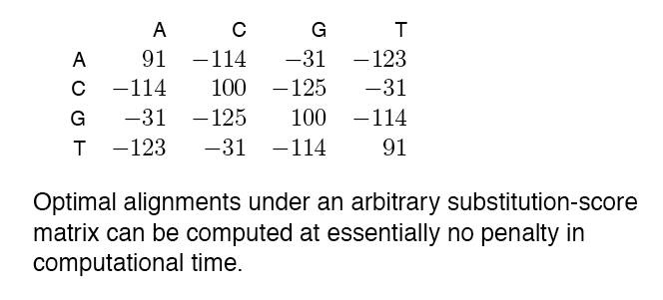
Substitution score matrix
More flexibility with a substitution-score matrix
W. Miller

Slide 10
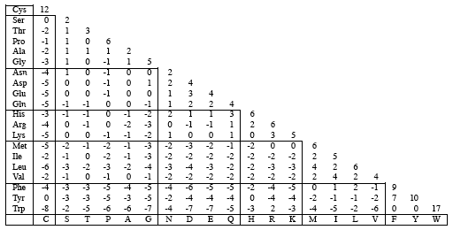
Substitution score matrix for amino acids
PAM 250 Matrix
W. Miller

Slide 11
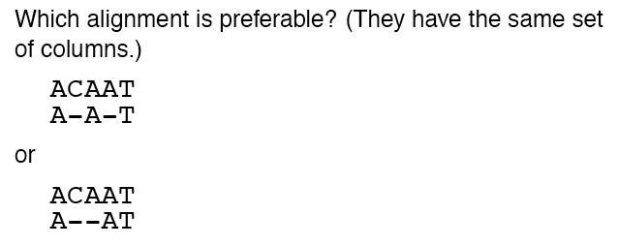
Dealing with gaps in alignments
W. Miller

Slide 12
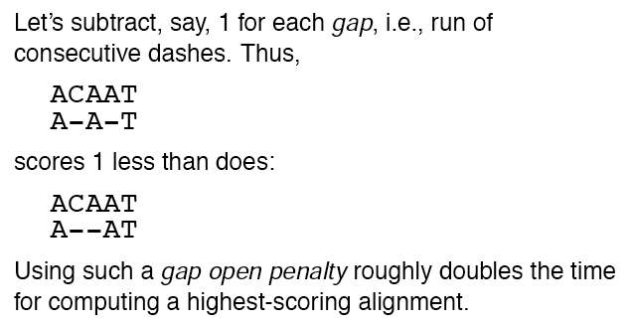
Gap open penalty
W. Miller

Slide 13
Affine gap penalties
Penalize gap opening more than gap extension
Penalty = q + rk
q is gap open penalty
r is gap extension penalty
k is the length of the gap
W. Miller

Slide 14
Basic approaches to alignments
Pairwise alignments

Slide 15
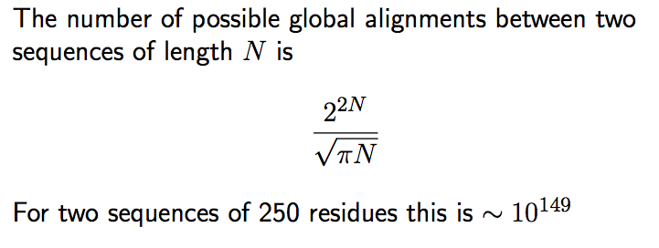
Brute force alignments?
You could find optimal alignments by computing scores for all possible alignments
Effectively impossible for even moderately long sequences
http://www.ludwig.edu.au/course/lectures2005/Likic.pdf
V. Lukic

Slide 16
Optimal alignments
Given a scoring rule, for any 2 sequences we can compute the highest scoring alignment, using dynamic programming
  “programming” in the sense of finding an optimal plan of action; “dynamic” in that choices may depend on current state
  Breaks a problem into smaller subproblems
  Find an optimal solution to subproblems
  Use solutions to subproblems to find solution to original problem
Global alignments: Needleman and Wunsch, 1970
  Program “needle” under EMBOSS in Galaxy
Local alignments: Smith and Waterman, 1981
  Program “water” under EMBOSS in Galaxy
Require time proportional to the lengths of the 2 sequences: O(nm), where n and m are the sequence lengths

Slide 17
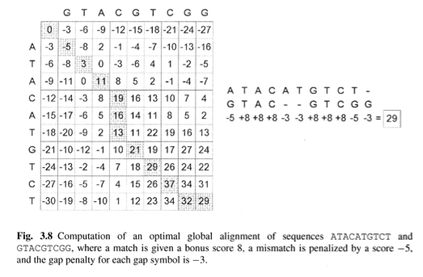
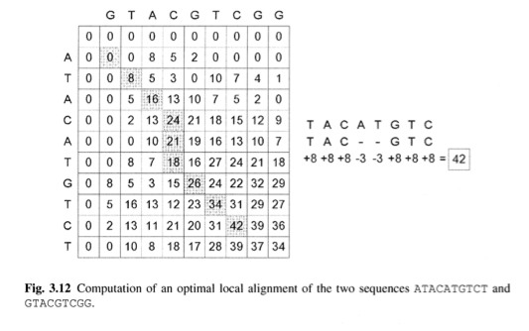
Optimal global and local alignments
Chao & Zhang, Sequence Comparisons

Slide 18
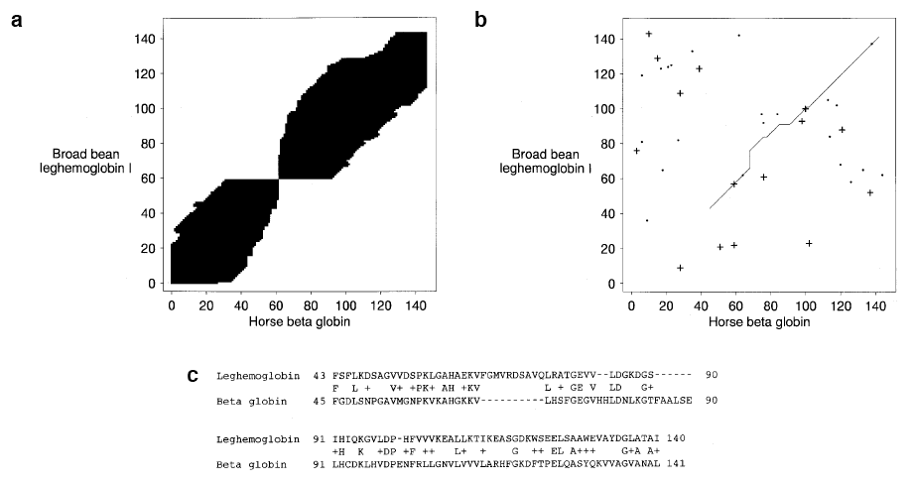
Heuristics for efficient computation of high quality, close to optimal alignments
Find initial seeds or hits, and extend these judiciously
Do not consider every possible alignment
Greater efficiency is good for database searches, etc.
Blast, FastA; Blat
Altschul et al. BLAST2

Slide 19
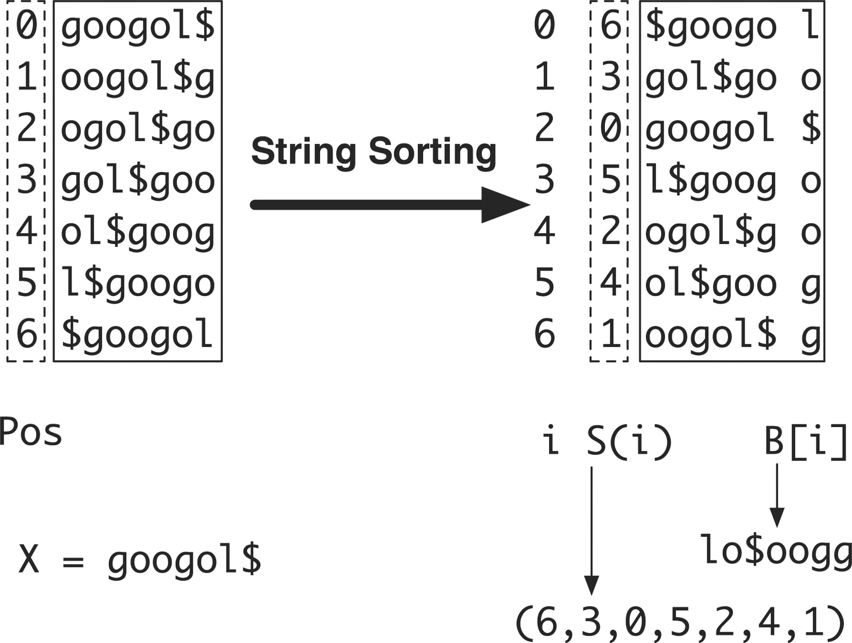

Burrows-Wheeler transform allows very efficient mapping of 100’s of millions of reads
Constructing suffix array and BWT string for X=googol$.
Li H , Durbin R Bioinformatics 2009;25:1754-1760
Notes:
Constructing suffix array and BWT string for X=googol$. String X is circulated to generate seven strings, which are then lexicographically sorted. After sorting, the positions of the first symbols form the suffix array (6, 3, 0, 5, 2, 4, 1) and the concatenation of the last symbols of the circulated strings gives the BWT string lo$oogg.

Slide 20
Summary on alignment basics
Choose the best alignment strategy for the problem you are studying
  Global: all characters (nucleotides or amino acids) in one sequence are aligned with a character (or gap) in the other sequence. Use this if the entirety of one sequence is similar to the entirety of the second sequence.
  Local: only high-scoring runs of characters are retained. Use this if sub-sequences are similar.
Scoring schemes
  Objective assessment of quality of alignments
  Range from simple to complex
  Commonly used scoring matrices are learned from existing high-quality alignments
  Affine gap penalties are more realistic than penalizing each gap in a run of gaps
Multiple methods have been developed to obtain close to optimal alignments of two sequences, even for very long sequences and large databases.

