Slide 1

DNA Sequencing
Second generation techniques
Hardison
Genomics 3_2

Slide 2
Second generation sequencing
Michael Metzker review
(2010) Nature Reviews Genetics 11: 31-46

Slide 3
Two generations of sequencing technology
Feature | First generation | Second generation
Isolate DNA fragments to sequence | Cloning in bacteria to generate many copies of the same DNA sequence, usually as a recombinant plasmid | Physical cloning to generate thousands of copies of a DNA molecule, separated on beads on or as positions on a flow cell
Purification of clones? | Prepare the plasmids from each bacterial clone | No need for plasmid preparation
DNA sequencing approach | Sequencing by synthesis or by base-specific degradation | Sequencing by synthesis, pyrosequencing, or ligation (SOLiD)
Method of detection | Electrophoresis to separate by size; fluorescent dyes | Light detection at each cycle of synthesis
Number of clones sequenced in parallel | scores to hundreds | hundreds of millions

Slide 4
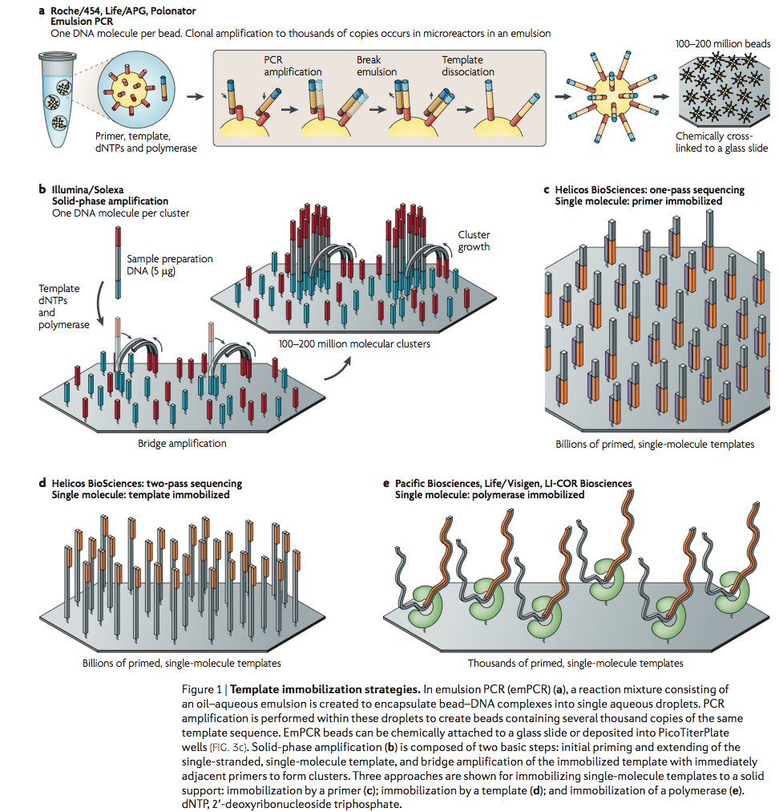
Templates: Physical clones or single molecules
No need for molecular clones (e.g. plasmids in bacteria)

Slide 5
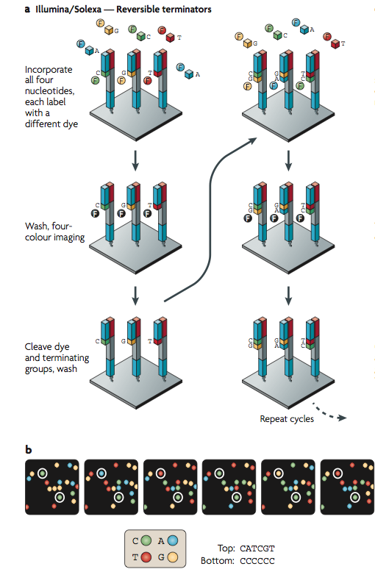
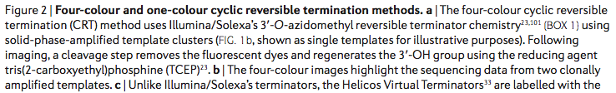
Four color cyclic reversible termination in Illumina sequencing

Slide 6
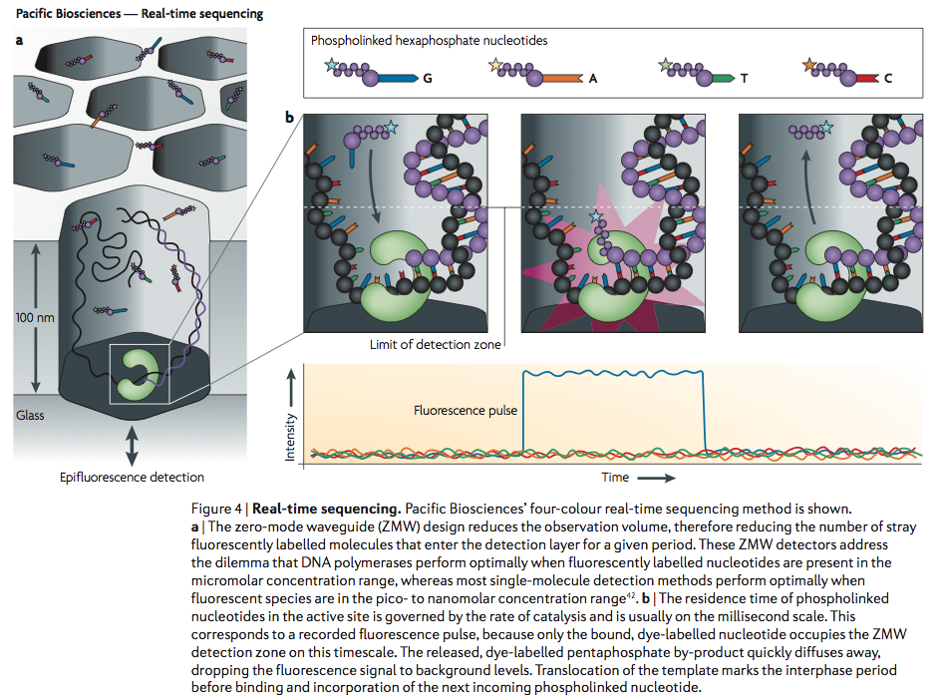
Pacific Biosciences: Long reads from single molecules
Low accuracy (~85%)

Slide 7
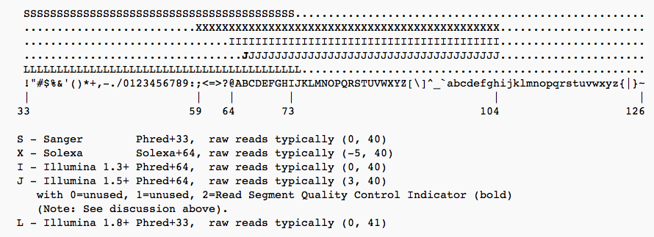
Sequence files with quality scores
FASTQ format
@SequenceName
Sequence in 1 letter code
Optional sequence name
Phred quality score in 1 letter ASCII code
@M00539:11:000000000-A1VFM:1:1101:13898:1904 1:N:0:1
GTGAGACCACTCTACACATCTCAACGAAATGTCCTATCCCTGTGTGCAGG
+
?????BB?DDDDDBDBFFFFFFCFHHHHBHGHFHHHHHHHGFHHGHHFHH
@M00539:11:000000000-A1VFM:1:1101:14998:1904 1:N:0:1
TATTCTCTGTACTTTGACTCATTGTGAGTCCCTGTATCAACCACCTTCC
+
?AAAABBBEDDDDEDDGGGGGGHIHIFHIIIIIFHHGHFGHIEFHIIIH
Encoding quality scores, from Wikipedia article on FASTQ:

Slide 8
Second generation sequencing on the Illumina platform
Includes material from Illumina
and from Cheryl A. Keller, PhD
Project manager and research associate
Center for Comparative Genomics and Bioinformatics
Department of Biochemistry and Molecular Biology
Penn State University

Slide 9
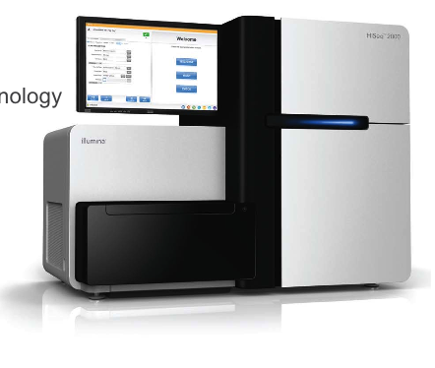
The HiSeq2000
Output (as of about 2012)
  Up to 600 Gb/run
Number of reads
  3 billion single end reads
  6 billion paired end reads
Sequencing data can be used for a variety of functional genomics assays
  Transcription factor binding
  DNA methylation
  Histone modifications
  Nucleosome mapping
  Genome resequencing
  Transcriptome analysis
  microRNA profiling
Dan Gheba

Slide 10
Illumina
Sample
Preparation
Cluster
Generation
Sequencing
Data Analysis
Sample Preparation
Cluster Generation
Sequencing By Synthesis (SBS)
Data Analysis

Slide 11
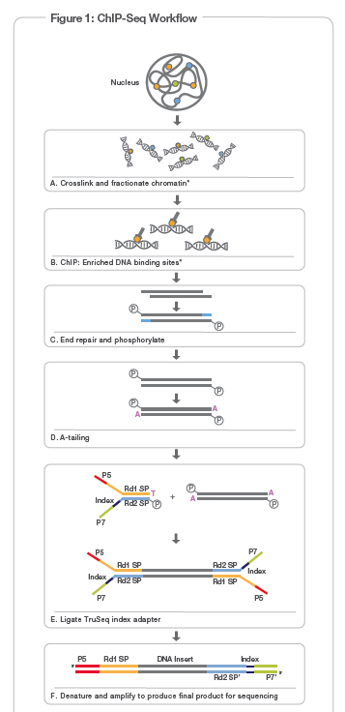

Slide 12
Single Read (SR) vs. Paired End (PE) sequencing
Read 1 SP
SR sequencing
- 50 bp reads
- Only forward strands are read in each cluster
Read 1 SP
PE sequencing
- 2 x 100 bp reads
- Forward and reverse strands are read in each cluster
- Allows for highly precise alignment of reads
Read 2 SP

Slide 13
Quality control checks
  Bioanalyzer
  qPCR quantification
Why check the size of your library?
  Only fragments in a certain size range can form clusters
  250-300 bp is ideal
  Need size data for accurate mapping and peak calling
Notes:
The Bioanalyzer is a chip-based capillary electrophoresis machine to analyse RNA, DNA, and protein.
Data plot of migration time versus fluorescence intensity.

Slide 14
Quality control checks
  Bioanalyzer
  qPCR quantification
Quantitative PCR
  Real time PCR
  Used to simultaneously amplify and quantify
Why use qPCR for quantification of a library?
  Only amplifies molecules capable of cluster formation on the flow cell
  Enables more precise control over cluster density, which is crucial to obtaining high quality sequence reads
Illumina qPCR_Quantification_Guide_11322363_B

Slide 15
Cluster Generation
Sample
Preparation
Cluster
Generation
Sequencing
Data Analysis
Automated cluster generation systems
  Clonal amplification of template
Flow cell
  Proprietary
  Solid surface containing covalently-bound adapters to which templates attach
Cluster generation
  Process by which attached DNA fragments are extended and bridge amplified to create hundreds of millions of clusters, each of which contains ~1,000 identical copies of a single template molecule.

Slide 16
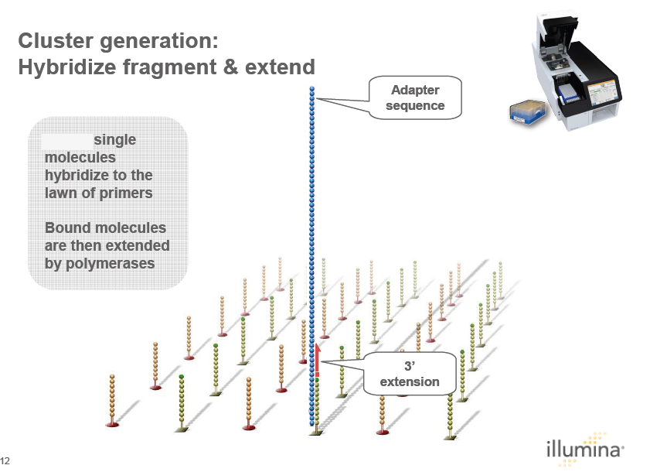

Slide 17
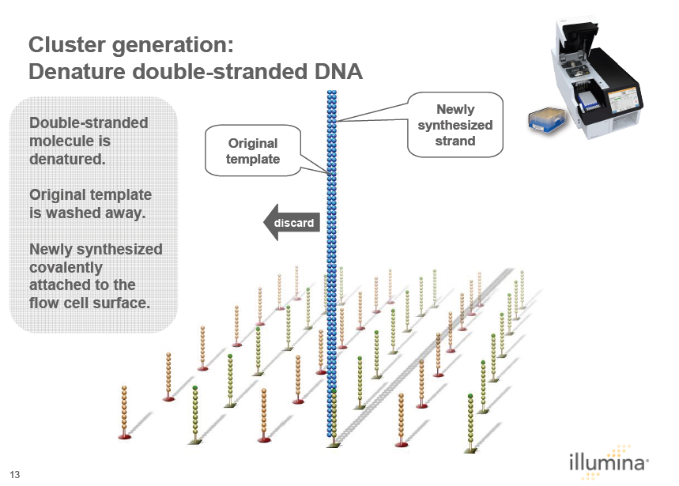
Joe Alessi

Slide 18
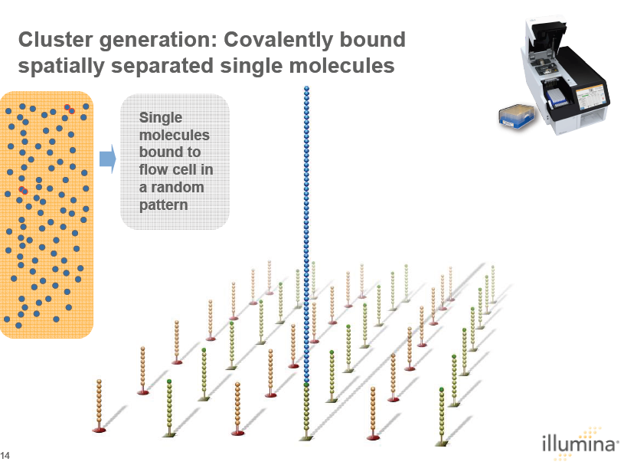
Joe Alessi

Slide 19
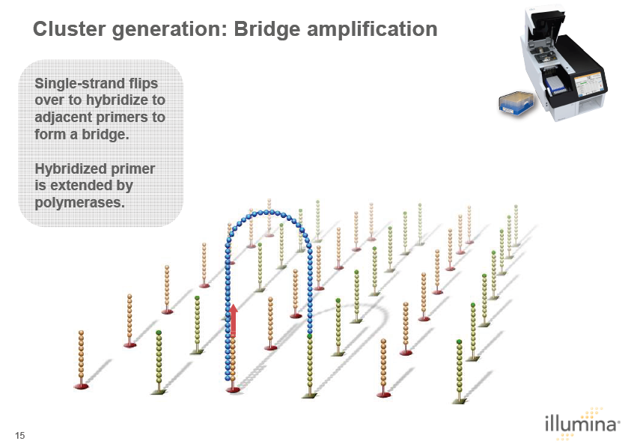
Joe Alessi

Slide 20
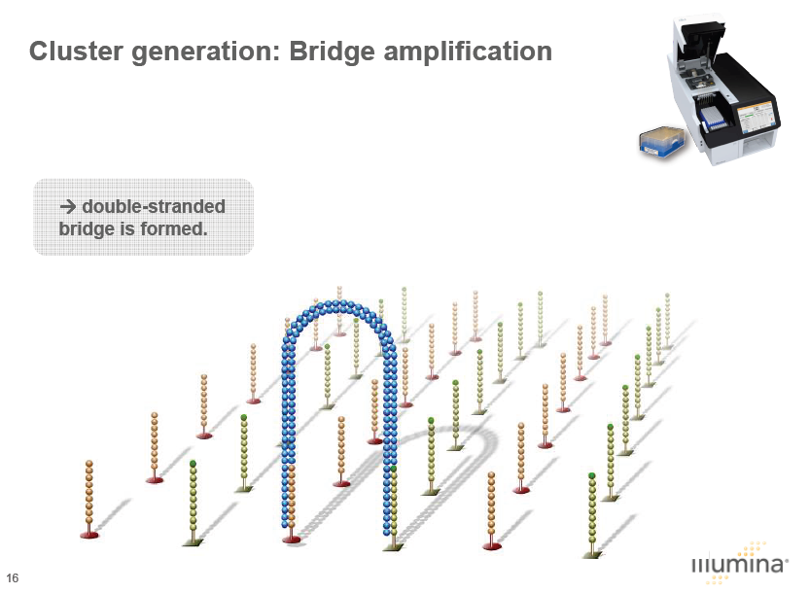
Joe Alessi

Slide 21
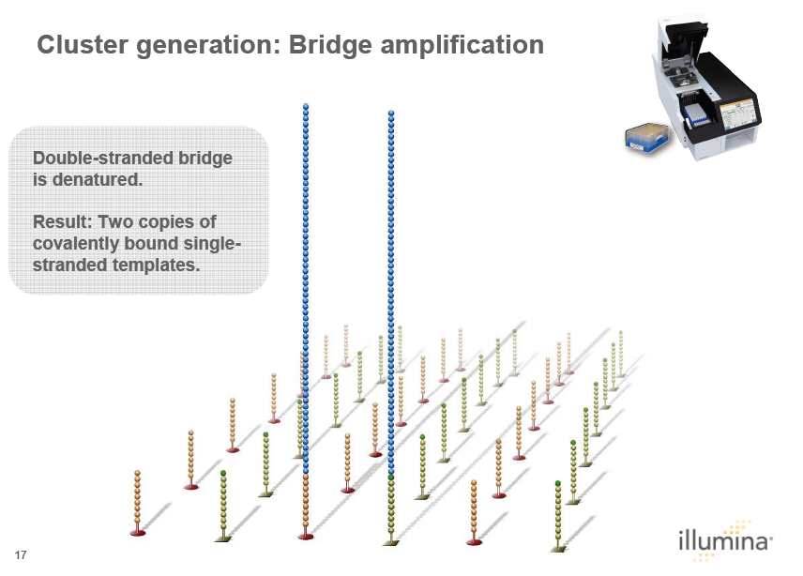
Joe Alessi

Slide 22
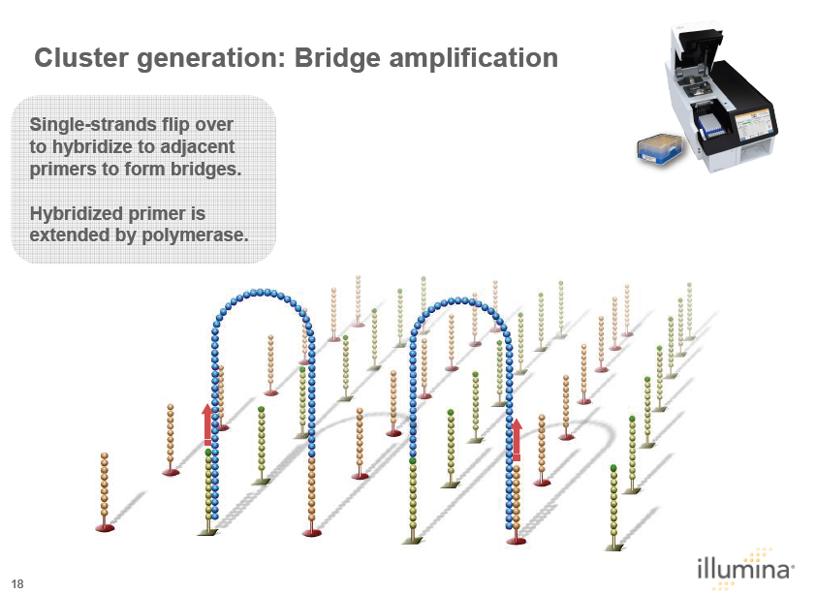
Joe Alessi

Slide 23
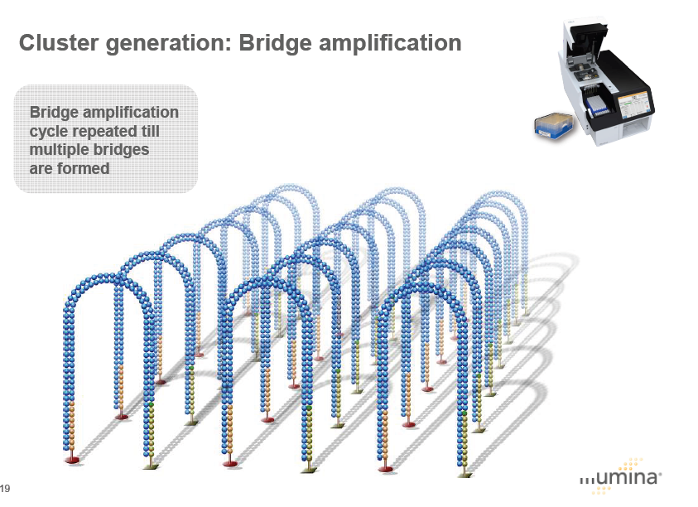
Joe Alessi

Slide 24
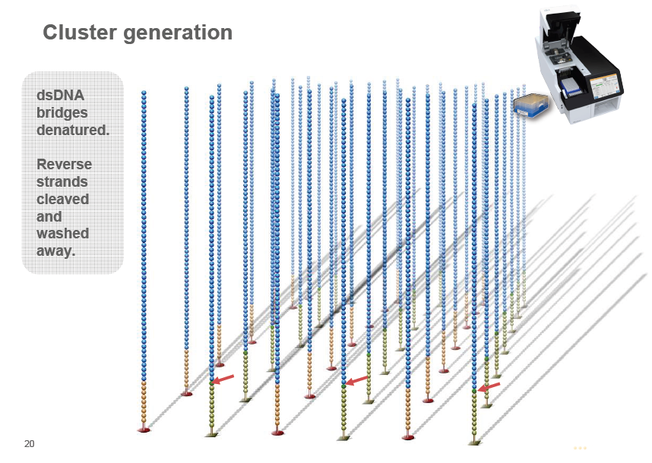
Joe Alessi

Slide 25
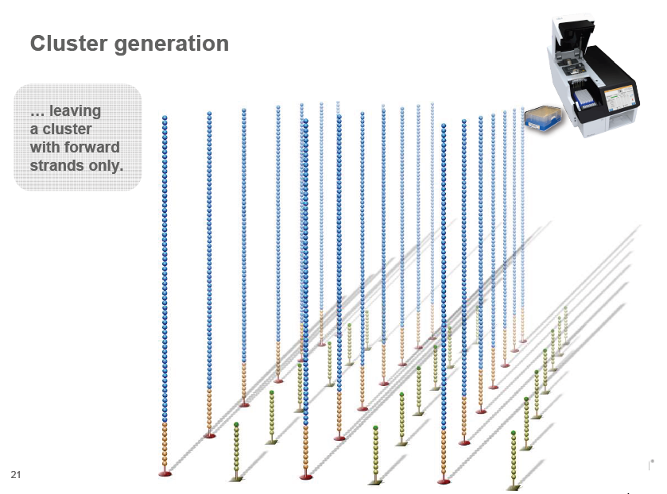
Joe Alessi

Slide 26
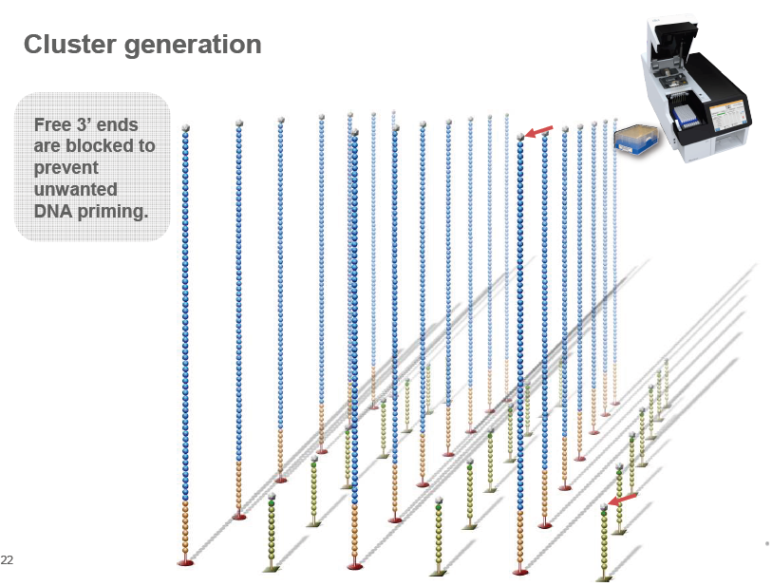
Joe Alessi

Slide 27
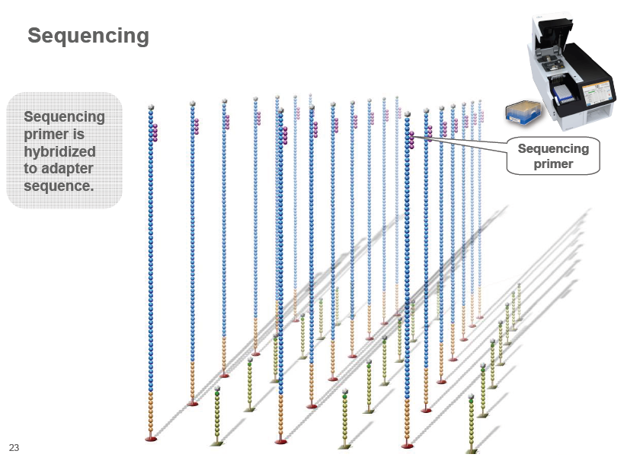
Joe Alessi

Slide 28
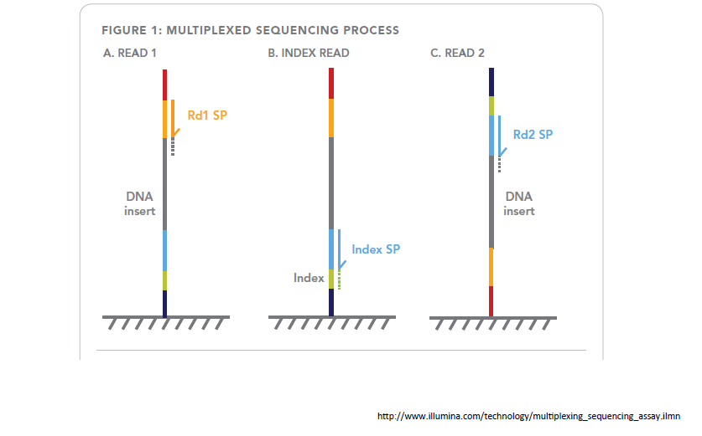
Sequencing of a paired-end indexed sample requires 3 reads

Slide 29
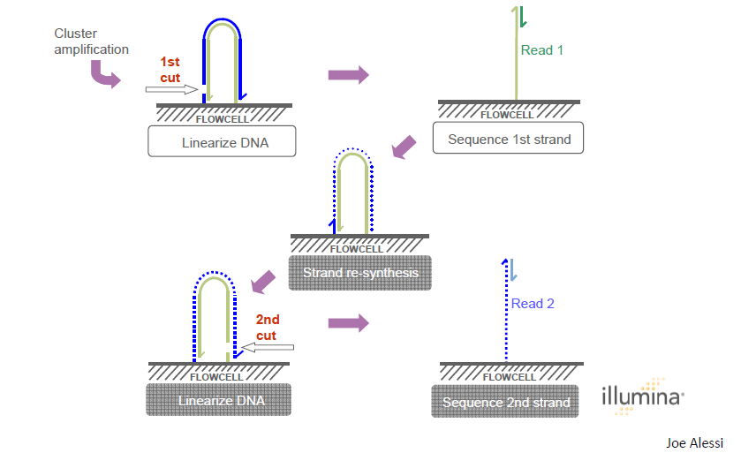
Second round of cluster amplification of a paired end library occurs directly on the HiSeq2000

Slide 30
Sequencing
Sample
Preparation
Cluster
Generation
Sequencing
Data Analysis
Starting a run
HiSeq Control Software (HSC)
Sequencing By Synthesis (SBS)
Real Time Analysis (RTA)
Monitoring the run
Data Metrics

Slide 31
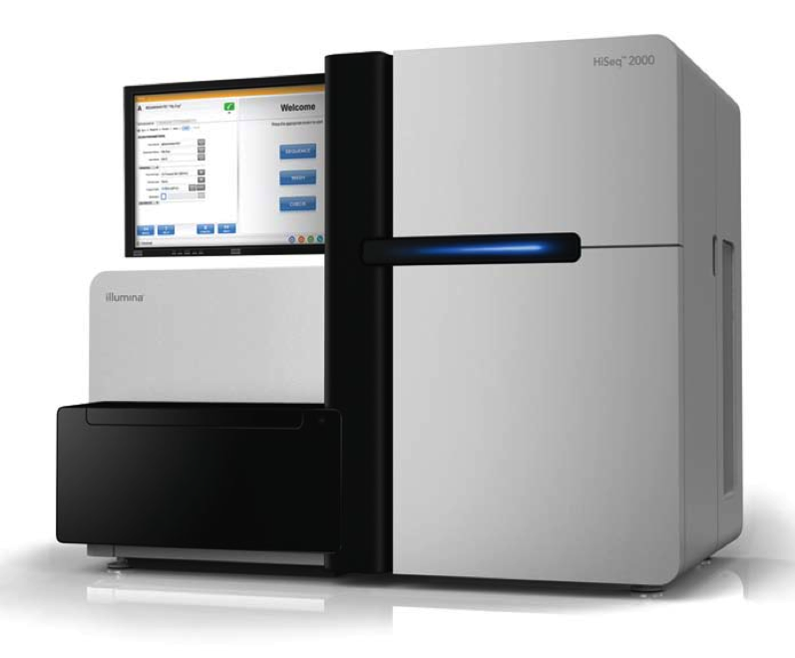
Sequencing By Synthesis (SBS)
  Chemistry/incorporation
  Imaging
  Cleavage

Slide 32
Sequencing By Synthesis (SBS)
  Chemistry/incorporation
  Imaging
  Cleavage
Joe Alessi

Slide 33
Sequencing By Synthesis (SBS)
  Chemistry/incorporation
  Imaging
  Cleavage
Joe Alessi

Slide 34
Sequencing By Synthesis (SBS)
  Chemistry/incorporation
  Imaging
  Cleavage
Joe Alessi

Slide 35
Sequencing By Synthesis (SBS)
  Chemistry/incorporation
  Imaging
  Cleavage
Joe Alessi

Slide 36
Real Time Analysis (RTA)
  Clusters
  Basecalling
Bjoern Hihn

Slide 37
Real Time Analysis (RTA)
  Clusters
  Basecalling
Joe Alessi

Slide 38
Real Time Analysis (RTA)
  Clusters
  Basecalling
RTA will be ready to call a base if:
Color matrix has been generated (corrects for cross-talk between channels)
Phasing has been calculated
Cluster intensity file for that cycle exits
Joe Alessi
Notes:
Since all four reversible terminator-bound dNTPs are present during each sequencing cycle, natural competition minimizes incorporation bias. Base calls are made from signal intensity measurements for each cycle.
Phasing = RTA assumes that a fixed fraction of molecules in each cluster become "phased" at
each cycle, in the sense that those molecules fall one base behind in sequencing.
RTA will be ready to call a base if:
Color matrix has been generated for that tile (corrects for cross-talk between channels)
Phasing has been calculated
CIF file exits

Slide 39
Real Time Analysis (RTA)
  Clusters
  Basecalling
Fluorescent intensity of each base during the first 4 cycles is used to generate a base-calling algorithm
  Illumina cluster detection algorithms are optimized around a balanced representation of A, T, G, C
  If samples are not balanced, one should select a balanced sample as a control lane
  Algorithm must account for “cross-talk” or overlap between channels because the excitation and emission spectrums for each base overlap
RTA assumes that a fixed fraction of molecules in each cluster become "phased" at each cycle, in the sense that those molecules fall one base behind in sequencing.
Joe Alessi
Notes:
Since all four reversible terminator-bound dNTPs are present during each sequencing cycle, natural competition minimizes incorporation bias. Base calls are made from signal intensity measurements for each cycle.
Phasing = RTA assumes that a fixed fraction of molecules in each cluster become "phased" at
each cycle, in the sense that those molecules fall one base behind in sequencing.
RTA will be ready to call a base if:
Color matrix has been generated for that tile (corrects for cross-talk between channels)
Phasing has been calculated
CIF file exits

Slide 40
Data Metrics
What kind of information can be monitored?
  Cluster density – must be able to resolve individual clusters
  Intensity values – strength of fluorescent signal
  Flowcell chart – can monitor intensity values and cluster density for each lane using a heat map scale
  % base – indication of G-C balance
  Q scores – measures the quality of a given base
    A Q score of 30
      Probability of incorrect base call = 1 in 1000
      Inferred base call accuracy = 99.9%
Notes:
Qscore = Quality scoring refers to the process of assigning a quality score to each base call. For example Q30 equates
to an error rate of 1 in 1000, or 0.1% and Q40 equates to an error rate of 1 in 10,000 or
0.01%.
%base = Displays bases read
Intensity values = displays intensity of bases read
FWHM—Displays the focus quality, as indicated by the full width
at half maximum of clusters (in pixels).

Slide 41
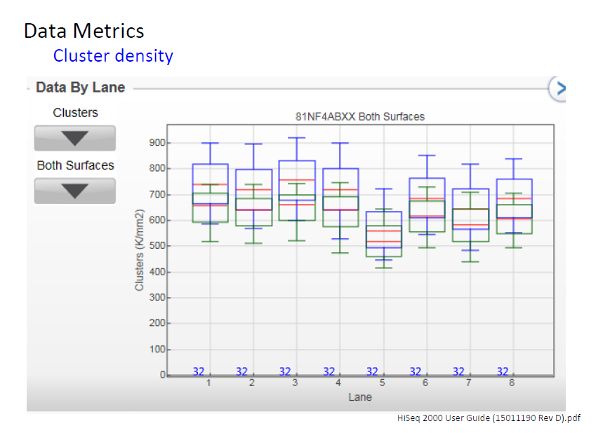

Slide 42
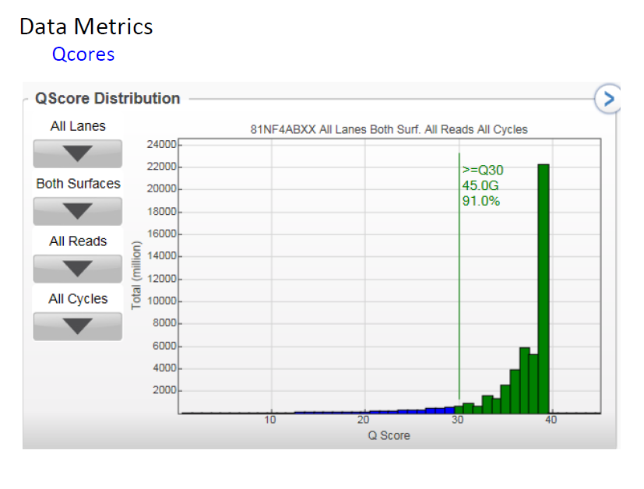

Slide 43
Illumina
Sample
Preparation
Cluster
Generation
Sequencing
Data Analysis
Sample Preparation
Cluster Generation
Sequencing By Synthesis (SBS)
Data Analysis
  Bcl to Fastq conversion
  Demultiplexing (if necessary)
  Bioinformatic analysis

Slide 44
A few take home points…
Illumina
Sample
Preparation
Cluster
Generation
Sequencing
Data Analysis
Sample prep involves the ligation of a forked adaptor to size- selected fragments of interest.
Accurate sample quantification is crucial to the success of a run.
Illumina uses a reversible terminator SBS based chemistry.
Samples should be GC-balanced for accurate basecalling.
Run data metrics can be monitored to determine success of a run.

