Slide 1

DNA Sequencing
First generation techniques
Hardison
Genomics 3_1

Slide 2
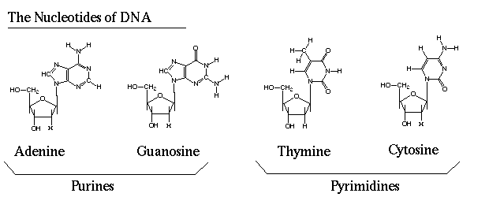
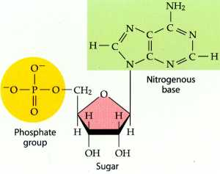
Building blocks of DNA
nucleosides
A nucleotide has one or more phosphates attached to the 5’ hydroxyl of the (deoxy)ribose

Slide 3
Structure of a dinucleotide
The 3’ C of one nucleotide is linked to the 5’ C of the next nucleotide in a phosphodiester linkage. This repeats up to hundreds of millions of times in a linear chain for each strand of DNA.

Slide 4
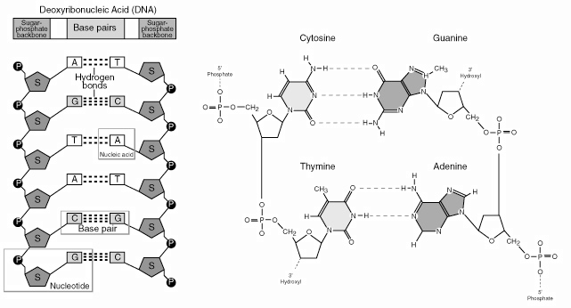

Pairing of the bases

Slide 5
Implications of complementarity
One chain (strand) of DNA can serve as the template for synthesis of the complementary chain.
DNA replication: sequence of nucleotides in one chain of the duplex determines the sequence of nucleotides in the other chain.
Transcription: sequence of nucleotides in one chain of the duplex determines the sequence of nucleotides in mRNA or its precursor.
The information on a template strand is used to determine the sequence of nucleotides in sequencing by synthesis.

Slide 6
Construction of a DNA library
3 x
Chromosome
Coverage
Break chromosome into fragments for sequencing

Slide 7
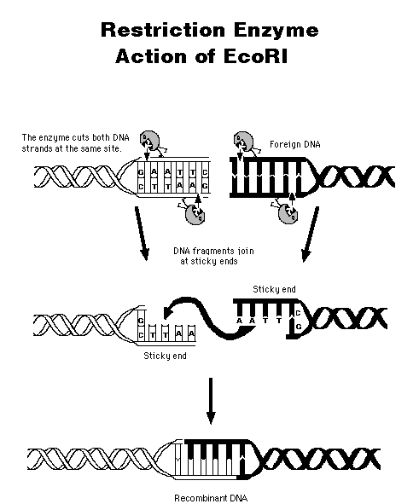
cleavage of DNA
enzymatic
physical
pressure
pressure
shearing of DNA

Slide 8
Two generations of sequencing technology
Feature | First generation | Second generation
Isolate DNA fragments to sequence | Cloning in bacteria to generate many copies of the same DNA sequence, usually as a recombinant plasmid | Physical cloning to generate thousands of copies of a DNA molecule, separated on beads on or as positions on a flow cell
Purification of clones? | Prepare the plasmids from each bacterial clone | No need for plasmid preparation
DNA sequencing approach | Sequencing by synthesis or by base-specific degradation | Sequencing by synthesis, pyrosequencing, or ligation (SOLiD)
Method of detection | Electrophoresis to separate by size; fluorescent dyes | Light detection at each cycle of synthesis
Number of clones sequenced in parallel | scores to hundreds | hundreds of millions

Slide 9
Multiplying of DNA by Cloning
Insert containing human DNA
E.coli
Plasmid
Bacterial growth
Isolation of Plasmids

Slide 10
sequencing of plasmids
stretches of known DNA are needed to sequence unknown DNA
Newly synthesized DNA
Primer
Primer
Plasmid

Slide 11
Strategy to determine DNA or RNA sequence
Generate a nested set of fragments with one common end
The other end terminates at one of the 4 nucleotides
Electrophoretic resolution of the fragments allows the reading of the sequence:
  Fragment of length 47 ends at G
  48 A
  49 T
  Sequence is …GAT….
G
A
T

Slide 12
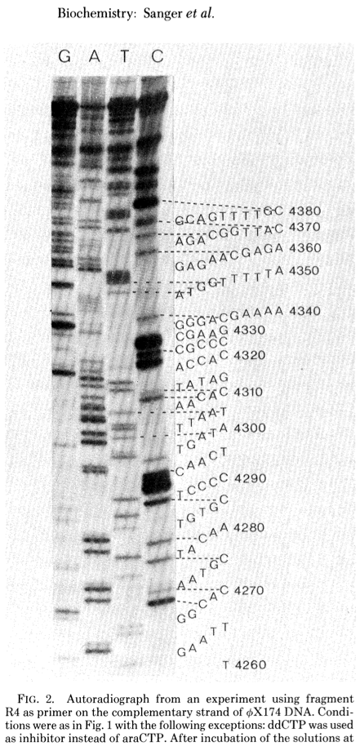
Read the sequence from a high-resolution gel
Can you read the sequence?
Sanger, Nicklen and Coulson (1977) DNA sequencing with chain-terminating inhibitors. PNAS 74: 5463-5467.

Slide 13
Read the sequence from a high-resolution gel
Can you read the sequence?
Sanger, Nicklen and Coulson (1977) DNA sequencing with chain-terminating inhibitors. PNAS 74: 5463-5467.

Slide 14
Sequence files
From 5’ to 3’:
TGAATTGGCACAATGCTACAATGTGCTCCCCCAACTTGATATTAATAACACTATAG…
FASTA format:
>PhiX174_R4
TGAATTGGCACAATGCTACAATGTGCTCCCCCAACTTGATATTAATAACACTATAG…
FASTA is a format for any sequence
>gi|164663818|ref|NP_001106879.1| LIM domain-binding protein 1 isoform 1 [Mus musculus]
MSVGCACPGCSSKSFKLYSPKEPPNGNAFPPFHPGTMLDRDVGPTPMYPPTYLEPGIGRHTPYGNQTDYR
IFELNKRLQNWTEECDNLWWDAFTTEFFEDDAMLTITFCLEDGPKRYTIGRTLIPRYFRSIFEGGATELY
YVLKHPKEAFHSNFVSLDCDQGSMVTQHGKPMFTQVCVEGRLYLEFMFDDMMRIKTWHFSIRQHRELIPR
SILAMHAQDPQMLDQLSKNITRCGLSNSTLNYLRLCVILEPMQELMSRHKTYSLSPRDCLKTCLFQKWQR
MVAPPAEPARQQPSKRRKRKMSGGSTMSSGGGNTNNSNSKKKSPASTFALSSQVPDVMVVGEPTLMGGEF
GDEDERLITRLENTQFDAANGIDDEDSFNNSPALGANSPWNSKPPSSQESKSENPTSQASQ
>FranklinsTower Grateful Dead, Robert Hunter
You ask me where the four winds dwell
In Franklin's tower there hangs a bell
It can ring, turn night to day
Ring like fire when you lose your way
>name
String of letters from an alphabet
Invalid letters are ignored

Slide 15

Automated Dye Terminator Sequencing
Sanger dideoxynucleotide sequencing, hundreds of plasmid preps, ~ 700 to 1400 nt per sequence
DNA template
Taq Polymerase
dNTPs
Dye terminator
removal
A
A
C
A
C
C
Annealing
Extension
A
C
C
G
A
C
C
G
T
Di-deoxy Terminators
A
C
C
G
T
A
Completed
sequencing
reaction
Primer
A
C
C
G
T
A
T
A
C
G
T
The colored circles represent different types of fluorescent dye.
The extended primers represent the shortest molecules in a population with lengths of up to 1400 bases.
Automated sequencing chemistries: A: Sequencing with dye-labeled primers
B: Sequencing with dye-labeled terminators.

Slide 16
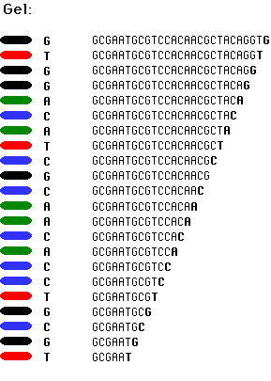
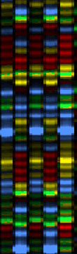
http://seqcore.brcf.med.umich.edu/doc/educ/dnapr/sequencing.html

Slide 17
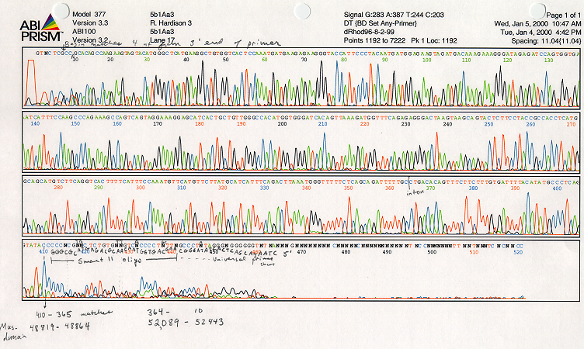
Example of output from automated dideoxysequencing

Slide 18
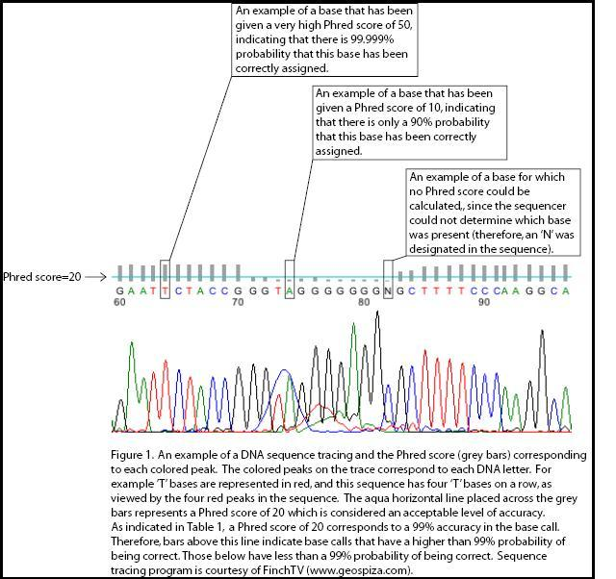
Phred quality scores
Q = -10 (log ₁₀ P)
P is the probability of calling the nucleotide (nt) incorrectly
Phred quality score | Probability of incorrect nt call | Nucleotide call accuracy
10 | 1 in 10 | 90%
20 | 1 in 100 | 99%
30 | 1 in 1000 | 99.9%
40 | 1 in 10,000 | 99.99%
50 | 1 in 100,000 | 99.999%
Wikipedia article on “Phred quality score”; see Ewing and Green (1998) Genome Res. 8: 175-185; 186-194

Slide 19
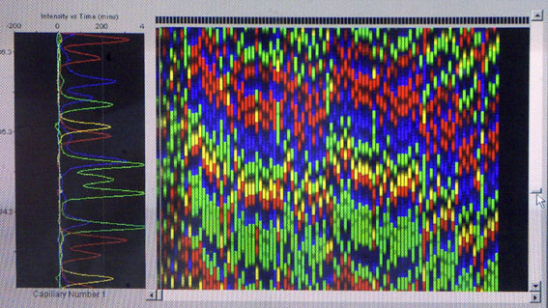
Sequencing by Capillary-Array-Technique

Slide 20
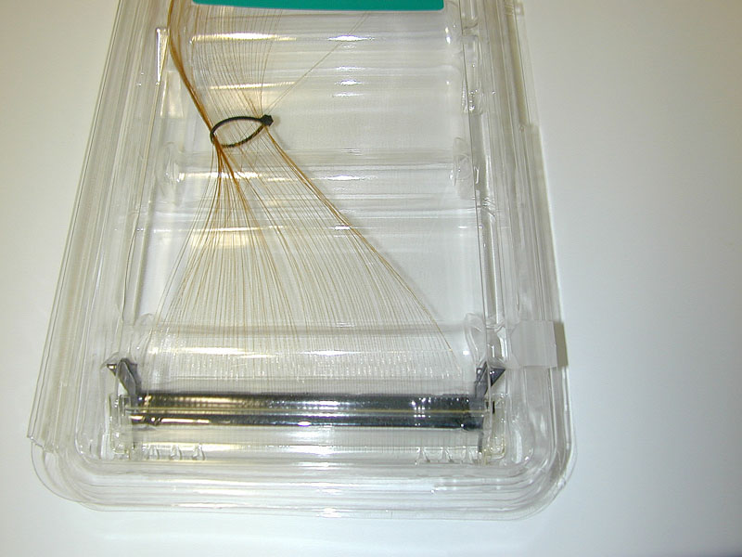

Slide 21

Feature | First generation
Isolate DNA fragments to sequence | Cloning in bacteria to generate many copies of the same DNA sequence, usually as a recombinant plasmid
Purification of clones? | Prepare the plasmids from each bacterial clone
DNA sequencing approach | Sequencing by synthesis or by base-specific degradation
Method of detection | Electrophoresis to separate by size; fluorescent dyes
Number of clones sequenced in parallel | scores to hundreds
TAAGTTATTATTTAGTTAATACTTTTAACAATATTATTAAGGTATTTAAAAAATACTATT
ATAGTATTTAACATAGTTAAATACCTTCCTTAATACTGTTAAATTATATTCAATCAATAC
ATATATAATATTATTAAAATACTTGATAAGTATTATTTAGATATTAGACAAATACTAATT
TTATATTGCTTTAATACTTAATAAATACTACTTATGTATTAAGTAAATATTACTGTAATA
CTAATAACAATATTATTACAATATGCTAGAATAATATTGCTAGTATCAATAATTACTAAT
ATAGTATTAGGAAAATACCATAATAATATTTCTACATAATACTAAGTTAATACTATGTGT
AGAATAATAAATAATCAGATTAAAAAAATTTTATTTATCTGAAACATATTTAATCAATTG

Slide 22
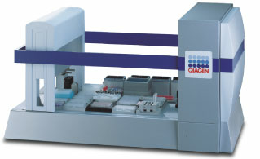
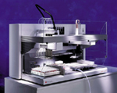
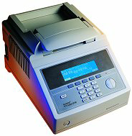
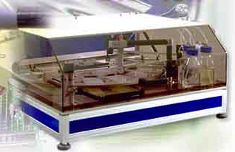
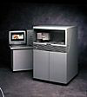
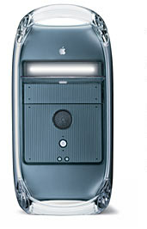
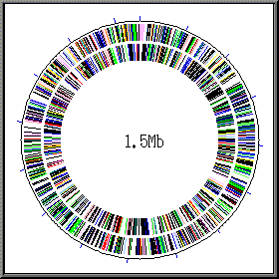
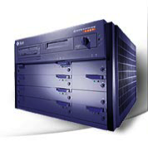
Plasmid Robot
Pipette-Robot
PCR-Machine
central File-Server
Colony-Picker
DNA
Sequencer
Annotation
Unix Computer
8 CPU
32 Gigabyte RAM

