Slide 1

Illuminating the Dark Matter of the Genome
Hardison
Genomics 2_2

Slide 2
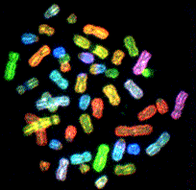
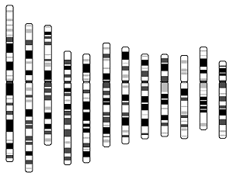
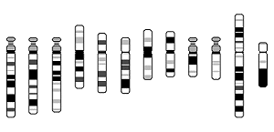
A human genome (male)
The genome is all the DNA in a cell.
  All the DNA on all the chromosomes.
3 billion bp = 3 Gb
Chr1 247 Mb
Chr12 132 Mb
Y Chromosome
Chr22 50 Mb

Slide 3
Genome size, number of genes
Bacterial genome size range:
  0.58 million bp (Mb), 467 genes (Mycoplasma genitalium)
  4.64 Mb, 4289 genes (Escherichia coli)
Yeast S. cerevisiae: 12 Mb, 6241 genes
  Only 2.6 X that of E. coli.
Caenorhabditis elegans: 97 Mb; 18,424 genes
Drosophila melanogaster: 180 Mb; 13,601 genes
  ~120 Mb euchromatic (sequenced)
Homo sapiens: ~3200 Mb; ~21,000 genes

Slide 4
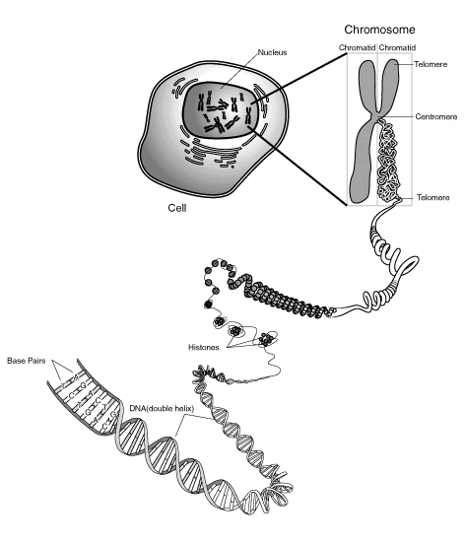

human DNA is 180 cm long
2 cm are coding for proteins
Shape of the duplex DNA is similar throughout - what distinguishes functional from nonfunctional DNA?

Slide 5
Compared to bacterial genomes, vertebrate genomes:
Are MUCH bigger
Have a complex gene structure
A majority of the DNA does NOT code for protein
  What other grammars in addition to the genetic code are needed to interpret genomes?
Are subject to wide-spread methylation, with multiple roles (not fully understood)
Sustain continued “assault” by transposable elements
  Endogenous viruses
  DNA transposons
  Retro-transposons (move via RNA)
Almost every genomic feature varies along chromosomes
  Gene density
  G+C content
  Repeat content
  Rates of nucleotide substitutions, insertions, deletions

Slide 6
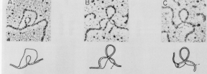
Genes can be in many pieces in eukaryotes
Electron micrographs of duplexes between mature mRNA and the genomic DNA that encodes it
The introns separating exons are transcribed but then are removed by splicing to form mRNA

Slide 7
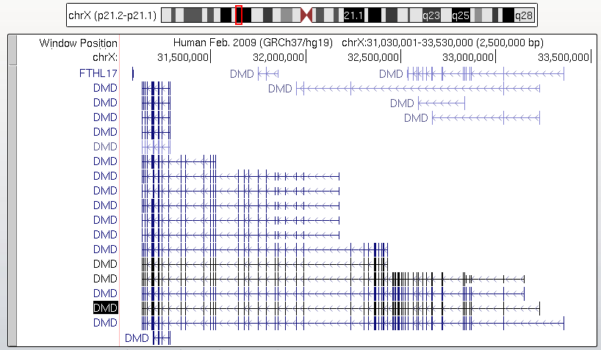
Human DMD is the size of some eubacterial genomes

Slide 8
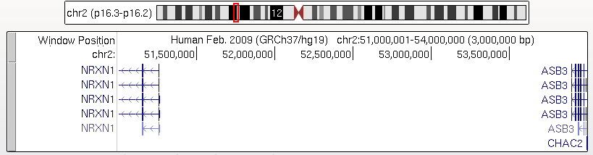
Gene desert

Slide 9
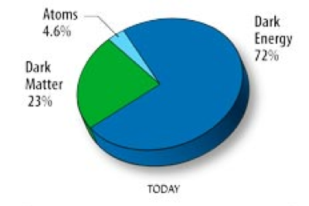
Dark matter in astronomy and cosmology
A theoretical form of matter that is not detectable by emitted radiation
Does not interact with electromagnetic radiation (is invisible)
Is inferred from gravitational effects on visible matter
Wikipedia

Slide 10
Dark matter of the genome
Genomic DNA sequences that seem to have a function but (as of now) we have not deduced what it is
Just like astronomers infer invisible mass because of effects on gravity, we infer “invisible” function from
  Signatures of natural selection
  Biochemical signatures of gene expression or regulation
Examples
  DNA under evolutionary constraint but does not code for protein
  Noncoding transcripts
  DNA bound by transcription factors or with distinctive chromatin marks, but we don’t know which genes it is regulating, or even if it is involved in regulation

Slide 11
… and 2000 more pages in human genome

Slide 15
Functional annotation of large genomes

Slide 16
Functional annotation of large genomes
Protein-coding genes are important, as always
Many other sequences are important
But perhaps the bulk of the genome has an clearly identifiable function
We will use evolutionary conservation and evidence of biochemical activity on a locus as independent approaches to try to find likely functional elements in a background (perhaps a large excess) of close to neutral DNA

Slide 17

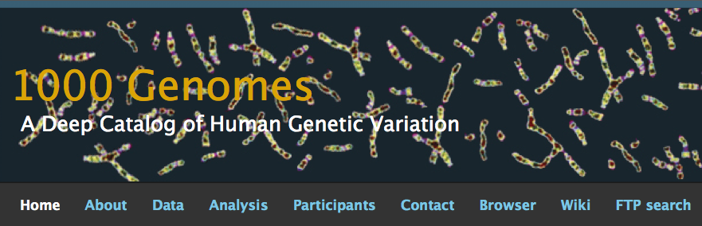
Genome sequence variation among individuals

Slide 18
Genetic variants associated with phenotypes

Slide 19
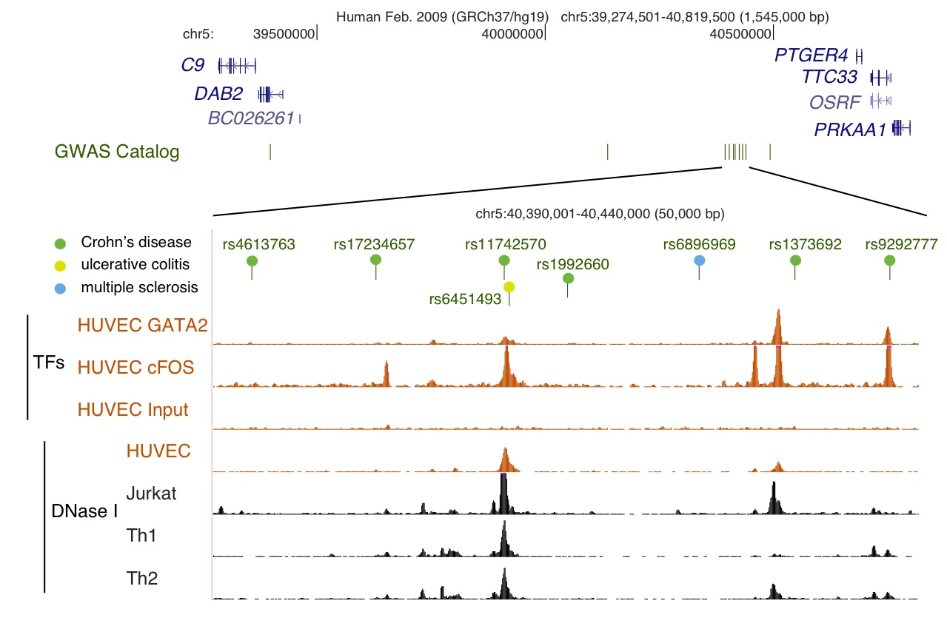
Genetic variants associated with complex traits are highly enriched in candidate gene regulatory regions
SNPs associated with inflammatory diseases are close to sites occupied by GATA factor
ENCODE project consortium (2012) Integrative analysis, Nature

