Slide 1

Fundamentals of Genomics
Hardison
Genomics 2_1

Slide 2
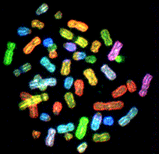
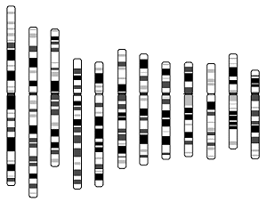
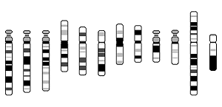
A human genome (male)
The genome is all the DNA in a cell.
  All the DNA on all the chromosomes.
3 billion bp = 3 Gb
Chr1 247 Mb
Chr12 132 Mb
Y Chromosome
Chr22 50 Mb

Slide 3
Genomics, Genetics and Biochemistry
Genetics: study of inherited phenotypes
  Mainly focused on genes
Genomics: study of genomes
  Covers all genes but all non-genic DNA as well
Biochemistry: study of the chemistry of living organisms and/or cells
  Sequencing a genome is a comprehensive determination of a biochemical structure
  Also use sequencing technologies to examine many biochemical features associated with genomes (epigenetic features such DNA methylation, histone modification, polymerase binding, etc.)
Revolution launched by full genome sequencing
  Many biological problems now have finite (albeit complex) solutions.
  New era will see an even greater interaction among these three disciplines

Slide 4
Features of Genomics
Complete: Global studies
  Large datasets
Finite: Work with a defined “parts list”
  All genes (coding for protein or not)
  All DNA segments needed to regulate gene expression
  All DNA segments needed to maintain chromosome replication and integrity
Integrative
  Multiple disciplines
  Biology, biochemistry and molecular biology, genetics, statistics, computer science, bioengineering, …

Slide 5
The Genomics Revolution
Know (close to) all the genes in a genome, and the sequence of the proteins they encode.
BIOLOGY HAS BECOME A FINITE SCIENCE
  Hypotheses have to conform to what is present, not what you could imagine could happen.
No longer look at just individual genes
  Examine whole genomes or systems of genes
Lander (1996) Science

Slide 6
A light survey of genomes

Slide 7
Four phases of genomics
Genome sequence and assembly
  High resolution map (nucleotide pair resolution)
Annotation
  Place landmarks on the map
  Protein-coding genes
  Other genes
  Gene regulatory modules
  DNA segments needed for replication and integrity
    Replication origins, centromeres, telomeres, etc.
Variation (within populations) and divergence (between species) in genome sequence
Connect genotypes (variants in functional regions) to phenotypes, and explain the connection mechanistically

Slide 8
Overview of genome sequencing and assembly

Slide 9
Bacterial Genome
e.g. Halobacterial genome
Mega Plasmid
600,000 Bases
600 kb
Chromosome
2,000,000 Bases
2 Mb
Plasmid
200,000 Bases
200 kb
total Genome size
2.6 Megabases
Stephan Schuster

Slide 10
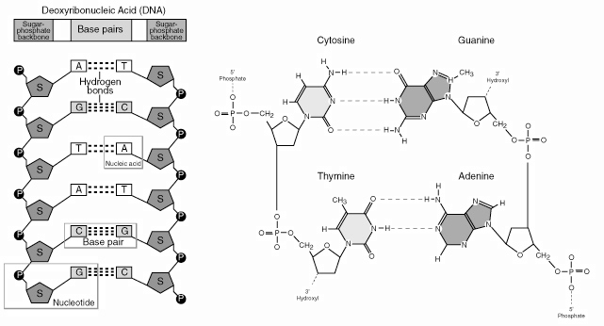

Pairing of bases and nucleotides in DNA

Slide 11
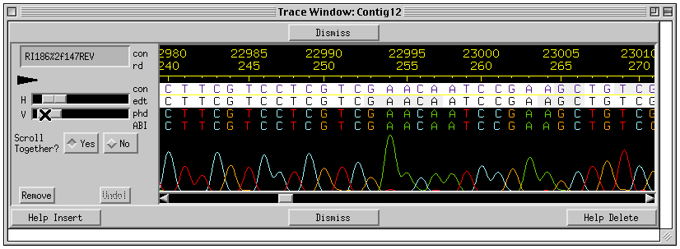
Overview of genome sequencing and assembly
Library construction:
Break the large chromosome(s) into small fragments
Isolate the fragments (microbiologically or physically)
Sequencing: Many technologies
Most use sequencing by synthesis
Assembly: Use alignments to put the pieces back together
Stephan Schuster

Slide 12
Genome sequences available
Thousands of eubacteria
Scores of archaea
Many fungi:
  Includes yeast Saccharomyces cerevisiae and about 10 sister species
Several protozoans: Plasmodium falciparum
Several worms: nematode Caenorhabditis elegans
At least 14 insects: Drosophila melanogaster and about 10 sister species, bees, others
Over 40 vertebrates:
  Several primates, e.g. Homo sapiens, H. neanderthalensis, Pan troglodytes, gorilla, orangutan
  Other mammalian orders, e.g. Mus domesticus, Rattus norvegius, Canis familiaris, including marsupials and monotremes
  Multiple birds
  One reptile
  One amphibian
  Multiple fish
Several plants: Arabidopsis, rice, potato, strawberry, cacao …
Rapidly expanding numbers of individuals
  Hundreds of humans, many more will be done
  Hundreds to thousands of individuals in other species

Slide 13
Genome size, number of genes
Bacterial genome size range:
  0.58 million bp (Mb), 467 genes (Mycoplasma genitalium)
  4.64 Mb, 4289 genes (Escherichia coli)
Yeast S. cerevisiae: 12 Mb, 6241 genes
  Only 2.6 X that of E. coli.
Caenorhabditis elegans: 97 Mb; 18,424 genes
Drosophila melanogaster: 180 Mb; 13,601 genes
  ~120 Mb euchromatic (sequenced)
Homo sapiens: ~3200 Mb; ~21,000 genes

Slide 14
Overview of annotation

Slide 15
Annotation of microbial genome
Genes comprise the vast majority of microbial genomes
Annotation is largely a gene-finding exercise.
View part of genome of Aquifex aeolicus
Microbial Genome Browser, UCSC
Lowe Lab along with UCSC Genome Browser Group
http://microbes.ucsc.edu/

Slide 16
Central dogma of molecular biology
DNA
RNA
Protein
transcription
translation

Slide 17
One grammar used in genomics: The Genetic Code maps information in DNA (RNA) to protein
Position in Codon
1st 2nd . 3rd
U C A G
U UUU Phe UCU Ser UAU Tyr UGU Cys U
UUC Phe UCC Ser UAC Tyr UGC Cys C
UUA Leu UCA Ser UAA Term UGA Term A
UUG Leu UCG Ser UAG Term UGG Trp G
C CUU Leu CCU Pro CAU His CGU Arg U
CUC Leu CCC Pro CAC His CGC Arg C
CUA Leu CCA Pro CAA Gln CGA Arg A
CUG Leu CCG Pro CAG Gln CGG Arg G
A AUU Ile ACU Thr AAU Asn AGU Ser U
AUC Ile ACC Thr AAC Asn AGC Ser C
AUA Ile ACA Thr AAA Lys AGA Arg A
AUG* Met ACG Thr AAG Lys AGG Arg G
G GUU Val GCU Ala GAU Asp GGU Gly U
GUC Val GCC Ala GAC Asp GGC Gly C
GUA Val GCA Ala GAA Glu GGA Gly A
GUG* Val GCG Ala GAG Glu GGG Gly G
* Sometimes used as initiator codons.
25 words are needed to code for the 20 amino acids and the start and stop sites
The Triplet Code allows for 64 codons to be coded
=> Degeneracy of the genetic code

Slide 18
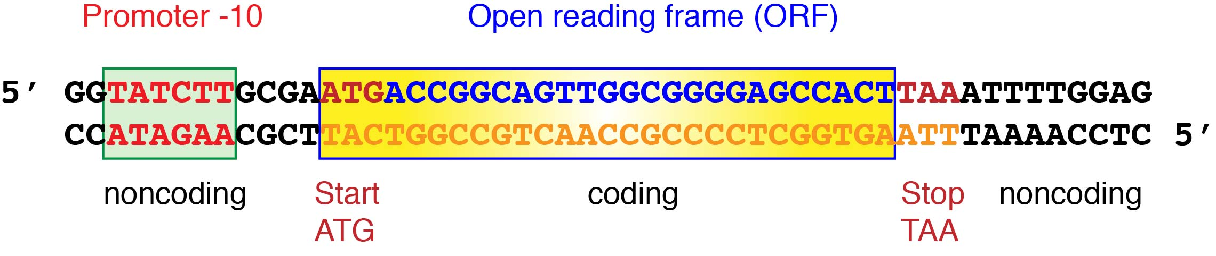
Gene structure in bacteria

Slide 19
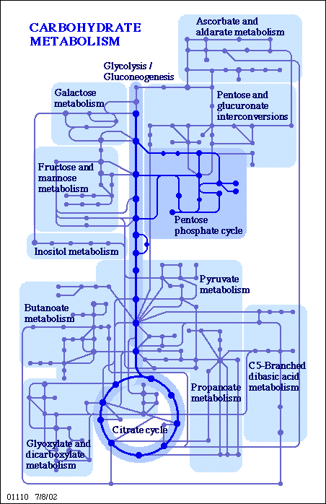
Predicting functions of candidate protein-coding genes
Has this sequence been seen before?
  Match to sequence database
“Guilt” by association:
  Is this sequence similar to a known protein in another species?
  Is the expression pattern similar to that of known genes? E.g. co-expression with genes for ribosomal proteins suggests that the encoded protein could have a ribosomal function
Deduce physiological function within a context of pathways
KEGG (Ogata et al.1999)

