Slide 1
Review of the Molecular Biology of Genes in Eukaryotes
Split genes: Exons and introns
Chromatin structure and states: Epigenetics

Slide 2
Classification by +/- nucleus
Prokaryotes: Organisms whose cells lack a nucleus
  Bacteria and Archaea
  Still have genomic DNA, but not in a specialized organelle
Eukaryotes: Organisms whose cells contain a nucleus
  Protists, fungi, plants, animals, …

Slide 3
Split genes and introns
The mRNA-coding portion of a gene can be split by DNA sequences that do not encode mature mRNA
Exons are the segments of a gene that code for mRNA, introns are the segments of genes that do not encode mRNA.
Introns are found in most genes in eukaryotes, also some in Archaea

Slide 4
R-loops can reveal introns
5’
5’
5’
5’

Slide 5
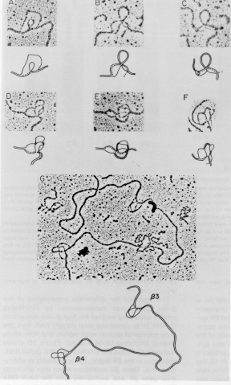
Examples of R-loops in mammalian hemoglobin genes

Slide 6
Types of exons
Transcription start
polyA
Stop
5’
GT
AG
GT
AG
GT
AG
GT
AG
Gene
3’
promoter
Open reading frame
Initial exon
Internal exon
Internal coding exon
Terminal exon
Translation
Translation
Start
Stop
mRNA
5’
3’
5’ untranslated
region
Protein
coding
region
3’ untranslated
region

Slide 7
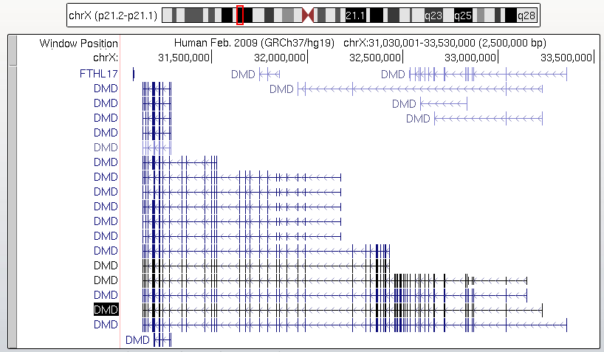
Human DMD gene

Slide 8
Introns are removed by splicing RNA precursors
5’
5’
5’

Slide 9
Alternative splicing can generate multiple polypeptides from a single gene

Slide 10
Alternative splicing can generate multiple polypeptides from a single gene, part 2

Slide 11
Chromosomes and chromatin

Slide 12
Chromosomes organize genes inside cells and enable their expression
Bind packaging proteins to DNA to make it more compact.
  Histones +DNA = chromatin in eukaryotes
  Virion proteins in viruses
Dynamic, covalent modifications of histones are associated with active portions of chromosomes
  Transcription
  Regulation
  Replication

Slide 13
Bands and specialized regions of human chromosomes
Human chromosome 11:
125 Mb, 180 cM

Slide 14
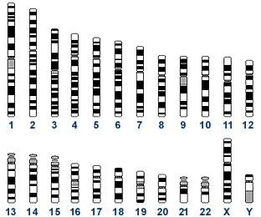
Human chromosomes, ideograms
Mitotic chromosomes are spread and stained with Geimsa. Those that stain are shown in black.
G-bands (more A+T rich).

Slide 15
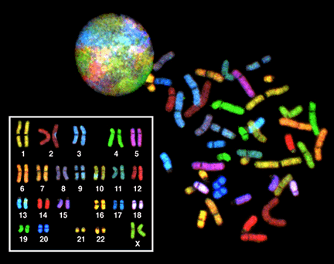
Human chromosomes, spectral karyotype
Reagents specific to each chromosome.
Chromosome
painting.

Slide 16
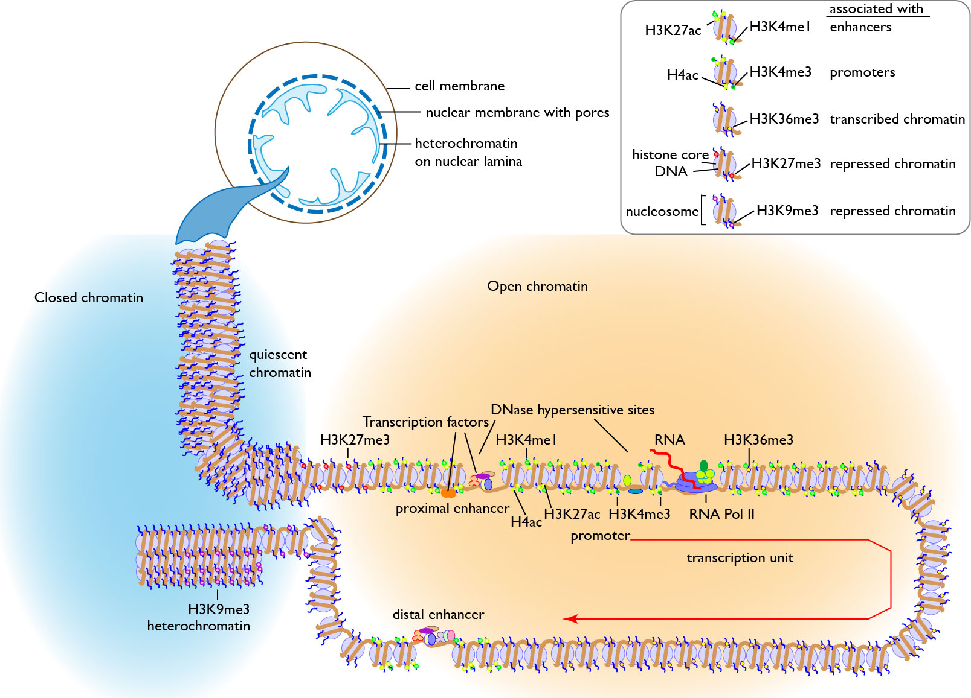
Chromatin states in interphase nuclei
Adapted from Makova and Hardison (2015) Nature Reviews Genetics

Slide 17
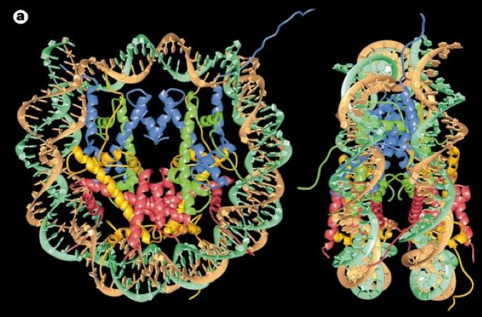
Nucleosome core structure, 3D
146 bp duplex DNA wrapped around 8 histones molecules:
2 each of the dimers H2A-H2B, H3-H4
N-terminal tails of histones emerge from the core
Luger et al. (1997) Nature 389: 251, Richmond lab

Slide 18
Principal proteins in chromatin are histones
H3 and H4 : Arg rich, mostly conserved sequence
H2A and H2B : Slightly Lys rich, fairly conserved
H1 : very Lys rich, most variable in sequence
between species

Slide 19
Histone structure and function

Slide 20
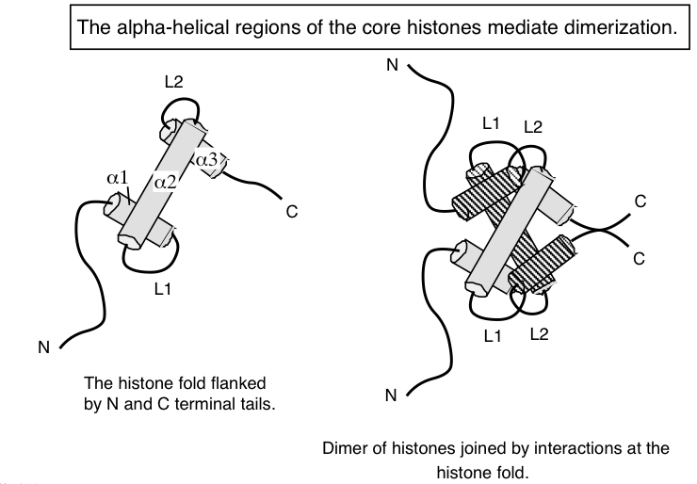
Histone interactions via the histone fold

Slide 21
Nucleosome core structure, 3D
146 bp duplex DNA wrapped around 8 histones molecules:
2 each of the dimers H2A-H2B, H3-H4
N-terminal tails of histones emerge from the core
Luger et al. (1997) Nature 389: 251, Richmond lab

Slide 22
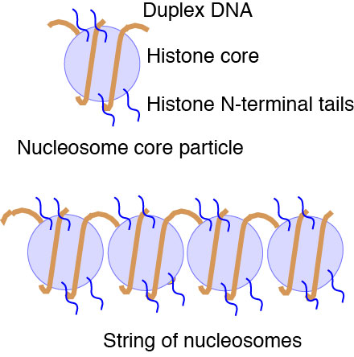
Simplified view of nucleosomes
Linker: Sensitive to
micrococcal nuclease

Slide 23
Alterations to chromatin structure are key steps in regulation

Slide 24
Phosphorylation of histones

Slide 25
Acetylation and Deacetylation of lysines in proteins

Slide 26
Acetylation and deacetylation of histones
Co-activator EP300 is a HAT

Slide 27
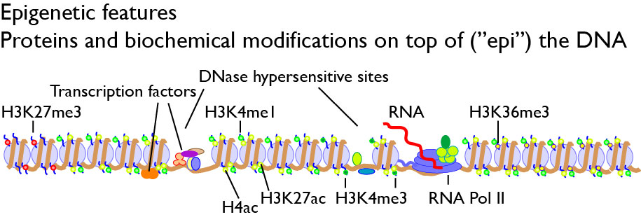
Epigenetic features

Slide 28
Chromatin states in interphase nuclei
Adapted from Makova and Hardison (2015) Nature Reviews Genetics

