Slide 1
Molecular Biology of Genes
A review
Ross Hardison

Slide 2
What are genes?

Slide 3
Characteristics of Genes
Units of heredity
  Determine heritable phenotypes
Are mutable: allelic variants
Are on chromosomes
  Behavior of genes mimics movement of chromosomes
  Allelic variants segregate equally (1st Law)
  Different genes usually sort independently (Mendel’s 2nd Law)
Linked on chromosomes in a linear array

Slide 4
Types of alleles
Wild type: normal, functional product
Loss-of-function: usually recessive
  Null: No product
  Hypomorph: Less product
Gain-of-function: usually dominant
  New function
  Hypermorph: More product
Dominant negative: mutant product interferes with function of wild-type product
Some alleleic variants have no observable effects

Slide 5
Genes are composed of nucleic acids (usually DNA)
Pneumococcus can be transformed from an avirulent to a virulent strain
DNA is the transforming principle
DNA in bacteriophage particles appears in the progeny, but very little protein does.

Slide 6
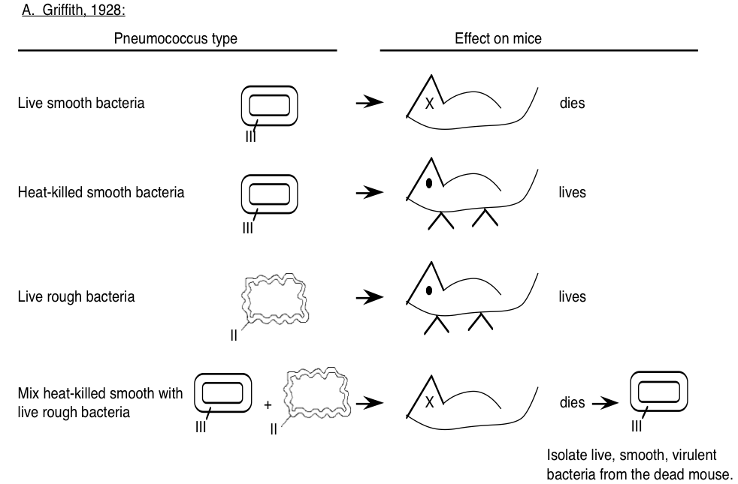
DNA is the transforming principle

Slide 7
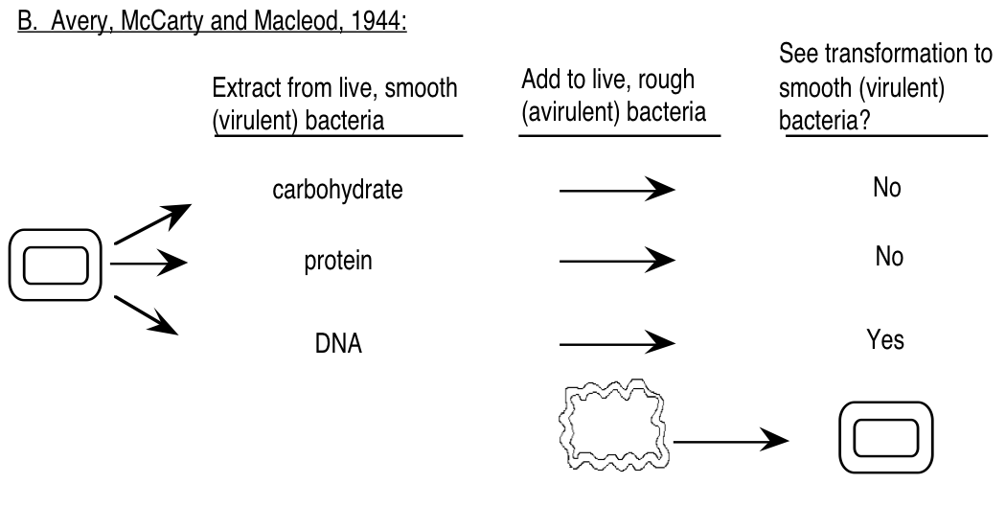
DNA is the transforming principle

Slide 8
Structures of nucleic acids
Nucleotides
DNA structures

Slide 9
A simple view of DNA
5’
AGCCTCGCAT
TCGGAGCGTA
5’
Anti-parallel strands
Reverse complement

Slide 10
Nucleotides
3 components to nucleotides:
  Purine or pyrimidine base
  Ribose (RNA) or 2-deoxyribose (DNA) sugar
  Phosphate
Base + sugar = Nucleoside
Base + sugar + phosphate = Nucleotide

Slide 11
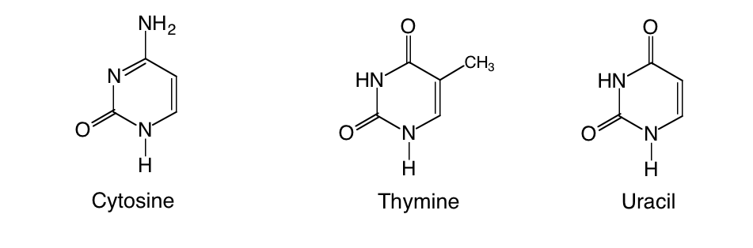
Types of bases in nucleotides
Pyrimidines
Amino-
Keto-

Slide 12
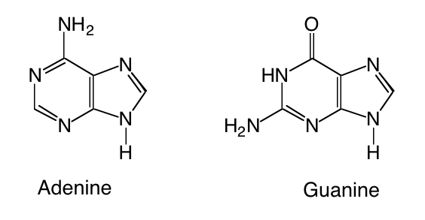
Nucleotides: purine bases
6-aminopurine
A keto-purine

Slide 13
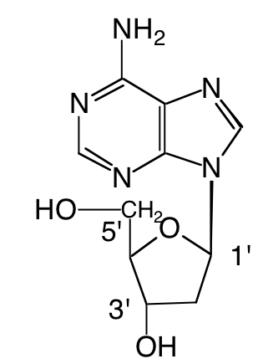
Bases are attached to C1’ of the sugar via an N-glycosidic bond
2’-deoxyadenosine, a nucleoside

Slide 14
Phosphate is attached to C5’ of the sugar
1st phosphate is a phosphoester, others are attached as phosphoanhydrides.
γ
β
α

Slide 15
Structure of a dinucleotide
The 3’ C of one nucleotide is linked to the 5’ C of the next nucleotide in a phosphodiester linkage.

Slide 16
Nucleic acids are linear chains of nucleotides
The 3’ C of one nucleotide is linked to the 5’ C of the next nucleotide.
The linkage is by a phosphoester.
The chain has an orientation defined by the sugar-phosphage backbone.
One terminal nucleotide has a “free” 5’ end, and the other has a “free” 3’ end.
Thus we designate orientation by 5’ to 3’.

Slide 17
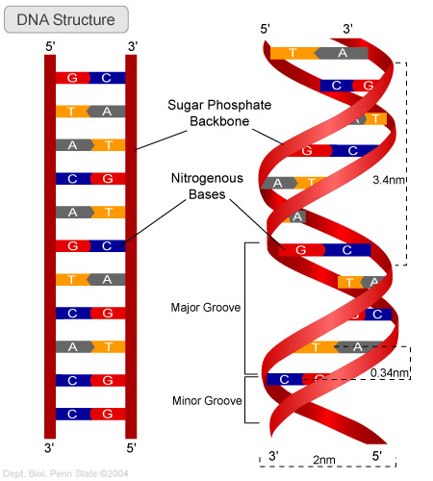
Duplex DNA

Slide 18
Complementarity of two strands of DNA
Duplex DNA has 2 complementary strands
Complementarity is based on H-bonding between
  Keto bases with amino bases
  Pyrimidines with purines
G pairs with C
A pairs with T (or U)

Slide 19
Duplex DNA
Two strands coil around each other.
Right-handed coils.
Coils form major and minor grooves.
Strands have opposite polarity (antiparallel).
Opposing bases in strands are complementary.
Sugar-phosphate backbone is on the outside, bases on the inside

Slide 20
Implications of complementarity
One chain (strand) of DNA can serve as the template for synthesis of the complementary chain.
DNA replication: sequence of nucleotides in one chain of the duplex determines the sequence of nucleotides in the other chain.
Transcription: sequence of nucleotides in one chain of the duplex determines the sequence of nucleotides in mRNA or its precursor.

Slide 21
More on orientation of chains of nucleic acids
5’ACTG 3’ is different from 3’ ACTG 5’
Unless specified otherwise, a chain is written with the 5’ end on the left and the 3’ end on the right.
When complementary strands in DNA are written, usually the top strand is written 5’ to 3’, left to right, and the bottom strand is written 3’ to 5’, left to right.
    5’ GATTCGTACCG
    3’ CTAAGCATGGC

Slide 22
Central Dogma of Molecular Biology

Slide 23
Untranslated sequences are at the ends of mRNA

Slide 24
Only one strand of duplex DNA codes for a product
translation
transcription

