Slide 1
DNA Strand Polarity, Transcriptional Orientation, Numbering Conventions
Hardison
Genomics 1_1_2

Slide 2
Different polarity for the two strands of DNA
The sequence of each strand is the reverse complement of the other.
5’
Top, plus, +
AGCCTCGCAT
TCGGAGCGTA
Bottom, minus, -
5’
The sequence of the bottom strand is read in the opposite direction
as that of the top strand.

Slide 3
Exercise on reverse complement
1. What is the reverse complement of this sequence?
10 20 30 40 50 60
....|....|....|....|....|....|....|....|....|....|....|....|
5’ GCGTTTCTGAAAGAGTTGCTGTGGGAAGATGTGGAGACTTCTCTGTAAACCTTCCAGACT 3’

Slide 4
Reverse complement, answer
1. What is the reverse complement of this sequence?
10 20 30 40 50 60
....|....|....|....|....|....|....|....|....|....|....|....|
5’ GCGTTTCTGAAAGAGTTGCTGTGGGAAGATGTGGAGACTTCTCTGTAAACCTTCCAGACT 3’
Answer is generated by writing the complementary nucleotide for each position:
3’ CGCAAAGACTTTCTCAACGACACCCTTCTACACCTCTGAAGAGACATTTGGAAGGTCTGA 5’
But the convention for reading a sequence is from 5’ to 3’, just like DNA polymerases and RNA polymerases, so we need to reverse that complementary sequence we just wrote if we want to have the 5’ end at the left, like so:
5’ AGTCTGGAAGGTTTACAGAGAAGTCTCCACATCTTCCCACAGCAACTCTTTCAGAAACGC 3’

Slide 5
Conventions for duplex DNA
For issues that are best addressed by examining both strands in the duplex, then we
just write the sequence with the top strand 5’ to 3’ left to right, and the bottom strand
5’ to 3’ right to left, like below:
10 20 30 40 50 60
....|....|....|....|....|....|....|....|....|....|....|....|
5’ GCGTTTCTGAAAGAGTTGCTGTGGGAAGATGTGGAGACTTCTCTGTAAACCTTCCAGACT 3’
3’ CGCAAAGACTTTCTCAACGACACCCTTCTACACCTCTGAAGAGACATTTGGAAGGTCTGA 5’
If the polarity is not indicated, then the convention is that the 5’ end is on the left.
Note that a position number refers to a nucleotide pair, e.g. position 30 is a T on the
top strand and an A on the bottom strand.

Slide 6
Numbering conventions for nucleotide pairs along chromosomes
Linear chromosomes
Numbering begins at the telomere of the short arm of the chromosome
Ends at the telomere of the long arm of the chromosome
0
135,086,622
Circular chromosomes
Numbering begins at an arbitrary point
(e.g. start of transfer by F’ factor in E. coli)
4,641,652
1
Each position is a nucleotide pair
in the duplex DNA

Slide 7
RNA polymerase synthesizes RNA in the 5’ to 3’ direction
RNA polymerase moves in opposite directions on each of
the two strands.
5’GCAU>
5’
AGCCTCGCAT
TCGGAGCGTA
5’
<UCGGA5’
This is analogous to the convention that you only drive on one
side of the road. In this metaphor, RNA polymerase follows the convention of the United Kingdom, etc. - it “drives” on the left side of the road.

Slide 8
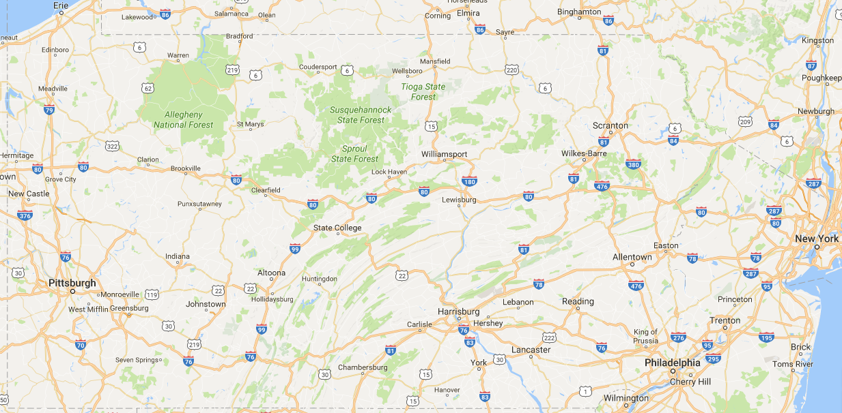
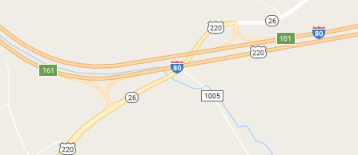
A mile marker refers to a location, regardless of direction of travel
0
Clearfield
310
Lewisburg
West
East
Enter I-80 at mile marker (interchange) 161
Go east 49 miles, you are at exit 210, close to Lewisburg
Go west 41 miles, you are at exit 120, close to Clearfield

Slide 9
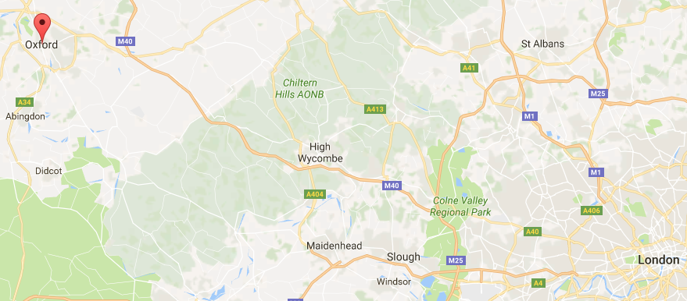
The polymerase analogy is even better for driving in the UK
West
“bottom
strand”
East: “top strand”

Slide 10
Analogy between mile markers and positions in duplex DNA
Similarly to driving along an interstate, the position along a chromosome is numbered the same regardless of the direction of “travel”, e.g. reading by RNA polymerase.
10 20 30 40 50 60
....|....|....|....|....|....|....|....|....|....|....|....|
5’ GCGTTTCTGAAAGAGTTGCTGTGGGAAGATGTGGAGACTTCTCTGTAAACCTTCCAGACT 3’
3’ CGCAAAGACTTTCTCAACGACACCCTTCTACACCTCTGAAGAGACATTTGGAAGGTCTGA 5’
If transcription of the top strand starts at position 30 and stops after 20 nucleotides, then the last nucleotide is the A encoded at position 49.
If transcription of the bottom strand starts at position 30 and stops after 20 nucleotides, then the last nucleotide is the U encoded by the T at position 11.

Slide 11
Exercise on reading the top strand
Given this duplex DNA sequence:
10 20 30 40 50 60
....|....|....|....|....|....|....|....|....|....|....|....|
5’ GCGTTTCTGAAAGAGTTGCTGTGGGAAGATGTGGAGACTTCTCTGTAAACCTTCCAGACT 3’
3’ CGCAAAGACTTTCTCAACGACACCCTTCTACACCTCTGAAGAGACATTTGGAAGGTCTGA 5’
What are the first 10 nucleotides of the sequence of the top strand starting at position 15?

Slide 12
Exercise on reading the top strand
Given this duplex DNA sequence:
10 20 30 40 50 60
....|....|....|....|....|....|....|....|....|....|....|....|
5’ GCGTTTCTGAAAGAGTTGCTGTGGGAAGATGTGGAGACTTCTCTGTAAACCTTCCAGACT 3’
3’ CGCAAAGACTTTCTCAACGACACCCTTCTACACCTCTGAAGAGACATTTGGAAGGTCTGA 5’
What are the first 10 nucleotides of the sequence of the top strand starting at position 15?
Answer: GTTGCTGTGG

Slide 13
Exercise on reading the bottom strand
Given this duplex DNA sequence:
10 20 30 40 50 60
....|....|....|....|....|....|....|....|....|....|....|....|
5’ GCGTTTCTGAAAGAGTTGCTGTGGGAAGATGTGGAGACTTCTCTGTAAACCTTCCAGACT 3’
3’ CGCAAAGACTTTCTCAACGACACCCTTCTACACCTCTGAAGAGACATTTGGAAGGTCTGA 5’
What are the first 10 nucleotides of the sequence of the bottom strand starting at position 15?

Slide 14
Exercise on reading the bottom strand
Given this duplex DNA sequence:
10 20 30 40 50 60
....|....|....|....|....|....|....|....|....|....|....|....|
5’ GCGTTTCTGAAAGAGTTGCTGTGGGAAGATGTGGAGACTTCTCTGTAAACCTTCCAGACT 3’
3’ CGCAAAGACTTTCTCAACGACACCCTTCTACACCTCTGAAGAGACATTTGGAAGGTCTGA 5’
What are the first 10 nucleotides of the sequence of the bottom strand starting at position 15?
Answer: CTCTTTCAGA
Not AGACTTTCTC
Not CAACGACACC

Slide 15
Exercise on deducing an RNA sequence from annotation of a DNA sequence
Given this duplex DNA sequence:
10 20 30 40 50 60
....|....|....|....|....|....|....|....|....|....|....|....|
5’ GCGTTTCTGAAAGAGTTGCTGTGGGAAGATGTGGAGACTTCTCTGTAAACCTTCCAGACT 3’
3’ CGCAAAGACTTTCTCAACGACACCCTTCTACACCTCTGAAGAGACATTTGGAAGGTCTGA 5’
If a transcript is annotated as running from right to left, starting at position 50, what are the first 10 nucleotides of that transcript?

Slide 16
Exercise on deducing an RNA sequence from annotation of a DNA sequence
Given this duplex DNA sequence:
10 20 30 40 50 60
....|....|....|....|....|....|....|....|....|....|....|....|
5’ GCGTTTCTGAAAGAGTTGCTGTGGGAAGATGTGGAGACTTCTCTGTAAACCTTCCAGACT 3’
3’ CGCAAAGACTTTCTCAACGACACCCTTCTACACCTCTGAAGAGACATTTGGAAGGTCTGA 5’
If a transcript is annotated as running from right to left, starting at position 50, what are the first 10 nucleotides of that transcript?
Answer: 5’ GUUUACAGAG
Not 3’ GGAAGGTCTG
That sequence starts at position 50 on the bottom strand, but it proceeds 3’ to 5’, and includes the 9 nucleotides BEFORE the transcript starts.

