Slide 1
The need for deep phenotyping after genome editing
A cautionary tale
Lesson 12, Presentation 4
BMMB551 Genomics
Hardison

Slide 2
Genome Editing
Removal, modification, or addition of a functional element into the genome of a living cell or organism
Genes, regulatory regions
Random changes
Insertion of plasmids or viruses at any of many accessible targets
Directed changes
Homologous recombination
Sequence-specific DNA binding macromolecules
Protein domains: Zn fingers, TALEs
RNA: CRISPR
Loss-of-function assays can be definitive, but they do sometimes show no phenotype for strong gain-of-function enhancers

Slide 3
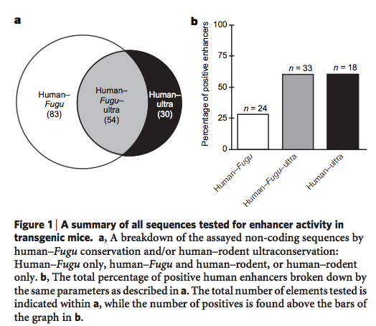
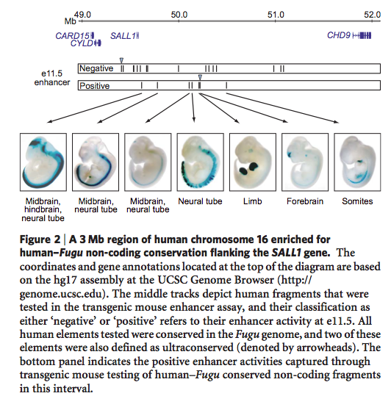
Highly constrained noncoding sequences are frequently tissue-specific enhancers
Pennacchio et al. (2006) Nature 444: 499-502

Slide 4
Implications of enhancer activities in highly constrained sequences
Non-coding regions that are conserved at an unusually high level are highly enriched in enhancers located near developmental genes
We should be able to predict many enhancer regions based on strong sequence constraint
Assumption: These regions are sequence constrained because of functional constraint
Slides edited from:
Jonathan McGovern
BMMB 541
4/30/09

Slide 5
Deletion of Ultraconserved Elements Yields Viable Mice Nadav Ahituv, Yiwen Zhu, Amy Holt, Veena Afzal, Len A. Pennacchio and Edward Rubin PLoS Biology, September 2007
But…

Slide 6
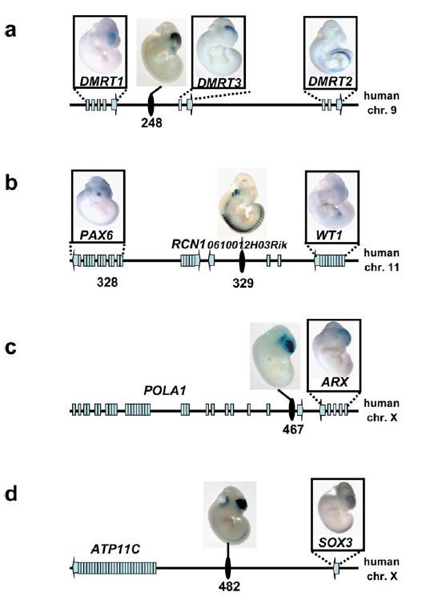
Selection of Ultraconserved Enhancers
KO PHENOTYPE
KO PHENOTYPE
Dmrt1: Male sexual development abnormalities
Pax6: Eye defects, lethality, CNS, craniofacial, pituitary and pancreatic abnormalities
DNA polymerase: Assumed Lethal
ATP11C: Assumed Lethal
Dmrt3: Male sexual development abnormalities, lethal due to dental malformation
WT1: Wilms tumor, kidney defects, lethality, mesothelium defects, heart/lung malformation
ARX: Lethality, male sexual development abnormalities, small brain
Sox3: Abnormal sexual development and pituitary function, mental retardation in humans

Slide 7
Successful Knock-Out
KO PHENOTYPE
KO PHENOTYPE
Dmrt1: Male sexual development abnormalities
Pax6: Eye defects, lethality, CNS, craniofacial, pituitary and pancreatic abnormalities
DNA polymerase: Assumed Lethal
ATP11C: Assumed Lethal
Dmrt3: Male sexual development abnormalities, lethal due to dental malformation
WT1: Wilms tumor, kidney defects, lethality, mesothelium defects, heart/lung malformation
ARX: Lethality, male sexual development abnormalities, small brain
Sox3: Abnormal sexual development and pituitary function, mental retardation in humans

Slide 8
Results for KO on autosomes
uc248 knockout :
-Expected Phenotype: Male reproductive abnormality, severe dental malformation
-Observed Phenotype: Normal reproductive capability (Table 4), normal dentition
uc329 knockout:
-Expected Phenotype: Wilms tumor, WAGR syndrome, other kidney abnormality, eye abnormalities
-Observed Phenotype: ~2% unilateral renal agenesis (compare to 0.5% in wt), normal eyes
Table 2 (Expect 1:2:1 Ratio)
Notes:
WAGR syndrome: Wilms tumor, Aniridia (lack of iris), Genitourinary malformation, mental Retardation (in humans)

Slide 9
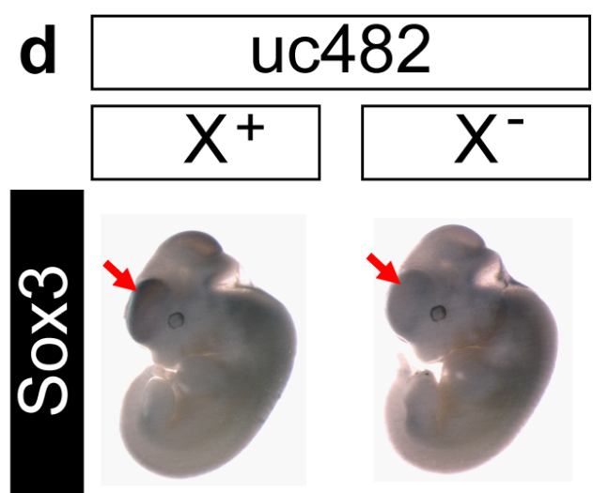
Results for X-linked KOs
uc467 knockout:
-Expected Phenotype: Perinatal mortality, small brain, male sexual reproductive abnormality
-Observed Phenotype: Normal brain, normal reproductive capability, normal survival
uc482 knockout:
-Expected Phenotype: Hypopituitarism, hypoparathyroidism, growth hormone deficiency (reduction in weight), sexual abnormality
- Observed Phenotype: Normal reproductive capability, normal weight, normal calcium levels
Figure 2
Table 3 (Expect 1:1:1:1 ratio)

Slide 10
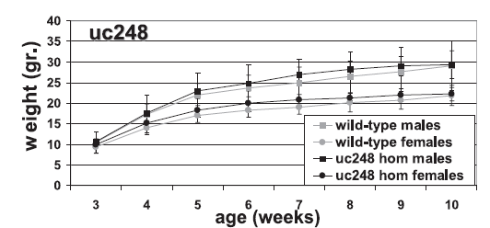
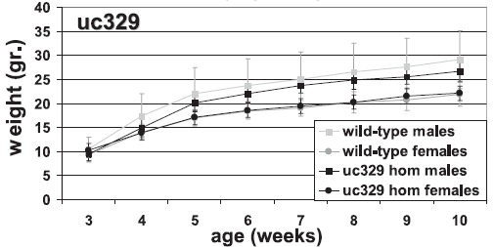
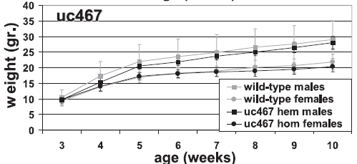
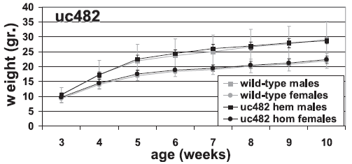
Practically Perfect Mice
No gross pathological differences
100% survival over 25 weeks
Normal weight
Normal clinical chemistry
Normal reproductive ability

Slide 11
Summary #2
Loss of highly conserved regulatory regions leads to insignificant (if any) phenotype
Maybe there is phenotype outside lab or over time
Regulatory element redundancy probable
The idea that highly conserved non-coding regions are hotspots for developmental enhancers is not being challenged but it raises the question…
What prevents sequence change?

Slide 12
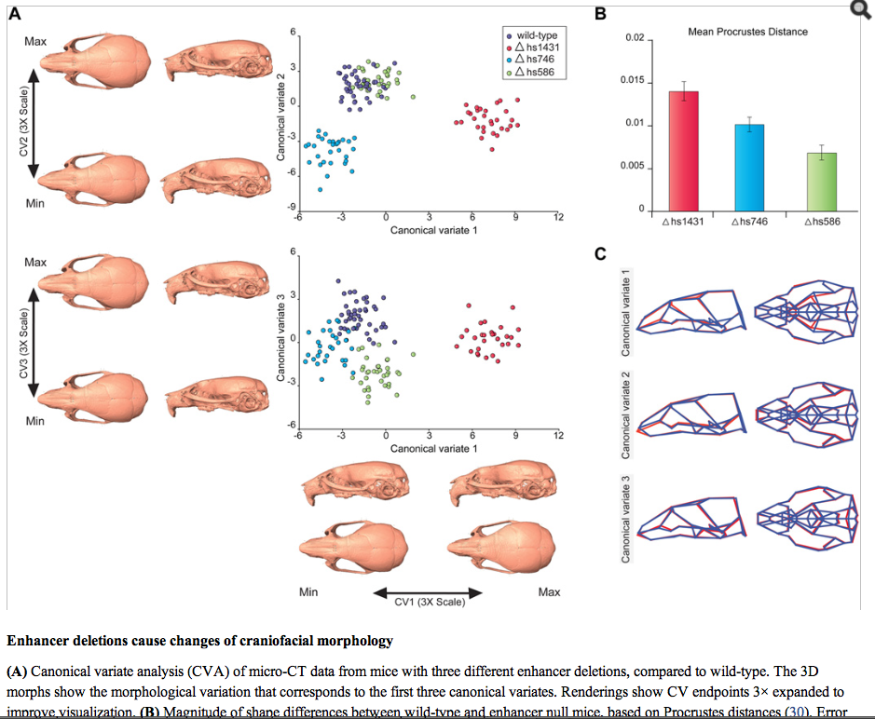
Deep phenotyping can reveal defects from enhancer deletions
Predict cranio-facial enhancers by P300 ChIP-seq.
Delete candidate enhancers.
Look for phenotypes by morphometic analysis.
Attanasio et al…Pennacchio, Visel (2013) Science 342:1241006

Slide 13
Genomics of Gene Regulation: Integration and Assays
Individual features can be good predictors, but they tend to point to similar regions
EP300, tissue-specific TFs, H3K4me1, H3K27ac
Integration of features by unsupervised machine-learning can reveal frequently occurring (and important) states
Debate over how good they are at predicting CRMs
Supervised machine-learning (e.g. EnhancerFinder) does a good job of finding the enhancers it was trained to find: developmental enhancers
Significant progress in ramping up the scale of gain-of-function assays for enhancers
Loss-of-function assays can be definitive, but they do sometimes show no phenotype for strong gain-of-function enhancers

