Slide 1
Genome Editing
BMMB 551 Genomics
Lesson 12, presentation 3
Hardison
(several slides from Dr. Cooduvalli Shashikant)

Slide 2
Genome Editing
Removal, modification, or addition of a functional element into the genome of a living cell or organism
Genes, regulatory regions
Random changes
Insertion of plasmids or viruses at any of many accessible targets
Directed changes
Homologous recombination
Sequence-specific DNA binding macromolecules
Protein domains: Zn fingers, TALEs
RNA: CRISPR

Slide 3
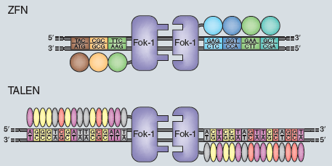
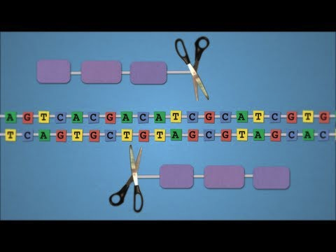
Sequence-directed DNA cleavage
Nature Methods January 2012 issue
http://www.youtube.com/watch?v=zDkUFzZoQAs
Notes:
Nature Methods January issue
Nature Methods, 9, 27, 2012

Slide 4
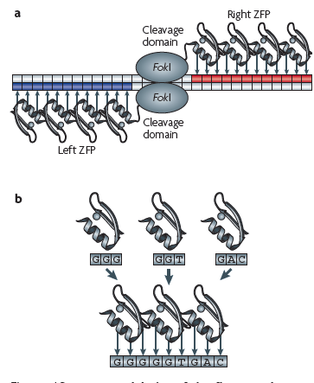
Zinc Finger Endonuclease
Array of zinc fingers (3-6) recognizing specific sequences are designed
Zn finger domains linked to FokI endonuclease domain
Bind to specific sequences and cleave sequences
Induces double stranded break that can be repaired
Urnov et al., Nat rev gen, 11, 636, 2010

Slide 5
TALES
Transcription Activator-like Effectors (TALE) produced by plant pathogen, Xanthomonas spp
17-18 repeats of 34 amino acids arranged side by side
DNA binding specificity is determined by the amino acids at positions 12 and 13 within each repeat

Slide 6
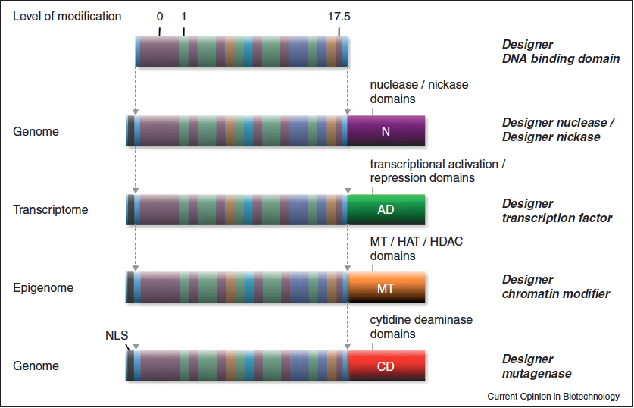
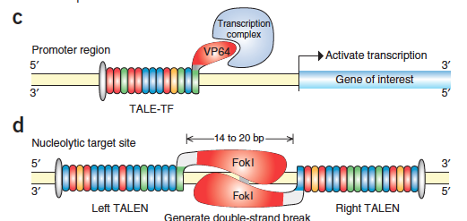
TALENS

Slide 7
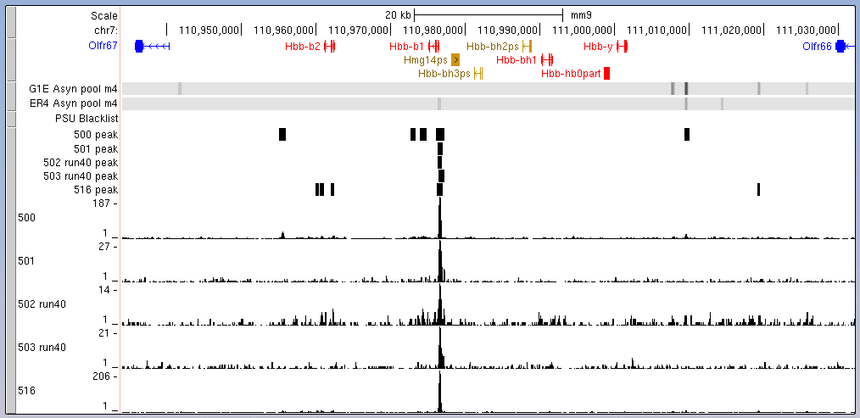
Example of targeted binding

Slide 8
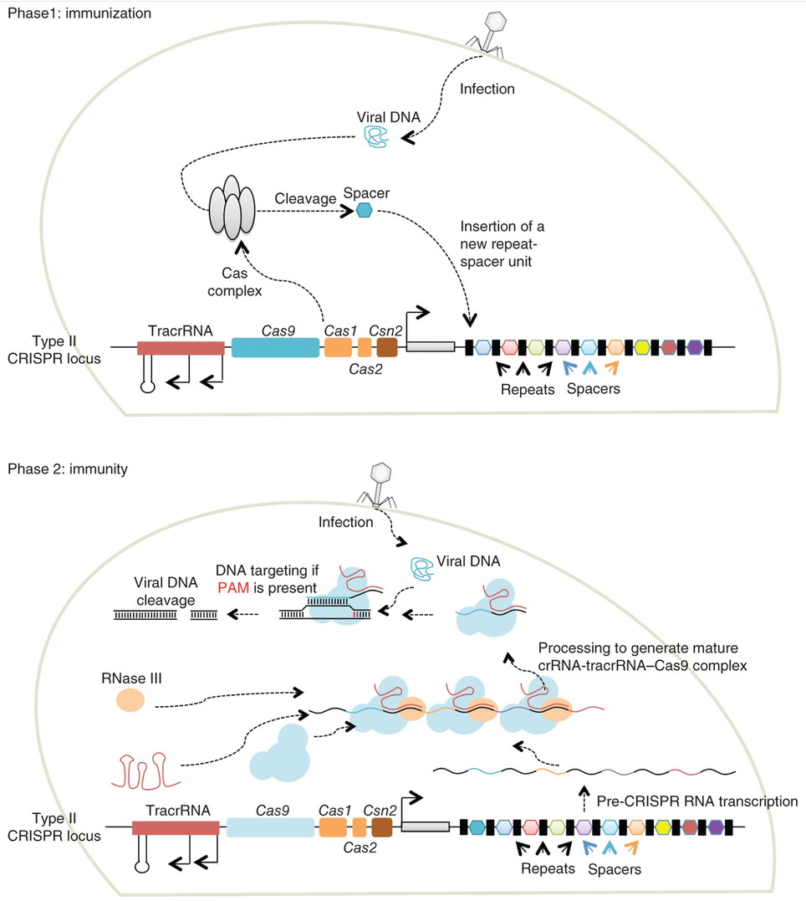
CRISPR and CAS9
Mali et al. (2013) Nature Methods 10: 957- 963

Slide 9
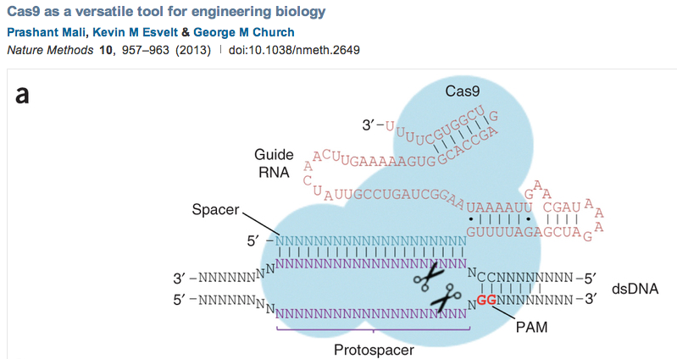
CRISPR RNAs guide CAS9 to specific genomic targets

Slide 10
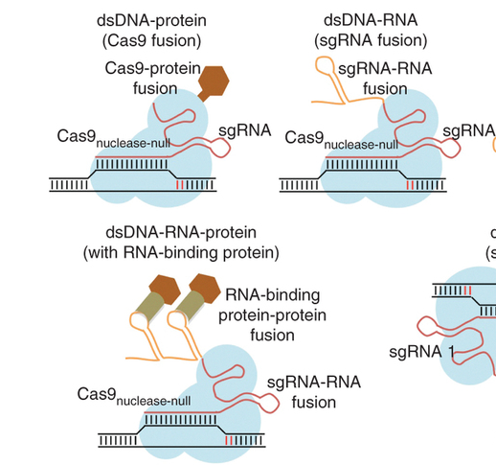
CAS9 can be modified to direct a marker or enzyme to a specific genomic target
Mali et al. (2013) Nature Methods 10: 957- 963

Slide 11
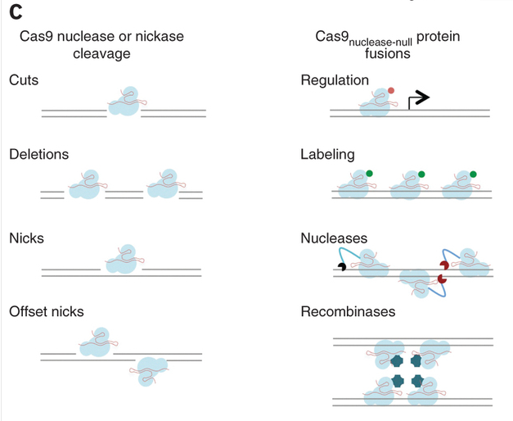
CAS9-CRISPR to alter sequences or direct activities to specific locations
Mali et al. (2013) Nature Methods 10: 957- 963

