Slide 1
Genome Editing
BMMB 551 Genomics
Lesson 12, presentation 3
Hardison
(many slides from Dr. Cooduvalli Shashikant)

Slide 2
Genome Editing
Removal, modification, or addition of a functional element into the genome of a living cell or organism
Genes, regulatory regions
Random changes
Insertion of plasmids or viruses at any of many accessible targets
Directed changes
Homologous recombination
Sequence-specific DNA binding macromolecules
Protein domains: Zn fingers, TALEs
RNA: CRISPR

Slide 3
GENE TARGETING
This section is taken from material from Dr. Cooduvalli Shashikant, PSU
KNOCKOUT, KNOCK-IN, KNOCKDOWN. Genome editing

Slide 4
Gene Targeting
Site-specific modification of the genome
Gene Disruptions
subtle mutations
Chromosomal rearrangements
Conditional gene targeting
Notes:
Gene targeting refers to the introduction of site-specific modifications into the genome by homologous recombination
Has advanced the field of mouse genetics and allowed the analysis of diverse aspects of gene function in whole organism
It is possible to engineer specific genetic alterations ranging from
subtle mutations
Chromosomal rearrangements
Tissue-specific inducible gene targeting with spatiotemporal control

Slide 5
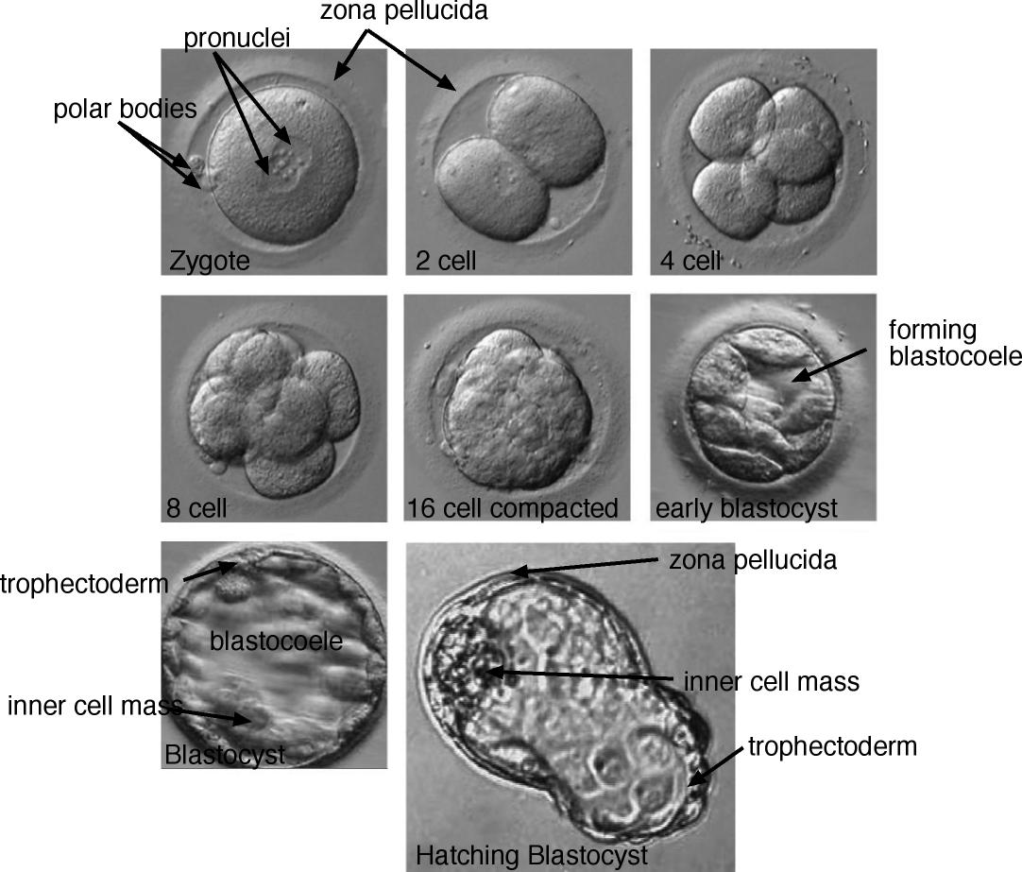
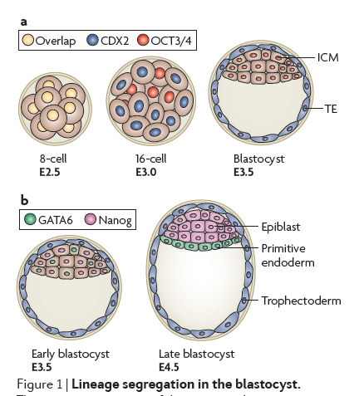
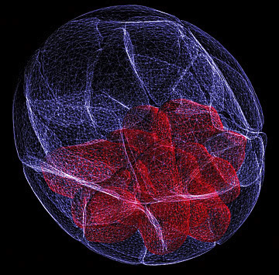
Embryogenesis

Slide 6
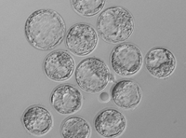
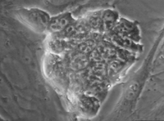
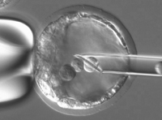
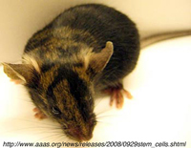
ES CELLS AND CHIMERIC MOUSE
Blastocysts
ES cells in a dish
ES cells injected into a mouse blastocyst
chimeric mouse
host embryo (black fur) and ES cells (brown fur)

Slide 7
ES cells
ES cell lines are derived from ICM
Contribute to both somatic and germ-line tissues
ES cells are generally derived from 129 sv strain of mice (white)
Transferred into C57BL blastocysts (black)
Chimeric mice are agouti

Slide 8
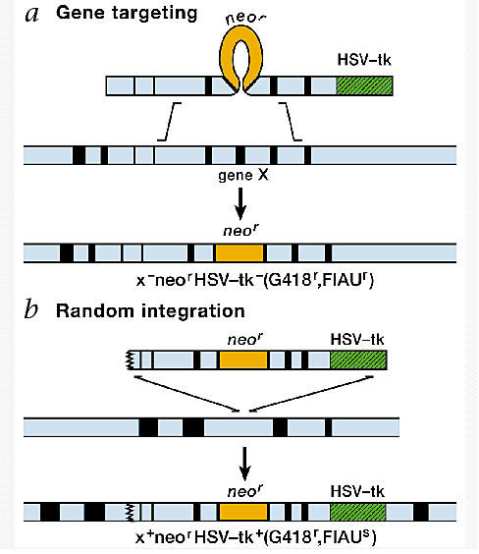
Positive-negative
Selection
G418 selects for neomycin
resistance
FIAU kills cells that contain
thymidine kinase

Slide 9
Generation of knockout mice
Isolation of ES cells containing a targeted mutation
Generation of chimeric mice able to transmit the mutant gene to their progeny

Slide 10
Gene Targeting
(Tywman, 2005)
Targeting Strategy Objective
Gene “Knockout” (KO) Disruption or deletion of selected
endogenous target---removal of single
exon may suffice to achieve KO (Null)
Allele Replacement replacing a wildtype allele with a subtle
mutation ---In cystic fibrosis, + to Δ508F
Gene repair dysfunctional mutant replaced by
functional copy of gene
(Gene therapy/Gene Medicine)
Targeted Insertion insertion of transgene at specific locus
may not disrupt the endogenous locus
Gene “Knock-in” replacement of endogenous allele with a non-allelic sequence ---use regulatory
info from one gene to drive another
Gene “Knock-down” reduces expression of allele---

Slide 11
Conditional deletions
CRE-LOX

Slide 12
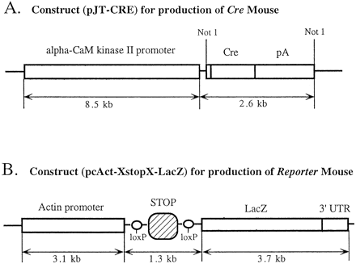
(CAM Kinase promoter is expressed in restricted regions in the adult
Forebrain)

Slide 13
Setting up binary system
CAM Kinase promoter is expressed in restricted regions in the adult forebrain
It directs expression of Cre to CA1 region of the hippocampus
Floxed stop signal stops lacZ gene gene being transcribed/translated
Removal of floxed stop signal leads to activation of lacZ in CA1 region of the hippocampus

Slide 14
LacZ Expression in the Brain
Restricted expression of lacZ in different transgenic lines in the CA1 region of the hippocampus

Slide 15
Genome editing
ZFNS AND TALENS

Slide 16
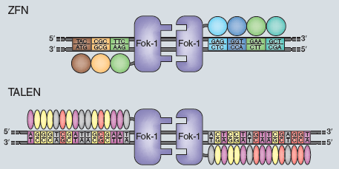
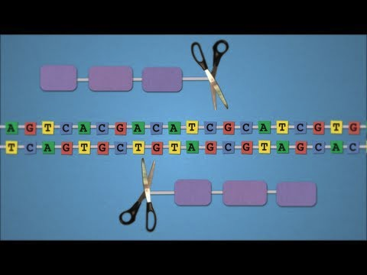
Method of the year-2011
Nature Methods January 2012 issue
http://www.youtube.com/watch?v=zDkUFzZoQAs
Notes:
Nature Methods January issue
Nature Methods, 9, 27, 2012

Slide 17
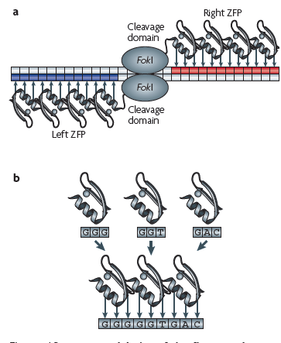
Zinc Finger Endonuclease
Array of zinc fingers (3-6) recognizing specific sequences are designed
Zn finger domains linked to FokI endonuclease domain
Bind to specific sequences and cleave sequences
Induces double stranded break that can be repaired
Urnov et al., Nat rev gen, 11, 636, 2010

Slide 18
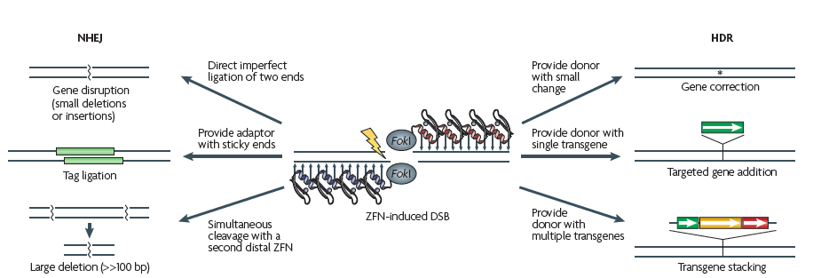
Urnov et al., Nat rev gen, 11, 636, 2010

Slide 19
TALES
Transcription Activator-like Effectors (TALE) produced by plant pathogen, Xanthomonas spp
17-18 repeats of 34 amino acids arranged side by side
DNA binding specificity is determined by the amino acids at positions 12 and 13 within each repeat

Slide 20
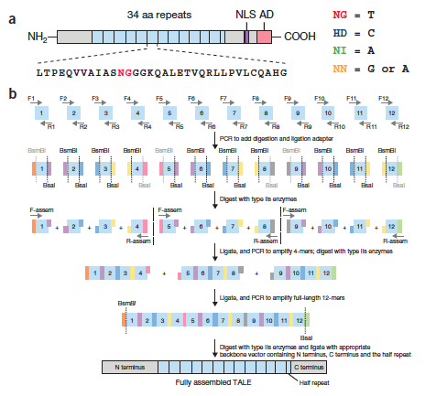
Artificial TALEs
Zhang et al., Nature Biotech, 29, 149, 2011

Slide 21
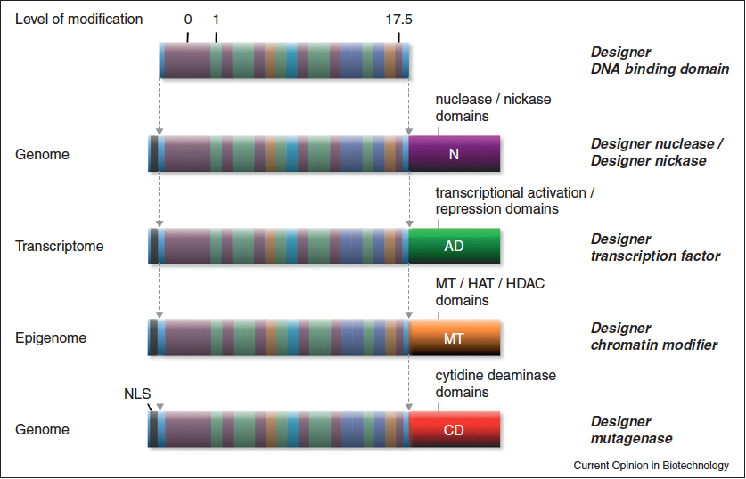
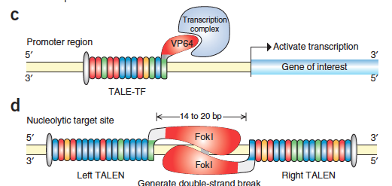
TALENS

Slide 22
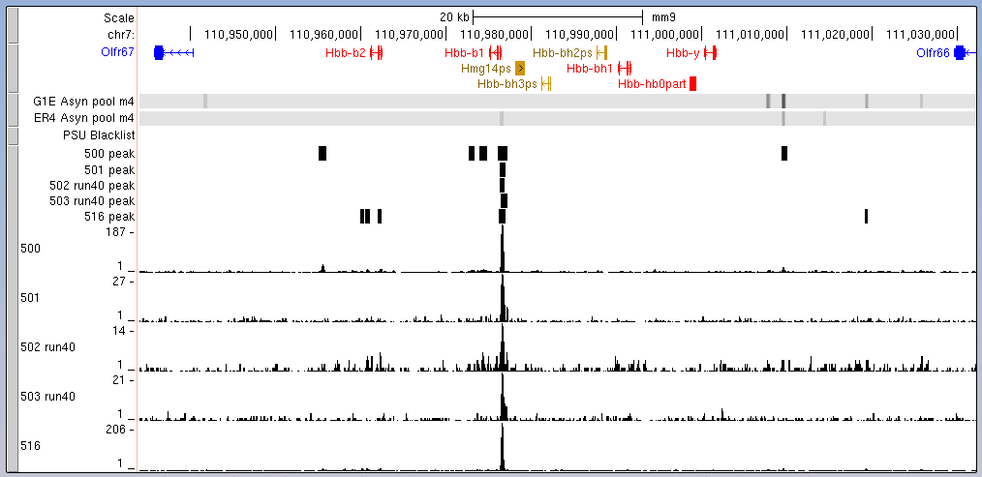
Example of targeted binding

Slide 23
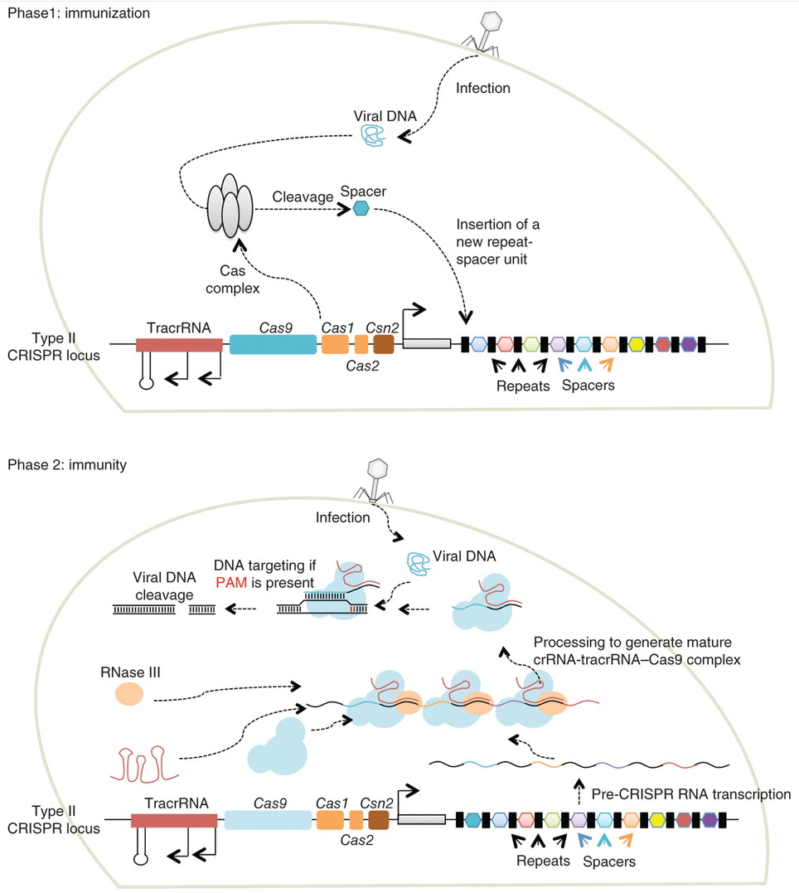
CRISPR and CAS9
Mali et al. (2013) Nature Methods 10: 957- 963

Slide 24
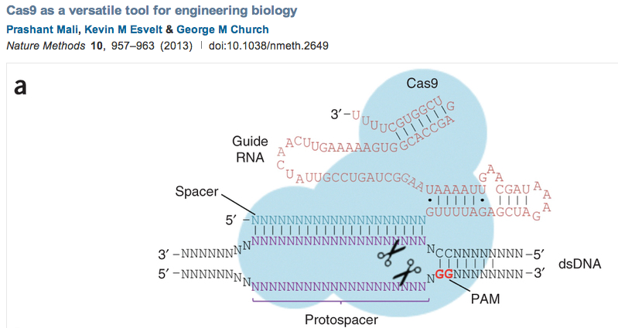
CRISPR RNAs guide CAS9 to specific genomic targets

Slide 25
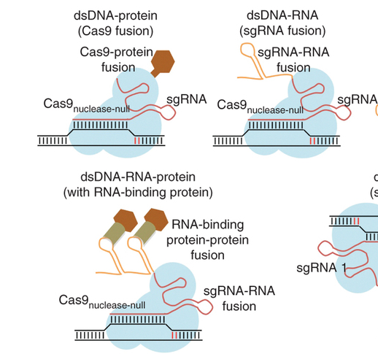
CAS9 can be modified to direct a marker or enzyme to a specific genomic target
Mali et al. (2013) Nature Methods 10: 957- 963

Slide 26
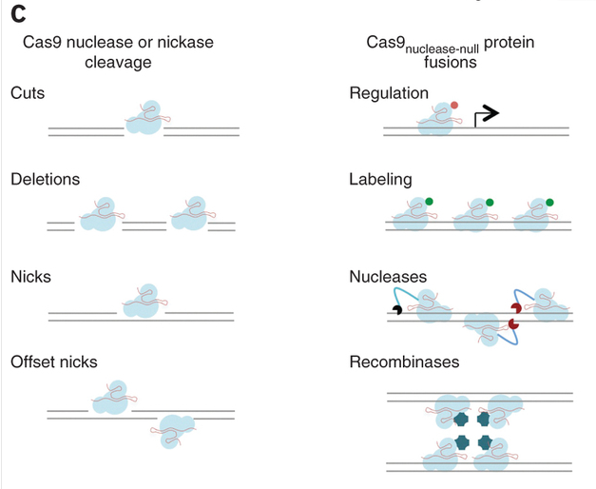
CAS9-CRISPR to alter sequences or direct activities to specific locations
Mali et al. (2013) Nature Methods 10: 957- 963

