Slide 1
Gene regulation and phenotype-associated genetic variants
BMMB 551 Genomics
Ross Hardison

Slide 2
Published GWA Reports, 2005 – 6/2012
1350
Total Number of Publications
Calendar Quarter
Through 6/30/12 postings

Slide 3
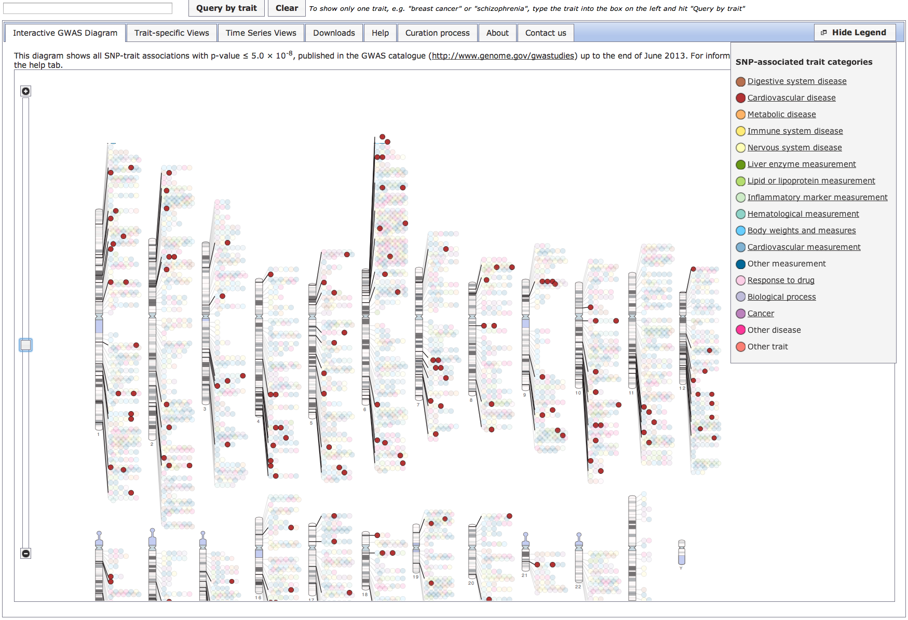
GWAS catalog interactive browser
http://www.ebi.ac.uk/fgpt/gwas/

Slide 4
Moving from maps of loci associated with a trait to identifying the causative genetic variants
Mendelian disorders: Once a locus was strongly implicated in the disease, attention was rightly focused on the protein-coding genes in the region
Many of the causative variants impact the structure of the encoded protein
Likely that a substantial fraction of genetic variants contributing to complex traits in humans are involved in gene regulation
Observed in model organisms such as flies.
Most phenotype-associated variants discovered in GWAS are far from protein-coding regions, even appearing in gene deserts
Similar to the genomic distribution of most cis-regulatory modules (CRMs) such as promoters and enhancers
Trait-associated variants from GWAS are more likely to be associated with quantitative variation in gene expression than are other variants on the genotyping arrays

Slide 5
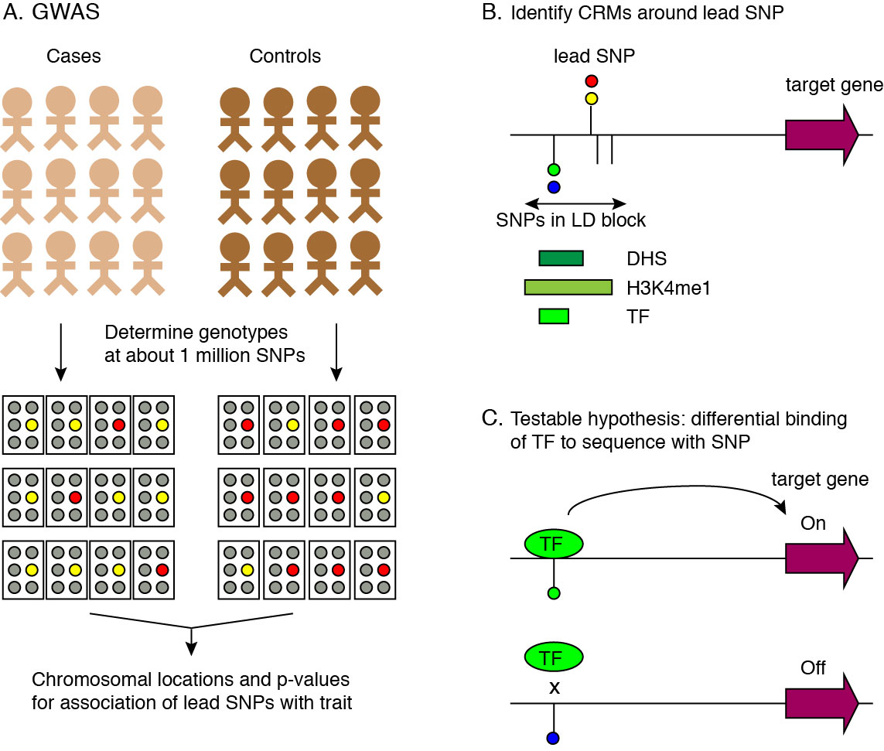
From GWAS results to allele-specific regulation
Hardison: JBC minireview on Epigenetic data as guide to interpret GWAS

Slide 6
Phenotype-associated SNPs tend to fall in function-associated genomic segments
ENCODE consortium
Ewan Birney
Penn State: Belinda Giardine, Bob Harris, Ross Hardison
The ENCODE Project Consortium (2012) An integrated Encyclopedia of DNA Elements in the human genome. Nature

Slide 7
Hypothesis: Phenotype associated variants is associated with function from biochemical assays
f_bp = bp in DNA segment implicated in function by ENCODE data (10% - 80%)
Whole
genome
f_SNPs
(0.45%)
1 M
SNPs on array
3 Gbp
300 M
4.5 K
?

Slide 8
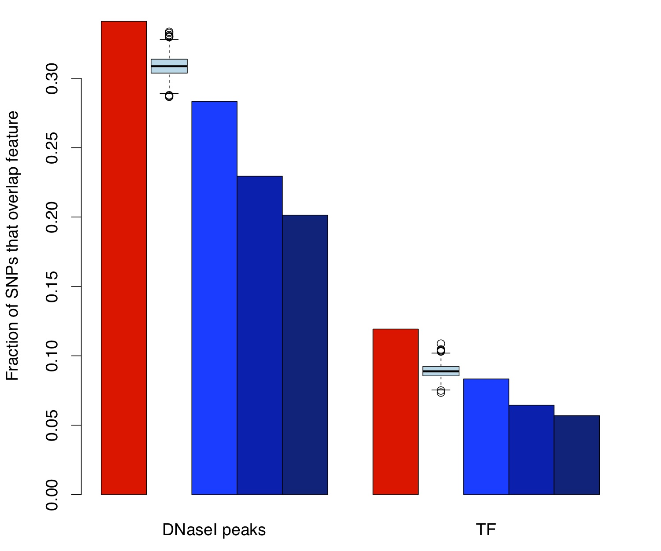
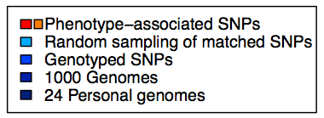
GWAS SNPs are enriched in function-associated regions: DNase HSs and TF-occupied segments
Fractions increase to 71% (DHS) and 31% (Tfos) if include SNPs in LD with lead GWAS SNP
The ENCODE Project Consortium (2012) An integrated Encyclopedia of DNA Elements in the human genome. Nature 489: 57-74

Slide 9
ENCODE data reveal likely causative SNP for susceptibility to breast and prostate cancer at 8q24
Wokolorczyk et al. (2008) A range of cancers is associated with the rs6983267 marker on chromosome 8. Cancer Res 68, 9982-9986
Al Olama et al. (2009) Multiple loci on 8q24 associated with prostate cancer susceptibility. Nat Genet 41, 1058-10560
Tuupanen et al. (2009) The common colorectal cancer predisposition SNP rs6983267 at chromosome 8q24 confers potential to enhanced Wnt signaling. Nat Genet 41, 885-890
Pomerantz et al. (2009) The 8q24 cancer risk variant rs6983267 shows long-range interaction with MYC in colorectal cancer. Nat Genet 41, 882-884
Jia et al. (2009) Functional enhancers at the gene-poor 8q24 cancer-linked locus. PLoS Genet 5, e1000597
The ENCODE Project Consortium (2011) A User's Guide to the Encyclopedia of DNA Elements (ENCODE). PLoS Biology 9: e1001046.

Slide 10
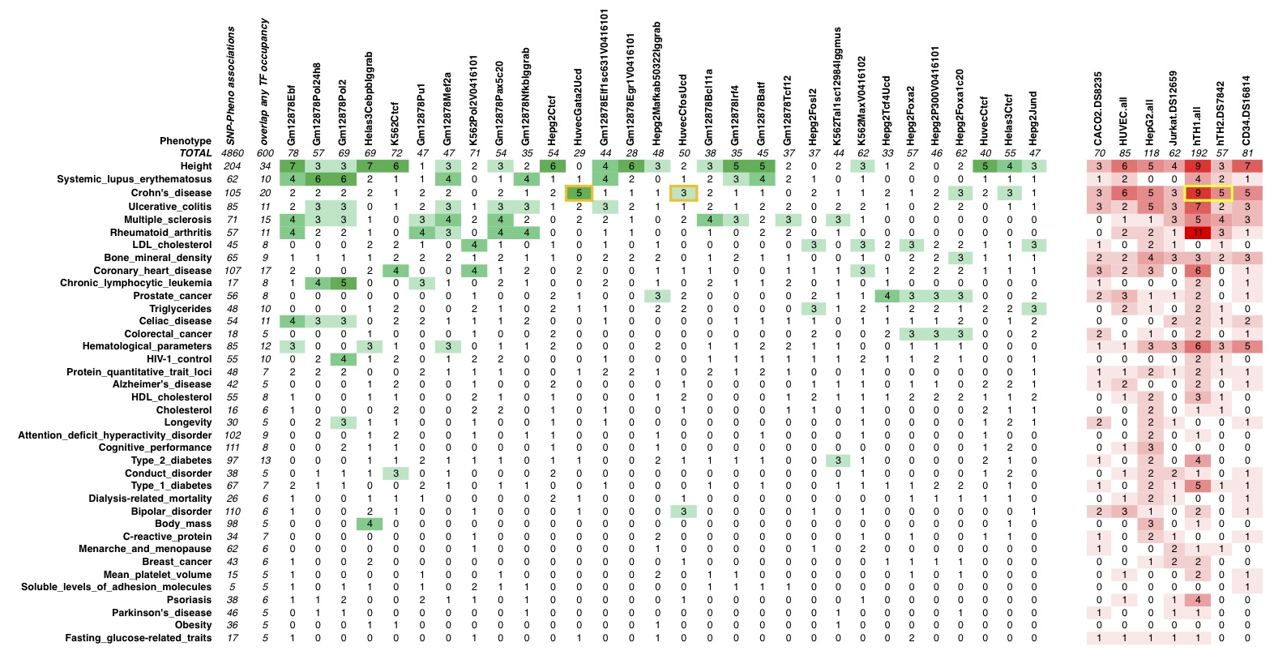
Some SNPs associated with one phenotype are found in segments occupied by a specific TF
302 phenotype-SNP groups: test overlap with 414 TF-cell and 80 DNase-cell datasets
SNPs associated with Crohn disease, ulcerative colitis are in DNA segments
- occupied by GATA2 or cFOS
- DNase HSs in T-helper cells
The ENCODE Project Consortium (2012) An integrated Encyclopedia of DNA Elements in the human genome. Nature 489: 57-74

Slide 11
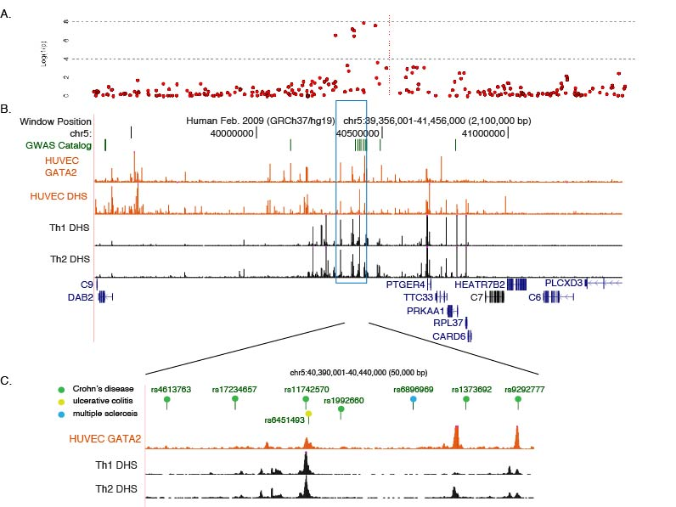
Crohn Disease-associated SNPs in gene desert appear to regulate PTGER4
Libioulle, C., …... Georges, M. (2007) Novel Crohn disease locus identified by genome-wide association maps to a gene desert on 5p13.1 and modulates expression of PTGER4. PLoS Genet 3, e58
Hardison: JBC minireview on Epigenetic data as guide to interpret GWAS
The ENCODE Project Consortium (2012) An integrated Encyclopedia of DNA Elements in the human genome. Nature 489: 57-74

Slide 12
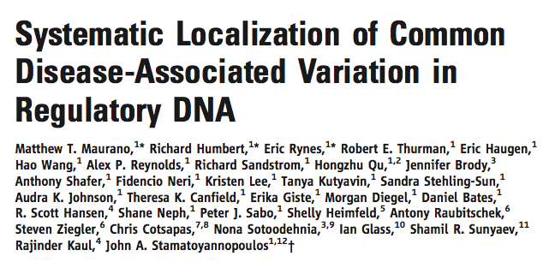

Slide 13
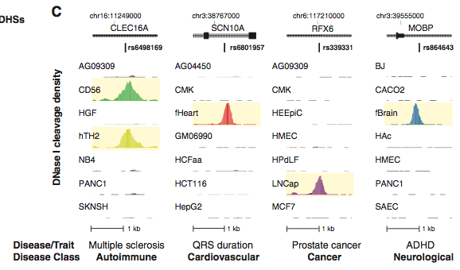
Disease associated SNPs tend to be in DHS specific to tissue affected by the disease
Cell type-specific DHSs

Slide 14
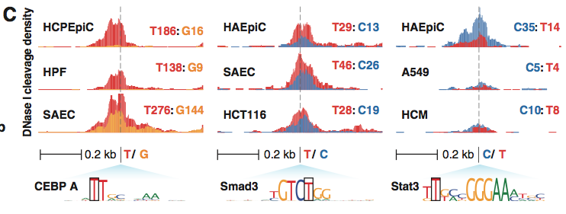
Allelelic differences in DHSs
“Examples of allele-specific DNase I sensitivity in cell types derived from heterozygous individuals for GWAS variants that alter transcription factor recognition motifs within DHSs. Each cell type track shows DNase I cleavage density scaled by allelelic imbalance at the GWAS variants and colored by the variant nucleotide … Total reads from each allele are also shown.
The difference in level of DNase sensitivity is likely caused by the alteration in the TF binding site motif, since that is the only difference in sequences of the two alleles. The variant with high binding affinity for the TF has greater DNase sensitivity, suggesting that the difference in DNA sequence leads to differential occupancy by the TF and different usage of the CRM.

Slide 15
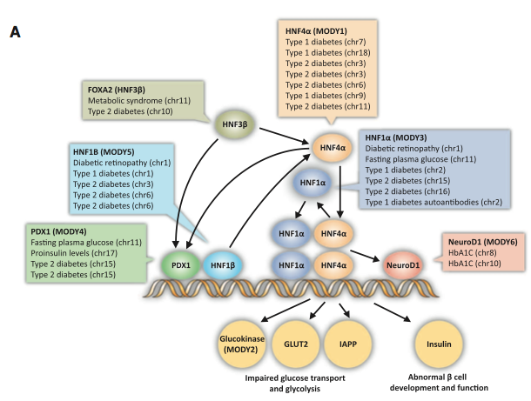
Disease-associated variants cluster in transcriptional regulatory pathways
Mendelian phenotypes for maturity-onset diabetes of the young (MODY) are known to be caused by loss-of-function mutations in the TFs shown (ovals). The variants associated with non-Mendelian (complex) susceptibility to type I and type II diabetes tend to be in DHSs and in recognition sites for binding by these same TFs.

Slide 16
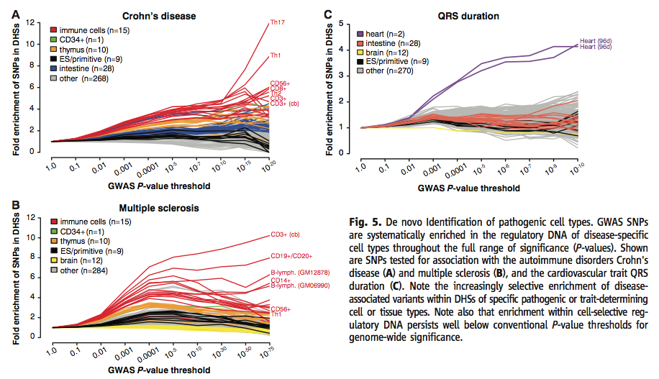
Identifying cell types affected by pathology without prior biological knowledge
Do GWAS SNPs localize selectively in the regulatory DNA of individual cell types? Start with all the variants tested for association with a disease or trait, not just the ones with significant association (1 to 3 million each). Determine the “cell- and tissue-selective enrichment patterns of progressively more strongly associated variants to expose collective localization within specific lineages or cell types.” IF you condition on regulatory DNA, you can apply a less stringent statistical threshold to find hundreds of phenotype associated variants that likely affect regulatory function.

Slide 17
Unexplained variation
Despite mapping multiple loci with high resolution and significance, the amount of heritability explained is very low for most complex traits, almost always less than 10% (10).
The search for the missing heritability is proceeding on many fronts (11,12)
Including departures from the assumption that common variants are involved (13,14).
10. Frazer, K. A., Murray, S. S., Schork, N. J., and Topol, E. J. (2009) Nat Rev Genet 10, 241-251
11. Manolio, T. A., Collins, F. S., Cox, N. J., et al. (2009) Nature 461, 747-753
12. Eichler, E. E., Flint, J., Gibson, G., Kong, A., Leal, S. M., Moore, J. H., and Nadeau, J. H. (2010) Nat Rev Genet 11, 446-450
13. Cirulli, E. T., and Goldstein, D. B. (2010) Nat Rev Genet 11, 415-425
14. Zhu, Q., Ge, D., Maia, J. M., Zhu, M., Petrovski, S., Dickson, S. P., Heinzen, E. L., Shianna, K. V., and Goldstein, D. B. (2011) Am J Hum Genet 88, 458-468

Slide 18
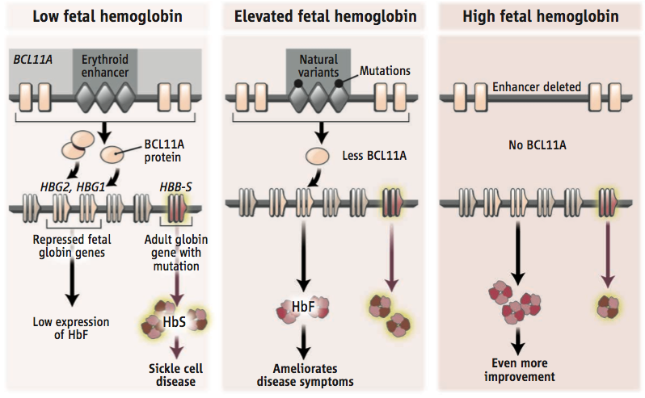
Exploiting nature’s variants
Bauer et al.(2013) Science 342: 253; Hardison and Blobel (2013) Science 342: 206

Slide 19
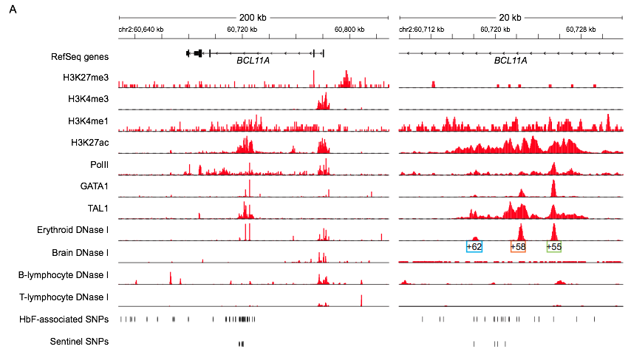
Candidate enhancer in intron of BCL11A
Bauer et al.(2013) Science 342: 253

Slide 20
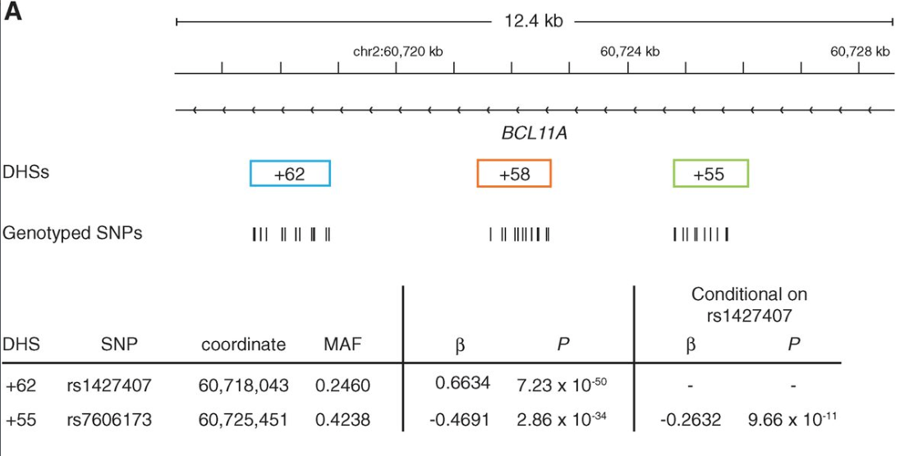
SNP in candidate enhancer is associated with high HbF
Bauer et al.(2013) Science 342: 253

Slide 21
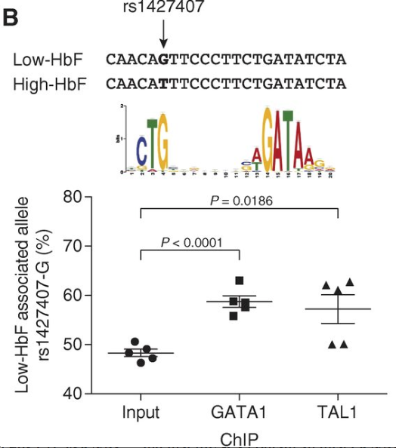
SNP in candidate enhancer shows allele-specific binding by TFs
Bauer et al.(2013) Science 342: 253

Slide 22
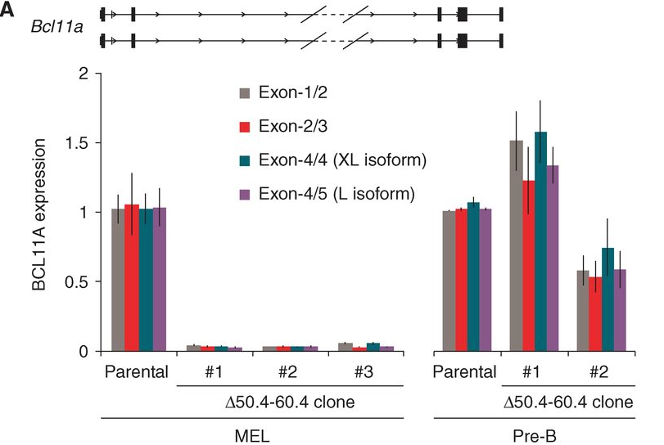
Targeted deletion of enhancer leads to tissue-specific loss of expression of BCL11A
Bauer et al.(2013) Science 342: 253

