Slide 1
Genome-wide Association Studies
Genomics Lesson 12_1
Ross Hardison

Slide 2
Genetic association
The occurrence together in a population, more often than can be readily explained by chance, of two or more traits of which at least one is known to be genetic.
This can be
between phenotypes, e.g. visible characteristics such as flower color or height,
between a phenotype and a genetic polymorphism, such as a single nucleotide polymorphism,
between two genetic polymorphisms.
Association between genetic polymorphisms occurs when there is non-random association of their alleles as a result of their proximity on the same chromosome; this is known as genetic linkage.
Wikipedia

Slide 3
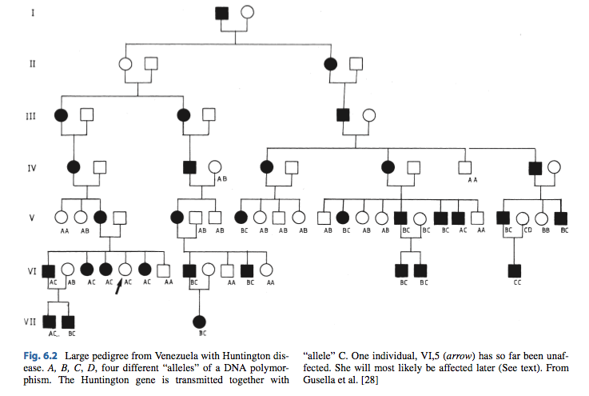
Huntington Disease Pedigree
haplotype
Vogel and Motulsky’s Human Genetics, 4th edition, Chpt 6, 2010.

Slide 4
Mendelian traits and diseases: Can affect protein structure
Mutations that lead to Mendelian inheritance of traits or disease usually alter the function of single genes
Often reduce or modify the function of the protein product by changing the encoded amino acid sequence
Huntington Disease is caused by mutations in the gene HTT
Encodes huntingtin
Apparent role in neurons, but precise function unknown
Number of copies of a CAG repeat in the coding sequence
Normal: 10 to 35 copies of CAG
Disease-associated: 36 to >120 copies
Copy number between 36 and 39: may or may not develop symptoms
Copy number >= 40: almost always develop disorder
Genetics Home Reference
http://ghr.nlm.nih.gov/condition/huntington-disease

Slide 5
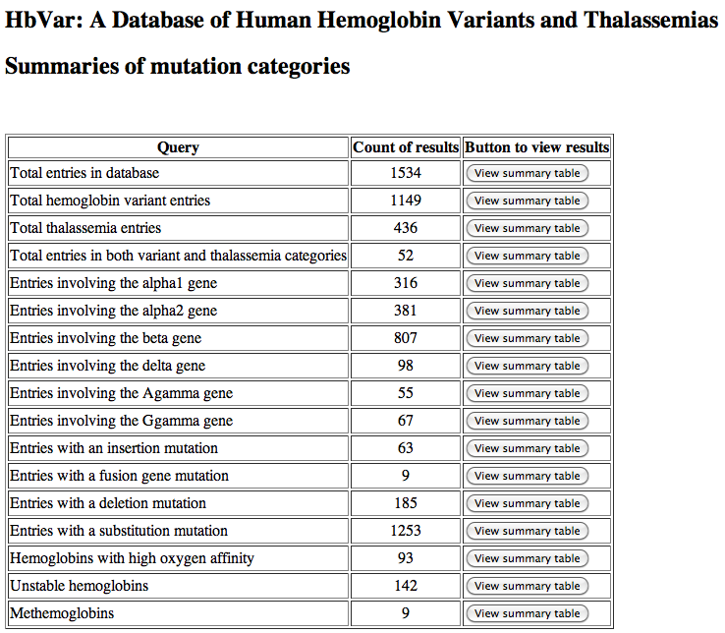
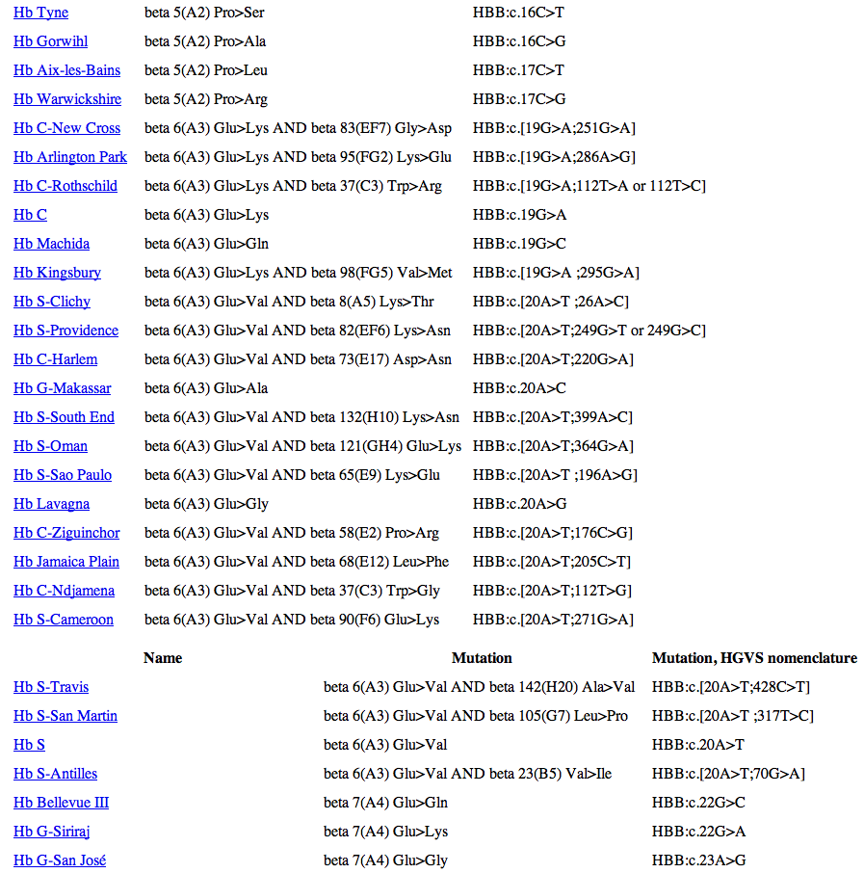
Variants in genes encoding Hb
Portion
of entries

Slide 6
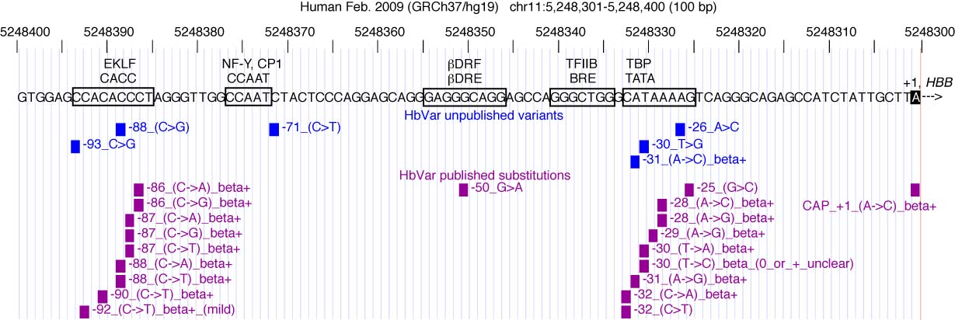
Mendelian traits and diseases: Can affect amount of protein
In addition, some Mendelian diseases are caused by debilitating mutations in promoters or enhancers of a gene
Results in a deficiency of the protein product and the consequent pathological phenotype
E.g. beta-thalassemia
Giardine et al. (2011) Nature Genetics 43: 295-301

Slide 7
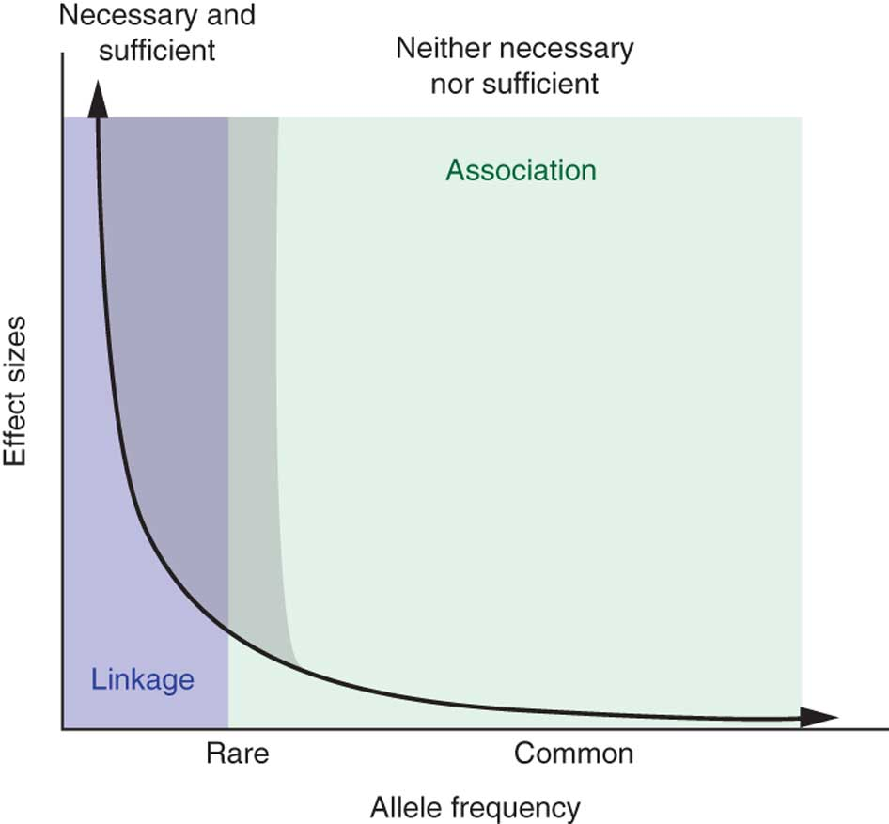
Mendelian variants: rare but with large effect size
Genetic variants causing Mendelian disease are rare in the human population because selective pressure against their deleterious effects keeps their allele frequency low
One model for common (and complex) traits is that they are determined by common alleles of low effect size
Matthew W State & Pat Levitt (2011) The conundrums of understanding genetic risks for autism spectrum disorders. Nature Neuroscience 14, 1499–1506

Slide 8
Mapping variants causing Mendelian disease
Since the genetic variants causing monogenic diseases are rare, mapping studies are confined to detailed analyses of affected families and kindreds
Such studies have mapped genetic variants at the heart of many monogenic disorders
The Online Mendelian Inheritance in Man database currently lists almost 3400 phenotypes for which the molecular basis known.

Slide 9
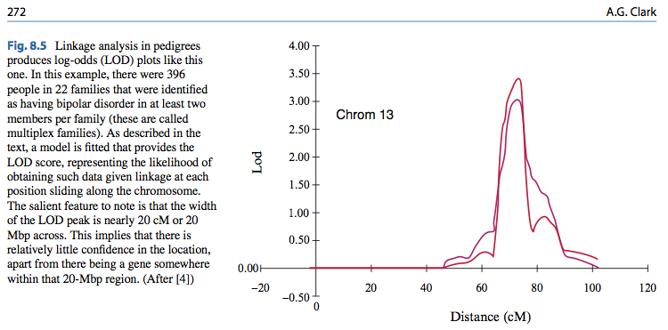
Linkage analysis in pedigrees for bipolar disorder
Vogel and Motulsky’s Human Genetics, 4th edition, Chpt 8, 2010.

Slide 10
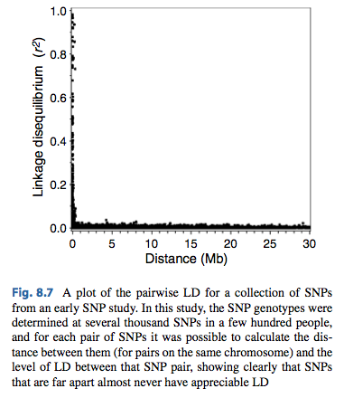
SNPs are linked only over short distances
Can use association of a trait with many SNPs to get a high resolution map of determinants of a phenotype
Not in a family
Vogel and Motulsky’s Human Genetics, 4th edition, Chpt 8, 2010.

Slide 11
Genetics of susceptibilities to common diseases
E.g. coronary artery disease, many forms of cancer and Type II diabetes
Have substantial genetic components
These phenotypes are affected by variants at multiple loci
Contrast to the Mendelian diseases
Thus susceptibility to a common disease is a complex trait
Mapping the multiple loci that contribute to these important traits usually follows a case-control design (next slide)
The mapping experiments examine single nucleotide polymorphisms (SNPs) to ascertain the genotypes that are significantly more prevalent in the affected group than in the nonaffected group
These genotypes are associated with the trait of interest
When genotypes are determined at SNPs throughout the genome of each individual, the study is called a genome-wide association study, or GWAS.

Slide 12
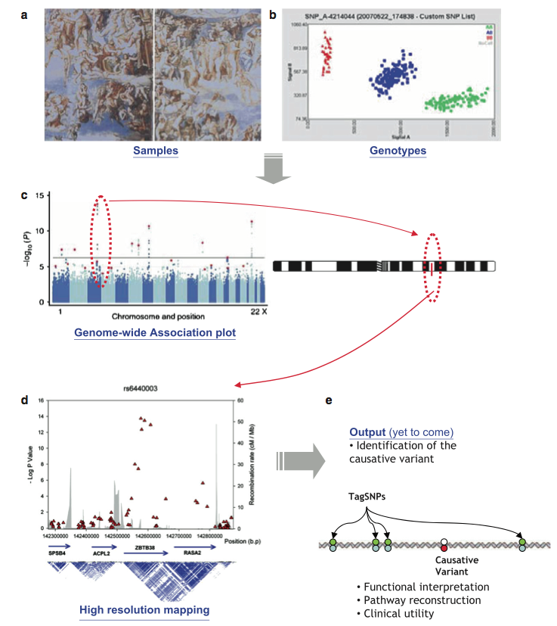
Steps in GWAS
Case Control
BB
AB
AA
Signal B
Signal A
Vogel and Motulsky’s Human Genetics, 4th edition, Chpt 8.1, 2010.

Slide 13
Genetic association
Find SNPs with allele frequencies that differ significantly between groups
Hardison: JBC minireview on Epigenetic data as guide to interpret GWAS

Slide 14
Common variants may be the main genetic determinants of complex traits
Genetic variants causing Mendelian disease are rare in the human population because selective pressure against their deleterious effects keeps their allele frequency low
One model for common (and complex) traits is that they are determined by common alleles
But low effect size
Small phenotypic effect allows allele frequencies to increase to “common”, i.e. >=0.05
HapMap project greatly facilitated GWAS
Matthew W State & Pat Levitt (2011) The conundrums of understanding genetic risks for autism spectrum disorders. Nature Neuroscience 14, 1499–1506

Slide 15
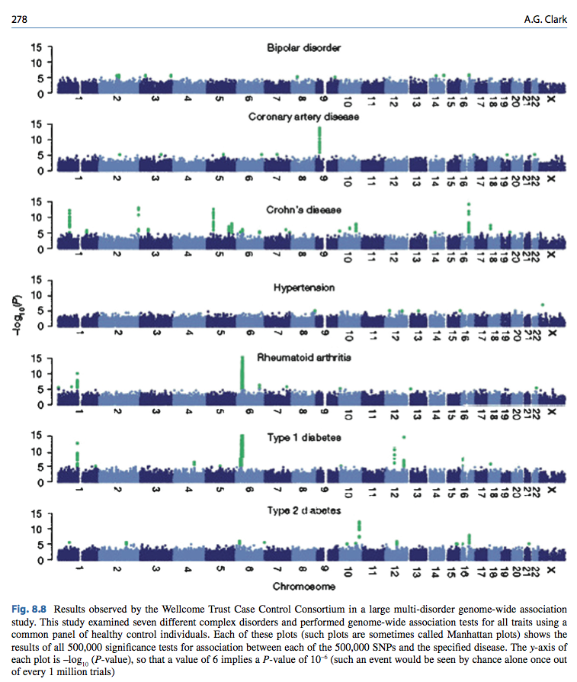
GWAS results for 7 diseases
Vogel and Motulsky’s Human Genetics, 4th edition, Chpt 8, 2010.

Slide 16
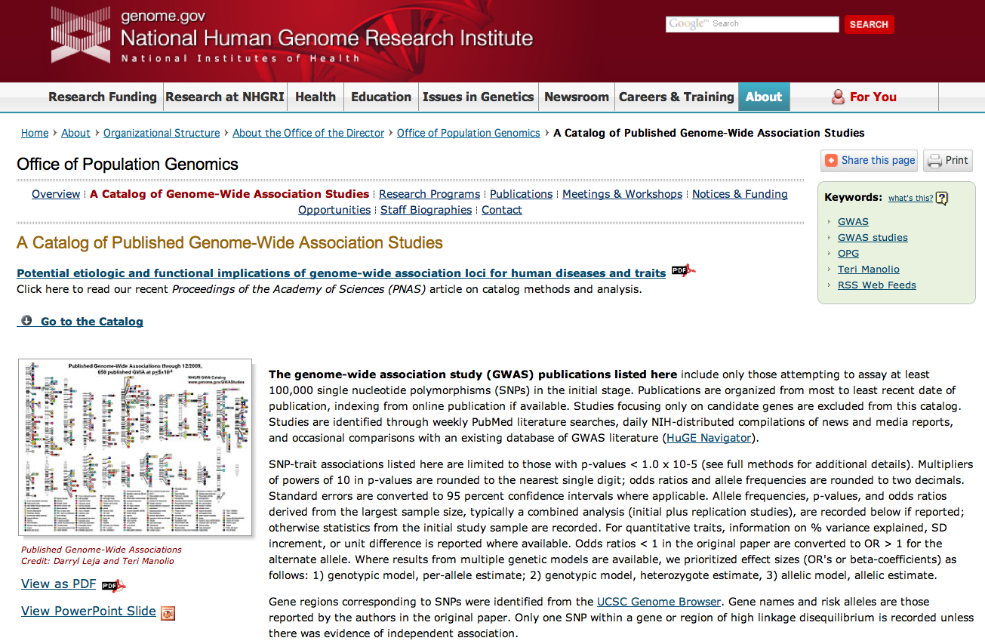
http://www.genome.gov/GWAStudies/

Slide 17
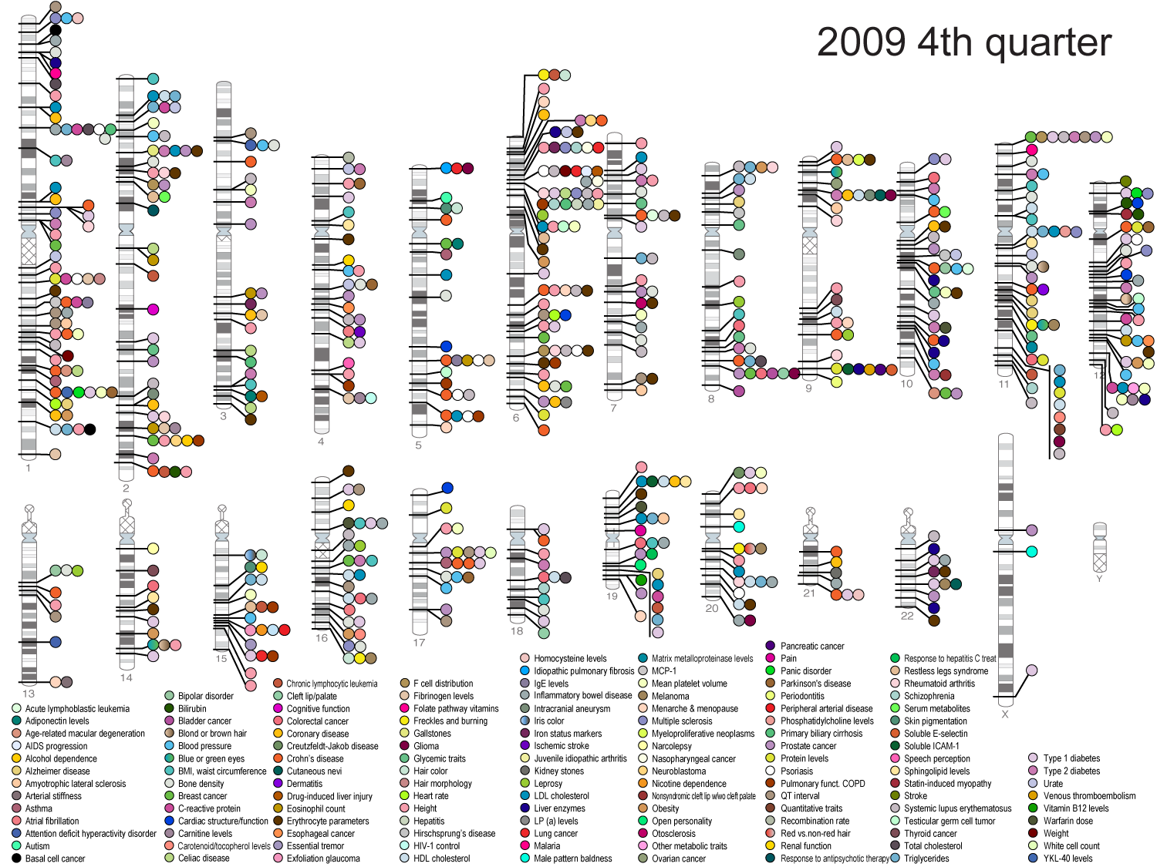
Published Genome-Wide Associations through 12/2009,
658 published GWA at p<5x10⁻⁸; in 2011: 1449 GWAS, 237 traits
NHGRI GWA Catalog
www.genome.gov/GWAStudies

Slide 18
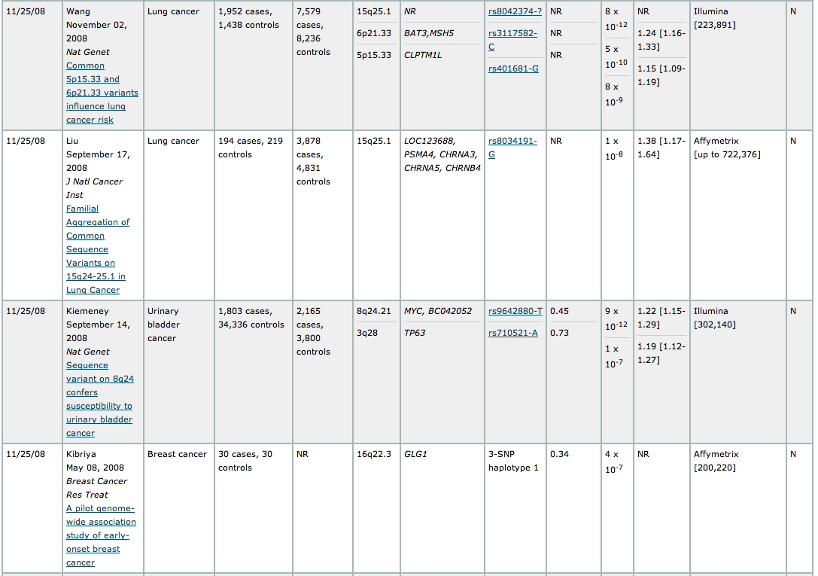
Examples of cancer association studies

