Slide 1
Much ado about function
Genomics
Lesson 11_ 2
Hardison

Slide 2
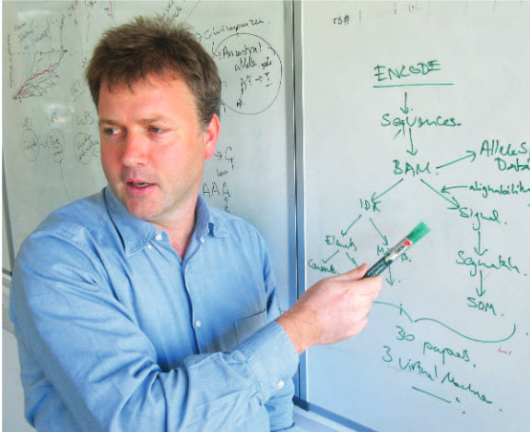
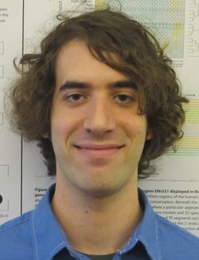
Controversy over evidence for function in genome sequences
“An integrated encyclopedia of DNA elements in the human genome”
ENCODE Consortium Nature 2012
“On the immorality of television sets: ‘Function’ in the human genome according to the evolution-free gospel of ENCODE”
Graur D et al. Genome Biol Evol 2013; 5:578-90.
Presentation from Michael M. Hoffman, 4 April 2013
Was a lead analyst in ENCODE Consortium, University of Washington
Now Princess Margaret Cancer Centre, Toronto
Defining functional DNA elements in the human genome”
Kellis et al., Proc Natl Acad Sci USA 2014

Slide 3
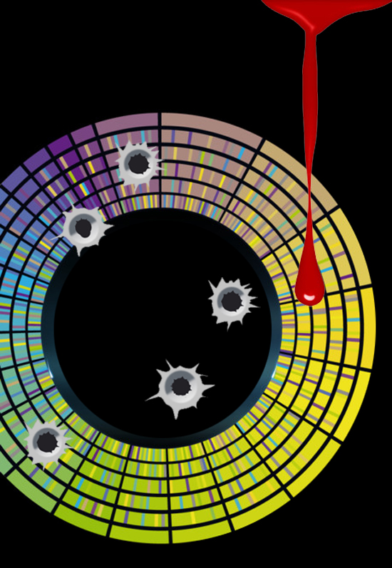

Slide 4
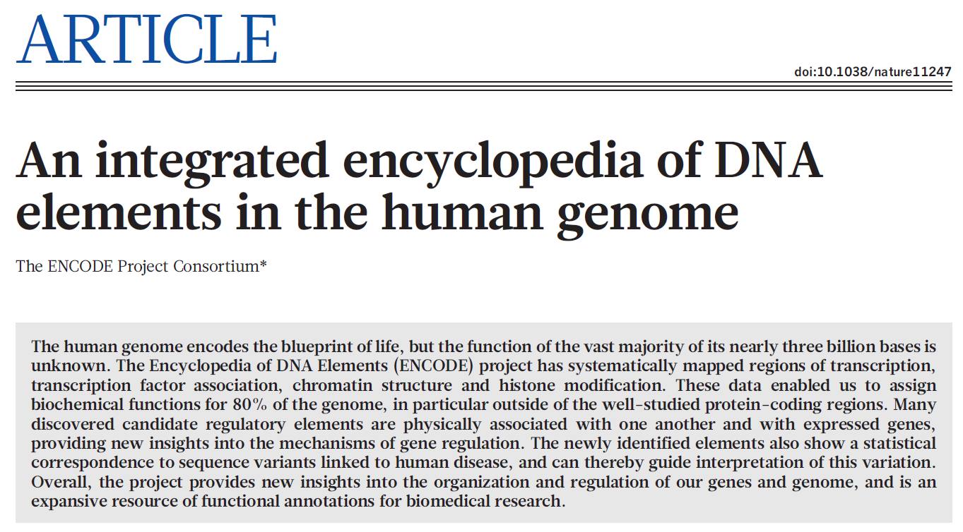
“These data enabled us to assign biochemical functions for 80% of the genome, in particular outside of the well-studied protein-coding regions.”

Slide 5
What is “biochemical function?”
“Operationally, we define a functional element as a discrete genome segment that encodes a defined product (for example, protein or non-coding RNA) or displays a reproducible biochemical signature (for example, protein binding, or a specific chromatin structure).”
“The vast majority (80.4%) of the human genome participates in at least one biochemical RNA- and/or chromatin-associated event in at least one cell type.”
“An integrated encyclopedia of DNA elements in the human genome.” Paragraphs 2 and 4.

Slide 6
Relation to evolution?
“Comparative genomic studies suggest that 3–8% of bases are under purifying (negative) selection and therefore may be functional, although other analyses have suggested much higher estimates.”
“An integrated encyclopedia of DNA elements in the human genome.” Paragraph 2.

Slide 7
Estimates in ENCODE paper
Purifying selection | Biochemical function
3%–8% | 80.4%
ENCODE consortium. 2012 Nature
Kellis et al. 2015 PNAS

Slide 8
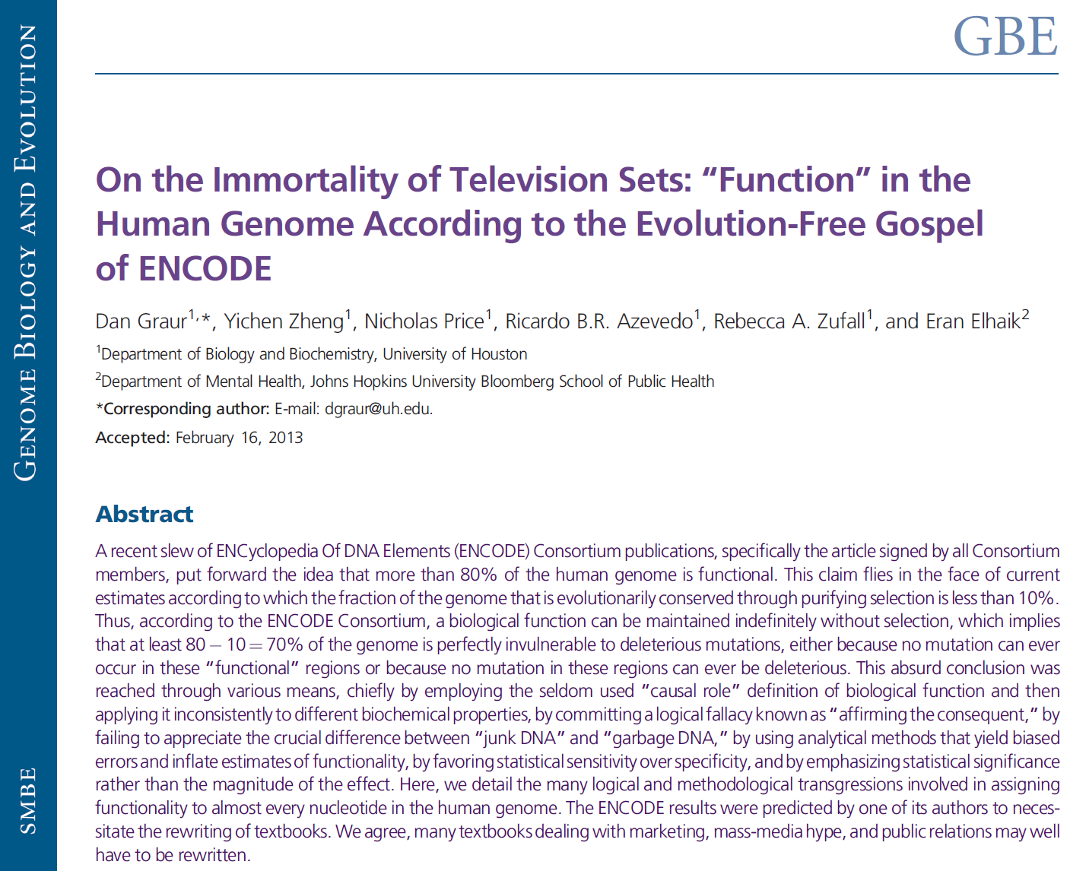
m

Slide 9
Main complaints of Graur et al.
ENCODE’s definition of function is wrong
ENCODE’s definition leads to absurd consequences
ENCODE favors sensitivity over specificity
ENCODE does not demonstrate selection
ENCODE is not useful

Slide 10
Two definitions of function
Selected effect. Evolutionary. For trait T to have function F, necessary:
T is a copy of some trait that performed F in the past; and
T exists because of F.
Causal role. Non-evolutionary. For trait Q to have function G, necessary:
Trait Q performs G.

Slide 11
Why use selected effect?
“The main advantage of the selected-effect function definition is that it suggests a clear and conservative method of inference for function in DNA sequences; only sequences that can be shown to be under selection can be claimed with any degree of confidence to be functional.”
Graur et al. 2013, GBE

Slide 12
Narrow utility of selected effect
“The main advantage of the selected-effect function definition is that it suggests a clear and conservative method of inference for function in DNA sequences; only sequences that can be shown to be under selection can be claimed with any degree of confidence to be functional.”
Hardison Reply: Lineage-specific function really does occur; e.g., there are multiple examples of lineage specific aspects to gene regulation. Some cases arise from new DNA sequences generated by transposition, some cases arise from turnover (nucleotide substitutions that cause a loss of TF binding site motifs compensated by other substitutions that generate new binding site motifs).

Slide 13
Absurd consequences
“Unless a genomic functionality is actively protected by selection, it will accumulate deleterious mutations and will cease to be functional. The absurd alternative, which unfortunately was adopted by ENCODE, is to assume that no deleterious mutations can ever occur in the regions they have deemed to be functional.” Graur et al. 2013, GBE
Hoffman’s analysis of the logic:
Not (Trait Q under selection) ⇒ Q will eventually lose function.
ENCODE says (Q functional); insufficient evidence for (Q under selection).
Graur infers: Therefore ENCODE assumes these regions will never lose function.
Therefore ENCODE’s conclusions are absurd and wrong.

Slide 14
Absurd arguments
“Unless a genomic functionality is actively protected by selection, it will accumulate deleterious mutations and will cease to be functional. The absurd alternative, which unfortunately was adopted by ENCODE, is to assume that no deleterious mutations can ever occur in the regions they have deemed to be functional. Such an assumption is akin to claiming that a television set left on and unattended will still be in working condition after a million years because no natural events, such as rust, erosion, static electricity, and earthquakes can affect it.” Graur et al. 2013, GBE

Slide 15
Sensitivity and specificity
“ENCODE chose to bias its results by excessively favoring sensitivity over specificity. In fact, they could have saved millions of dollars and many thousands of research hours by ignoring selectivity altogether, and proclaiming a priori that 100% of the genome is functional.” Graur et al. 2013, GBE
Hardison Reply: Assessing the most effective balance of sensitivity and specificity is best done when a large and diverse reference set of functional elements is available. RNA-seq and related techniques do have unprecedented sensitivity for genome-wide discovery, but it is premature to dismiss those discoveries on ad hoc adherence to a single criterion (e.g. purifying selection across mammalian orders) for function. Perhaps larger scale genetic assays will help provide such a reference set.

Slide 16
Is ENCODE useful?
“Did ENCODE generate massive amounts of reliable and easily accessible data? Judging by the computer memory it takes to store the data, ENCODE certainly delivered quantitatively. Unfortunately, the ENCODE data are neither easily accessible nor very useful—without ENCODE, researchers would have had to examine 3.5 billion nucleotides in search of function, with ENCODE, they would have to sift through 2.7 billion nucleotides.”
“According to Eric Lander, a Human Genome Project luminary, ENCODE is the ‘Google Maps of the human genome.’ We beg to differ, ENCODE is considerably worse than even Apple Maps.” Graur et al. 2013, GBE

Slide 17
Response to Graur et al.
ENCODE’s definition of function is wrong. The “selected effect” definition excludes many traits of incredible biomedical interest.
ENCODE’s definition leads to absurd consequences. Only if you use it in an illogical argument.
ENCODE favors sensitivity over specificity. Best balance is still to be determined; their data analysis is wrong.
ENCODE does not demonstrate selection. The Consortium paper and other analyses do show evidence of recent selection (in humans) for annotated regions in aggregate; potential selection on individual elements cannot be assessed at this time
ENCODE is not useful. Only if you lack imagination.

Slide 18
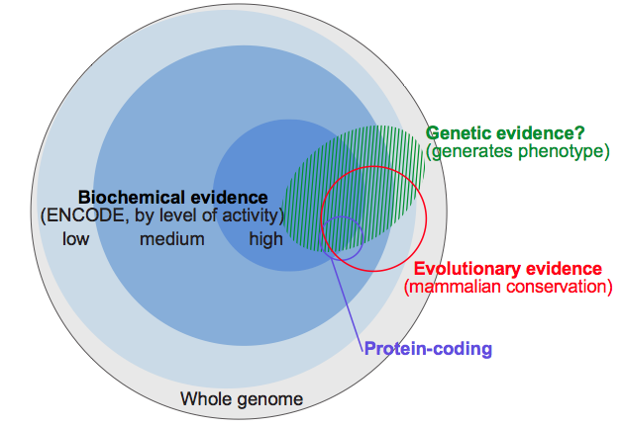
Relationships among biochemical, evolutionary and genetic evidence
Kellis et al. (2014) Defining functional elements in the human genome. PNAS

Slide 19
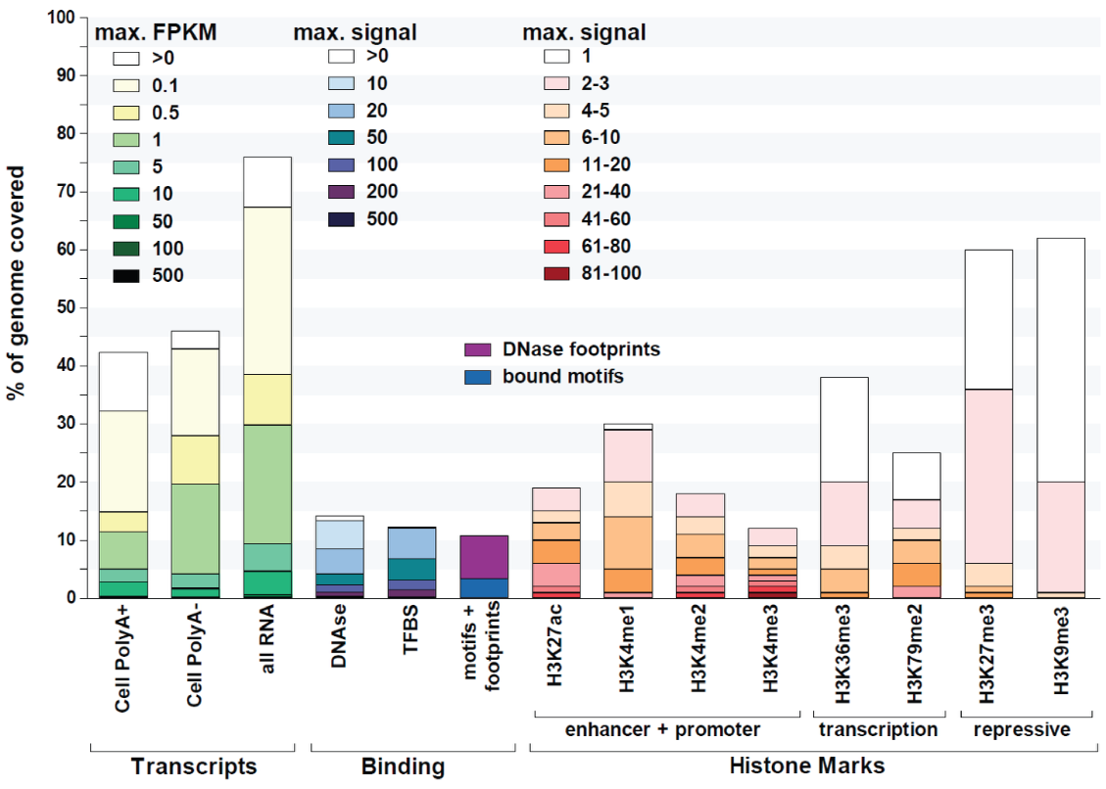
Coverage varies immensely with signal strength
Georgi Marinov, Barabara Wold in Kellis et al. 2014 PNAS

Slide 20
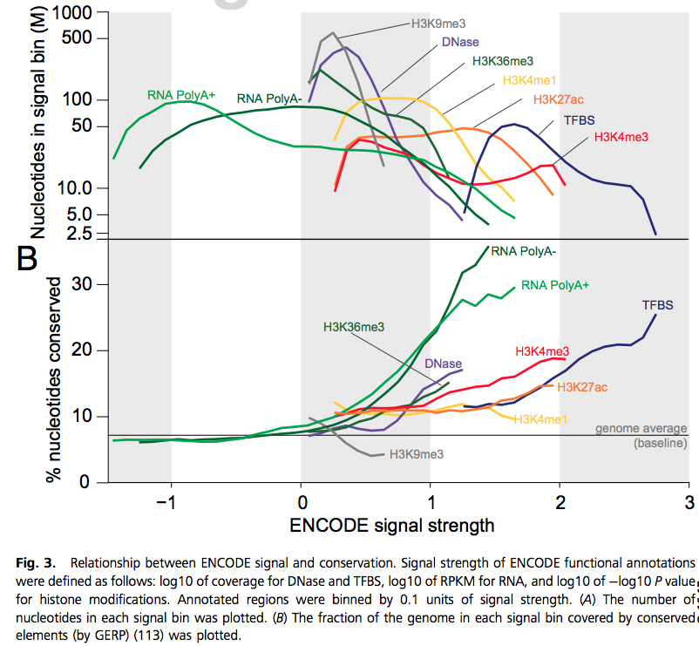
Evolutionary conservation tracks with stronger epigenetic signals
Luke Ward, M Kellis in Kellis et al. 2014 PNAS

Slide 21
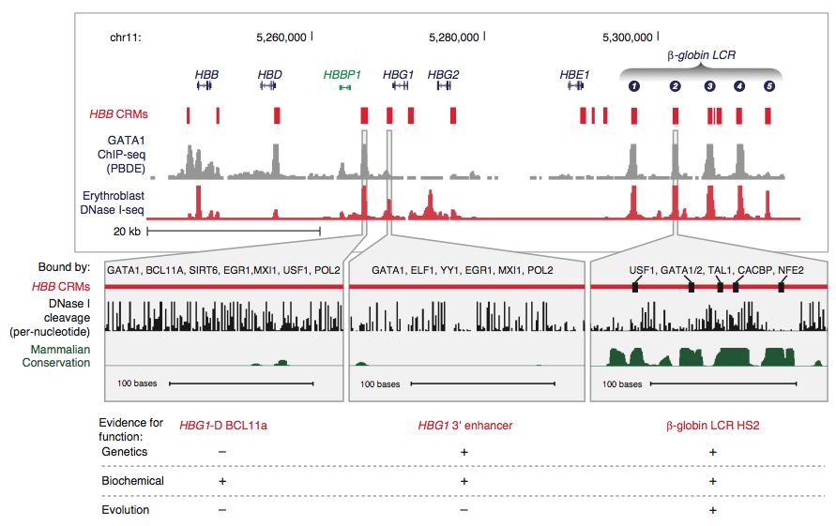
Diversity of evidence supporting regulatory regions
Jeff Vierstra, John Stamatoyannopoulos, R Hardison in Kellis et al. 2014 PNAS

Slide 22
Penultimate thoughts from Ross
The disparity may not be as great as has been claimed.
Our current upper bound estimate of the proportion of the human genome under purifying selection is 10-15%
But how well can we detect nearly neutral evolution?
Based on multiple, highly specific biochemical assays (ChIP-seq, DNase-seq, etc.), at least 10-15% of the human genome is involved in biochemical processes other than transcription
A lot of the human genome is transcribed
If you include transcripts that are present << 1 copy per cell, about 80% of the genome is transcribed
But there is no reason to think that all transcripts will affect cellular or organismal physiology: most introns, some intergenic transcripts, etc.

Slide 23
The set up Graur et al.

Slide 24
Frank Zappa’s 1979 rock opera “Joe’s Garage”, “Packard Goose”
…
Wonder what became of Mary?
Voice Of Mary's Vision:
Hi! It's me . . . the girl from the bus . . .
Remember?
The last tour?
Well . . .
Information is not knowledge
Knowledge is not wisdom
Wisdom is not truth
Truth is not beauty
Beauty is not love
Love is not music
Music is THE BEST . . .
Wisdom is the domain of the Wis (which is extinct)
Beauty is a French phonetic corruption
Of a short cloth neck ornament
Currently in resurgence . . .

