Slide 1
Long noncoding RNAs = lncRNAs
BMMB 541 Genomics
Hardison

Slide 2
Transcriptome
All the DNA that is transcribed in all the cells in an organism
Protein-coding genes
Both primary transcript and mature mRNA
Noncoding genes
tRNA, rRNA for translation
snRNAs for RNA splicing
microRNAs: regulatory
long noncoding RNAs: regulatory and ???

Slide 3
RNA interference
RNA-based mechanisms that block gene expression
Some RNAs prevent transcription
E.g. Xist: turn off expression from one X chromosome in females
Some RNAs prevent the expression of transcribed genes
Post-transcriptional gene silencing (PTSG)
E.g. microRNAs, short interfering RNAs

Slide 4
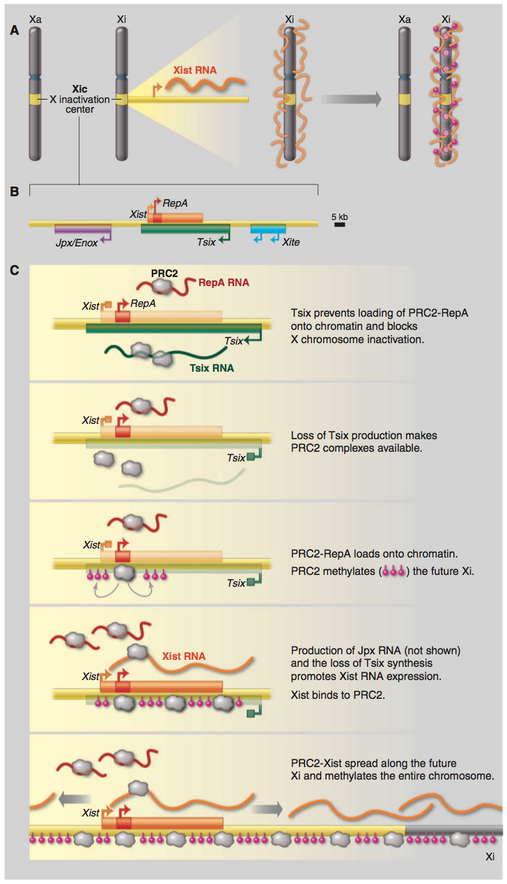
Inactivation of chr X
Fig. 1. LncRNAs in X-chromosome inactivation. (A) The lncRNA Xist is transcribed from the Xic of the inactive X chromosome (Xi). Xist RNA covers the entire chromosome and silences gene expression through epigenetic modification of histones and DNA. (B) The core region of the Xic and its lncRNAs. (C) LncRNA- protein interactions at the initiation of XCI.
Jeannie T. Lee (2012) Epigenetic regulation by long noncoding RNAs, Science 338: 1435-1439

Slide 5
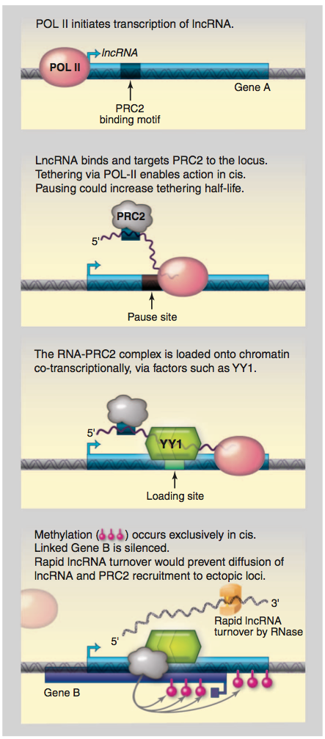
lncRNAs connect to regulation by chromatin modulators
Fig. 2. LncRNAs tether epigenetic complexes to chromatin, enabling allele- and locus-specific regulation. LncRNA that is synthesized binds to an epigenetic complex (such as PRC2) and, together, are loaded onto chromatin cotranscriptionally through DNA-bound factors (such as YY1 for Xist RNA). Epigenetic modifications then silence the gene, and rapid lncRNA turnover prevents its diffusion to other loci.
Jeannie T. Lee (2012) Epigenetic regulation by long noncoding RNAs, Science 338: 1435-1439

Slide 6
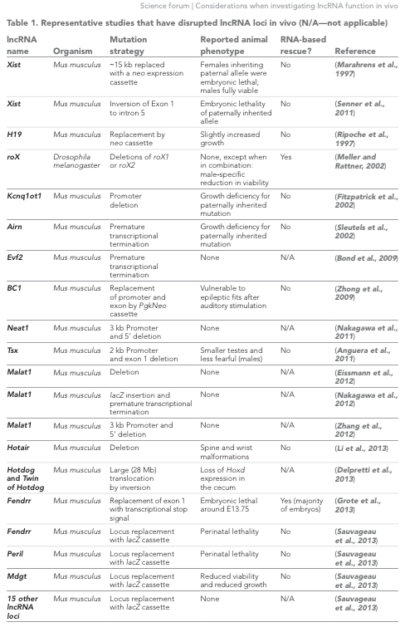
lncRNAs studied by genetic disruption
Bassett et al. eLife 2014;3:e03058

Slide 7
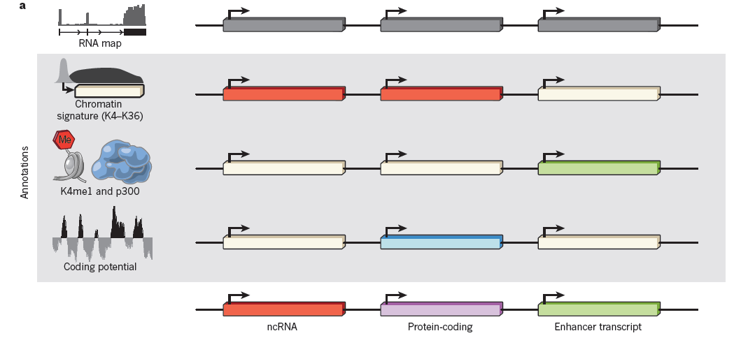
Classifying transcripts by layers of information
Guttman and Rinn (2012) Nature 482: 339-346

Slide 8
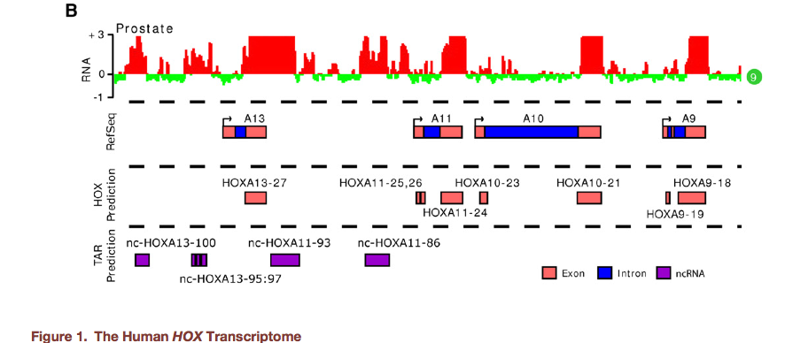
Expression profile of HOX genes
Hybridize polyA+ RNA to tiling arrays across HOX loci at 5 bp resolution. Assayed fibroblast RNA from 11 tissues covering different positions in the body; these retain the embryonic patterns of HOX gene expression.
Rinn et al. (2007) Cell 129: 1311-1323

Slide 9
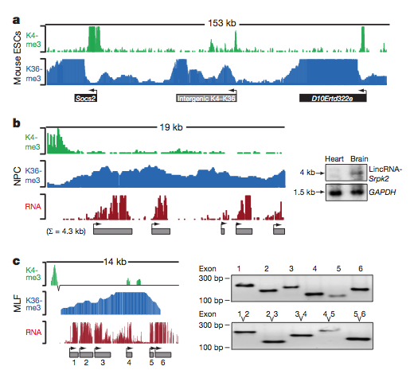
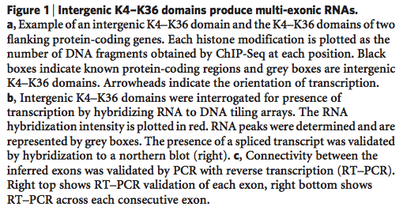
Chromatin domains as indicators of lncRNAs
Mouse embryonic stem cells (ESC), neural precursor cells (NPC), mouse lung fibroblasts (MLF), mouse embryonic fibroblasts (MEF)
Guttman et al. (2009) Nature 458: 223-227

Slide 10
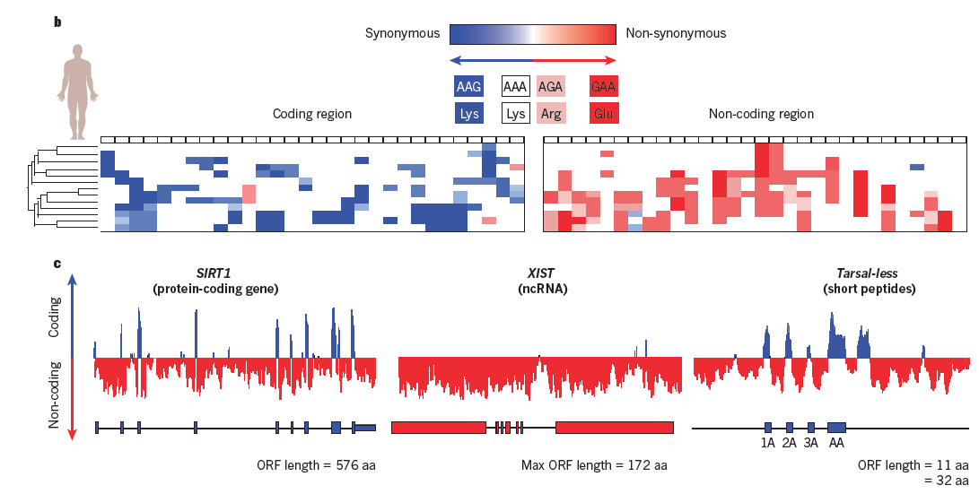
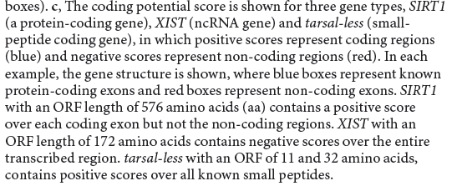
Coding potential scores can distinguish noncoding genes from protein- or peptide-coding genes
Codon substitution frequency score
Guttman and Rinn (2012) Nature 482: 339-346

Slide 11
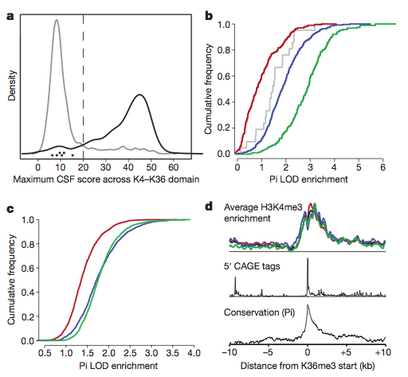
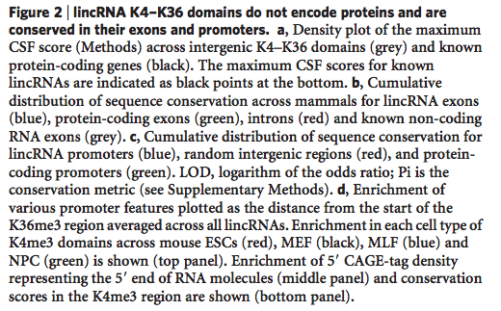
lncRNAs do not code for proteins but exons are conserved between species
CSF = codon substitution frequency
Guttman et al. (2009) Nature 458: 223-227

Slide 12
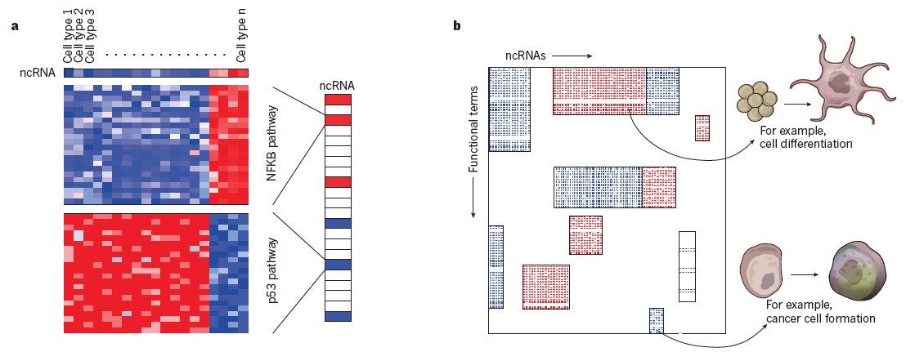
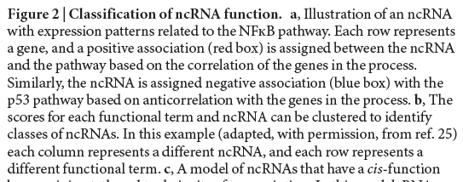
Classifying ncRNA functions by correlations
Guttman and Rinn (2012) Nature 482: 339-346

Slide 13
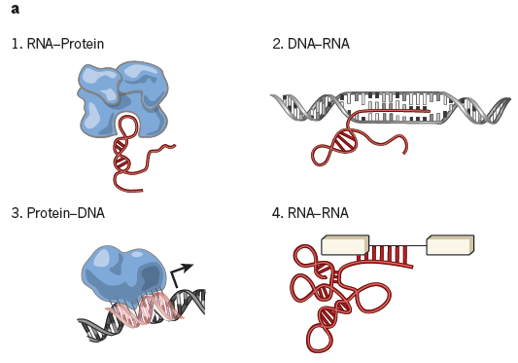
Principle types of interactions between nucleic acids and proteins
Guttman and Rinn (2012) Nature 482: 339-346

Slide 14
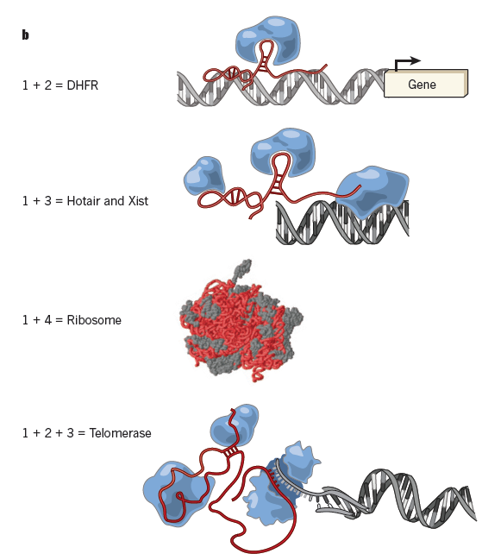
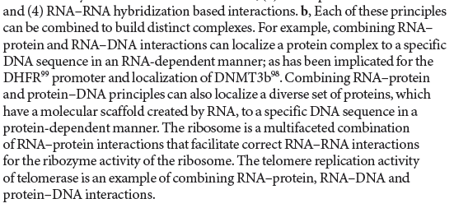
Modular principles for lncRNA action
Guttman and Rinn (2012) Nature 482: 339-346

Slide 15
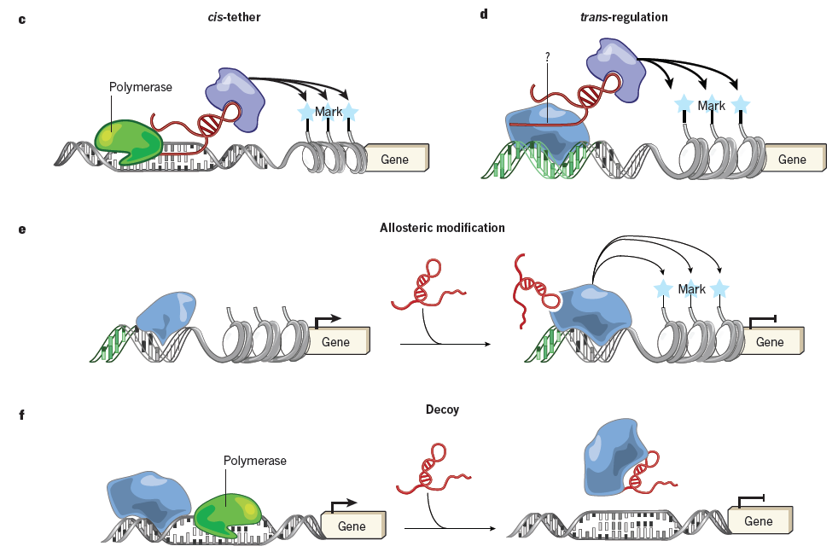
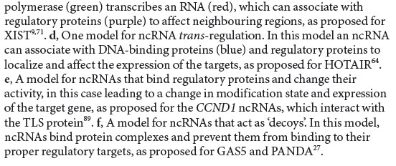
Models for lncRNA action, cis vs trans, regulation
Guttman and Rinn (2012) Nature 482: 339-346

Slide 16
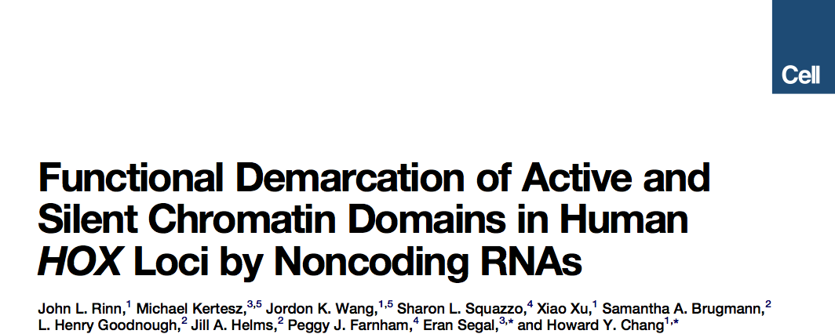
Long noncoding RNAs regulating gene expression
Rinn et al. (2007) Cell 129: 1311-1323

Slide 17
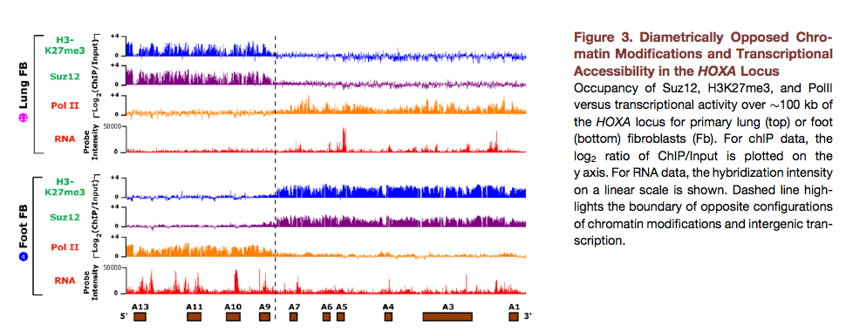
Active vs repressed domains in HOX loci
ChIP for histone modifications or protein binding, and hybridize to tiling arrays across HOX loci at 5 bp resolution. Lung represents a “proximal” tissue (to the trunk of the body), and foot is “distal.” The chromatin modifications mark active and inactive regions that preserve the “positional identity” of the cells in embryos.
The boundary of the diametric chromatin domains is the same as that seen by transcriptional analysis.
Rinn et al. (2007) Cell 129: 1311-1323

Slide 18
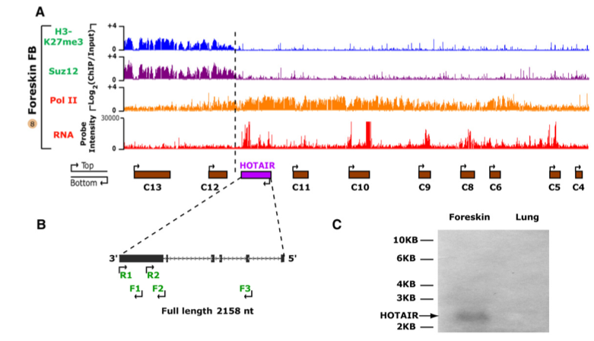
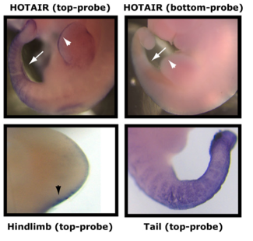
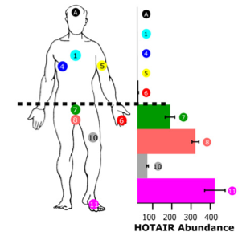
HOTAIR is a ncRNA transcribed at the boundary between diametric chromatin domains of HOXC
Parts of Fig. 4. HOX Antisense Intergenic RNA = HOTAIR. 2158 nt antisense transcript relative to HOXC coding genes. Spliced polyA+ RNA, transcribed from region at border between distal and proximal HOX genes. Preferential expression at posterior and distal sites, shown by RT-PCR in adult fibroblasts (left) and in situ hybridizations in developing mouse embryos (above).
Rinn et al. (2007) Cell 129: 1311-1323

Slide 19
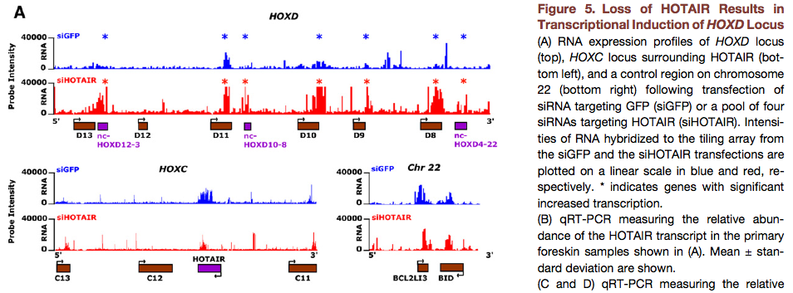
HOTAIR regulates expression in trans
Does HOTAIR work in cis or in trans? Is it the act of transcription or the production of a stable product that confers function? To address this, the authors depleted HOTAIR ncRNA by RNA interference (siHOTAIR), and looked for changes in transcription at HOX loci. RNA abundance changed at HOXD (in trans), not at HOXC (in cis). The RNA interference would not affect the act of transcription of HOTAIR, so the phenotype argues against a transcriptional or co-transcriptional effect.
Rinn et al. (2007) Cell 129: 1311-1323

Slide 20
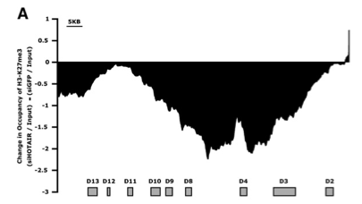
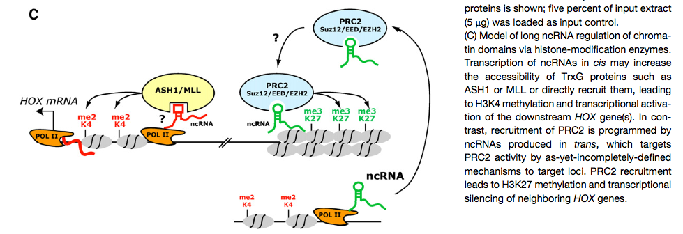
Model: HOTAIR recruits enzymes that place repressive marks on chromatin
Depletion of HOTAIR RNA leads to removal of H3K27me3 (Polycomb) marks and decrease of PRC2 (SUZ12) from HOXD. However, the silent HOXB locus is not affected: it is a specific effect. Native immunoprecipitation of SUZ12 also retrieved HOTAIR RNA, but not splicing components.
Rinn et al. (2007) Cell 129: 1311-1323

Slide 21
From RNA-seq to lncRNAs

Slide 22
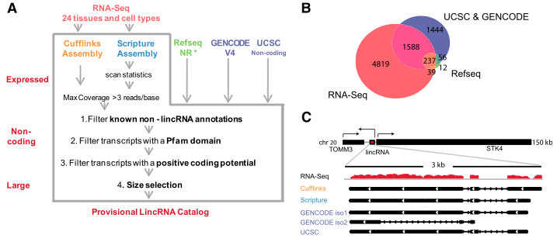
Filter to remove any possible coding regions
Figure 1. lincRNA catalog generation. (A) An integrative computational pipeline to map, reconstruct, and determine the coding potential of lincRNAs based on known annotations and computational methods, and its application to human lincRNAs. The pipeline takes as input RNA-seq data (top, red) and existing annotation sources (top) (RefSeq NR, Gencode, and UCSC annotation for humans). RNA-seq data are assembled by two assemblers: Cufflinks (gold) and Scripture (blue). Transcripts from all inputs are filtered by known annotations, presence of a Pfam domain, and positive coding potential. Transcripts annotated by RefSeq NR (*) were not filtered by the Pfam domain scan and the coding potential score. Finally, only multiexonic transcripts >200 base pairs (bp) are retained. (B) The number of lincRNA loci identified and their overlap with other annotation sources. The Venn diagram shows the overlap between transcripts from RNA-seq assembly (red), GENCODE and UCSC (purple), and RefSeq (green). (C) A representative example of a noncoding tran- script that was reconstructed by Cufflinks and Scripture and was also curated in GENCODE and UCSC. (Top) The human genomic locus of the human lincRNAs (red) and its protein-coding neighbors. (Black, arrowhead) Direction of transcription. (Bottom) Magnified view of the lincRNA locus showing the coverage of RNA-seq reads from the testes (red) and the transcripts identified by each source (black). (iso) Isoform.
Cabili et al. (2011) Genes & Dev. 25: 1915-1927

Slide 23
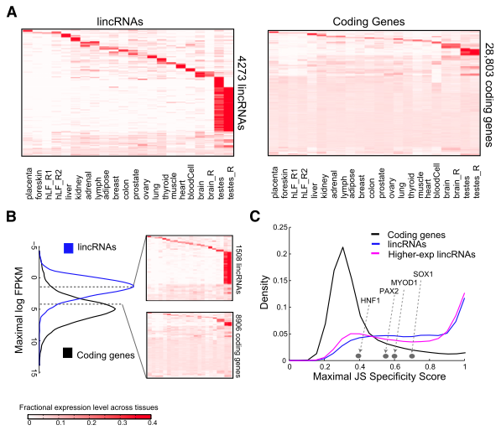
Tissue specificity of lncRNAs
Figure 2. Tissue specificity of lincRNAs and coding genes. (A) Abundance of 4273 lincRNA (rows, left panel) and 28,803 pro- tein-coding genes (rows, right panel) across tissues (columns). Rows and columns are ordered based on a k-means clustering of lincRNAs and protein-coding genes. Color intensity represents the fractional density across the row of log-normalized FPKM counts as estimated by Cufflinks (saturating <4% of the top normalized expression values) (Supplemental Methods). (B) lincRNAs are more lowly expressed than protein-coding genes. Maximal expression abundance (log2- normalized FPKM counts as estimated by Cufflinks) of each lincRNA (left panel, blue) and coding (left panel, black) transcript across tissues. The right panel shows the expression levels of 1508 lincRNAs (top right) and 8906 coding genes (bottom right) that have a maximal expression level within the range bounded by the dashed segments in the left panel ([1.6–4.3] log2 FPKM)). Heat maps are clustered and visualized as in A. (C) Tissue-specific expression. Shown are distributions of maximal tissue specificity scores calculated for each transcript across the tissues from the data in A for coding
genes (black), lincRNAs (blue), and the 1508 highly expressed lincRNAs (pink; as in B). Examples of the tissue specificity score of coding genes with known tissue-specific patterns are marked by gray dots.
Cabili et al. (2011) Genes & Dev. 25: 1915-1927

Slide 24
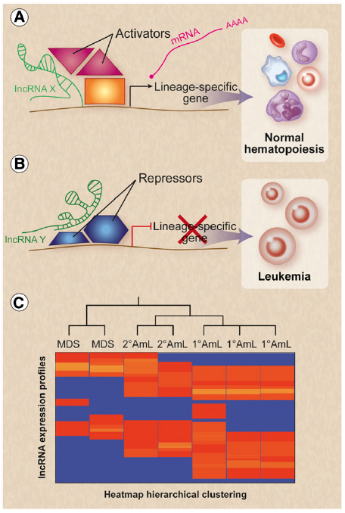
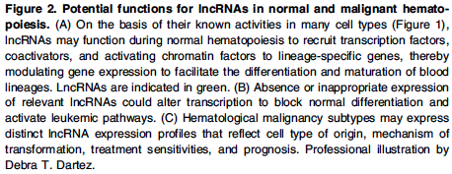
Potential roles of lncRNAs in disease
MDS = myelodysplastic syndrome
AmL = Acute myelogenous leukemia
Paralkar and Weiss (2013) Blood 121: 4842-4846.

