Slide 1

Cis-regulatory modules (CRMs): Prediction and experimental tests
BMMB 551 Genomics
Ross Hardison

Slide 2
Methods in Genomics of Gene Regulation

Slide 3
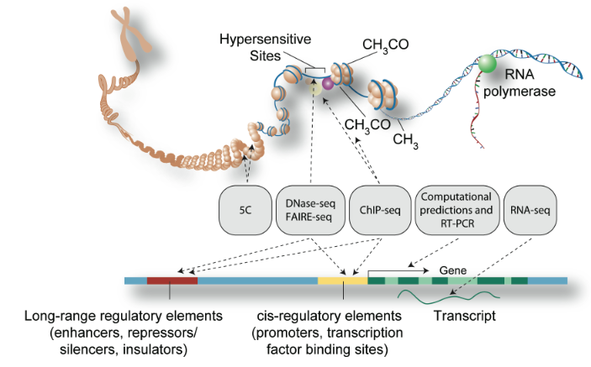
Mapping Functional Elements
ENCODE consortium, 2011, PLoS Biology 9: e1001046
Notes:
3

Slide 4

The many steps of ChIP-seq
Living cells
Crosslink and
isolate chromatin
Shear
ChIP
Control
Immunoprecipitate
Reverse-crosslink
Ligate Adapters
Amplify
Size-select
Daniel Savic
Sequence
Align
Find Peaks

Slide 5
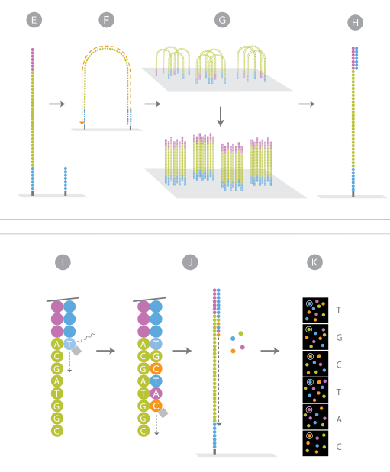
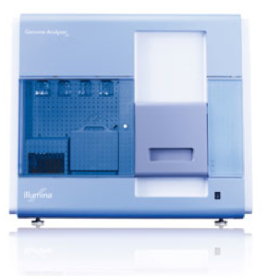
Illumina short read sequencing
- 8 lanes per run
- 375 M reads or read pairs of 100 nucleotides per lane.
- 1 lane can produce enough reads to map locations of 15 or more transcription factors in a mammalian genome.

Slide 6
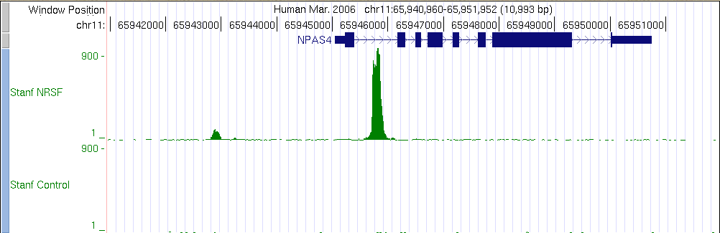
Example of ChIP-seq
ChIP vs NRSF = neuron-restrictive silencing factor
Jurkat human lymphoblast line
NPAS4 encodes neuronal PAS domain protein 4
Johnson DS, Mortazavi A, Myers RM, Wold B. (2007) Genome-Wide Mapping of in Vivo Protein-DNA Interactions.
Science 316:1497-1502.

Slide 7
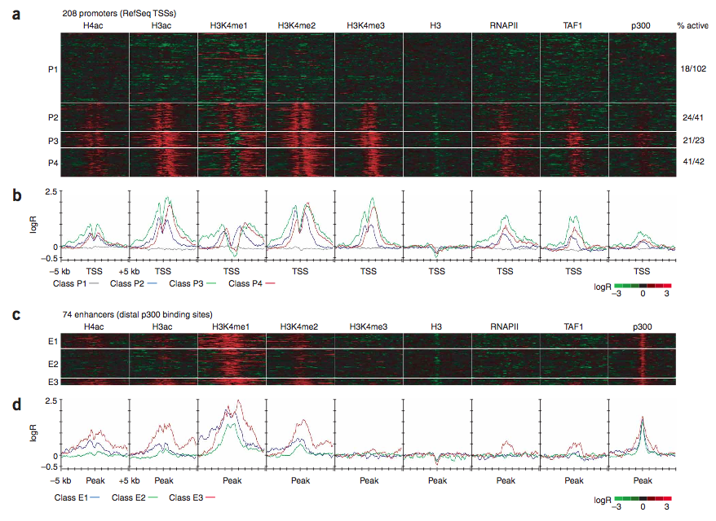
Distinctive histone modifications and protein binding at promoters and enhancers
Promoters
  H3K4me3, H3K4me2
  RNA Pol II
Enhancers
  H3K4me1
  P300 coactivator
Heintzman …Ren (2007) Nature Genetics 39:311-308; Birney et al. (2007) Nature, 447:799-816

Slide 8
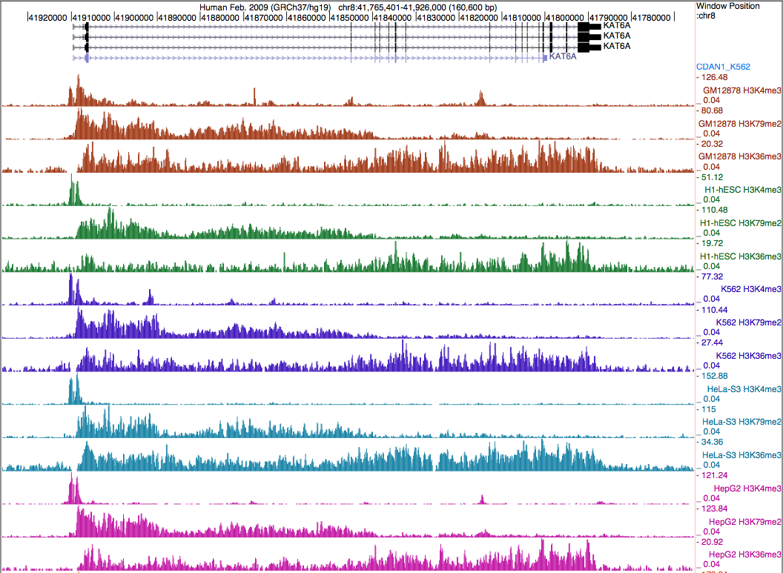
Patterns of histone H3 modifications in transcription unit
K4me3→K79me2 →K36me3
Bernstein lab,
ENCODE

Slide 9
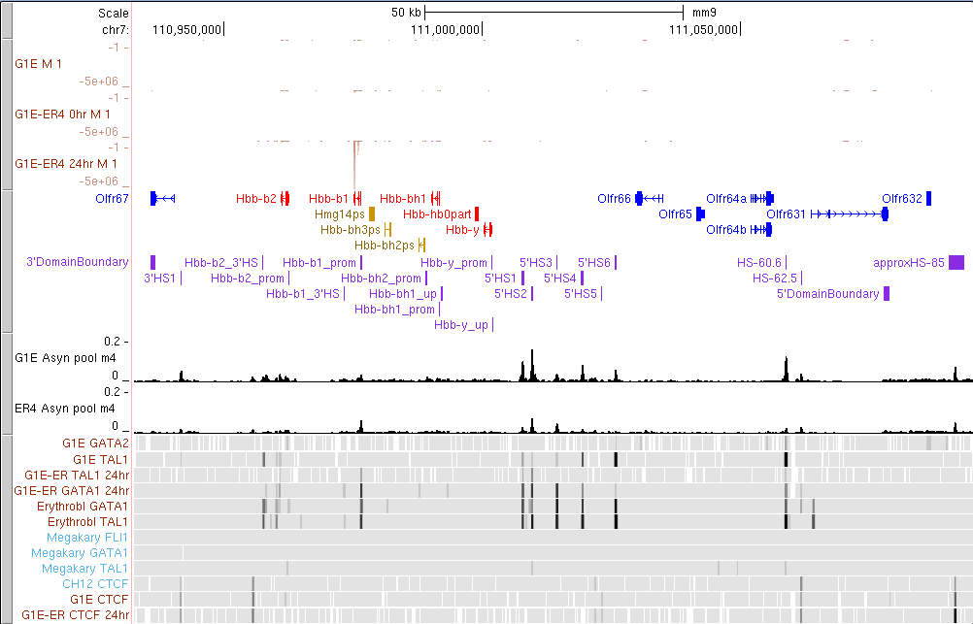
DNase-seq in Hbb locus
RNA-seq
Genes
Known CRMs
DNase hyper-
sensitive sites
Txn factors
G1E: Gata1 knock out “erythroid progenitor”
G1E-ER4+E2: Gata1 restored “erythroblasts”
Primary erythroblasts
Ex vivo cultured megakaryocytes

Slide 10
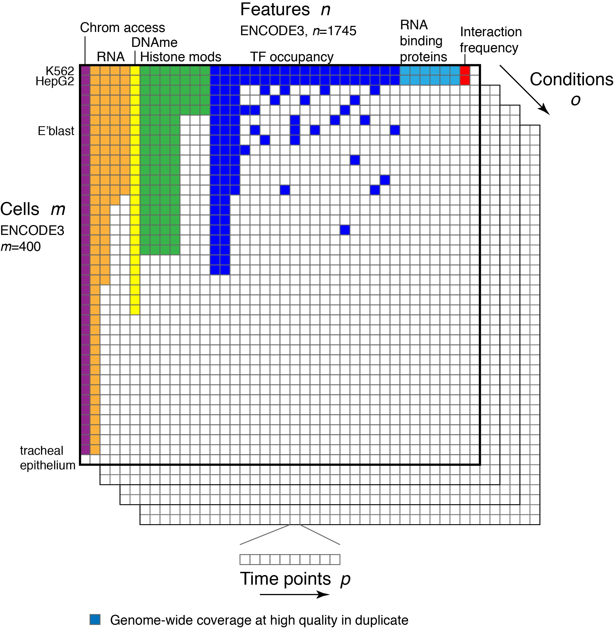
The current state of mapping function-associated features

Slide 11
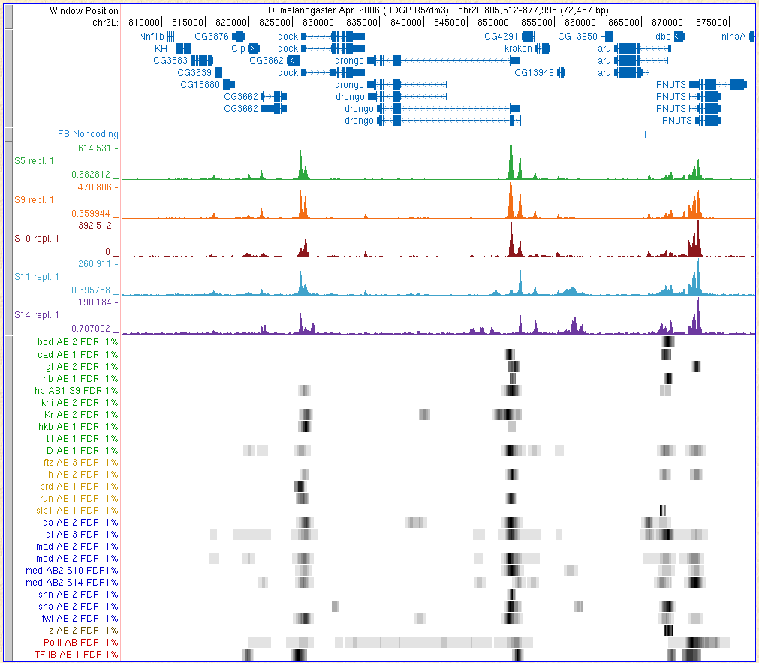
DNase sensitivity and TF occupancy during fly development
Genes
DNase sensitivity
TF occupancy
Berkeley Drosophila Transcription Network Project

Slide 12

Epigenomic features in modENCODE
www.modENCODE.org

Slide 13
Integrative Analyses
ENCODE consortium

Slide 14
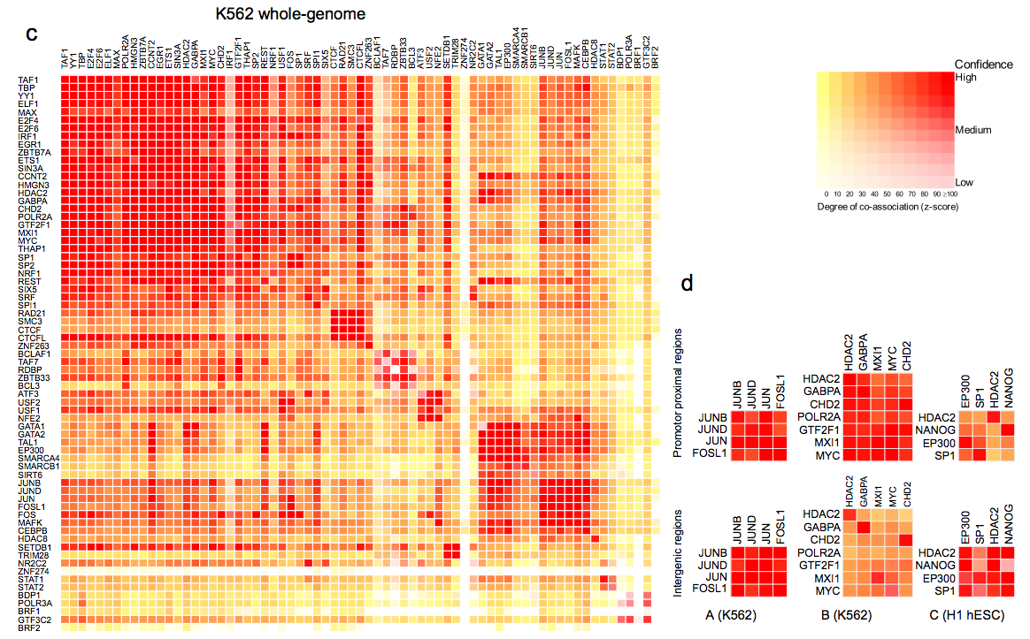
Large-scale interaction maps of TFs
Distal to promoter
ENCODE Project Consortium (2012) Nature

Slide 15
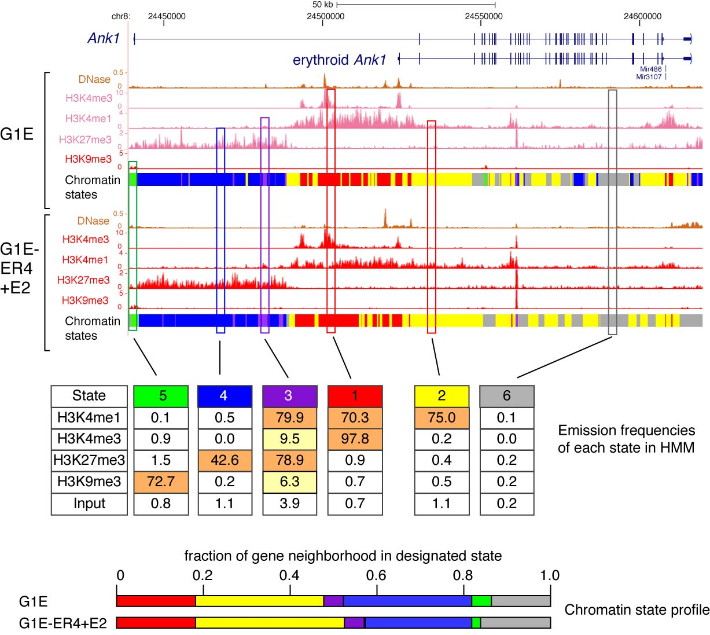
“Paint” genomic regions by dominant histone modifications: multivariate HMM
Ernst and Kellis (2010) Nature Biotechnology 28: 817…
Wu et al. 2011 Genome Res 21: 1659-1671

Slide 16
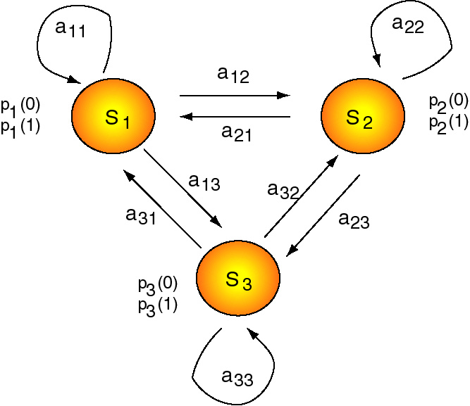
A general hidden Markov model = HMM
Still have a group of N discrete states
  S₁, S₂,…, S_{N}
Now each state has a probability (p) of emitting an observable character
  0 or 1
  A, G, C or T
Still have transition probabilities (e.g. a₁₂) for changing between states.
You can think of an HMM as a machine that generates sequences. Starting with an initial state, a new state is chosen. This can be the same as the initial one (e.g. if the initial state is S₁, then the probability of staying in it is a₁₁) or a different state (e.g. going to state S₂ with a probability of a₁₂). In the new state, a character is emitted to the sequence, with a probability characteristic of that state; e.g. emission of a 0 from S₁ has a probability of p₁(0). When completed, a series of characters is observed, e.g. 0110111000111, but the path through the states from which they are emitted is not observed (hence the Markov chain is hidden).

Slide 17
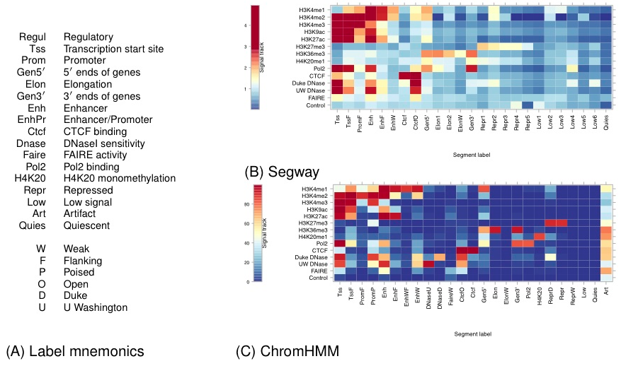
Integrate features using multivariate segmentations
ENCODE Project Consortium (2012) Nature
M. Hoffman, J. Ernst et al. 2013. Integrative segmentations of function-associated marks. NAR

Slide 18
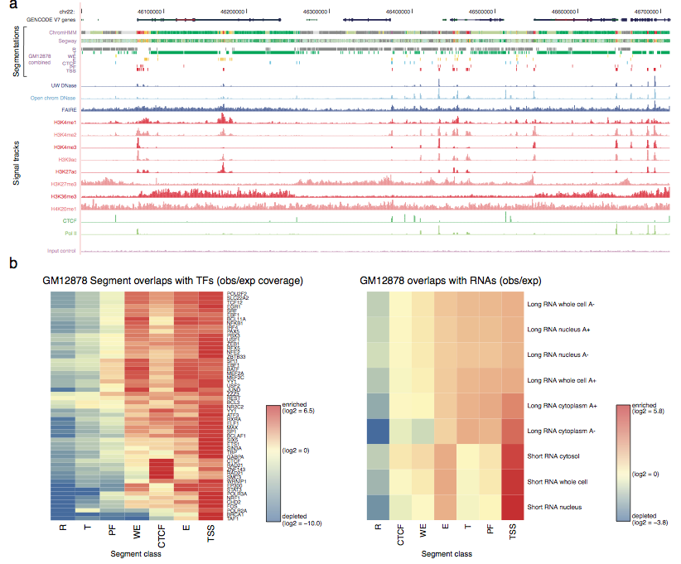
Specific functional associations for segmentation categories
Mnemonics for states from segmentation
R = repressed or quiescent
T= transcribed
PF = promoter flanking
WE = weak enhancer marks
CTCF = bound by CTCF
E = enhancer marks
TSS = transcription start site
ENCODE Project Consortium (2012) Nature

Slide 19
Predicting and testing crms
Using epigenetic features for predictions

Slide 20
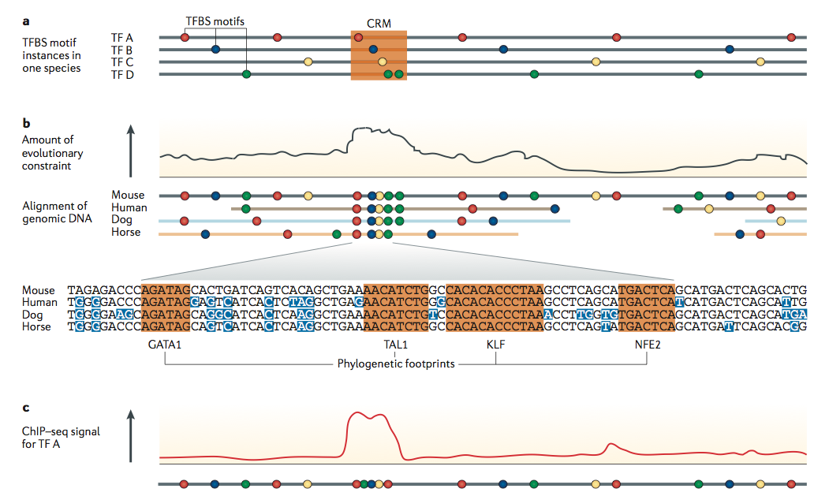
Methods for predicting CRMs
Hardison &Taylor (2012) Nature Reviews Genetics 13: 469-483

Slide 21
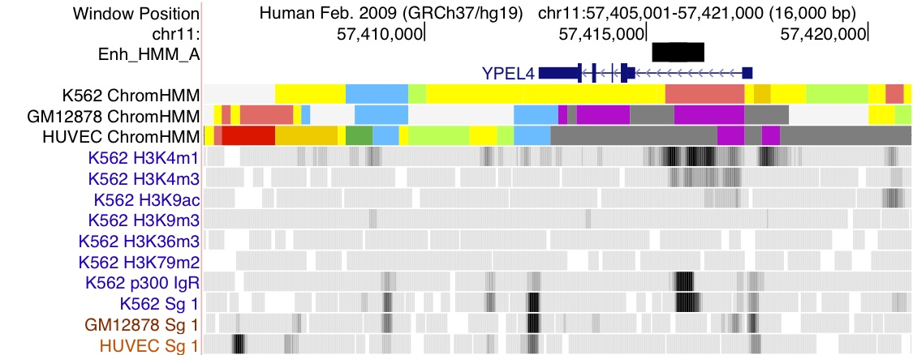

Enhancer predicted from HMM segmentation based on histone modifications
ENCODE Project Consortium:
Combined segmentation results from chromHMM (Ernst et al) and Segway (Hoffman et al) to generate 25-state models from histone modifications and other epigenetic features.
Use state with enhancer-associated state to predict CRMs. Test in mice and fish.
DNase HSs
ENCODE Project Consortium (2012) Nature

Slide 22
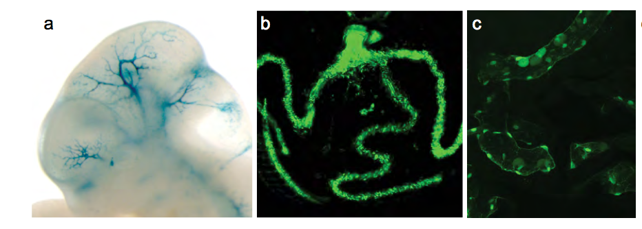
Accurate predictions of enhancers
Transient transgenic mouse embryo
Circulating erythrocytes with GFP in transgenic Medaka fish
ENCODE Project Consortium (2012) Nature

Slide 23
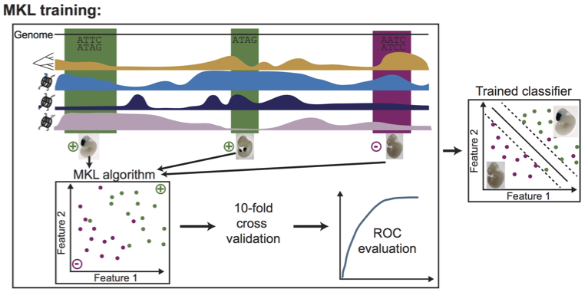
EnhancerFinder integrates diverse datasets to predict developmental enhancers
motifs
constraint
epigenetic 1
epigenetic 2
epigenetic 3
Erwin et al (K. Pollard) 2014. PLoS Comp Biol 10: e1003677

Slide 24
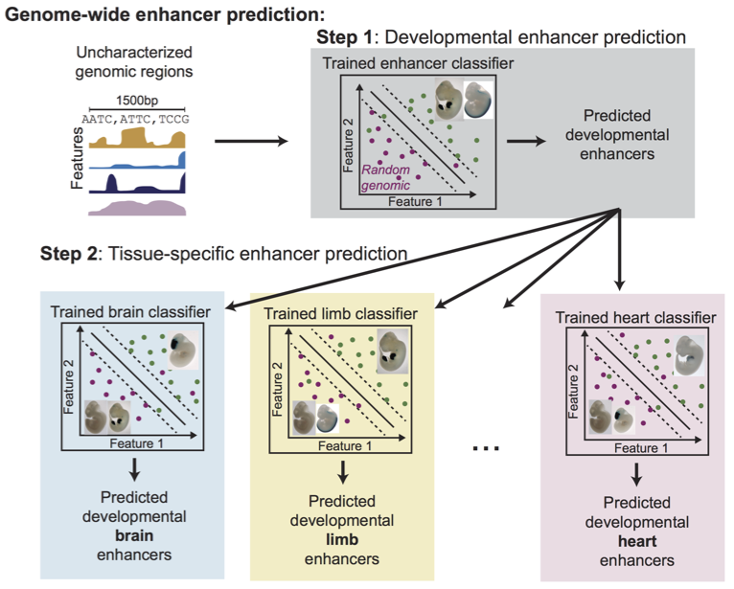
EnhancerFinder: Two stage predictions
Erwin et al (K. Pollard) 2014. PLoS Comp Biol 10: e1003677

Slide 25
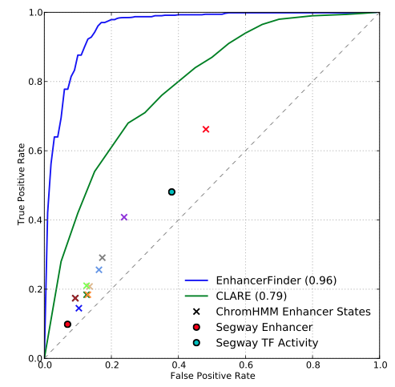
Strong performance from EnhancerFinder in cross-validation
CLARE: Ovcharenko, motifs and sequence patterns
“…we evaluated the performance of all prediction algorithms using 10-fold cross validation to compute the area under the curve (AUC) for receiver operating characteristic (ROC) curves.”
Erwin et al (K. Pollard) 2014. PLoS Comp Biol 10: e1003677

Slide 26
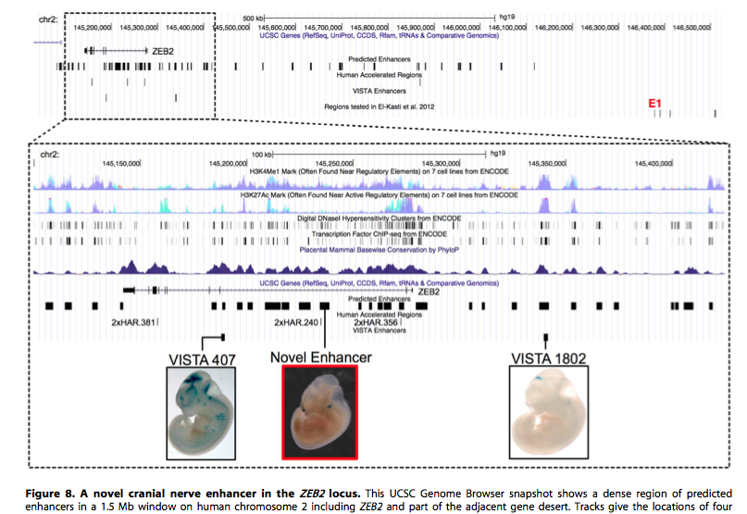
Examples of successful enhancer predictions
Erwin et al (K. Pollard) 2014. PLoS Comp Biol 10: e1003677

Slide 27
Direct selection for activity to find enhancers
Forget the genomics and bioinformatics …

Slide 28
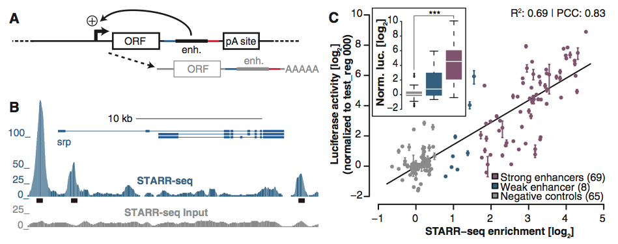
STARR-seq: Self-transcribing active regulatory region sequencing
Arnold et al (A. Stark) 2013. Science 339: 1074-1077

Slide 29
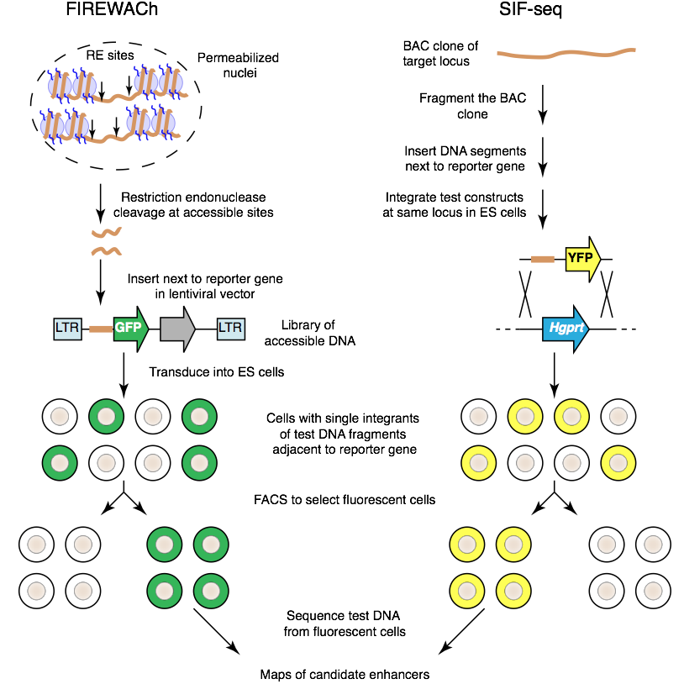
Other methods of screening for enhancer activity on a large scale
Murtha, M. et al. Nat. Methods 11, (2014).
Dickel, D.E. et al. Nat. Methods 11, (2014).
Hardison, R.C. Nat. Methods 11, News&Views (2014).

Slide 30
Massively parallel enhancer assays
Still use the genomics and epigenomics, but ramp up the scale of assays

Slide 31
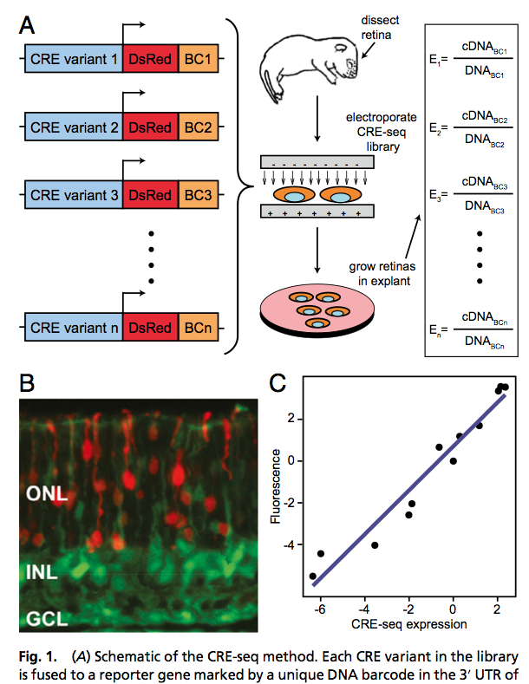
CRE-seq
Similar assays from Shendure and Mikkelson groups
Kwasnieski, J.C. et al. (B.A. Cohen) 2012. PNAS USA 109:19498–19503

Slide 32
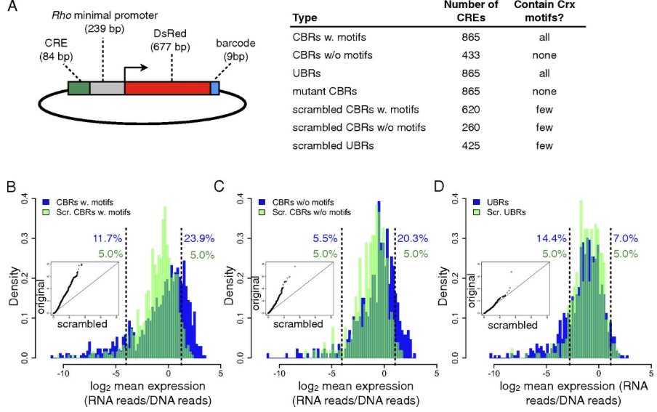
CRE-seq: For DNA segments with CBX binding site motifs, occupancy by CBX correlates with enhancer activity
White, Myers, Corbo, Cohen (2013). PNAS USA 110:11952-11957

Slide 33
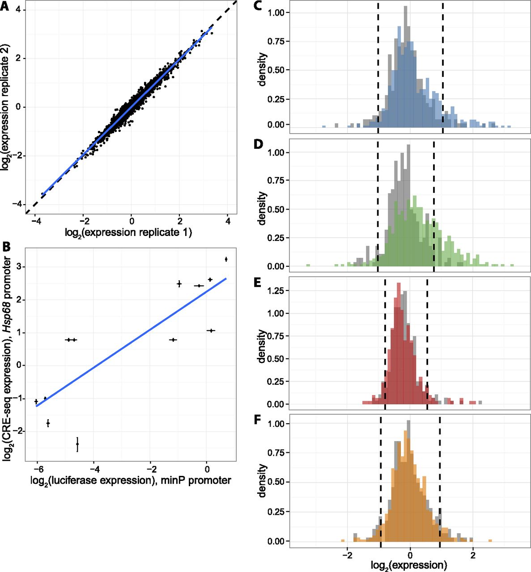

Reproducible expression measurements show differences in expression by segmentation class.
High throughput experimental tests of enhancers predicted by chromHMM segmentation based on histone modifications and DHSs
Kwasnieski J C et al. Genome Res. 2014;24:1595-1602
© 2014 Kwasnieski et al.; Published by Cold Spring Harbor Laboratory Press
Notes:
Reproducible expression measurements show differences in expression by segmentation class. (A) Representative scatterplot showing expression of each CRE in two biological replicates (R² = 0.95, range of R² between all replicates: 0.95–0.97). Dashed black line is line of equality and blue line is best fit. (B) Correlation between CRE-seq and luciferase assays. Expression driven by 12 CREs was measured in individual luciferase assay (upstream of minP promoter, x-axis) and batch CRE-seq assay (upstream of Hsp68 promoter, y-axis). Luciferase expression is normalized to the Renilla transfection control, and CRE-seq expression is normalized to the basal promoter alone. Error bars represent the standard error of the mean. Blue line is best fit. R² = 0.70. (C–F) Histograms of genomic CRE expression measurements in K562 cells. Each class is compared to scrambled controls with equivalent GC and dinucleotide content (gray). Dashed lines are the fifth and 95th percentiles of the scrambled distributions. (C) K562 Enhancer class (blue), (D) K562 Weak Enhancer class (green), (E) K562 Repressed class (red), (F) H1-hESC Enhancer class (orange).

Slide 34
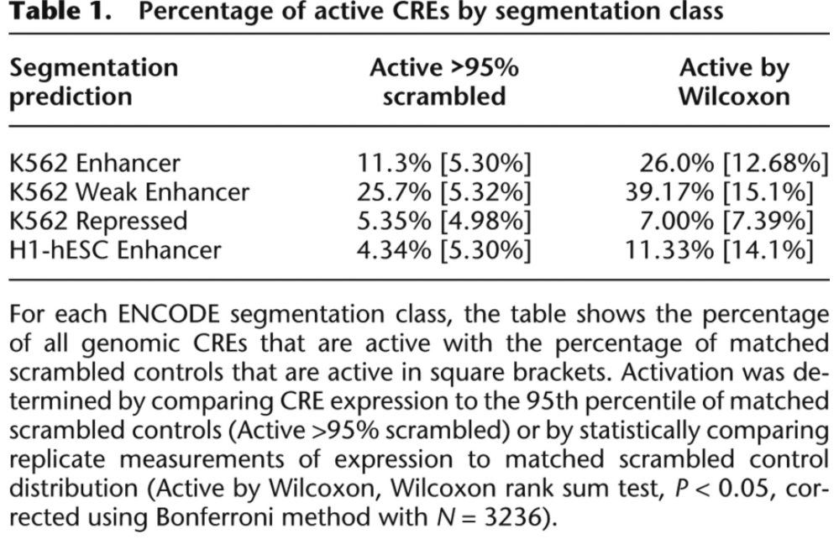
Fraction of “predictions” that are active in CRE-seq
Kwasnieski J C et al. Genome Res. 2014;24:1595-1602

Slide 35
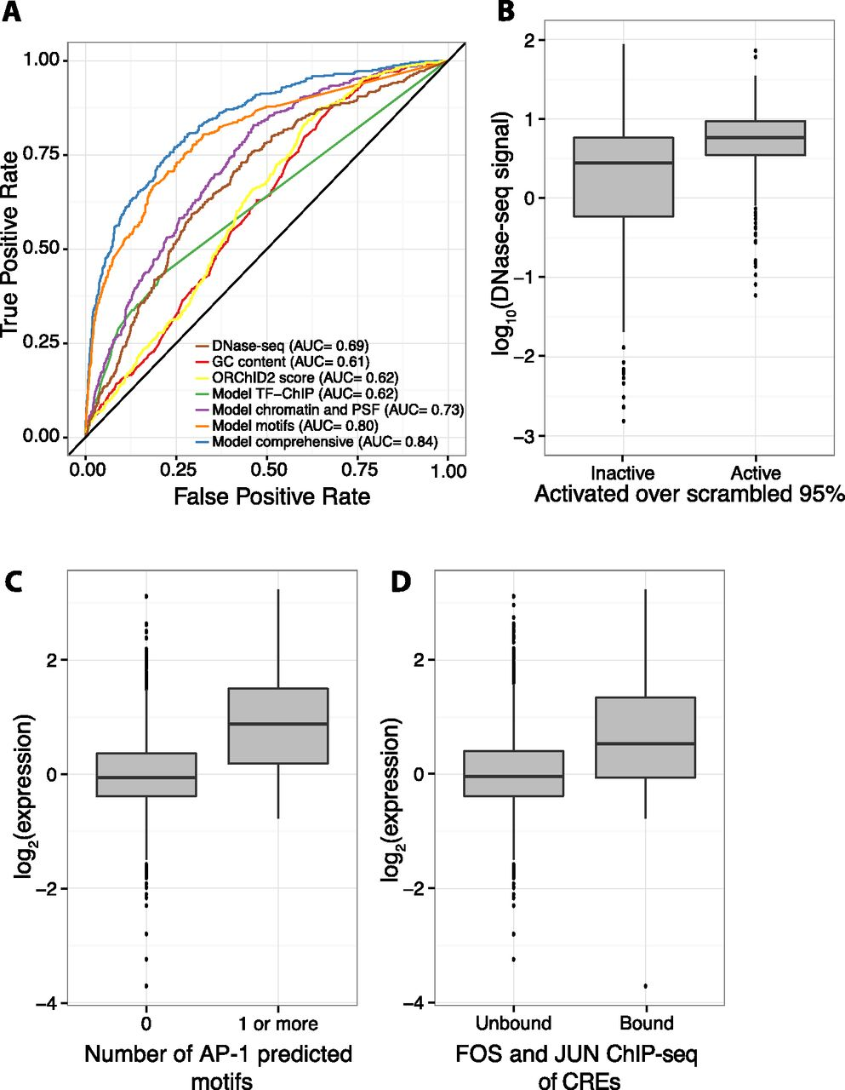
Chromatin features and sequence-specific binding identify active sequences.
Kwasnieski J C et al. Genome Res. 2014;24:1595-1602
© 2014 Kwasnieski et al.; Published by Cold Spring Harbor Laboratory Press
Notes:
Chromatin features and sequence-specific binding identify active sequences. (A) Receiver operating characteristic (ROC) curve shows that a logistic regression model (“Model comprehensive”) incorporating sequence-specific binding motifs, chromatin features, primary sequence features (PSFs), and TF-ChIP data is best able to identify active sequences. Of logistic regression models with fewer features, one with sequence-specific binding motifs (“Model motifs”) does best, followed by a model incorporating chromatin and primary sequence features (“Model chromatin and PSF”), and a model with only significant TF-ChIP features (“Model TF-ChIP”). Minor groove width as predicted by ORChID2 score, GC content, and DNase I HS are also shown. Area under the curve (AUC) is indicated in legend. (B) Boxplot showing that active CREs are enriched in high DNase I HS signal over inactive CREs. (C) Boxplot showing that CREs with at least one predicted AP-1 motif drive expression higher than CREs with no AP-1 predicted motifs. (D) CREs overlapping with ChIP-seq peaks for a FOS (FOS or FOSL1) family member and a JUN (JUNB or JUND) family member, the constituent proteins of AP-1, drive expression higher than unbound CREs.

Slide 36
TF occupancy is a good predictor of erythroid enhancers: TAL1
Nergiz Dogan et al. 2015 Epigenetics &Chromatin

Slide 37
Categorizing TAL1 OSs by additional epigenetic features may improve the accuracy of enhancer predictions.
TFs
DHS
K36m3 | K36m3+K4m1 | K4m1 | K4m1+K4m3 | K4m3 | K9m3 | zero | K27m3 | K4m1+K27m3

Slide 38
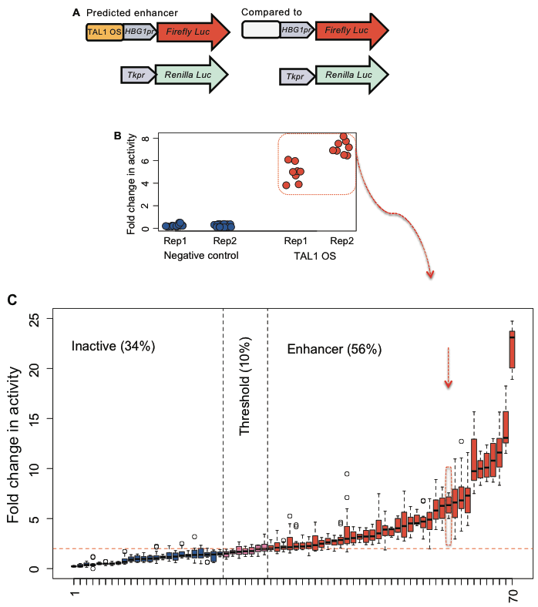
Many TAL1 OSs are acting as enhancers
Dogan et al. (2015) Epigenetics & Chromatin

Slide 39
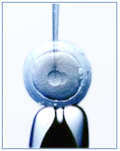
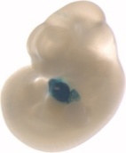
Functional characterization assay-II
(II) Transgenic mouse assay
Target region
Hsp68pr
LacZ
Mouse egg microinjection
E11.5 Reporter staining
(Collaboration with Len Pennacchio
Lawrence Berkeley National Laboratory; ENCODE)

Slide 40
65% of TAL1 OSs are active enhancers in various tissues
Tissue expressed: Heart Midbrain Forebrain Limb
VISTA Enhancer Browser (Visel et al. 2007)
Dogan et al. (2015) Epigenetics & Chromatin

Slide 41
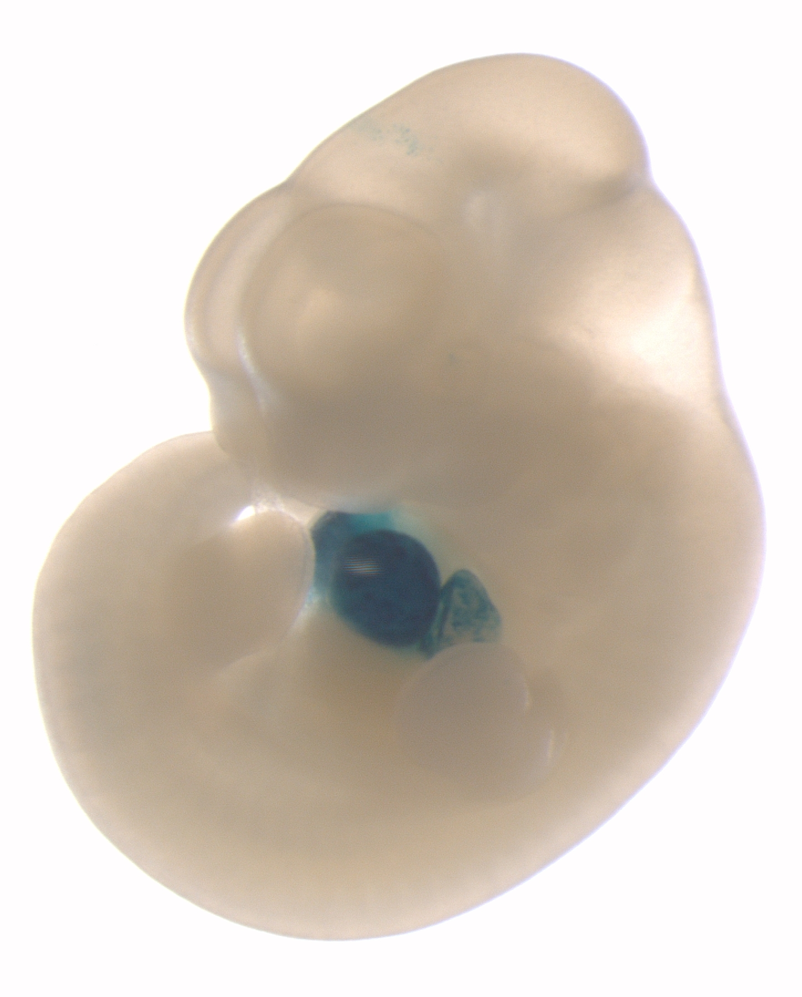
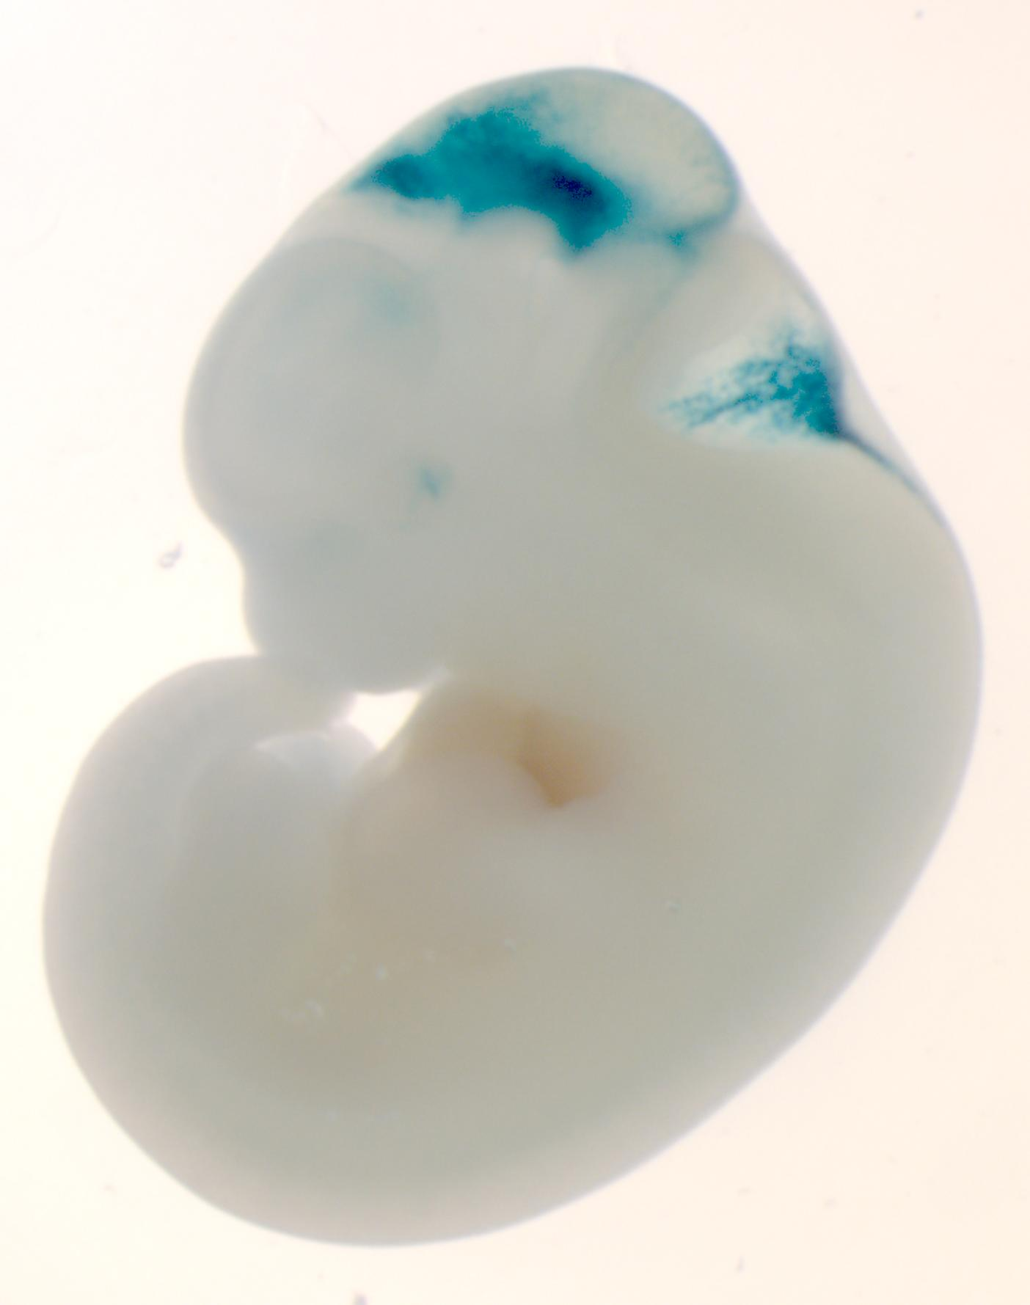
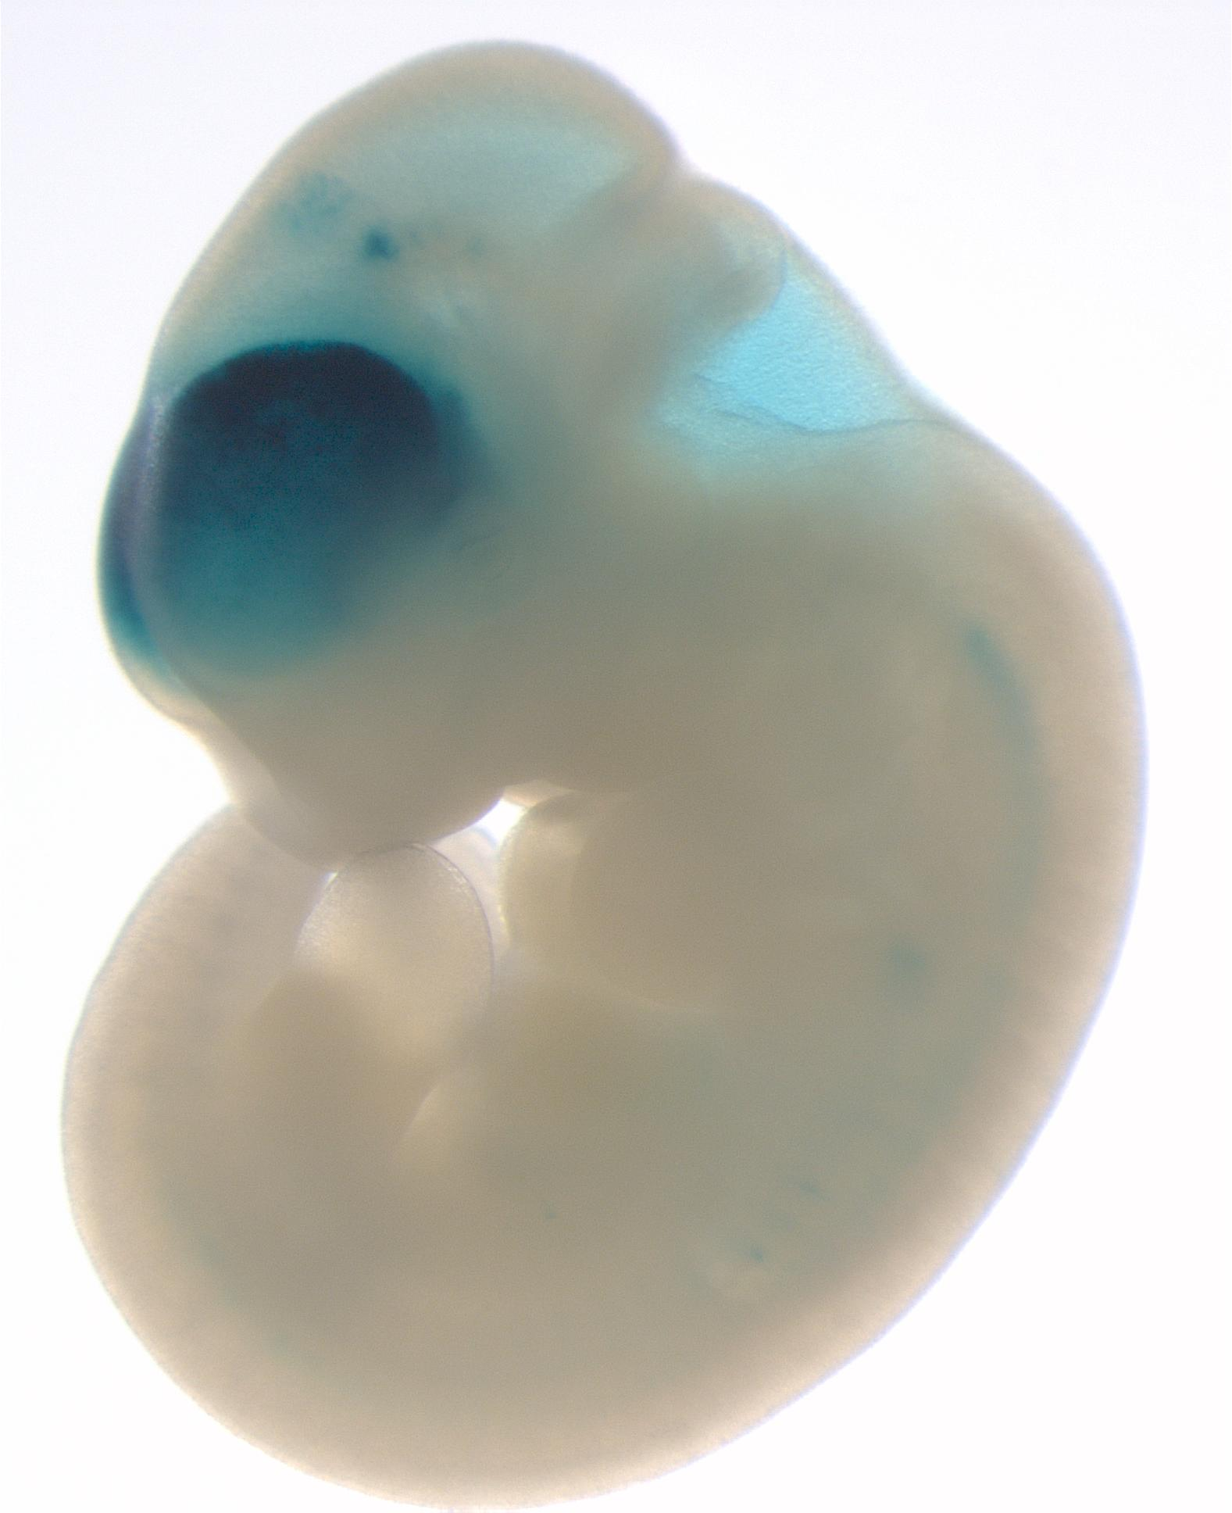
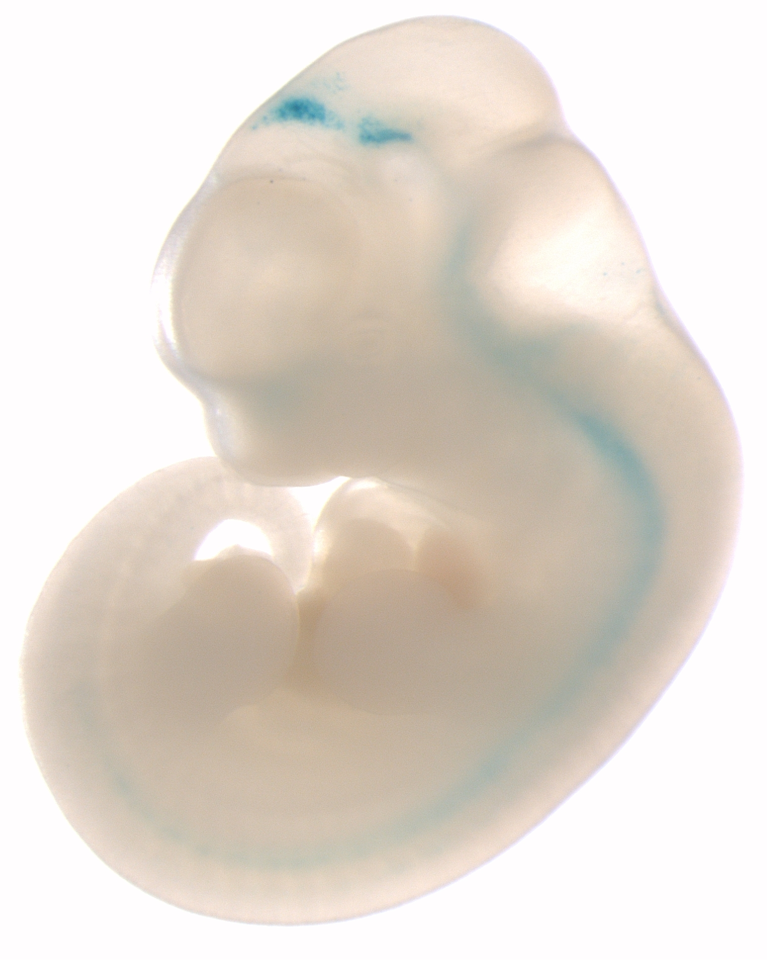
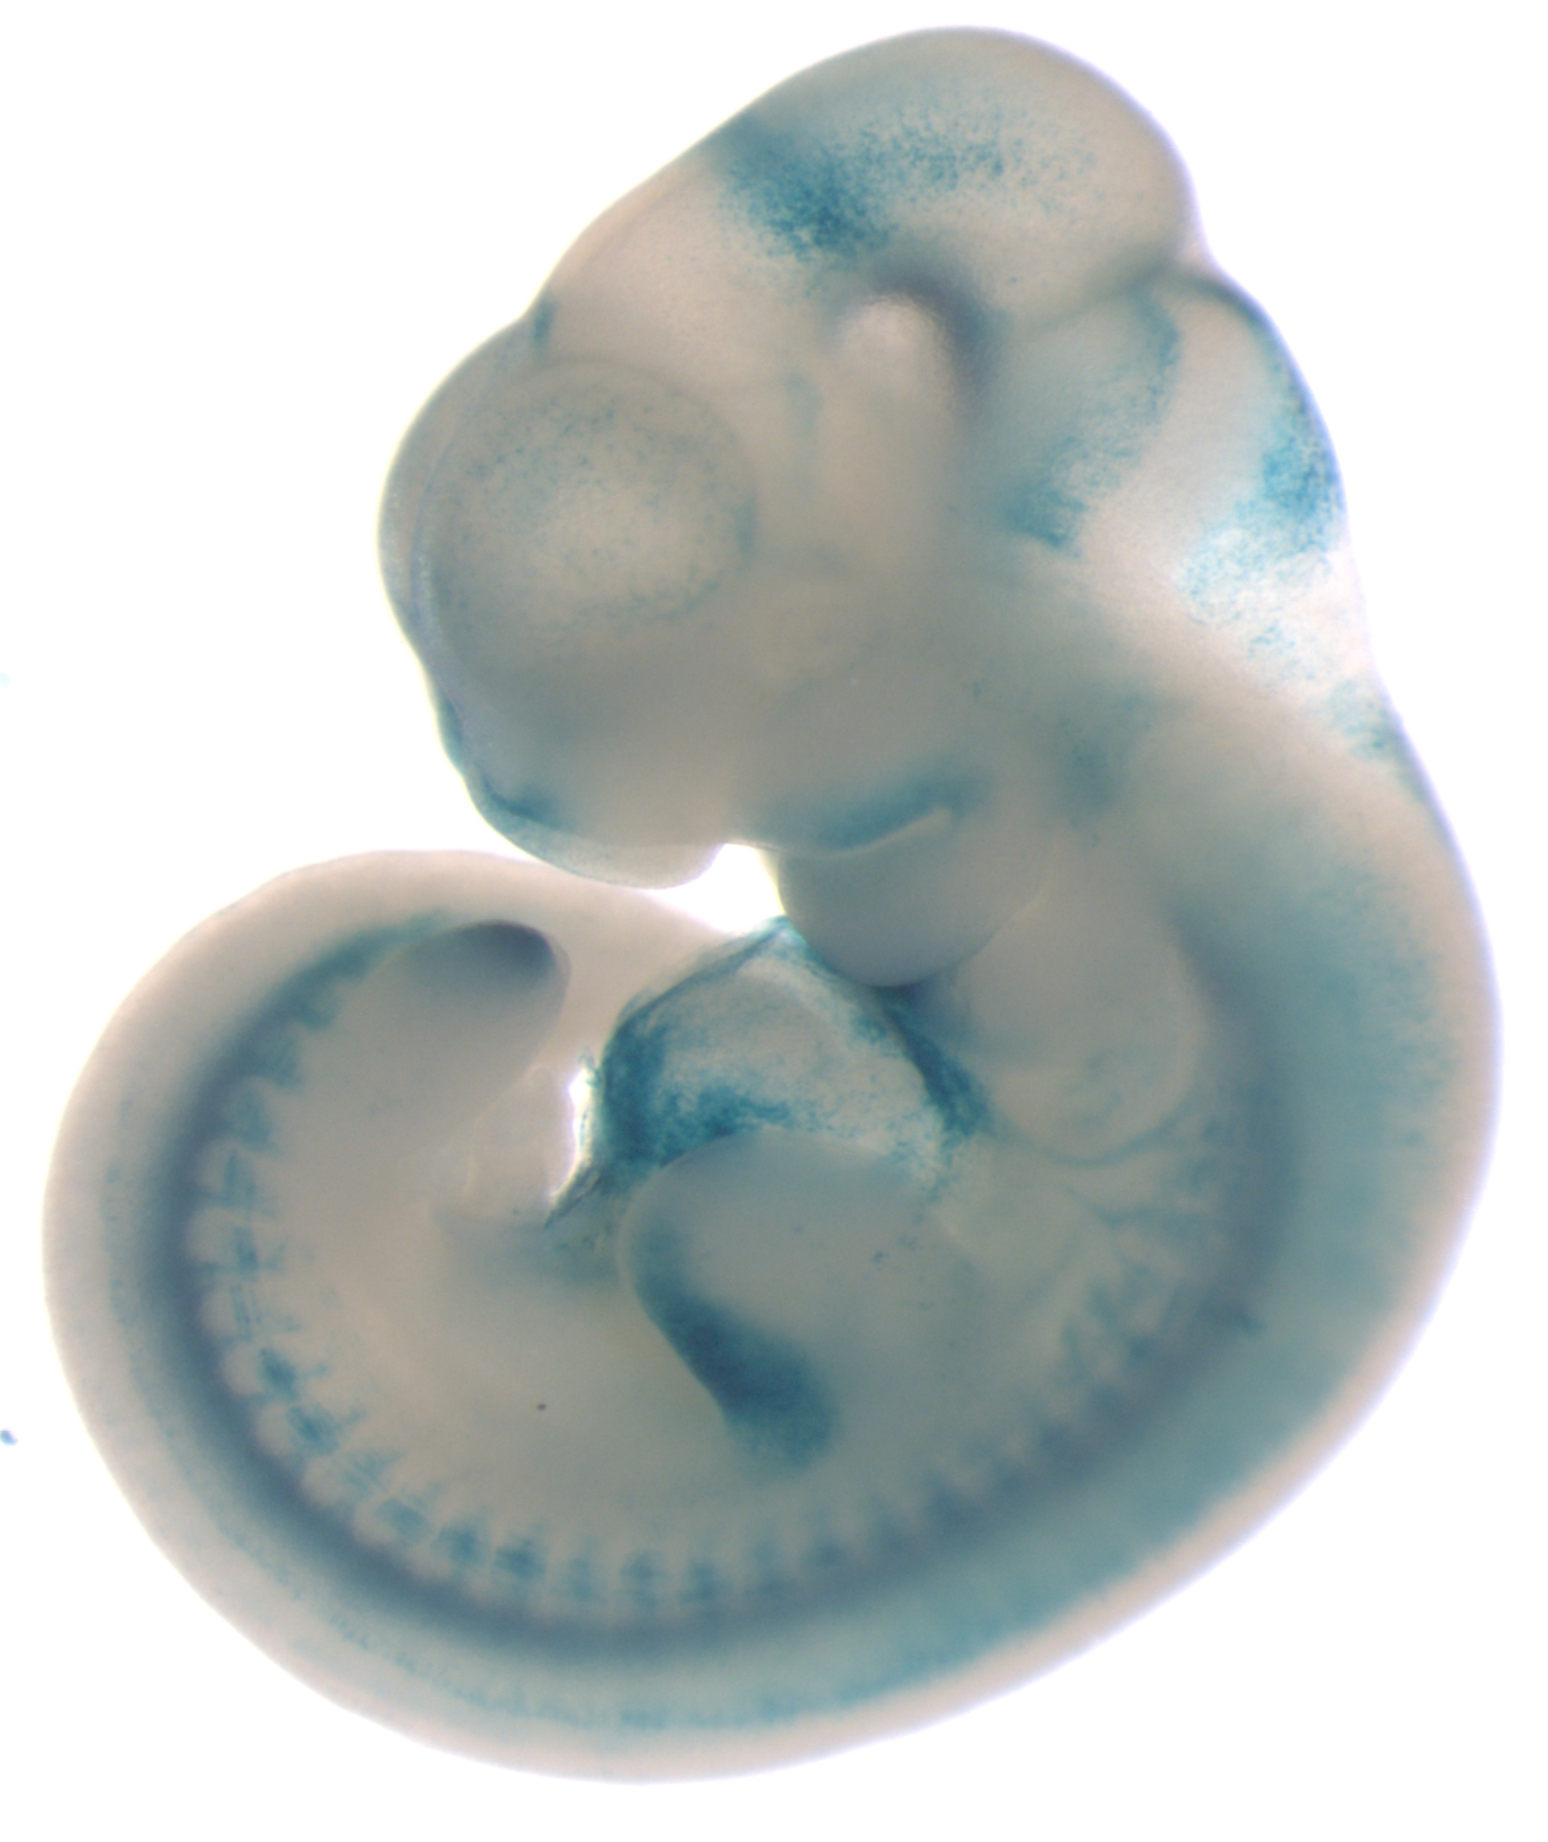
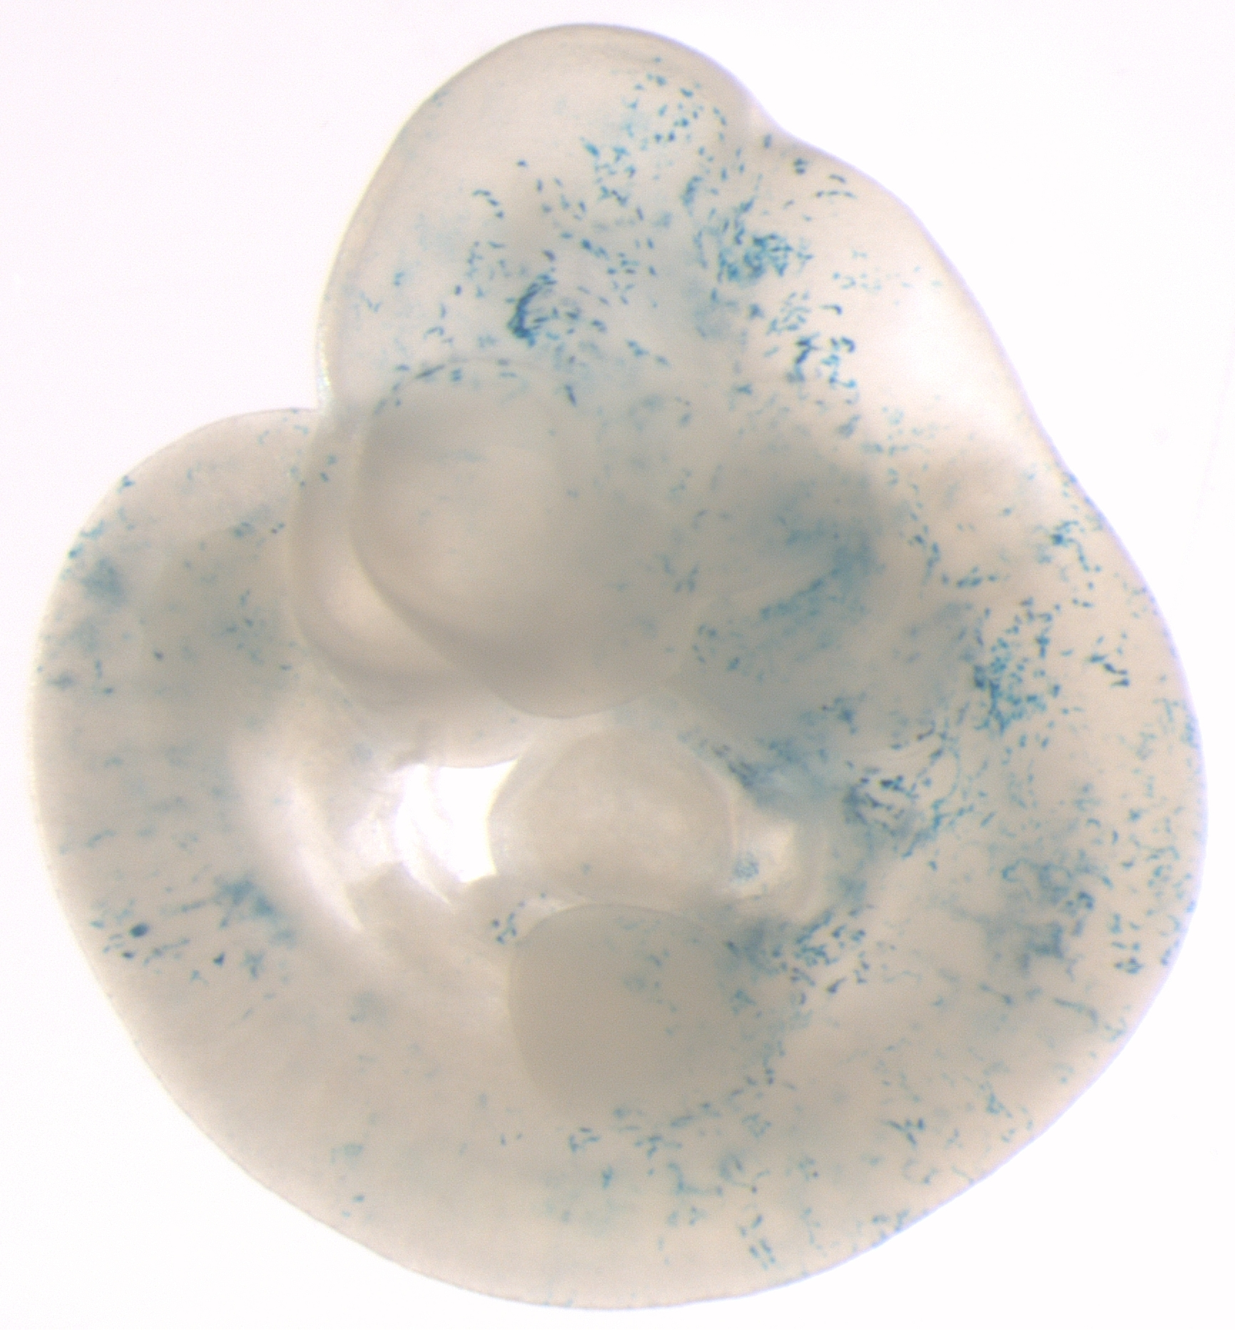
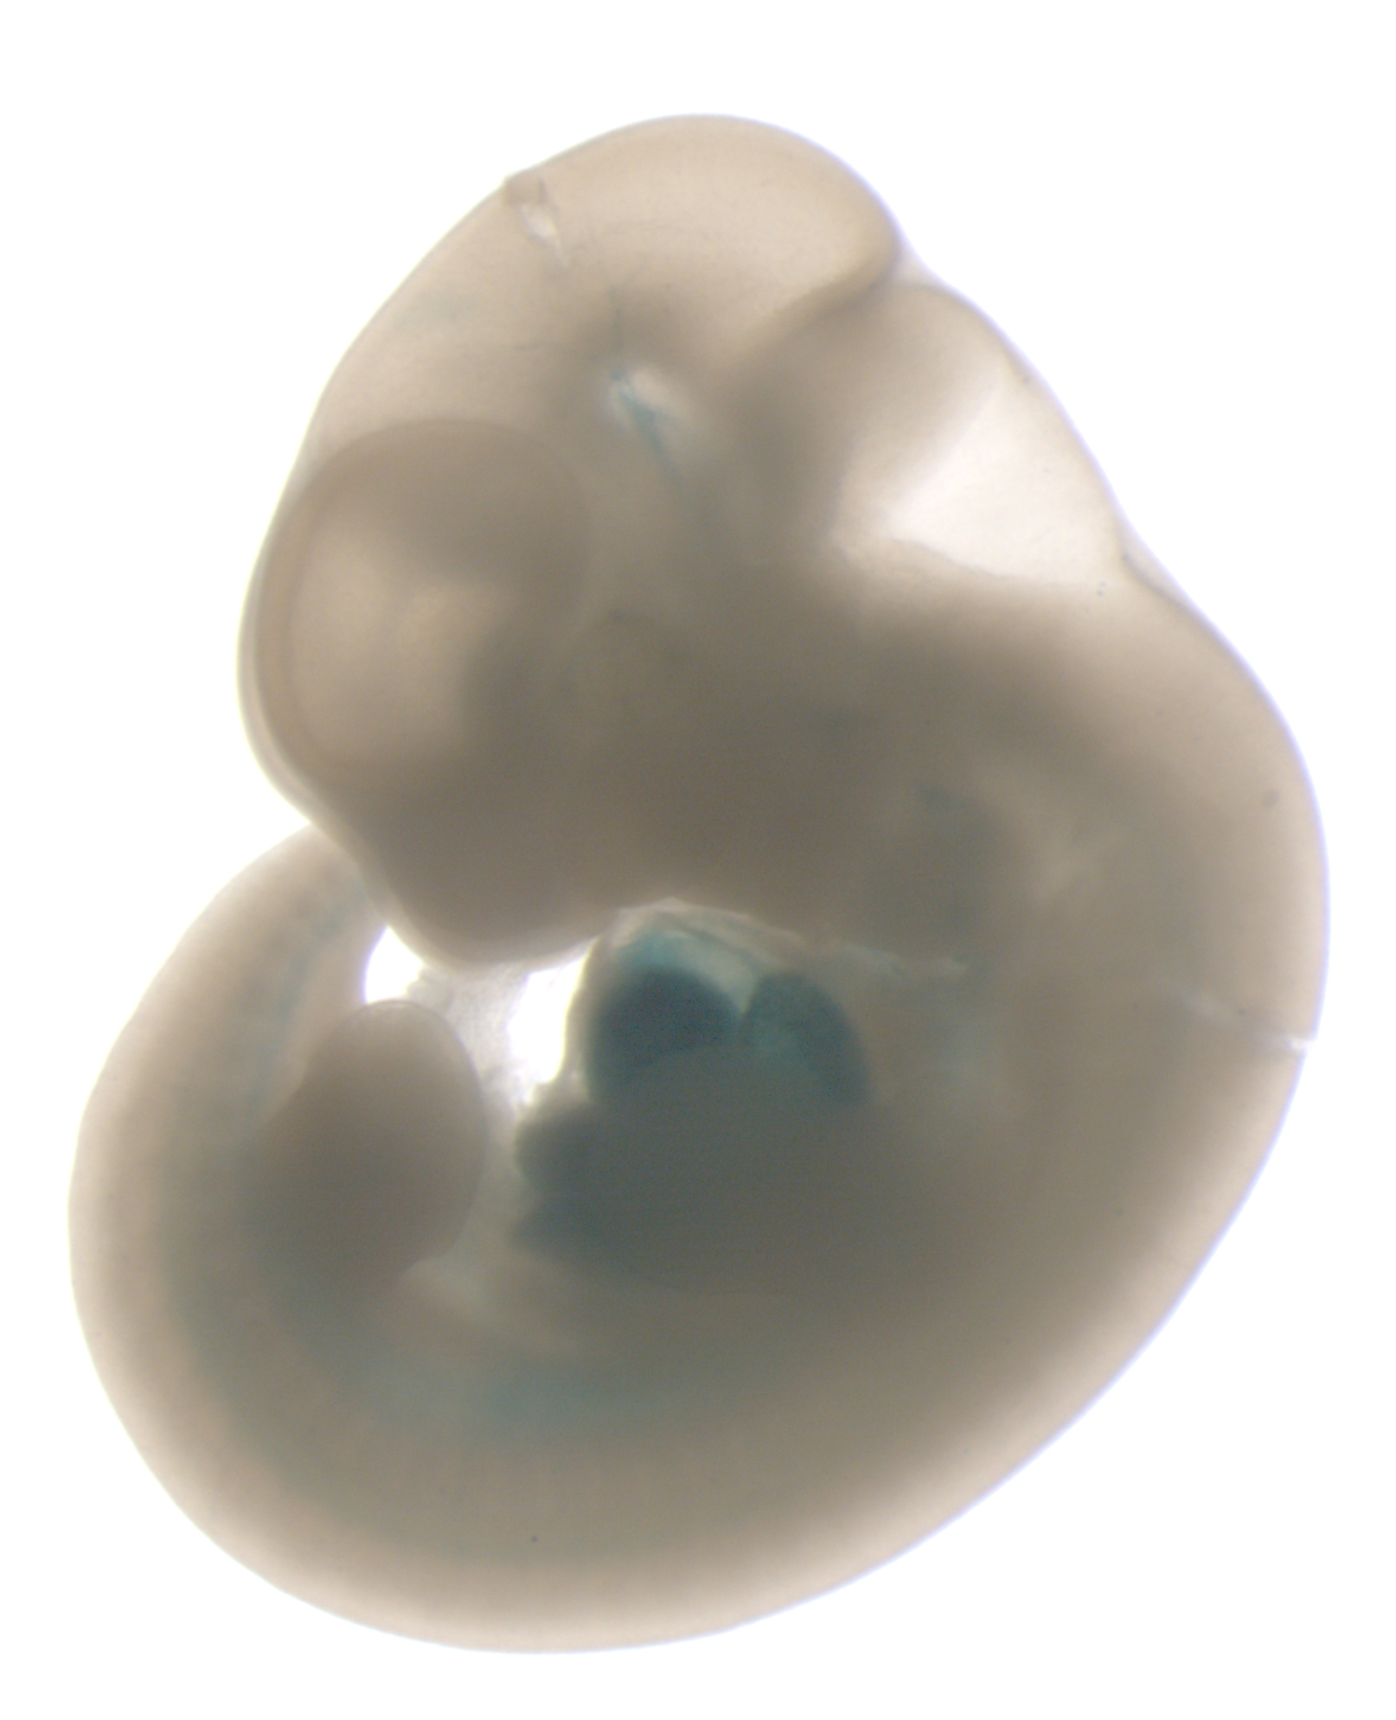
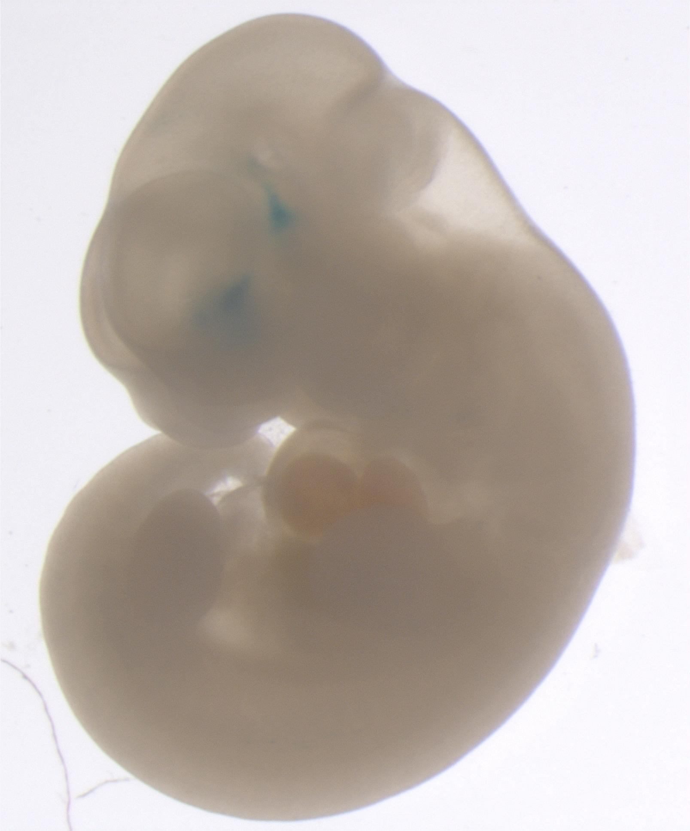
7 (out of 9) TAL1-bound DNA segments are active in both enhancer assays
Transgenic mouse (E11.5)
Transient transfection (K562)
Dogan et al. (2015) Epigenetics & Chromatin

Slide 42
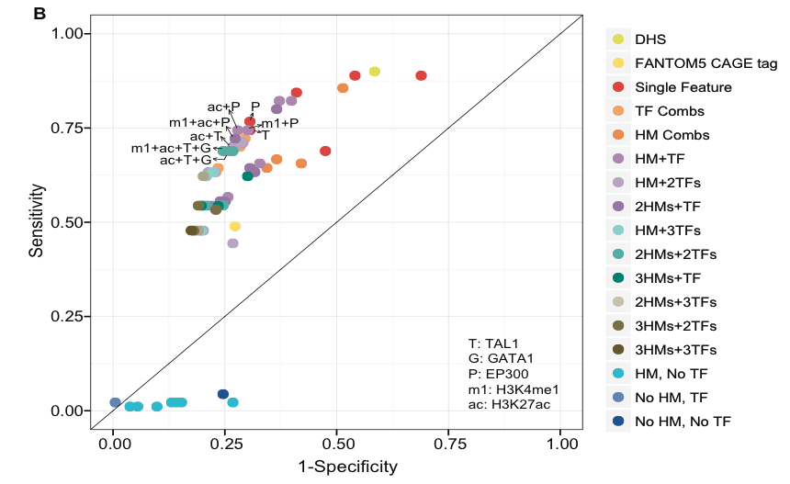
TF +/- Histone Mods are strong predictors of CRMs
Dogan et al. (2015) Epigenetics & Chromatin

Slide 43
Genomics of Gene Regulation: CRM prediction and assays
Biochemical features associated with cis-regulatory modules are being determined genome-wide for a range of cell types.
These can be used to predict CRMs
TF occupancy alone does not necessarily mean that the DNA is actively involved in regulation.
Enhancers predicted by epigenetic and other features with strong discriminatory power can be validated at high rates (60-80%).
Individual features can be good predictors, but they tend to point to similar regions
  EP300, tissue-specific TFs, H3K4me1+TF, H3K27ac+TF, DNase HS+TF
  Histone modifications or DHS without TFs: apparent high false positive rate
Integration of features by unsupervised machine-learning can reveal frequently occurring (and important) states
Supervised machine-learning (e.g. EnhancerFinder) does a good job of finding the enhancers it was trained to find: developmental enhancers
Significant progress in ramping up the scale of gain-of-function assays for enhancers

