Slide 1
Cis-regulatory modules (CRMs): Sequence and epigenetic features
BMMB 551 Genomics
Ross Hardison

Slide 2
DNA sequences regulating gene transcription
Cis-regulatory modules = CRMs

Slide 3
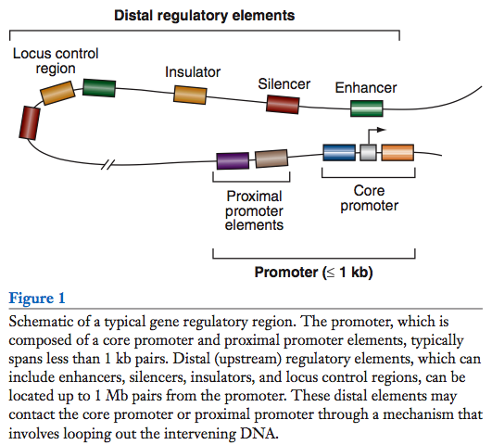
Distinct classes of regulatory regions
Act in cis, affecting expression of a gene on the same chromosome.
Cis-regulatory modules (CRMs)
Maston G, Evans S and Green M (2006) Annu Rev Genomics Hum Genetics 7:29-59

Slide 4
Operational definitions of cis-regulatory modules
A promoter is the DNA sequence required for correct initiation of transcription
Almost always at the 5’ end of the gene.
An enhancer is a DNA sequence that causes an increase in gene expression
Act independently of position and orientation with respect to the gene
A silencer is a DNA sequence that causes a decrease in gene expression
Similar to enhancer but has an opposite effect on gene expression
An insulator is a DNA sequence that blocks activation of promoter by an enhancer
Promoter
gene
Enhancer
gene
Silencer
gene
Enh
gene
Insulator

Slide 5
Reporter assays operationally define CRMs
Insu-
lator
Pr
neoR
Enhancer
Neo-resistant colonies
% of maximum
10
50
100
Silencer

Slide 6
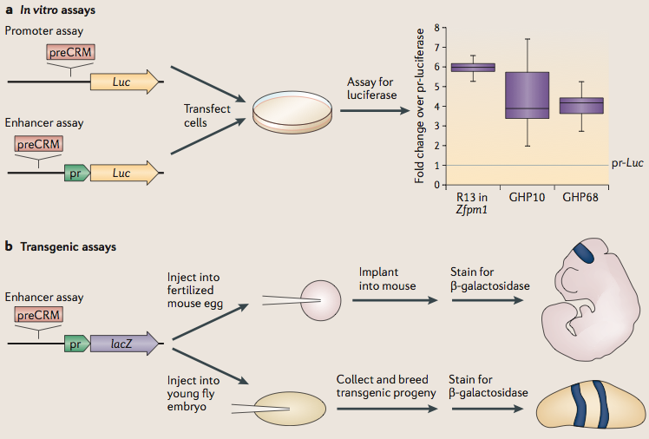
Gain-of-function assays to test predicted CRMs
Hardison &Taylor (2012) Nature Reviews Genetics 13: 469-483

Slide 7
Sequence determinants of crms
The importance of motifs

Slide 8
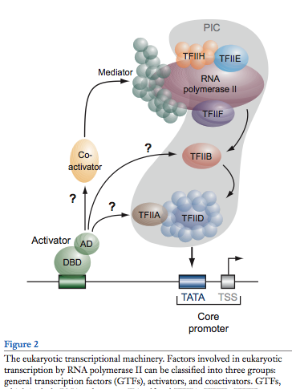
General features of promoters
RNA polymerase II
Upstream regulatory elements:
Regulate efficiency of utilization of minimal promoter
TATA box + Initiator:
Core or minimal promoter. Site of assembly of preinitiation complex
Maston, Evans & Green (2006) Ann Rev Genomics & Human Genetics, 7:29-59

Slide 9
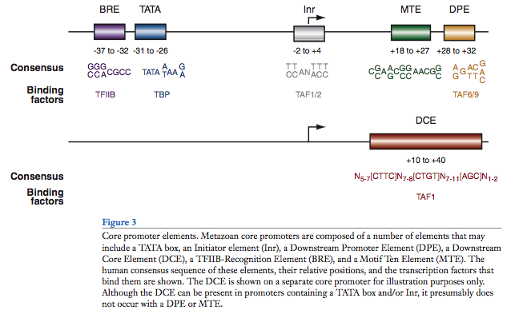
Conventional view of eukaryotic gene promoters
Maston, Evans & Green (2006) Ann Rev Genomics & Human Genetics, 7:29-59

Slide 10
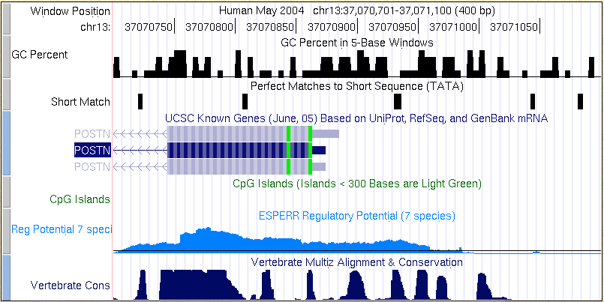
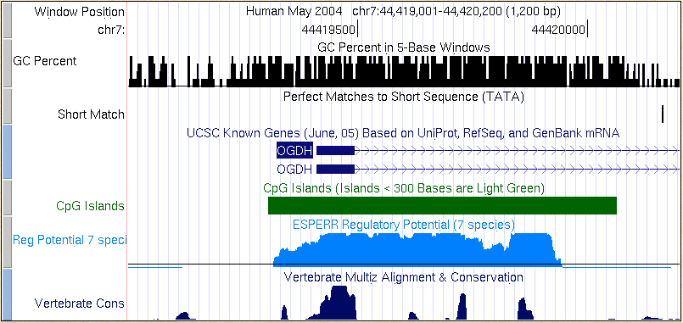
Most promoters in mammals are CpG islands
TATA, no CpG island
10-20% of promoters
CpG island, no TATA
80-90% of promoters
Carninci … Hayashizaki (2006)
Nature Genetics 38:626

Slide 11
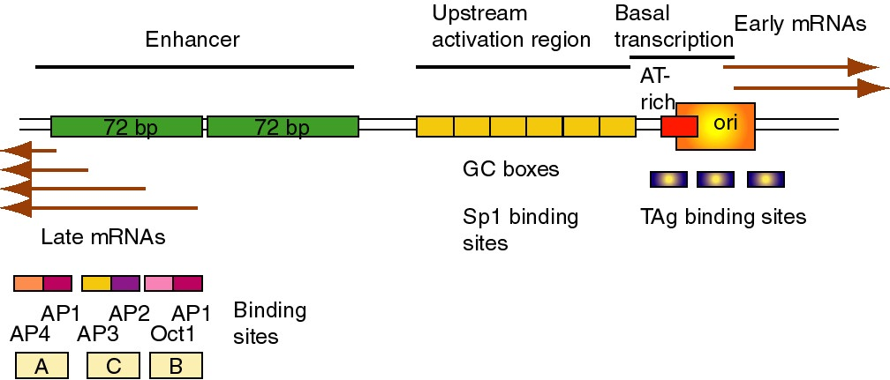
Enhancers
Many regulatory DNA sequences in SV40 control region
Enhancers are comprised of multiple binding sites for transcription factors

Slide 12
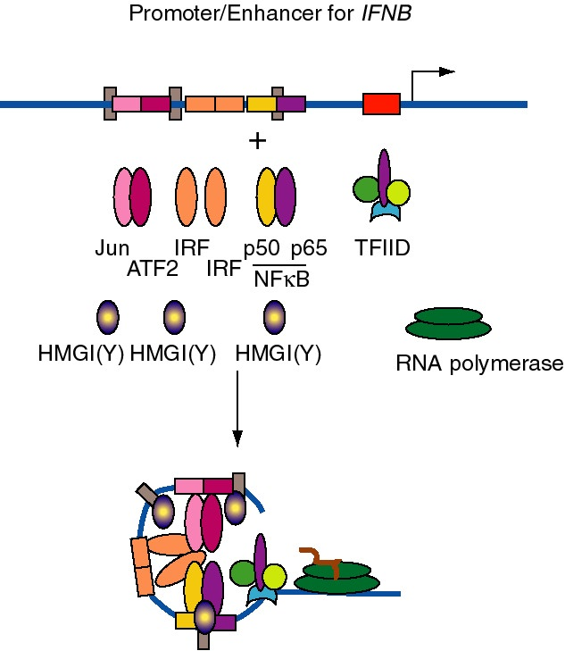
IFNB enhancer: Cluster of motifs for TF binding sites
Spacing matters
Folds into precise 3D structure
Hardison (2002) on-line textbook Working with Molecular Genetics http://www.bx.psu.edu/~ross/
BioWiki, UC Davis: http://biowiki.ucdavis.edu/Genetics

Slide 13
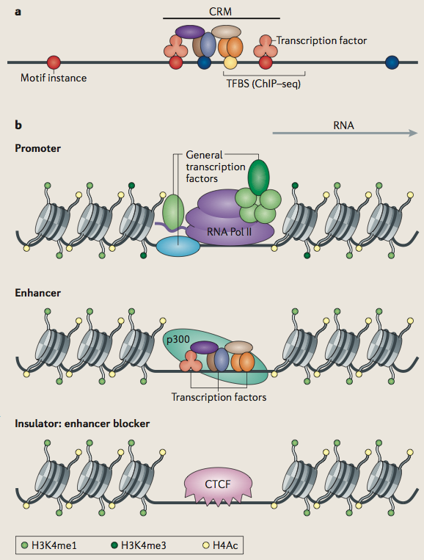
Features of cis-regulatory modules (CRMs)
Bound and unbound motif instances
Transcription factors and histone modifications characteristic of different CRMs
Hardison &Taylor (2012) Nature Reviews Genetics 13: 469-483

Slide 14
Motifs
Motif instance = match in a genomic DNA sequence to the preferred sequence for binding a transcription factor (TF)
Promoters and enhancers are composed of motif instances with spacer DNA
Are collections of motifs sufficient to define a promoter and/or enhancer?
Do motifs comprise a grammar that explains gene regulation?

Slide 15
Predicting CRMs from motif instances
Some success in Drosophila
Berman et al., 2002; Markstein et al., 2002; Rebeiz et al. 2002, Halfon et al., 2002; Schroeder et al., 2004.
Hardison and Taylor (2012) Nature Reviews Genetics 13: 469-483

Slide 16
Most instances of motifs for tf binding sites are not bound
The problem with motifs

Slide 17
8 million motif instances for binding GATA factors in mouse genome
= match to WGATAR

Slide 18
Only 15,000 are bound in erythroid cells
About 1 in 500 instances are bound.

Slide 19
How to identify the motif instances most likely to be bound by a TF?
Evolutionary conservation
Chromatin with hallmarks of gene activity
Lack of DNA methylation
DNase hypersensitive sites
Histone modifications associated with activity
Bound by a transcription factor (TF)

Slide 20
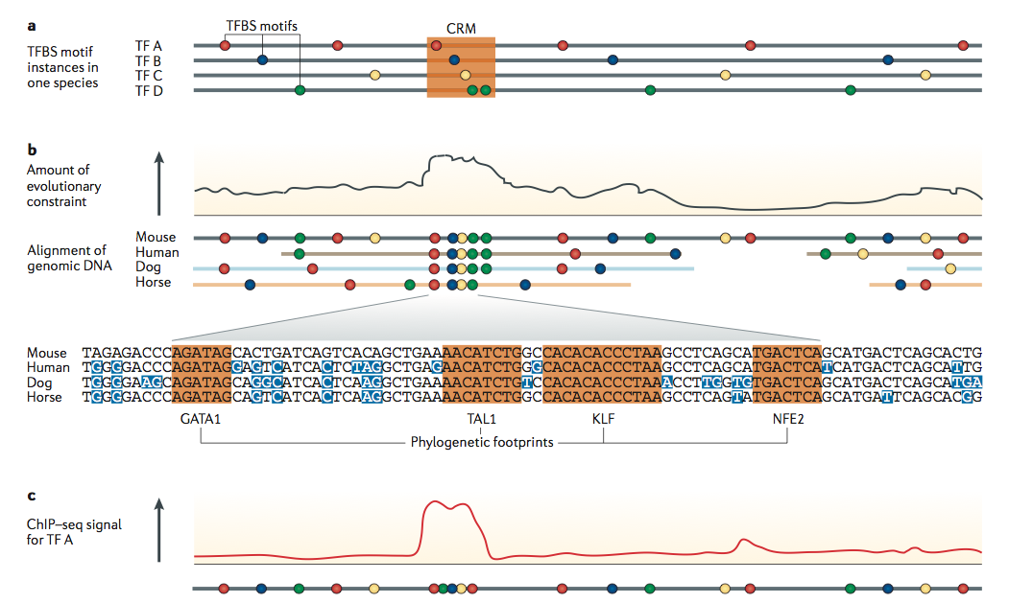
Predict CRMs by interspecies conservation of motifs or other regulatory information
Hardison and Taylor (2012) Nature Reviews Genetics 13: 469-483

Slide 21
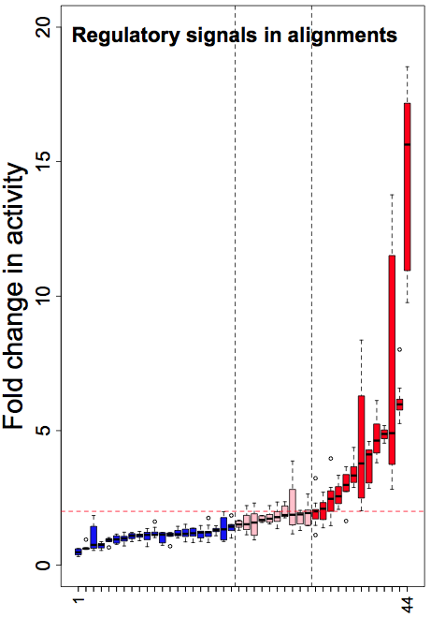
Constraint on regulatory signals is a good but imperfect predictor of CRMs
Machine learning on patterns in alignments in known regulatory regions plus preservation of motif instance: About half of preCRMs are active.
Strongly constrained noncoding sequences: About half of preCRMs are active.
Pennacchio et al (2006) Nature
Wang et al (2006) Genome Research

Slide 22
Predict CRMs by epigenetic signals
Hardison and Taylor (2012) Nature Reviews Genetics 13: 469-483

Slide 23
Epigenetics
Epigenetic features are biochemical molecules or modifications that are associated with DNA sequences, but not the DNA sequence itself
The prefix “epi” means “on top of”, i.e. biochemical features on top of the DNA sequence
DNA methylation, chromatin modifications, transcription factor (TF) binding, etc.
Does not imply trans-generational inheritance
Often passed from mother cell to daughter cells

Slide 24
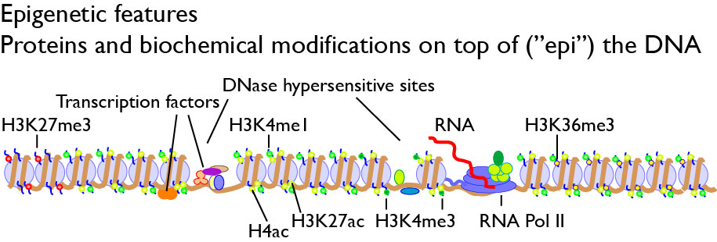
Epigenetic features

Slide 25
Epigenetic features control access to and activity of CRMs
Some features decrease activity of a CRM
Methylation of DNA at a promoter
Methylation of DNA at a TF binding site
Histone modifications H3K27me3 and H3K9me3
Wrapping into heterochromatin
Some features increase activity of a CRM
Accessibility (monitored by nucleases)
Binding by some TFs
Histone modifications such as H3K27ac and H3K4me(1,2,3)

Slide 26
DNA methylation, CpG islands
Most vertebrate promoters are CpG islands:

Slide 27
DNA methylation in animals and plants
Associated with gene silencing
DNA of inactive X chromosome is methylated
DNA on the nonexpressed allele of imprinted genes (one parental allele not expressed) is methylated
DNA methylation protects against “parasitic DNA”: endogenous viruses, some interspersed repeats are methylated
Several non-expressed genes are methylated at particular CpGs
Disruption of genes needed for de novo and maintenance methylation of DNA in mice leads to aberrant development
Recent studies of DNA methylation across mammalian genomes reveal more complicated patterns suggesting multiple roles for DNA methylation

Slide 28
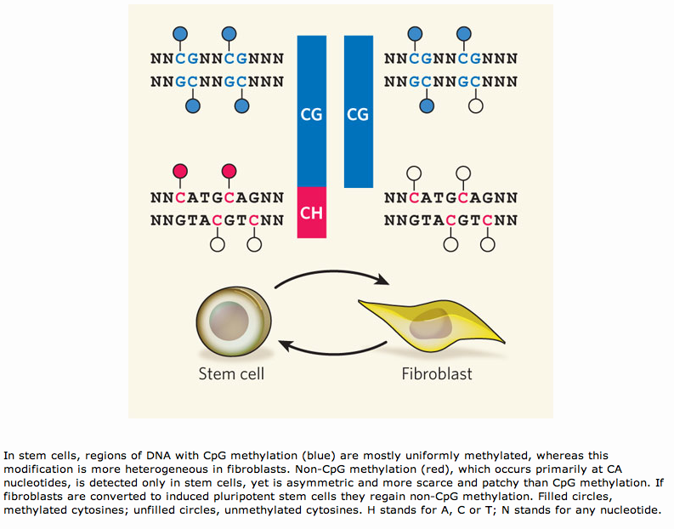
DNA methylation at CG, CA

Slide 29
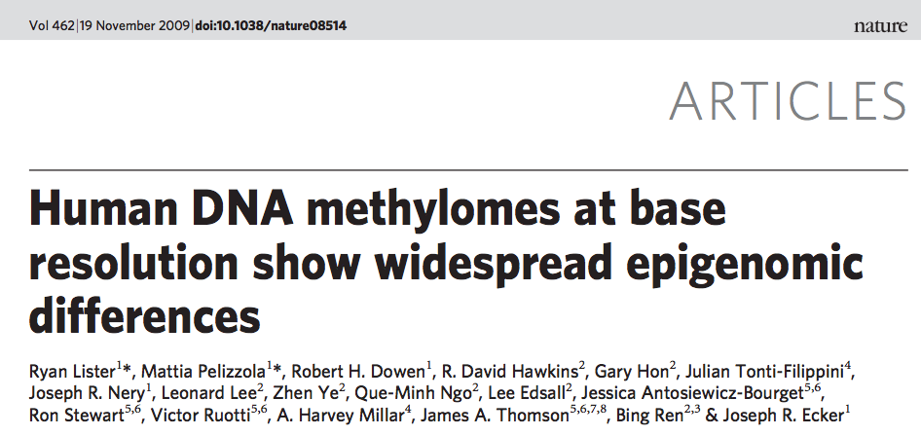
DNA methylation, genome-wide
Sequence bisulfite-converted DNA (C but not methyl-C converts to U)
Of the 583 million C’s in human haploid genome, at least 60% were covered by >= 3 reads: study them
Most C’s are not methylated (92 to 95%)
C’s in CpG: 55% are methylated
Decrease in amount of methylation during differentiation

Slide 30
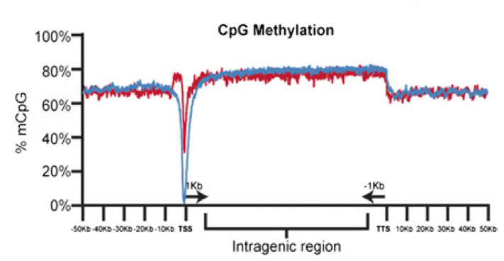
Transcribed genes: Methylation in body, not promoter
Regions around transcription start site (TSS, promoter) of active genes are depleted in methyl at CpGs, but body of gene is methylated
Depletion of methyl around TSS and increased methyl in body is correlated with level of expression
Laurent et al (2010) Genome Res.

Slide 31
CpG islands
Short regions with higher than “usual” frequency of the dinucleotide CpG
> about 200 bp (user defined)
CpG content approaches the value expected from G and C content
CpG / GpC > 0.6 or 0.75
G+C content > 50%
Often associated with transcriptional regulation
Promoters for about 80% of mammalian genes are in CpG islands
Can also be internal to genes

Slide 32
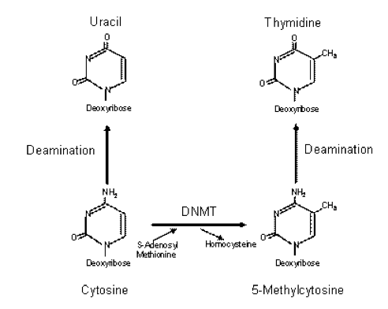
Deamination of methyl-C yields T
In many vertebrates, the DNMT acts primarily at CpG dinucleotides
Bryan et al. (2008) Cancer Therapy 6: 137-148

Slide 33
CpG islands are not methylated
CpG is the site of methylation in vertebrates and plants
Deamination changes methyl-C to T
Occurs about 10x more frequently than other transitions
Results in CpG changing to TpG or CpA (MeC > T on complementary strand)
Causes a substantial depletion of CpG in genome
to about 20% of expected frequency
Not common in Drosophila or yeast
Methylation of some CpGs is associated with gene silencing
Tends to be on CpGs outside CpG isalnds
Methylation is rare in CpG islands
Localized segments of the genome retain a high CpG content (CpG islands)
Are not methylated
Often (but not always) associated with “housekeeping” genes (expressed constitutively)

Slide 34
Chromatin signatures of regulatory regions

Slide 35
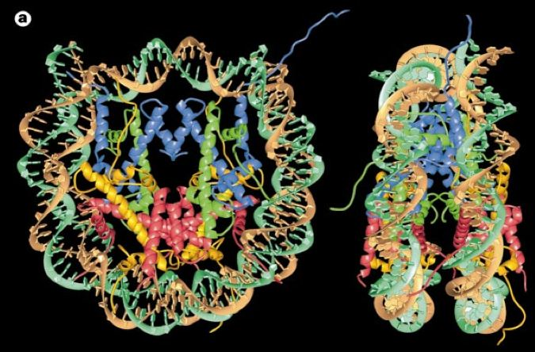
Nucleosome core structure, 3D
146 bp duplex DNA wrapped around 8 histones molecules:
2 each of the dimers H2A-H2B, H3-H4
N-terminal tails of histones emerge from the core
Luger et al. (1997) Nature 389: 251, Richmond lab

Slide 36
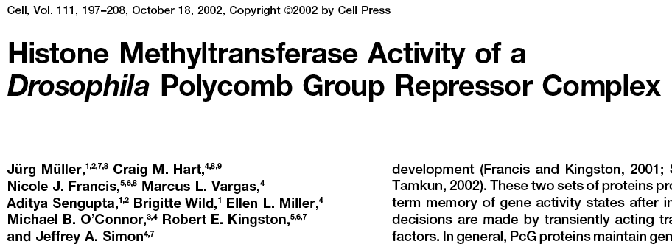
Repression by PcG proteins via chromatin modification
Polycomb Group (PcG) Repressor Complex 2:
ESC, E(Z), NURF-55, and PcG repressor
SU(Z)12
Methylates K27 of Histone H3 via the SET
domain of E(Z)
me3
K27
H3 N-tail
OFF

Slide 37
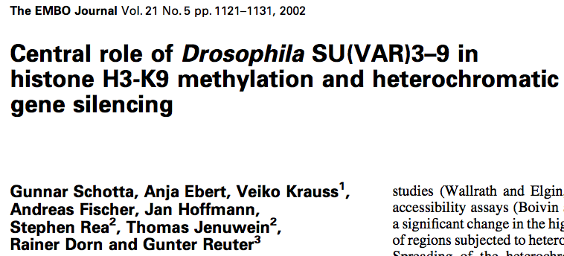
H3K9 methylation associated with repression
H3K9 methylation is catalyzed by SUV39H1 and G9a methyltransferases
G9a: mono and di-methylation
SUV39H1: trimethylation
di- and tri-Me H3K9: Binding site for heterochromatin protein 1 (HP1)
me3
K9
H3 N-tail
OFF

Slide 38
trx group (trxG) proteins activate via chromatin changes
SWI/SNF nucleosome remodeling
Histone H3 and H4 acetylation
Methylation of K4 in histone H3
Trx in Drosophila, MLL in humans
MLL = myeloid-lymphoid or mixed lineage leukemia
me1,2,3
K4
H3 N-tail
ON

Slide 39
Acetylation of H3K27 at active enhancers
Acetylation of K27 in H3 tail is associated with active enhancers
Note that is NOT methylation of H3K27 – that is is a mark of polycomb repression
More specific mark for enhancers than H3K4me1
ac
K27
H3 N-tail
ON

Slide 40
Features of cis-regulatory modules (CRMs)
Bound and unbound motif instances
Transcription factors and histone modifications characteristic of different CRMs
Hardison &Taylor (2012) Nature Reviews Genetics 13: 469-483

Slide 41
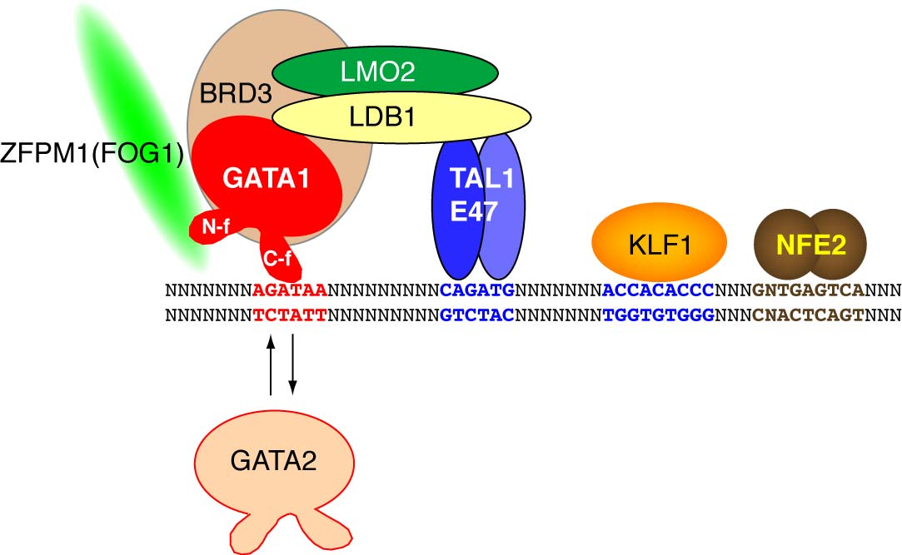
Assayed epigenetic features associated with transcriptional regulation
Repressed chromatin
Enhancer
Promoter
Repressed chromatin

Slide 42
Genomics of Gene Regulation: Integration and Assays
Individual features can be good predictors, but they tend to point to similar regions
EP300, tissue-specific TFs, H3K4me1, H3K27ac
Simple intersections do not increase power very much
Integration of features by unsupervised machine-learning can reveal frequently occurring (and important) states
Debate over how good they are at predicting CRMs
Supervised machine-learning (e.g. EnhancerFinder) does a good job of finding the enhancers it was trained to find: developmental enhancers
Significant progress in ramping up the scale of gain-of-function assays for enhancers
Loss-of-function assays can be definitive, but they do sometimes show no phenotype for strong gain-of-function enhancers

Slide 43
Summary: Features of CRMs
Almost all known cis-regulatory modules are clusters of motifs for TF binding sites: appropriate motifs at correct spacings
Motifs are short and abundant, such that they provide limited discriminatory power for predictions – even in clusters
Strong evolutionary constraint is a distinctive property for some but not all CRMs
Biochemical features associated with cis-regulatory modules do provide considerable discriminatory power for predictions
Current methods for predicting CRMs combine motifs analysis, conservation, and especially epigenetic features

