Slide 1

BMMB 551
Lesson 10 assignment: Gene regulatory modules
Analyze the human MYC locus for candidate regulatory regions

Slide 3
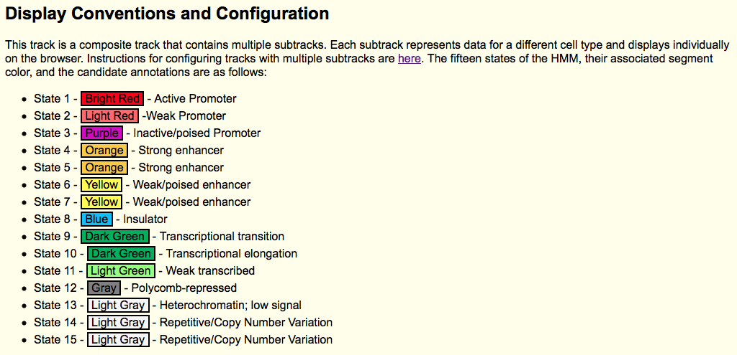
Colors for each chromHMM state

