Slide 2
It is a period of unrest. After millions of years, the atmosphere has stabilized and speciation runs rampant. The primates have emerged as the most advanced life form in the galaxy, but something will evolve to change them forever.
A long time ago on a supercontinent far, far away…

Slide 3
That’s as far as you can go?
Hi There! You’re probably wondering who I am.
Oh, you probably can’t see me can you?
Can you zoom in more with the camera?
Do you have an electron microscope attachment?
Great. Let me get my stunt double.
I don’t want to be bombarded by electrons!

Slide 4


I need the help of a cell from the Hominini tribe to replicate.
I like to think of it as a memento for my host to remember me by.
When I replicate, I use my LTRs to leave a copy of myself in my host’s genome
My genome contains gag, pol and env genes…
to encode the proteins and enzymes I need to replicate.
Perfect. Well now that you can see what I look like…
My name is HERV-K18 and I’m a retrovirus.

Slide 5
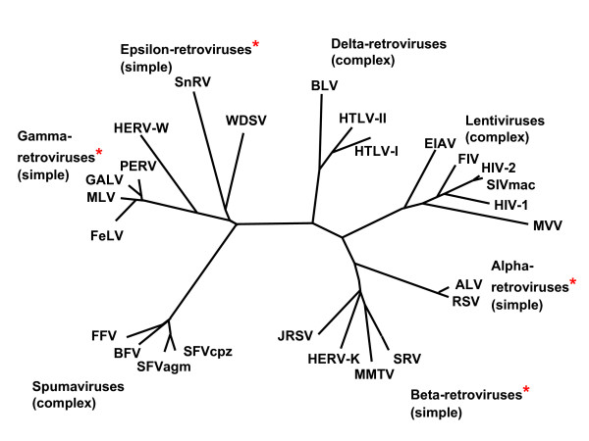

Someone from the future warned me that one of my distant cousins would cause a lot of problems…
That looks like a suitable host, pardon me I’m going to replicate.
Perhaps, you’ve heard of HIV-1?
Here’s my family tree… I’m in the red oval.

Slide 6


Ah, the CD48 gene, it looks like one of my ancestors is already integrated here, HERV-K11.
Yes, I integrated long ago before the Hominini tribe broke away from the other great apes.
Chromosome 1 looks like a good spot…

Slide 7
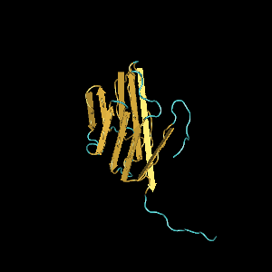

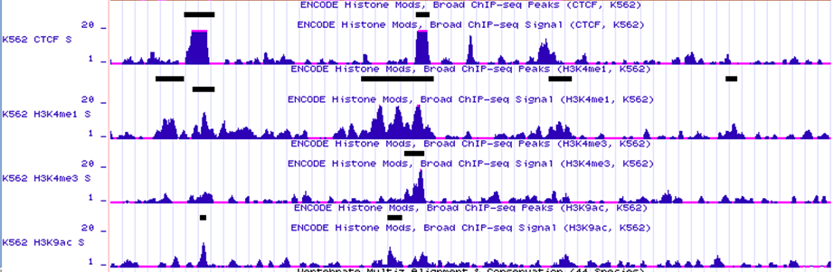
That will cause the expansion of Vβ7 T-cells and could cause a superantigen-like response from your host.
I can help you with that, Epstein-Barr virus is the name.
When I am around, your env gene can be transcribed. IFN-α can do the same thing.
Mono-methylation and CTCF binding stop me from having any fun.
I am special though, my haplotype gives my host resistance to type 1 diabetes.
I’d really just like to express myself, but my host keeps modifying its histones to stop me.
HERV-K18 still here. I’ve managed to put a copy of myself in every human and chimp.
Maybe it is better for me not to express myself.
Looks like more CD48 was just produced, I get cut out every time.
Millions of years later…

Slide 8
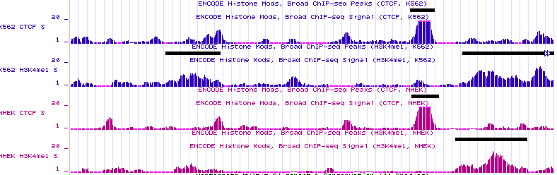
I try to help them fight off HIV-1, but it is difficult.
I’ve heard that 70-80% of people who get infected by that mean cousin of mine HIV-1 express my DNA.
I’ve contributed to an annotated transcript of unknown function.
I HERV-K102, haven’t been here quite as long as HERV-K18, but I also integrated into an relative HERV17.
I still get suppressed by my host, but 2-3% of my clones in healthy people get to express themselves.
35 kb centromeric on chromosome 1…

Slide 9
While normally my transcription is suppressed, I can be helpful if an exogenous retrovirus enters my host.
I do my best to make sure my host stays in good health, but my transcripts might cause some autoimmune problems.
My antisense transcript downregulates the expression of late retroviral transcripts.
The 70% of people whose genomes my clones are part of are lucky.
I’m HERV-K(C4). I live in the C4A complement gene.
I haven’t been in the genome as long as HERV-K18 or HERV-K102. I’m only found in 70% of the humans.
Though, I am found in orangutans.
Meanwhile, on chromosome 6…

Slide 10
Hopefully we can keep up this synergistic relationship for millennia into the future.
HERV-K113 is expressed more in people with MS and Sjögren’s syndrome.
Tell them where HERV-K113 and HERV-K115 live.
That doesn’t mean we can’t show them where they would integrate.
Meanwhile…
Don’t forget to pay attention to the credits, a lot of people worked hard to find us.
No, they don’t live in this host remember? They don’t try to be nice like us.
It’s too hard to explain, they are really only found in 29% and 16% of the population.
Let’s not talk about them anymore. Well, thanks for joining us inside your DNA.

Slide 11
Balada et al. Rev. Med. Virol. 2009. 19:273-286.
Bannert and Kurth Proc. Natl. Acad. Sci. U.S.A. 2004. 101:Suppl. 2 14572-14579.
Jha et al. Mol. Biol. Evol. 2009. 26:2617-2626.
Laderoute et al. AIDS. 2007. 21:2417-2424.
Tassabehji et al. Nucleic Acids Res. 1994. 22:5211-5217.
UCSC Genome Browser – www.genome.ucsc.edu
http://www.spaceflight.esa.int/users/images/gbf/ep-imm-micro.jp
Produced by
Nathan Schwalm

