Slide 1
Comparison of the complete genomes of Bifidobacterium animalis subsp. animalis and Bifidobacterium animalis subsp. lactis
Joseph Loquasto
Department of Food Science
The Pennsylvania State University

Slide 2
Probiotics
“Live microorganisms which when administered in adequate amounts confer a health benefit on the host”
    -(FAO/WHO 2002)
Notes:
Define probiotics
Probiotics include members of the genus Lactobacillus and Bifidobacterium. One such organism is…

Slide 3
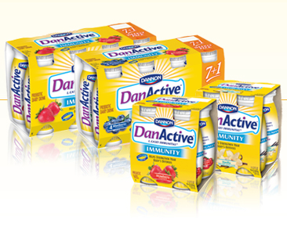
Potential Probiotic Organisms
Bifidobacterium
  B. animalis subsp. lactis
  B. longum subsp. longum
  B. longum subsp. infantis
  B. adolescentis
  B. breve
  B. bifidum
Lactobacillus
  L. rhamnosus
  L. acidophilus
  L. casei
  L. paracasei
  L. johnsonii
  L. reuterii
http://www.danactive.com

Slide 4
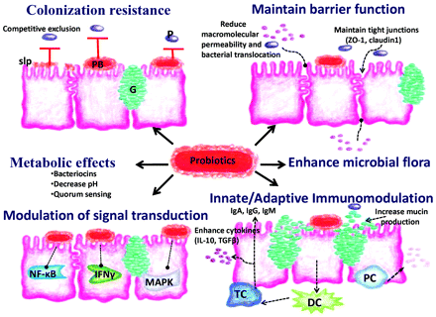
Mechanism of Probiotics
Sherman et al. 2009

Slide 5
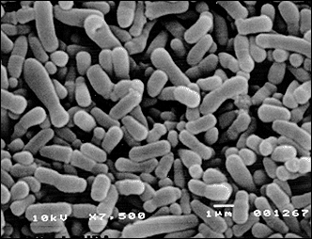
Bifidobacterium animalis ssp.
Gram positive
Non-spore forming
Non-motile
Obligate anaerobe
http://www.esculap.pl/danone
Notes:
Some characteristics of B. animalis ssp. are….

Slide 6
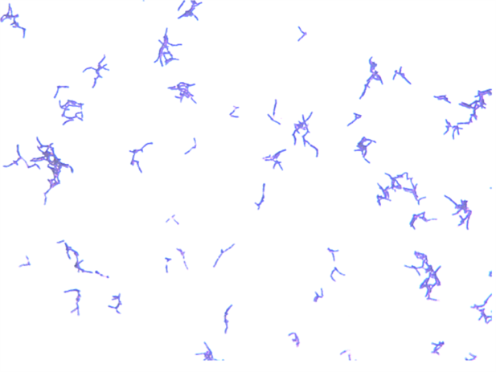
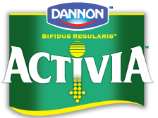
Bifidobacterium animalis subsp. lactis
First isolated and identified as a new species in 1997(Meile et al. 1997)
Most common (sub)species of bifidobacteria isolated from dairy products (Fasoli et al. 2003)
Important technological advantages
  Oxygen-tolerant
  Acid-resistant
  Bile-tolerant (Jayamanne and Adams 2006)
  Growth observed in milk and milk based media (Masco et al. 2004)
www.activia.com
Notes:
B. lactis was first isolated from a fermented milk samples
It is the most common bifidobacteria isolated from commercial dairy products
It is isolated from most commercial products because of some unique technological advantages, which cause it to be a contaminant in other bifidobacterial preparations
Oxygen and Acid tolerance allow for the survival in fermented dairy products, while bile tolerance allows it to survive the human GIT.
There are some documented health benefits associated with B. lactis

Slide 7
Bifidobacterium animalis subsp. lactis
Comparison of the complete genome sequences of Bifidobacterium animalis subsp. lactis DSM 10140 and Bl-04. Barrangou R, Briczinski EP, Traeger LL, Loquasto JR, Richards M, Horvath P, Coûté-Monvoisin AC, Leyer G, Rendulic S, Steele JL, Broadbent JR, Oberg T, Dudley EG, Schuster S, Romero DA, Roberts RF. J Bacteriol. 2009 Jul;191(13):4144-51.
Genome sequence of the probiotic bacterium Bifidobacterium animalis subsp. lactis AD011. Kim JF, Jeong H, Yu DS, Choi SH, Hur CG, Park MS, Yoon SH, Kim DW, Ji GE, Park HS, Oh TK.J Bacteriol. 2009 Jan;191(2):678-9.
Complete genome sequence of Bifidobacterium animalis subsp. lactis BB-12, a widely consumed probiotic strain. Garrigues C, Johansen E, Pedersen MB.J Bacteriol. 2010 May;192(9):2467-8

Slide 8
Bifidobacterium animalis subsp. animalis
First described in 1969 by Mitsuoka.
  Isolated from the feces of rat
Believed to:
  Lack the ability to grow in milk (Meile et al. 1997)
  Reduced oxygen-tolerance (when compared to BAL)
  Reduced ability to survive in acid and bile (when compared to BAL)
  Little evidence to support probiotic status
  Potentially pathogenic-Caused colonic inflammation in rats (Moran et al. 2009)

Slide 9
Bifidobacterium animalis subsp. animalis
Previous reports have suggested the level of homology between B. animalis subsp. animalis and B. animalis subsp. lactis to be around 85-95% homologous by DNA-DNA hybridization (Meile et al. 1997).
No complete genome existed for any strain of B. animalis subsp. animalis.
Despite obvious phenotypic differences there exists a high level of similarity between the genomes of the two organisms.

Slide 10
Objectives
1a.To determine the complete genome sequence of B. animalis subsp. animalis ATCC 25527^{T}.
1b.. To conduct a comparative analysis between the type strains of B. animalis subsp. animalis (ATCC 25527^{T)} and B. animalis subsp. lactis (DSMZ 10140^{T}).
1c. Use the Ka/Ks (dN/dS) ratio to determine if there is a positive selection for genes related to growth in milk
2. Investigate the phylogeny between B. animalis subsp. animalis and B. animalis subsp. lactis.
3. Examine interesting genetic differences observed in Objective 1.

Slide 11
Objective 1
Genomic DNA was isolated from cells grown overnight in MRS broth
Isolated DNA was submitted to the lab of Dr. Stephan Schuster at Penn State for 454 DNA sequencing
30 contigs were generated with 146X coverage (a total of 295,919,203 bases were generated)
Contigs were aligned using PGAP

Slide 12
BAL Scaffold
Bifidobacterium animalis subsp. lactis DSMZ 10140 Complete Genome
Bifidobacterium animalis subsp. animalis ATCC 25527 Unassembled Contigs
Bifidobacterium animalis subsp. animalis ATCC 25527Assembled Contigs for closing

Slide 13
Closing Reactions
Bifidobacterium animalis subsp. lactis DSMZ 10140 Complete Genome
Bifidobacterium animalis subsp. animalis ATCC 25527Assembled Contigs for closing
Primers were designed on the 5’ and 3’ ends of each contig. PCR was conducted on primers of matching ends. PCR products were sequenced to “fill in the gaps” and assembled to the existing contigs.

Slide 14
Bifidobacterium animalis subsp. animalis genome
1,932,693 bases in length encoding 1,595 genes and 60.4% G+C
  The B. animalis subsp. lactis genome is 1,938,482 bases in length encoding 1,631 genes and 60.5% G+C
Of all 12 species with at least draft genomes publicly available, B. animalis spp. are the smallest. All other genomes are greater than 2 MB in size.
Other genomes of this genus have a G+C content between 55-62%

Slide 15
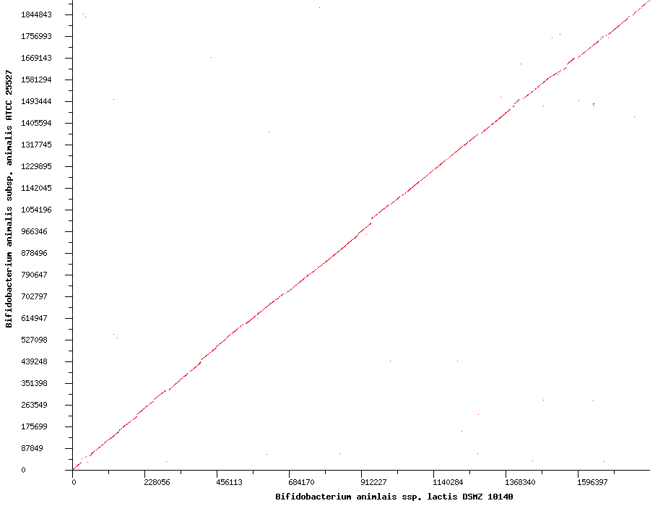
Objective 1
BLAST Dot Plot of B. animalis subsp. animalis ATCC 25527 vs. B. animalis subsp. lactis DSMZ 10140

Slide 16
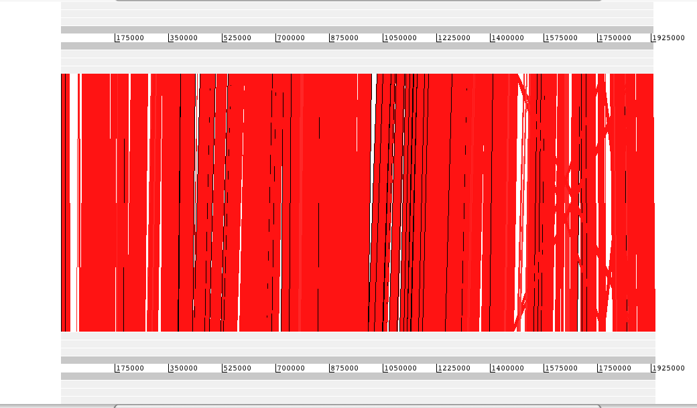
Objective 1
WebACT Comparison of B. animalis subsp. animalis ATCC 25527 and B. animalis subsp. lactis DSMZ 10140
B. animalis subsp. animalis ATCC 25527
B. animalis subsp. lactis DSMZ 10140

Slide 17
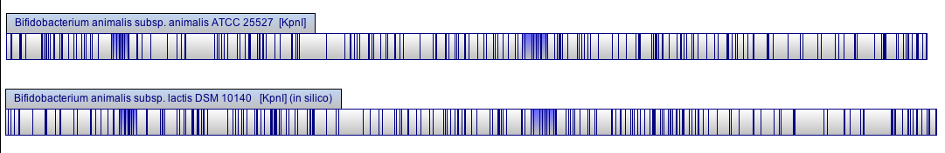
Objective 1
Optical Map Comparison of B. animalis subsp. animalis ATCC 25527 (with KpnI) and B. animalis subsp. lactis DSMZ 10140 (in silico, KpnI)

Slide 18
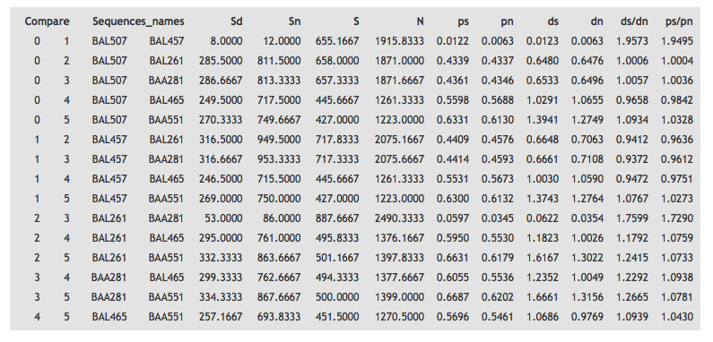
Positive Selection?
Beta-galactosidase

Slide 19
Positive Selection?
Beta-galactosidase
Lactose Transporter
Aminopeptidase
Endopeptidase

Slide 20
Objective 1- Summary
The genomes of B. animalis subsp. animalis ATCC^{T} and of B. animalis subsp. lactis DSMZ 10140^{T} revealed:
  Similar size, similar number of genes, similar G+C content
  High levels of synteny (Dot Plot)
  High levels of similarity in gene content (WebACT)
    There are 126 and 155 genes in the animalis subspecies that are absent and unique, respectively, as compared to the lactis subspecies
  Differential base content (Optical Maps)
  Does not appear to be positive selection on lacZ and select peptidases

Slide 21


Slide 22
Objective 2
2. Investigate the phylogeny between B. animalis subsp. animalis and B. animalis subsp. lactis.
Our lab has a collection of 24 strains of B. animalis subsp. lactis (Mostly commercial strains, and some from culture collections).
We would like to identify a parental strain of B. animalis subsp. lactis to better understand the evolution between the two subspecies.
The work of Briczinski et al. (2009) identified differences between highly related strains and gives some indication about the relatedness of our collection strains.

Slide 23
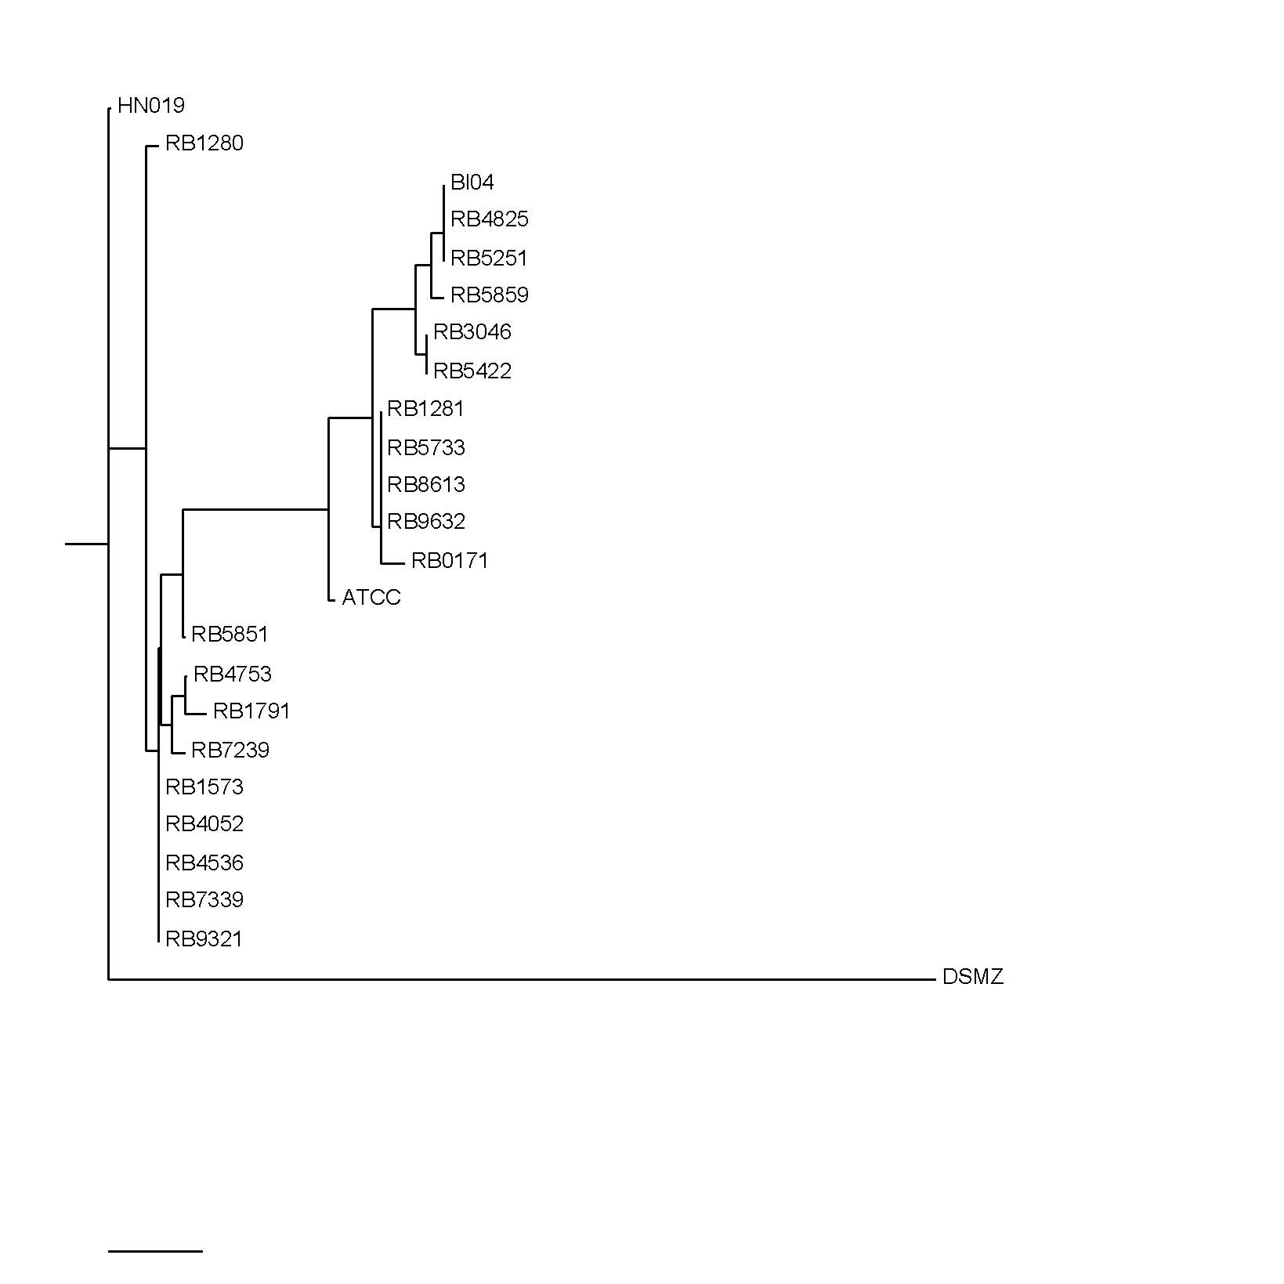
HN019 (8)
RB 1280 (2)
RB 4825 (9)
RB 5251 (9)
Bl-04 (9)
RB 5859 (10)
RB 3046 (11)
RB 5422 (11)
RB 1281 (12)
RB 5733 (12)
RB 8613 (12)
RB 9632 (12)
RB 0171 (13)
ATCC 27536 (14)
RB 5851 (5)
RB 4753 (6)
RB 1791 (7)
RB 7239 (4)
RB 1573 (3)
RB 4052 (3)
RB 4536 (3)
RB 7339 (3)
RB 9321 (3)
DSMZ 10140 (1)
Notes:
Input allelic profiles for all 24 strains into PubMLST.org and this will allow for clustering of strains with the same allelic profiles and the differentiation of strains with different allelic profiles.

Slide 24
Objective 3
3. Examine interesting genetic differences observed in Objective 1
Comparative genomic analysis revealed ~250 gene differences, however most were classified as “hypothetical protein”
No genes have yet to be identified that would explain differences seen in oxygen tolerance, bile resistance, or acid tolerance.

Slide 25
Objective 3
However, a difference was observed in the yafQ-dinJ toxin-antitoxin module
May be responsible for the pathogenic effect of ATCC 25527 seen by Moran et al. (2009)
Schematic of the comparison toxin-antitoxin modules
B. animalis subsp. animalis ATCC 25527
B. animalis subsp. lactis DSMZ 10140
Truncated version of yafQ in the yafQ and DnaJ Toxin-antitoxin module

Slide 26
Objective 3
Approach for Objective 3
  Use RT-PCR to detect the transcript of yafQ gene in ATCC 25527
  Use Western Blot to detect protein of the yafQ gene
  Construct a knockout of the yafQ gene in ATCC 25527
  Test ATCC 25527 and ATCC 25527-ΔyafQ mutant for pathogenicity

Slide 27
Summary
The genome of B. animalis subsp. animalis ATCC 25527 was determined and compared to the genome of B. animalis subsp. lactis DSMZ 10140.
A putative toxin-antitoxin module was identified in the genome of B. animalis subsp. animalis ATCC 25527 that has the potential to explain pathogenic effects observed by Moran et al. (2009).
A truncated version of the toxin was identified in the genome of B. animalis subsp. lactis DSMZ 10140 which may explain it long history of safe use.

Slide 28
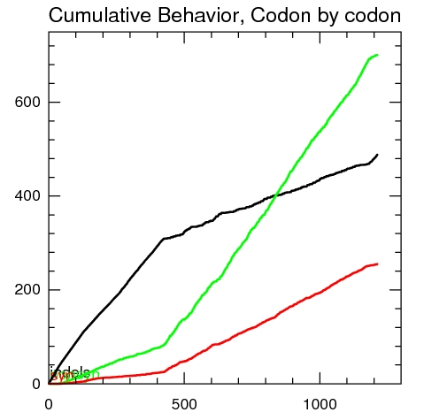
XYPLOT
Beta-galactosidase

