Slide 1
Changes in Highly Conserved Elements
John McGuigan
05/04/2009

Slide 2
Highly Conserved Elements
The most conserved elements at least 200 bp long
Highly Conserved Elements are a much broader set than UCEs
At least 200 bp long
100% similarity among Human, Rat, and Mouse

Slide 3
My Questions
Are mutations in these regions preserved, or are they reverted in later species?
Do mutations in these regions have anything to do with DNA binding motifs?

Slide 4
Getting the Alignments
Sequences from “MostConserved28Way” track
Intervals of the genome with scores ≥ 800
Score: transformed log-odds score between 0 and 1000 based on PhastCons across 28 vertebrates- higher score indicates more conservation
Result: 3,023 regions
Average score: 834

Slide 5
Getting the Alignments
Extract MAF blocks for 10 species:
Used 28-way multiZ alignment because it is more recent than 17-way
hg18 - Human
panTro2 - Chimp
rheMac2 - Macaque
mm8 - Mouse
rn4 - Rat
canFam2 - Dog
monDom4 - Opossum
galGal3 - Chicken
fr2 - Puffer fish
danRer4 - Zebra fish
Result: 27,829 alignment blocks
Filter for MAF blocks at least 200 bp long
Result: 2,660 alignment blocks (9.56%)

Slide 6
Getting the Alignments
Filter for MAF blocks that have all 10 species
Result: 874 alignment blocks (32.9%)

Slide 7
Looking at Motifs
CladiMo: A tool to scan multispecies alignments for conserved (or more generally) cladistic motifs.
http://www.bx.psu.edu/~dcking/cladimo/
Highlights motifs in a MAF file and displays them in a MAF browser

Slide 8
Limitations
Can only look at one alignment at a time
Sequences longer than 1000 bp cause problems
The only working motif set was “Fam”- “11 models describing shared binding properties of structural classes of transcription factors.”
The presence of binding motifs does not guarantee the use of those motifs

Slide 9
General Observations
Motifs would sometimes appear or disappear in the alignments with no clear patterns
Motifs in species from human to opossum generally lined up well
Zebra fish and puffer fish were vastly different from the other species and even each other

Slide 10
Some Examples

Slide 11
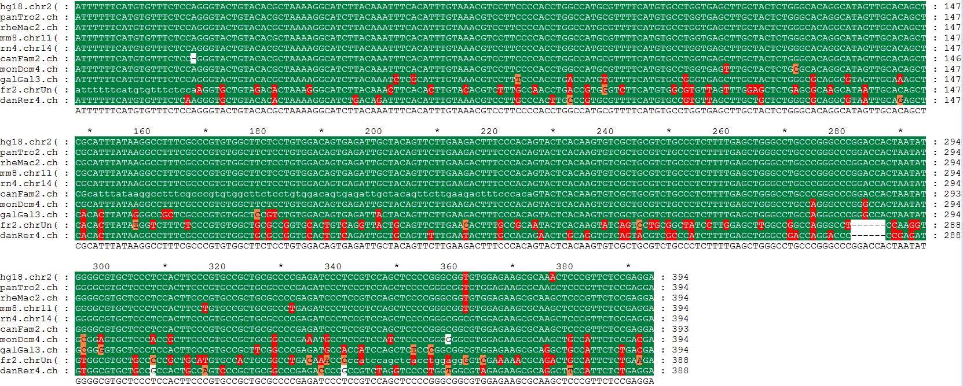
hg18.chr2(+):60541086-60541480
From the second-most conserved region
Look at sequences in GeneDoc to quickly see where mutations occur
The last row looks the most interesting

Slide 12
hg18.chr2(+):60541086-60541480

Slide 13
hg18.chr2(+):60541086-60541480
Results of mutations in the 6 species most closely related to humans
2 mutations occurred in places without motifs
2 mutations resulted in the loss of a motif (1 bHLH, 1 ETS)
Mutations
One mutation occurred in mouse and was preserved in the primates
Several mutations occurred in dog and were preserved through human
Some mutations occurred only in one species, though this was less common in the primates and closely related species

Slide 14
hg18.chr1(+):162556672-162556887
The least-conserved region used in the study
Only 3 mutations in top 6 species
Deletions that started in chicken were preserved through human

Slide 15
hg18.chr1(+):162556672-162556887

Slide 16
hg18.chr1(+):162556672-162556887
Results
No changes in the top 6 species
Some motifs appear to be in different positions in earlier species

Slide 17
Observations from other regions
Rat and Mouse often have mutations that are later reverted
Deletions, when present, usually occur from chicken to human
Motifs are often preserved from opossum through human
Sometimes motifs appear to be shifted by one or multiple bases, especially in the mouse genome

Slide 18
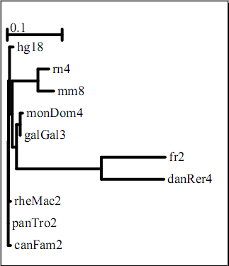
Phylogenetic Analysis
Representative Neighbor-Joining Tree

Slide 19
Are mutations in conserved regions preserved?
The regions are generally well conserved from chicken or opossum through human, although mutations do occur.
Single-species mutations are rare, but appear to occur most often in mouse and rat.

Slide 20
Problem
There is too much data (874 alignments)
There are no clear patterns
A more systematic approach is needed

Slide 21
Solution
Look at Human Accelerated Regions (HARs)
Regions that were conserved until humans
Focus on the changes that occurred in the human genome

Slide 22
HAR-01
14 substitutions
5 do not occur in motifs
4 cause the loss of a motif
5 cause the gain of a motif

Slide 23
HAR-02
13 mutations
8 do not occur in motifs
5 result in the gain of a motif

Slide 24
HAR-03
7 mutations
6 do not occur in motifs
1 results in the gain of a motif

Slide 25
HAR-04
5 substitutions
1 does not occur in a motif
1 does not change a motif
1 results in the gain of a motif
2 result in the loss of a motif

Slide 26
Totals- 10 most accelerated HARs

Slide 27
Do mutations in conserved regions have anything to do with DNA binding motifs?
Roughly half of all mutations were not involved in transcription factor binding site motifs
DNA binding motifs are probably not the main reason for conservation of these regions
Unless there are other motifs that have not been examined
Certain binding motifs may show correlations
bHLH and bZIP motifs seemed to be the most frequently added in this small sample

Slide 28
Thank You.

